Slide 1


Physics for Scientists and Engineers with Modern Physics
Fifth Edition
Chapter 14
Oscillations
Copyright © 2023 Pearson Education, Inc. All Rights Reserved
Notes:
If this PowerPoint presentation contains mathematical equations, you may need to check that your computer has the following installed:
1) MathType Plugin
2) Math Player (free versions available)
3) NVDA Reader (free versions available)

Slide 2
Units of Chapter 14
Oscillations of a Spring
Simple Harmonic Motion
Energy in the Simple Harmonic Oscillator
Simple Harmonic Motion Related to Uniform Circular Motion
The Simple Pendulum
The Physical Pendulum and the Torsion Pendulum
Damped Harmonic Motion
Forced Oscillations; Resonance

Slide 3
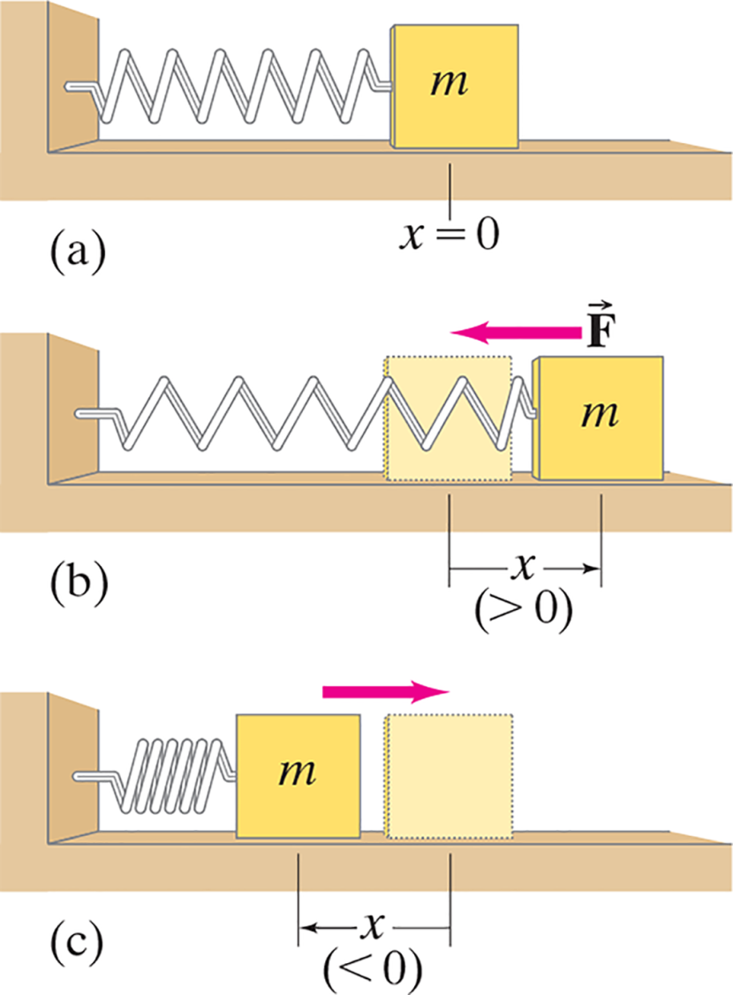
14-1 Oscillations of a Spring (1 of 6)
If an object vibrates or oscillates back and forth over the same path, each cycle taking the same amount of time, the motion is called periodic. The mass and spring system is a useful model for a periodic system.
Notes:
Figure 14-1. Caption: An object of mass m oscillating at the end of a uniform spring. The force F on the object at the different positions is shown above the object. (The pale yellow box represents the object at the
equilibrium position, x = 0.)
LD: Part (“a”): The horizontal surface has a marking x equals 0 at a point close to the center toward the right. The object is placed at the point x equals 0. The spring attached to the object is at rest. Part (b): A pale appearance of the object in Part (“a”) is shown in the same position in Part (b) and indicates the object is at equilibrium position, x equals 0. The object is placed at the right side of the object the equilibrium position. The spring is expanded. A force vector arrow labeled vector F points from the top of the object to the left. A vertical line is drawn downward from the center of the pale object and the center of the object of mass m. A double headed arrow labeled x (greater than 0) is placed between the lines. Part (c): The object of mass m is placed at the left side of the pale object. The spring is compressed. A force vector arrow placed at the top of the two objects points from the top of the object of mass m to the right, above the pale object. A vertical line is drawn downward from the center of the object of mass m. and the center of the pale object. A double headed arrow labeled x (less than 0) is placed between the lines.

Slide 4
14-1 Oscillations of a Spring (2 of 6)
We assume that the surface is frictionless. There is a point where the spring is neither stretched nor compressed; this is the equilibrium position. We
measure displacement from that point (
on the
previous figure).
The force exerted by the spring depends on the displacement:

Slide 5
14-1 Oscillations of a Spring (3 of 6)
The minus sign on the force indicates that it is a restoring force—it is directed to restore the mass to its equilibrium position.
k is the spring constant.
The force is not constant, so the acceleration is not constant either.

Slide 6
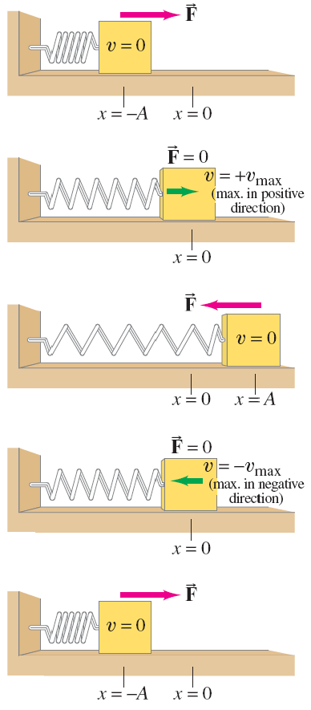
14-1 Oscillations of a Spring (4 of 6)
Displacement (x) is measured from the equilibrium point.
Amplitude (A) is the maximum displacement.
A cycle is a full to-and-fro motion.
Period (T ) is the time required to complete one cycle.
Frequency (f ) is the number of cycles completed per second.
Notes:
Figure 14-2. Caption: Force on, and velocity of, a mass at different positions of its oscillation cycle on a frictionless surface.
LD: The figure shows an object of velocity, v equals 0 placed on a horizontal frictionless surface. The object is attached to a vertical wall on the left through a spring. First part: The horizontal surface has the markings x equals negative “A” and x equals 0, which is placed equidistant to each other at a distance from the vertical wall. The object is place at the point x equals negative “A”. The spring attached to the object is compressed. A force vector arrow labeled vector F points from the top of the object to the right. Second part: The horizontal surface has the marking x equals 0 at the same position where it was initially marked in the first part. The object is placed at the point x equals 0. The spring is expanded slightly compared to that in the first part. A velocity vector arrow v equals positive v subscript max (max in positive direction) points from the left of the object to the right. Vector F equals 0 is written at the top of the block. Third part: The horizontal surface has the markings x equals 0 and x equals “A”. The object with velocity v equals 0 is placed at the point x equals “A”. The spring is expanded to a great extent. A force vector arrow labeled vector F points from the top of the object to the left. Fourth part: The horizontal surface has the marking x equals 0. The object is placed at the point x equals 0. A velocity vector arrow v equals negative v subscript max (max in positive direction) points from the center of the object to the left. Vector F equals 0 is written at the top of the object. Fifth part: The horizontal surface has the markings x equals negative “A” and x equals 0. The object is placed at the point x equals negative “A”. The spring attached to the object is compressed. A force vector arrow labeled vector F points from the top of the object to the right.

Slide 7
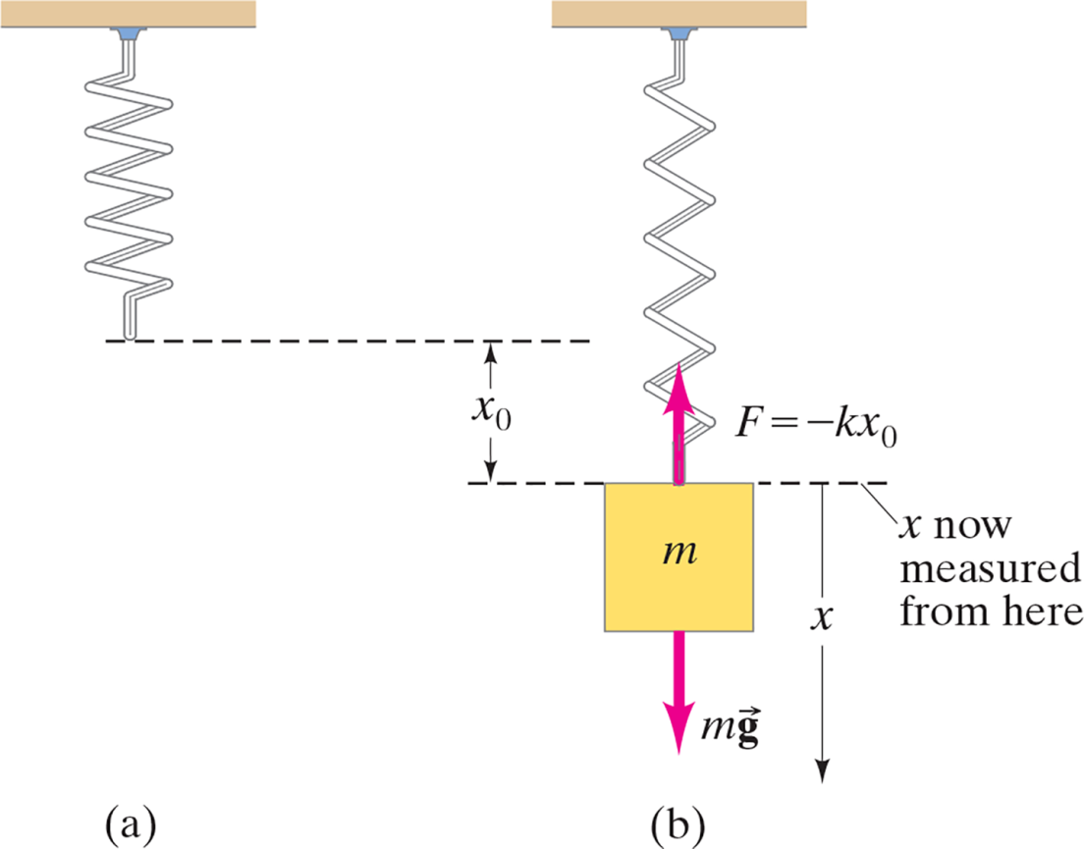
14-1 Oscillations of a Spring (5 of 6)
If the spring is hung vertically, the only change is in the equilibrium position, which is at the point where the spring force equals the gravitational force.
Notes:
Figure 14-3. Caption: (a) Free spring, hung vertically. (b) Mass m attached to spring in new equilibrium position, which occurs when ΣF = 0 = mg – kx0.
LD: Part (“a”) and Part (b) are placed next to each other. Part (“a”): The spring is hung freely from the top. Part (b): The spring is attached to a block of mass m at the bottom. A force vector arrow labeled F equals negative k x subscript 0 is pointing upward from the top of the block. A force vector arrow labeled m vector g is pointing downward from the bottom of the block. A dashed line from the bottom of the spring in Part (“a”) to the right. A dashed line is drawn from the top of the block in Part (b) to the left. The distance between the two dashed lines is indicated by a double-headed arrow labeled x subscript 0. A third dashed line is drawn from the top of the block to the right. The third dashed line is labeled x now measured from here. A double headed arrow labeled x indicates the distance from the third dashed line to the bottom of the force vector arrow labeled m vector g.

Slide 8
14-1 Oscillations of a Spring (6 of 6)
Example 14-1: Car springs.
When a family of four with a total mass of 200 k g step into their 1200-k g car, the car’s springs compress 3.0 c m. (a) What is the spring constant of the car’s springs, assuming they act as a single spring? (b) How far will the car lower if loaded with 300 k g rather than 200 k g?

Slide 9

14-2 Simple Harmonic Motion (1 of 13)
Any vibrating system where the restoring force is proportional to the negative of the displacement is in simple harmonic motion (S H M), and is often called a simple harmonic oscillator (S H O).
Substituting
into Newton’s second law gives the
equation of motion:
with solutions of the form:

Slide 10
14-2 Simple Harmonic Motion (2 of 13)
Example 14-2: Is the motion simple harmonic?
Which of the following forces would cause an object to move in simple harmonic motion?

Slide 11

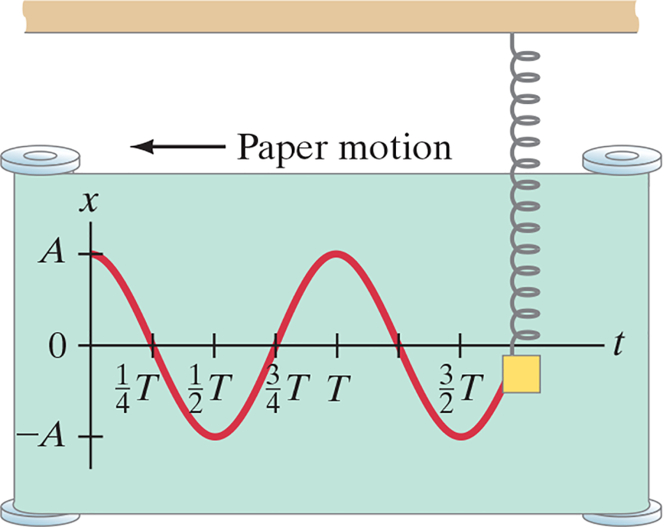
14-2 Simple Harmonic Motion (3 of 13)
Substituting, we verify that this solution does indeed satisfy the equation of motion, with:
The constants A and
will be determined by initial conditions; A is
the amplitude, and
gives the phase of
the motion at
Notes:
Figure 14-5. Caption: Sinusoidal nature of SHM: position as a function of time. In this case, x = A cos (2πt/T).
LD: A horizontal support at the top of the figure has a vertical spring attached below it near the right end of the support. The other end of the spring is attached to a square-shaped oscillating mass. A paper with rollers placed on its left and right sides is shown. An arrow labeled Paper motion is positioned just above the paper and points left showing the direction of movement of the paper. The oscillating mass is on the right end of the paper and the spring appears to be stretched. A graph is outlined on the moving paper by the oscillating pen on the x y coordinate plane. The horizontal x axis is labeled t and has the following markings from left to right: 0, 1 by 4 T, 1 by 2 T, 3 by 4 T, T, 5 by 4 T, and 3 by 2 T. The vertical y axis is labeled x and ranges from negative “A” to positive “A”. The graph resembles a sine wave. The curve starts from (0, “A”), goes down to the right, passes through (1 by 4 T, 0), moves further down to the right, dips till (1 by 2 T, negative “A”), curves upward to the right, passes through (3 by 4 T, 0), reaches a peak at (T, “A”), curves downward to the right, and passes through (5 by 4, 0). The curve goes further down to the right, dips till (3 by 2 T, negative “A”), and moves up to the right till it reaches the square-shaped oscillating mass connected to the spring.

Slide 12


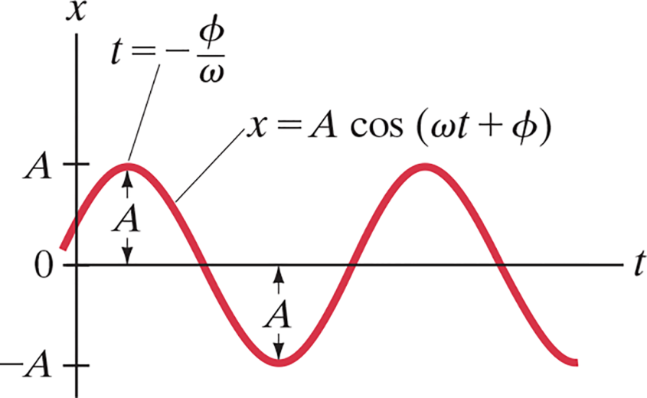
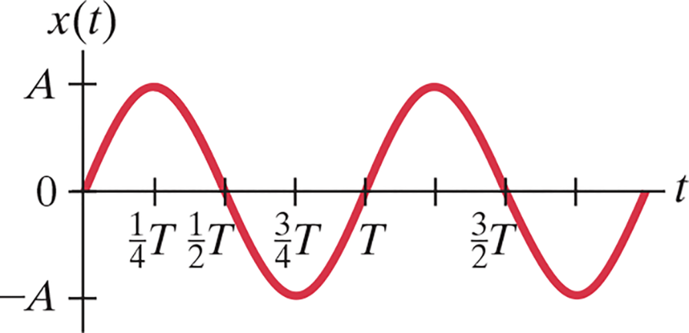
14-2 Simple Harmonic Motion (4 of 13)
The velocity can be found by differentiating the displacement:
These figures illustrate the effect of
Notes:
Figure 14-5. Caption: In this case of SHM, the mass m starts at t = 0 at the equilibrium position x = 0, and has initial velocity toward positive values of x (v > 0 at t = 0).
Figure 14-6. Caption: A plot of x = A cos (ωt +φ) when φ < 0.
LD: The horizontal axis labeled t ranges from 0 to 2 T in increments of 1 by 4 T. The vertical axis labeled x of t ranges from negative “A” to “A”. A wave with two cycles is shown on the graph. The curve starts from (0, 0), increases to the right, forms a crest, decreases to the right, and intercepts the t axis at (1 by 2 T, 0). The curve further decreases to the right, forms a trough, increases to the right, and intercepts the t axis at (T, 0). The cycle continues in the same manner, where the crests are formed at x of t equals “A” and the troughs are formed at x of t equals negative “A”.
LD The horizontal axis is labeled t. The vertical axis is labeled x and has the markings negative “A” on the negative vertical axis and “A” on the positive vertical axis. The curve starts from a point in the second quadrant above the negative t axis, increases toward the right, and intercepts with the positive x axis. The curve increases to the right and forms a crest at x equals “A” in the first quadrant. The curve decreases to the right, intercepts the t axis, further decreases to the right, and forms a trough in the fourth quadrant. The curve rises to the right, intercepts the t axis, and increases to the right, where it forms a crest. The curve decreases to the right, intercepts the t axis, further decreases to the right, and exits the viewing window. The midpoint of the first crest is labeled t equals negative StartFraction phi over omega EndFraction. The length of the crest and trough are labeled “A”, which is represented by a double-headed arrow.

Slide 13

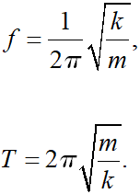
14-2 Simple Harmonic Motion (5 of 13)
Because
then

Slide 14
14-2 Simple Harmonic Motion (6 of 13)
Example 14-3: Car springs again.
Determine the period and frequency of a car whose mass is 1400 k g and whose shock absorbers have a
spring constant of
after hitting a bump.
Assume the shock absorbers are poor, so the car really oscillates up and down.

Slide 15
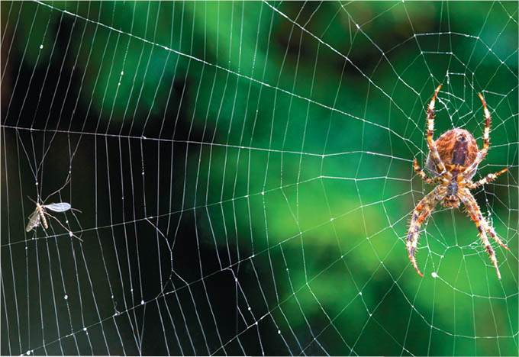
14-2 Simple Harmonic Motion (7 of 13)
Example 14-4: Spider web.
A spider of mass 0.30 g waits in its web of negligible mass. A slight movement causes the web to vibrate with a frequency of about 15 Hz. (a) Estimate the value of the spring stiffness constant k for the web. (b) At what frequency would you expect the web to vibrate if an insect of mass 0.10 g is trapped in addition to the spider?
Notes:
Figure 14 – 7 Example 14–4. A spider waits for its prey (on the left).

Slide 16
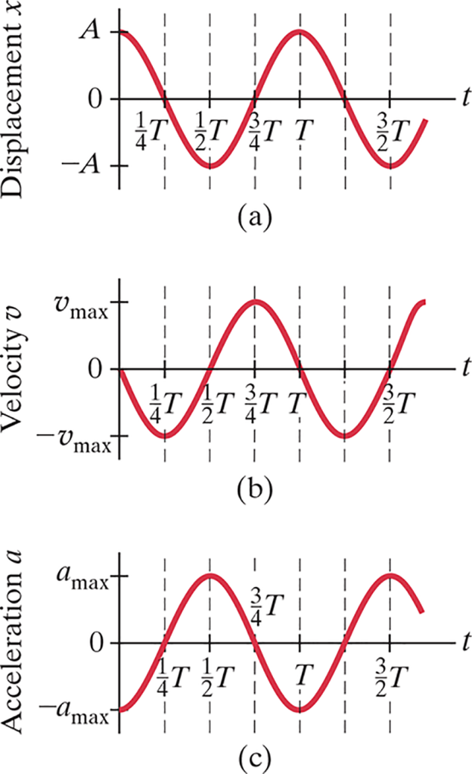


14-2 Simple Harmonic Motion (8 of 13)
The velocity and acceleration for simple harmonic motion can be found by differentiating the displacement:
Notes:
Figure 14-8. Caption: Graphs showing (a) displacement x as a function of time t: x = A cos vt ; (b) velocity as a function of time: v = -vmax sin vt, where vmax = Ak/m; (c) acceleration as a function of time: a = -amax cos t, where amax = Ak/m.
LD: Graph (“a”): The horizontal axis is labeled t and ranges from 0 to 3 by 2 T in increments of 1 by 4 T units. The vertical axis is labeled Displacement x and has the markings negative "A" on the negative vertical axis, 0 at the intersection of the axes and "A" on the positive vertical axis. The curve begins at (0, “A”), decreases till the point (1 by 4 T ,0), intercepts the t axis, further decreases and forms a trough at t equals 1 by 2 T. The curve increases from (1 by 2 T, negative “A”) to (3 by 4 T, 0), intercepts the t axis, increases toward the top, and forms a crest at (T, “A”). The cycle continues in the same manner as t increases and. Graph (b): The horizontal axis is labeled t and ranges from 0 to 3 by 2 T in increments of 1 by 4 T units. The vertical axis is labeled Velocity v and has the markings negative v subscript max on the negative vertical axis, 0 at the intersection of the axes, and v subscript max on the positive vertical axis. The curve begins from 0, decreases to the right, and forms a trough at (1 by 4 T, negative v subscript max ), increases till (1 by 2 T, 0), and intercepts the t axis. The curve further increases to the right, forms a crest at (3 by 4 T, v subscript max), decreases to (T, 0) , and intercepts the t axis. The cycle continues in the same manner as t increases. Graph (c): The horizontal axis is labeled t and ranges from 0 to 3 by 2 T in increments of 1 by 4 T units. The vertical axis is labeled Acceleration “a” and has the markings negative "a" subscript max on the negative vertical axis, 0 at the intersection of the axes, and “a” subscript max on the positive vertical axis. The curve begins from (0, negative “a” subscript max), increases till (1 by 4 T, 0), and intercepts the t axis. The curve further increases to the right, forms a crest at (1 by 2 T, “a” subscript max), decreases to (3 by 4 T, 0), and intercepts the t axis. The curve further decreases to (T, 0). The cycle continues in the same manner as t increases.

Slide 17
14-2 Simple Harmonic Motion (9 of 13)
Example 14-5: A vibrating floor.
A large motor in a factory causes the floor to vibrate at a frequency of 10 Hz. The amplitude of the floor’s motion near the motor is about 3.0 m m. Estimate the maximum acceleration of the floor near the motor.

Slide 18

14-2 Simple Harmonic Motion (10 of 13)
Example 14-6: Starting with.
The displacement of an object is described by the following equation, where x is in meters and t is in seconds:
Determine the oscillating object’s (a) amplitude, (b) frequency, (c) period, (d) maximum speed, and (e) maximum acceleration.

Slide 19
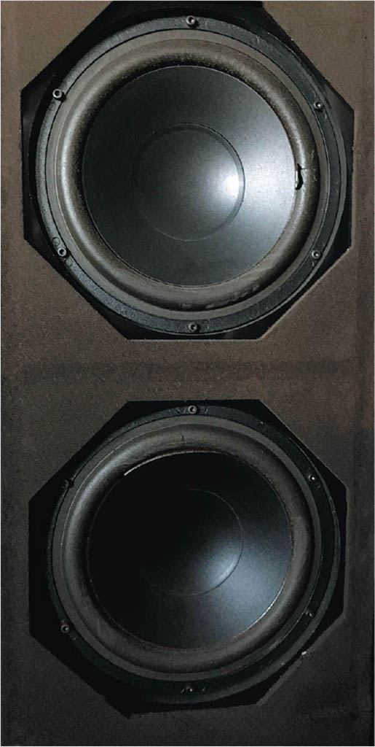
14-2 Simple Harmonic Motion (11 of 13)
Example 14-7: Loudspeaker.
The cone of a loudspeaker oscillates in SHM at a frequency of 262 Hz (“middle C”). The amplitude at the central part of the cone is
and at
(a) What equation describes the motion of the center of the cone? (b) What are the velocity and acceleration as a function of time? (c) What is the position of the cone at
Notes:
Figure 14-9. Caption: Example 14-7. Loudspeaker cone.

Slide 20

14-2 Simple Harmonic Motion (12 of 13)
Example 14-8: Spring calculations.
A spring stretches 0.150 m when a 0.300-k g mass is gently suspended from it. The spring is then set up horizontally with the 0.300-k g mass resting on a frictionless table. The mass is pulled so that the spring is stretched 0.100 m from the equilibrium point, and released from rest. Determine: (a) the
spring stiffness constant k and angular frequency
(b) the amplitude of the horizontal oscillation A; (c) the
magnitude of the maximum velocity
(d) the magnitude
of the maximum acceleration
of the mass; (e) the period T
and frequency f; (f) the displacement x as a function of
time; and (g) the velocity at

Slide 21

14-2 Simple Harmonic Motion (13 of 13)
Example 14-9: Spring is started with a push.
Suppose the spring of Example 14-8
is compressed 0.100 m from
equilibrium
but is given a shove to
create a velocity in the +x direction of
Determine (a) the phase angle
(b) the amplitude A,
and (c) the displacement x as a function of time, x(t).

Slide 22

14-3 Energy in the Simple Harmonic Oscillator (1 of 6)
We already know that the potential energy of a spring is given by:
The total mechanical energy is then:
The total mechanical energy will be conserved, as we are assuming the system is frictionless.

Slide 23
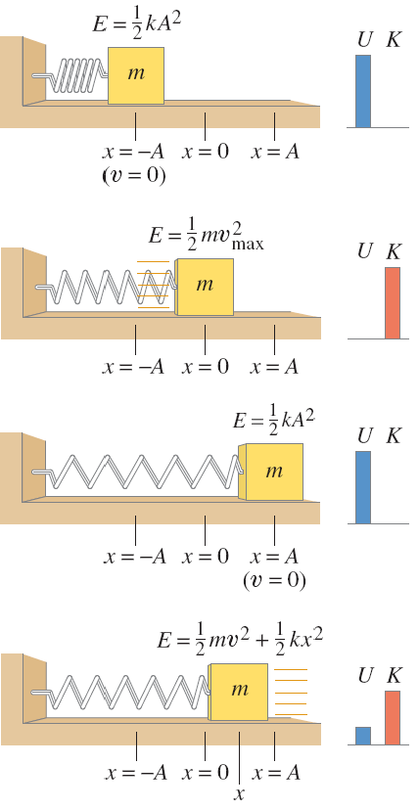
14-3 Energy in the Simple Harmonic Oscillator (2 of 6)
If the mass is at the limits of its motion, the energy is all potential.
If the mass is at the equilibrium point, the energy is all kinetic.
We know what the potential energy is at the turning points:
Notes:
Figure 14-10. Caption: Energy changes from potential energy to kinetic energy and back again as the spring oscillates. Energy bar graphs (on the right) are described in Section 8-4 (Fig. 8-7).
LD: The figure shows a block of mass m placed on a horizontal surface and is attached to a spring from the left, which in turn is attached to a vertical surface on the left. The horizontal surface has markings x equals negative “A”, x equals 0, and x equals “A” marked from a point at a distance from the vertical surface. Part (“a”): The block is placed at the point x equals negative “A”. The spring is compressed. A label E equals 1 by 2 k “A” squared is placed above the block. The velocity of the block given as v equals 0 is placed below the point x equals negative “A”. A vertical bar labeled U is placed on a horizontal line at the right of the figure. A label K is placed at the right of label U and the space below U is empty. Part (b): The block is placed at the point x equals 0. The spring is expanded slightly. A label E equals 1 by 2 m v squared subscript max is placed above the block. A label U is placed above a horizontal line at the right of the figure, where the space below U is empty. A vertical bar labeled K is placed at the right of label U. Part (c): The block is placed at the point x equals “A”. The spring is expanded to a great extent. A label E equals 1 by 2 k “A” squared is placed above the block. The velocity of the block given as v equals 0 is placed below x equals “A”. A vertical bar labeled U is placed on a horizontal line at the right of the figure. A label K is placed at the right of label U and the space below U is empty. Part (d): The block is placed at a point x that lies in the middle of the point x equals 0 and the point x equals “A”. The spring is compressed a little compared to that in Part (c). A label E equals 1 by 2 m v squared plus 1 by 2 k x squared is placed above the block. A vertical bar labeled U is placed on a horizontal line at the right of the figure. Another vertical bar almost thrice the size of the vertical bar labeled U is labeled K.

Slide 24



14-3 Energy in the Simple Harmonic Oscillator (3 of 6)
The total energy is, therefore,
And we can write:
This can be solved for the velocity as a function of position:
where

Slide 25
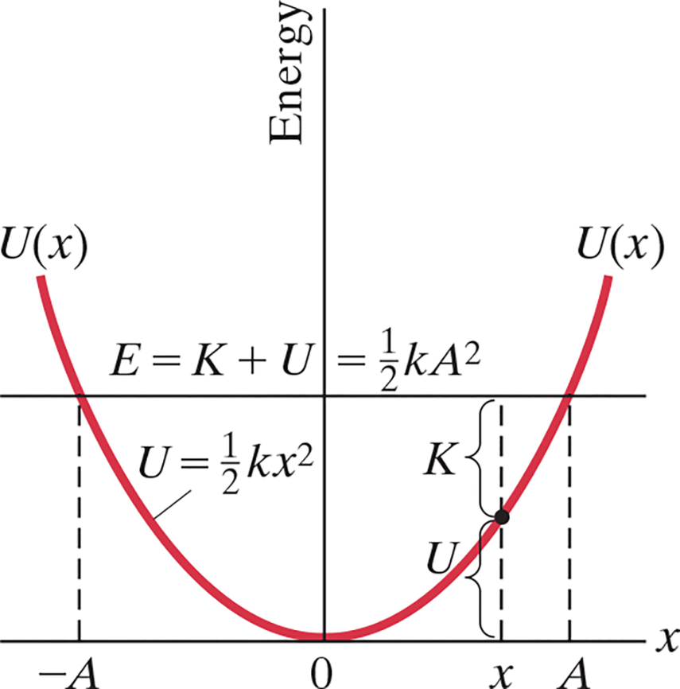
14-3 Energy in the Simple Harmonic Oscillator (4 of 6)
This graph shows the potential energy function of a spring. The total energy is constant.
Notes:
Figure 14-11. Caption: Graph of potential energy, U = ½ kx2, as a function of x. K + U = E = constant for any point x where –A ≤ x ≤ A. Values of K and U are indicated towards the right for an arbitrary position x.
LD: The graph is drawn on the x y coordinate plane. The x axis has the markings negative “A”, 0, and “A”. The y axis is labeled Energy. A curve labeled U equals 1 by 2 k x squared starts from the second quadrant, moves downward to the right till it reaches the origin (0,0), moves upward to the right, and ends at a point in the first quadrant that is opposite to the start point of the curve. The start and end points of the curve is labeled U of x. A horizontal line labeled E equals K plus U equals 1 by 2 k A squared bisects the curve horizontally at two points. Four vertical dashed lines are marked on the curve. The first line starts from the marking negative “A” on the x axis, moves upward and ends on the curve near the horizontal line. The second line starts from the marking “A” on the x axis, moves upward and ends on the curve near the horizontal line. The third line labeled U starts from a point x, which is marked to the left of “A” on the x axis, moves upward and ends on the curve. A point is marked on the curve where the third line ends. The fourth line labeled K starts from the point marked on the curve, moves upward and ends on the horizontal line.

Slide 26
14-3 Energy in the Simple Harmonic Oscillator (5 of 6)
Example 14-10: Energy calculations.
For the simple harmonic oscillation of Example 14-8 (where
and
determine (a) the total
energy, (b) the kinetic and potential energies as a function of time, (c) the velocity when the mass is 0.050 m from equilibrium, (d) the kinetic and potential energies at half
amplitude

Slide 27
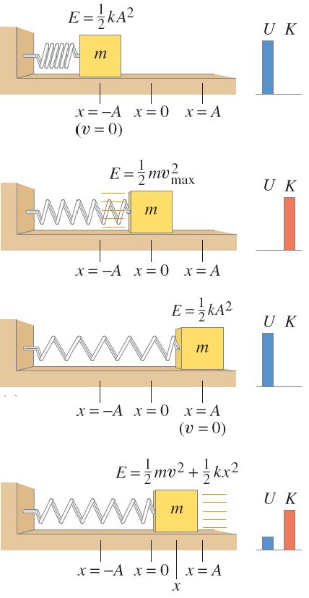
14-3 Energy in the Simple Harmonic Oscillator (6 of 6)
Conceptual Example 14-11: Doubling the amplitude.
Suppose this spring is stretched
twice as far
What
happens to (a) the energy of the system, (b) the maximum velocity of the oscillating mass, (c) the maximum acceleration of the mass?
Notes:
Figure 14-10, repeated.
b. The velocity is doubled.
c. The acceleration is doubled.
LD: The figure shows a block of mass m placed on a horizontal surface and is attached to a spring from the left, which in turn is attached to a vertical surface on the left. The horizontal surface has markings x equals negative “A”, x equals 0, and x equals “A” marked from a point at a distance from the vertical surface. First part: The block is placed at the point x equals negative “A”. The spring is compressed. A label E equals 1 by 2 k “A” squared is placed above the block. The velocity of the block given as v equals 0 is placed below the point x equals negative “A”. A vertical bar labeled U is placed on a horizontal line at the right of the figure. A label K is placed at the right of label U and the space below U is empty. Second part: The block is placed at the point x equals 0. The spring is expanded slightly. A label E equals 1 by 2 m v squared subscript max is placed above the block. A label U is placed above a horizontal line at the right of the figure, where the space below U is empty. A vertical bar labeled K is placed at the right of label U. Third part: The block is placed at the point x equals “A”. The spring is expanded to a great extent. A label E equals 1 by 2 k “A” squared is placed above the block. The velocity of the block given as v equals 0 is placed below x equals “A”. A vertical bar labeled U is placed on a horizontal line at the right of the figure. A label K is placed at the right of label U and the space below U is empty. Fourth part: The block is placed at a point x that lies in the middle of the point x equals 0 and the point x equals “A”. The spring is compressed a little compared to that in the third part. A label E equals 1 by 2 m v squared plus 1 by 2 k x squared is placed above the block. A vertical bar labeled U is placed on a horizontal line at the right of the figure. Another vertical bar almost thrice the size of the vertical bar labeled U is labeled K.

Slide 28
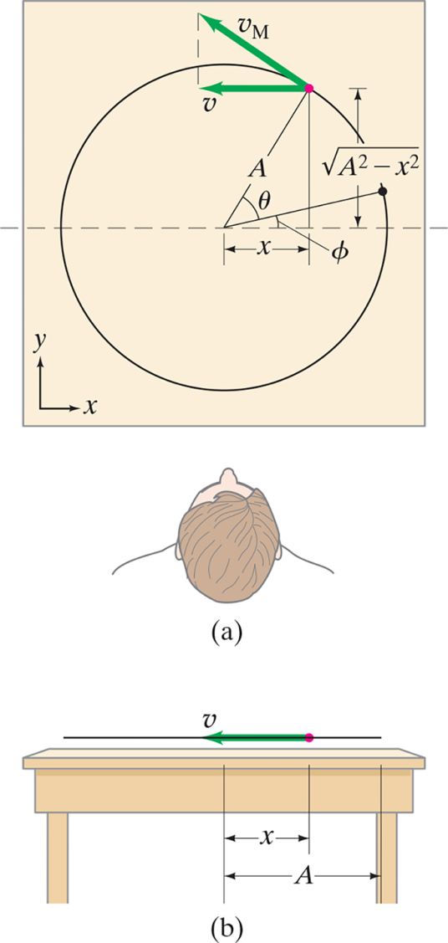


14-4 Simple Harmonic Motion Related to Uniform Circular Motion
If we look at the projection onto the x axis of an object moving in a circle of radius
A at a constant speed
we find that the x component of its velocity varies as:
This is identical to SHM.
Notes:
Figure 14-4. Caption: Analysis of simple harmonic motion as a side view (b) of circular motion (a).
LD: Part (“a”): The top view of the circular path taken by the particle is shown. A horizontal dashed line starts from the left, cuts the circular path into two halves, and extends beyond the circle on the right to represent the horizontal x axis. A particle is positioned toward the upper right on the circumference of the circle and is depicted as a pink-colored dot. A velocity vector arrow labeled v starts from the particle and points to the left. Another velocity vector arrow labeled v subscript M starts from the particle and points upward to the left, making a tangent to the circle. A vertical dashed line connects the tip of these two velocity vector arrows. A line labeled “A” is drawn from the center of the circle to the particle on the circle. A vertical line is drawn down from the particle to the horizontal dashed line. A vertical double-headed arrow labeled StartRoot “A” squared minus x squared EndRoot represents the length of the vertical line. A horizontal double-headed arrow labeled x represents the horizontal distance between the center of the circle and the vertical line. A point depicted as a black-colored dot is shown on the circumference of the circle toward the upper right and is close to the horizontal dashed line. A line is extended from the center of the circle to this black-colored dot such that it makes an angle labeled phi with the horizontal x axis. The line labeled “A” makes an angle labeled theta with the line connected to the black dot. The top view of a person watching the moving particle from the lower side of the table is shown. Part (b): The side view of a table with legs facing the observer is shown. A horizontal line parallel to the upper surface is positioned just above the table. A particle depicted as a pink-colored dot is marked on the horizontal line somewhere on the right. A velocity vector arrow labeled v starts from the particle and points to the left till it reaches the center of the horizontal line. A double-headed arrow labeled x represents the horizontal distance between the center of the horizontal line and the particle. Another double-headed arrow labeled “A” represents the horizontal distance between the center of the horizontal line and the right end of the horizontal line.

Slide 29
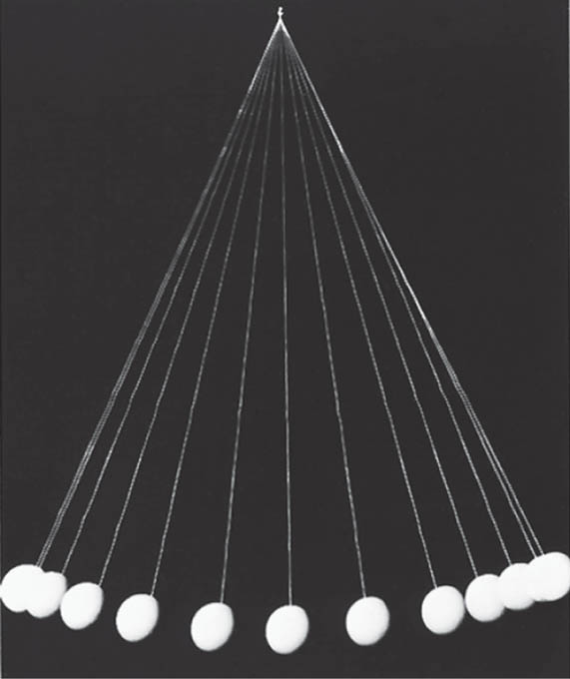
14-5 The Simple Pendulum (1 of 5)
A simple pendulum consists of a mass at the end of a lightweight cord. We assume that the cord does not stretch, and that its mass is negligible.
Notes:
Figure 14-13. Caption: Strobe-light photo of an oscillating pendulum photographed at equal time intervals.
LD: The string and the bob appear white against a black background. The movement of the pendulum from left to right is captured in 13 instances. The instances appear to overlap toward the ends and are spaced out toward the center.

Slide 30
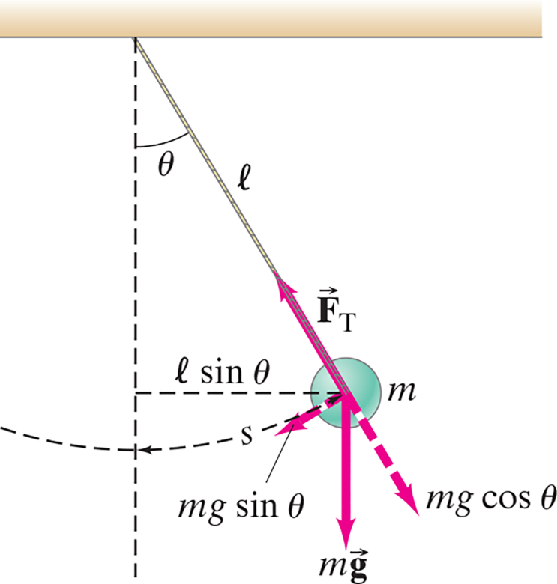
14-5 The Simple Pendulum (2 of 5)
In order to be in SHM, the restoring force must be proportional to the negative of the displacement. Here we
have:
which is proportional to
and not to
itself.
However, if the angle is small,
Notes:
Figure 14-14. Caption: Simple pendulum, and a free-body diagram.
LD: The pendulum is hung from a fixed point on a horizontal surface. The free end of the pendulum has a small object m at a distance l from the fixed point. The pendulum appears inclined to the right at a certain distance. A vertical dashed line is drawn from the fixed point. The angle between the vertical line and the cord of the pendulum is theta. The path of the moving pendulum is shown as a dashed curve from the left side of the vertical line to the center of the object and is labeled s. A horizontal dashed line labeled l sine theta is drawn from the center of the object to the vertical line. The forces acting at the object are as follows: A force vector arrow pointing downward is labeled m vector g. A diagonal force vector arrow pointing upward in alignment to the cord is labeled vector F subscript T. A dashed diagonal force vector arrow pointing downward to the right along the cord is labeled m g cos theta. A dashed diagonal force vector arrow pointing downward to the left and perpendicular to m g cos theta is labeled m g sine theta.

Slide 31



14-5 The Simple Pendulum (3 of 5)
Therefore, for small angles, we have:
where
The period and frequency are:

Slide 32

14-5 The Simple Pendulum (4 of 5)
So, as long as the cord can be considered massless and the amplitude is small, the period does not depend on the mass.
Notes:
Figure 14-15. Caption: The swinging motion of this elaborate lamp, hanging by a very long cord from the ceiling of the cathedral at Pisa, Italy, is said to have been observed by Galileo and to have inspired him to the conclusion that the period of a pendulum does not depend on amplitude.

Slide 33
14-5 The Simple Pendulum (5 of 5)
Example 14-12: Measuring g.
A geologist uses a simple pendulum that has a length of 37.10 c m and a frequency of 0.8190 Hz at a particular location on the Earth. What is the acceleration due to gravity at this location?

Slide 34
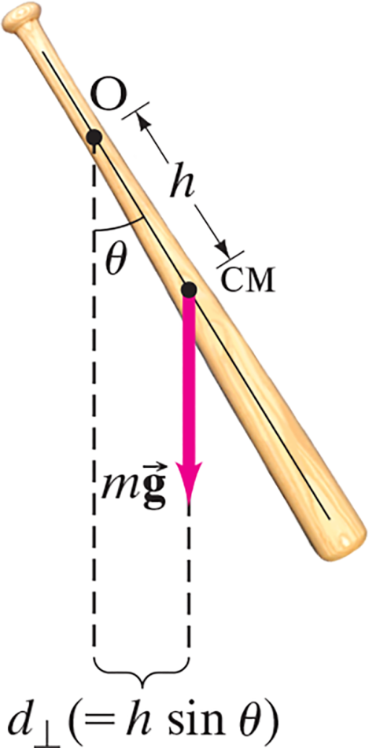


14-6 The Physical Pendulum and the Torsion Pendulum (1 of 4)
A physical pendulum is any real extended object that oscillates back and forth.
The torque about point O is:
Substituting into Newton’s second law gives:
Notes:
Figure 14-16. Caption: physical pendulum suspended from point O.
LD: The first point O is marked close to the narrow end of the bat. The second point labeled C M is marked closer to the wide end of the bat at the center and at a distance of h from point O. A force vector arrow from C M points downward and is labeled m vector g. The arrow is extended as a dashed line toward the bottom. A vertical dashed line from point O is drawn downward. The bat makes an angle theta with the vertical dashed line from point O. The distance between the dashed line and the extended dashed line is labeled d perpendicular (equals h sine theta).

Slide 35



14-6 The Physical Pendulum and the Torsion Pendulum (2 of 4)
For small angles, this becomes:
which is the equation for SHM, with

Slide 36
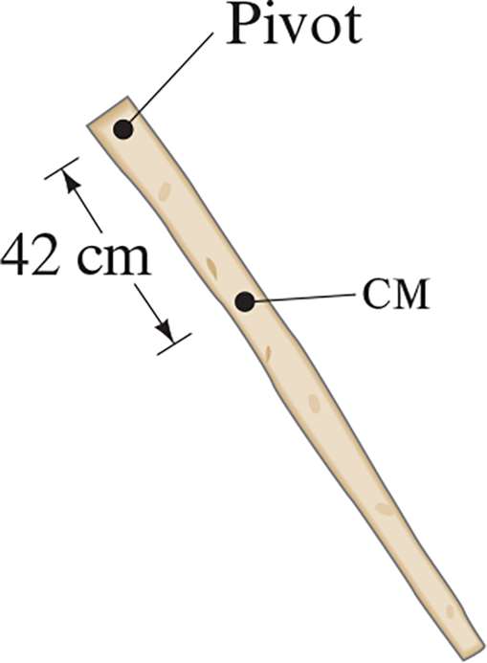
14-6 The Physical Pendulum and the Torsion Pendulum (3 of 4)
Example 14-13: Moment of inertia measurement.
An easy way to measure the moment of inertia of an object about any axis is to measure the period of oscillation about that axis. (a) Suppose a nonuniform 1.0-k g stick can be balanced at a point 42 c m from one end. If it is pivoted about that end, it oscillates with a period of 1.6 s. What is its moment of inertia about this end? (b) What is its moment of inertia about an axis perpendicular to the stick through its center of mass?
Notes:
Figure 14-17. Caption: Example 14-13.

Slide 37
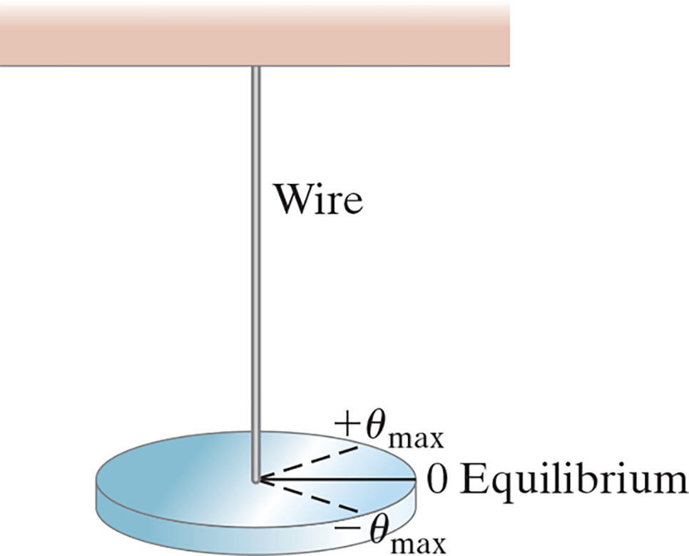

14-6 The Physical Pendulum and the Torsion Pendulum (4 of 4)
A torsion pendulum is one that twists rather than swings. The motion is SHM as long as the wire obeys Hooke’s law, with
(k is a constant that depends on the wire.)
Notes:
Figure 14-18. Caption: A torsion pendulum. The disc oscillates in SHM between θ max and –θ max .
LD: A wire is shown hanging from the center of a horizontal support. The other end of the wire is connected to the center of a horizontal disc on its upper surface. Three lines of similar lengths are drawn from the center of the disc on its upper surface to reach the periphery of the disc at three different points. The first line is a horizontal line labeled 0 Equilibrium drawn to the right. The second line is a dashed line labeled positive theta subscript max drawn toward the upper right. The third line is a dashed line labeled negative theta subscript max drawn toward the lower right.

Slide 38
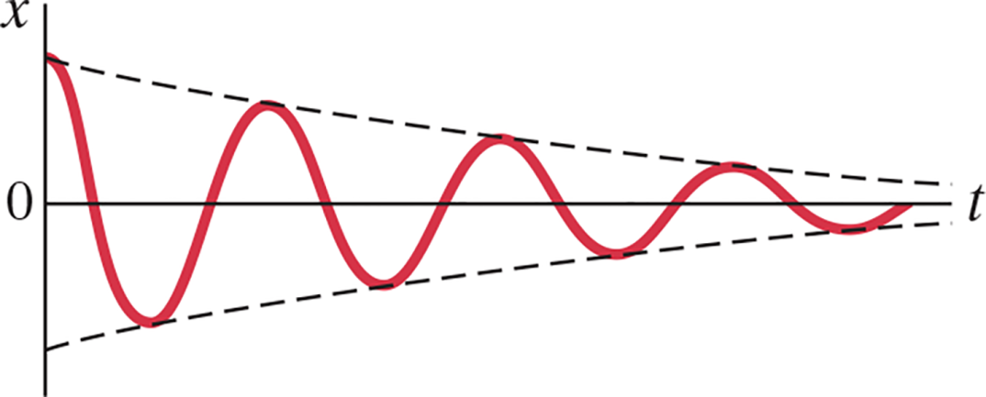

14-7 Damped Harmonic Motion (1 of 5)
Damped harmonic motion is harmonic motion with a frictional or drag force. If the damping is small, we can treat it as an “envelope” that modifies the undamped oscillation.
if
then
Notes:
Figure 14-19. Caption: Damped harmonic motion. The solid red curve represents a cosine times a decreasing exponential (the dashed lines).
LD: The graph is drawn on a coordinate plane. The horizontal axis is labeled t. The vertical axis is labeled x. The origin is labeled 0. The curve resembles a sine wave with three peaks and four troughs. The amplitude of the wave decreases as it moves away from the origin. The curve starts from a point on the positive vertical axis and ends at a point on the horizontal axis. A dashed line starts from the starting point of the curve on the positive vertical axis, moves down to the right to connect all the peaks of the curve, then reaches close to the horizontal axis and becomes parallel to the horizontal axis at the end. Similarly, another dashed line starts from the negative vertical axis, moves up to the right to connect all troughs of the curve, then reaches close to the horizontal axis and becomes parallel to the horizontal axis at the end. The starting points of both the dashed lines are equidistant from the origin 0.

Slide 39



14-7 Damped Harmonic Motion (2 of 5)
This gives
If b is small, a solution of the form
will work, with

Slide 40
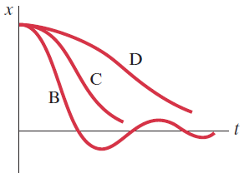
14-7 Damped Harmonic Motion (3 of 5)
If
is real and the
system is underdamped (case B).
If
the system is
critically damped (case C). This is the case in which the system reaches equilibrium in the shortest time.
If
becomes imaginary and the system is
overdamped (case D).
Notes:
Figure 14-20. Caption: Underdamped (B), critically damped (C), and overdamped (D) motion.
LD: The graph is drawn on a coordinate plane. The horizontal axis is labeled t. The vertical axis is labeled x. Three curves start from a point placed on the top half of the positive vertical axis. The first curve labeled B goes down to the right till it reaches the horizontal axis. This curve continues to go further down to the right in the negative vertical axis till it reaches a dip and then moves up to the right to reach the horizontal axis. This curve continues to go up to the right till it reaches a peak close to the horizontal axis. The curve now continues to go down to the right till it reaches the horizontal axis, then continues to go further down to the right in the negative vertical axis till it reaches a dip very close to the horizontal axis. This curve continues to go up to the right and ends on the horizontal axis. The second curve labeled C goes further down to the right beyond the curve B till it reaches close to the horizontal axis and ends just above the center of the horizontal axis. The third curve labeled D goes further down to the right beyond the curve C till it reaches close to the horizontal axis such that the last half of the curve appears nearly flat.

Slide 41
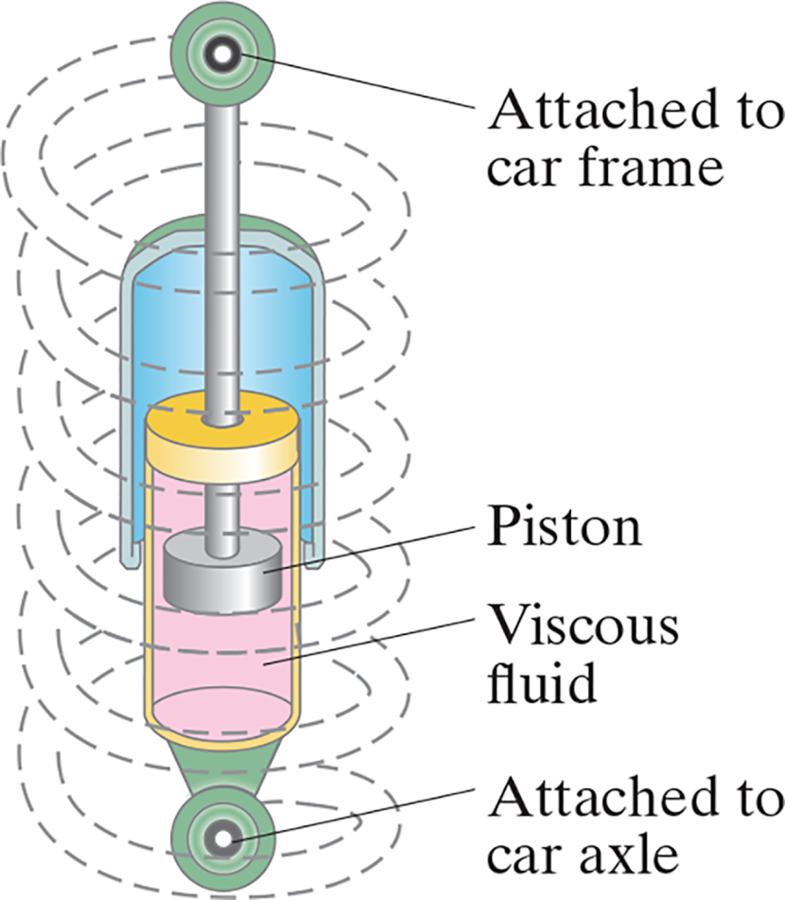
14-7 Damped Harmonic Motion (4 of 5)
There are systems in which damping is unwanted, such as clocks and musical instruments.
Then there are systems in which it is wanted, and often needs to be as close to critical damping as possible, such as automobile shock absorbers and earthquake protection for buildings.
Notes:
Figure 14-21. Caption: Automobile spring with shock absorber which provides damping so that a car won’t bounce up and down endlessly. See Chapter-Opening photograph, page 399.
LD: The shock absorber has two circular joints attached to the car. The circular joint at the top is labeled Attached to car frame and the circular joint at the bottom is labeled Attached to car axle. The top circular joint appears to be connected below to a vertical rod that is further connected to a piston labeled Piston that points down. This vertical rod is enclosed by a frame that starts from the center of the vertical rod and ends at the level of Piston. Inside this frame, the vertical rod passes through a disc above its crown. The disc and the crown are inside a vertical chamber filled with a label Viscous fluid. Piston appears to be placed in the center of the vertical chamber closer to the top. The vertical chamber is further connected to the circular joint labeled Attached to car axle at the bottom. A spring represented by dashed lines starts from the circular joint on top of the shock absorber, coils around the shock absorber, and ends at the circular joint at the bottom of the shock absorber.

Slide 42
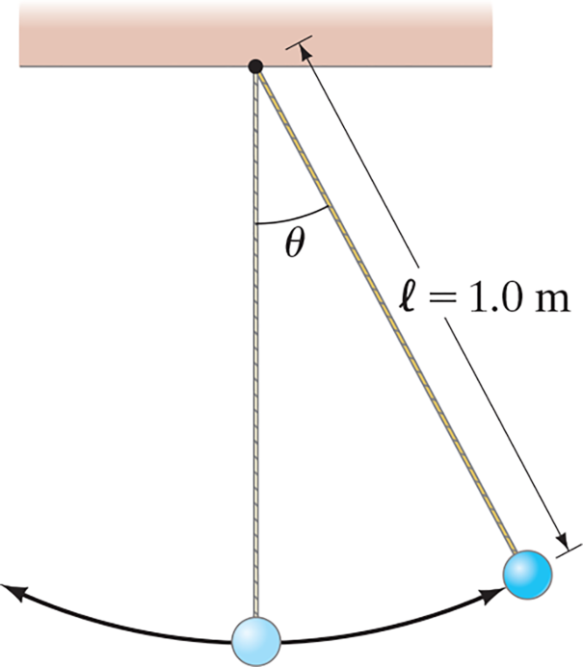
14-7 Damped Harmonic Motion (5 of 5)
Example 14-14: Simple pendulum with damping.
A simple pendulum has a length of 1.0 m. It is set swinging with small-amplitude oscillations. After
5.0 minutes, the amplitude is only 50% of what it was initially. (a) What
is the value of
for the motion?
(b) By what factor does the frequency, fˊ, differ from f, the undamped frequency?
Notes:
Figure 14-23. Caption: Example 14-14.
LD: A horizontal support placed at the top of the figure is connected to two strings from a black dot at the center. The first string is placed vertically downward and connects to a bob. The second string is placed downward to the right, connects to another bob and makes an angle of theta degrees with the first string. A double-headed arrow labeled l equals 1.0 m represents the length of the string. A curved arrow starts from the first bob and points toward the right at the second bob indicating the forward direction of the oscillation of the bob. Similarly, another curved arrow having the same magnitude as the first curved arrow, starts from the first bob and points toward the left. The second curved arrow indicates the backward direction of the oscillation of the bob.

Slide 43
14-8 Forced Oscillations; Resonance (1 of 4)
Forced vibrations occur when there is a periodic driving force. This force may or may not have the same period as the natural frequency of the system.
If the frequency is the same as the natural frequency, the amplitude can become quite large. This is called resonance.
Notes:
Figure 14-25. Caption: (a) Large-amplitude oscillations of the Tacoma Narrows Bridge, due to gusty winds, led to its collapse (1940). (b) Collapse of a freeway in California, due to resonance in the soft ground below, caused y the 1989 earthquake.
LD: Part (“a”): A photograph of the collapsed Tacoma Narrows Bridge in 1940 is shown. A tower of the bridge is visible which appears connected to other towers at the top through large hanging cables. These hanging cables are connected to the roadway on the bridge through a series of vertical cables. The roadway appears to be distorted from the center.
LD: Part (b): A photograph of a collapsed freeway in California due to the 1989 earthquake is shown. The freeway has two trailers and a damaged car on it. There is a road on the right of the collapsed freeway. Two cars and a firetruck are parked on the right side of the road. Two people are standing next to the collapsed freeway while two more people are seated on the right sidewalk of the road facing the collapsed freeway.

Slide 44
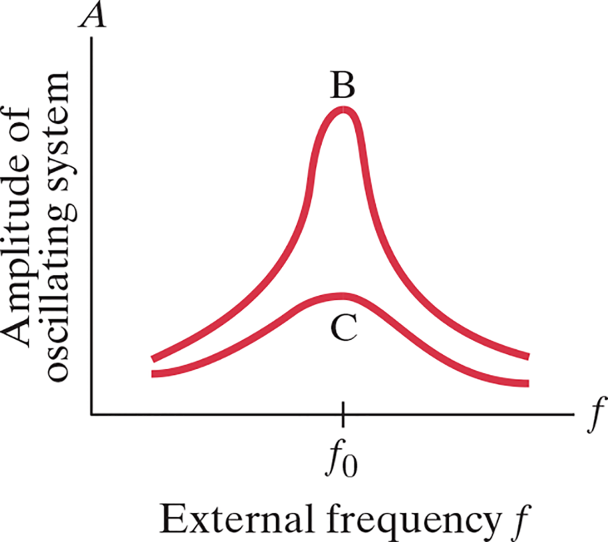
14-8 Forced Oscillations; Resonance (2 of 4)
The sharpness of the resonant peak depends on the damping. If the damping is small (B) it can be quite sharp; if the damping is larger (C) it is less sharp.
Like damping, resonance can be wanted or unwanted. Musical instruments and TV/radio receivers depend on it.
Notes:
Figure 14-24. Caption: Amplitude as a function of driving frequency f , showing resonance for lightly damped (B) and heavily damped (C) systems.
LD: The graph is drawn on a coordinate plane. The horizontal axis is labeled External frequency f with a marking f subscript 0 placed at the center of the axis. The vertical axis is labeled Amplitude of oscillating system “A”. The graph consists of two curves. The first curve labeled C starts near the origin, moves up to the right, peaks at a point corresponding to f subscript 0 on the positive vertical axis, then goes down to the right till it reaches close to the horizontal axis. The second curve labeled B starts near the origin above the starting point of C, moves up to the right, peaks at a point corresponding to f subscript 0 on the positive vertical axis much above the peak of C, then goes down to the right till it reaches close to the horizontal axis above the end point of C.

Slide 45


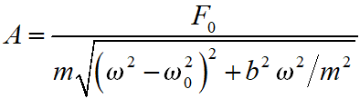

14-8 Forced Oscillations; Resonance (3 of 4)
The equation of motion for a forced oscillator is:
The solution is:
where
and

Slide 46
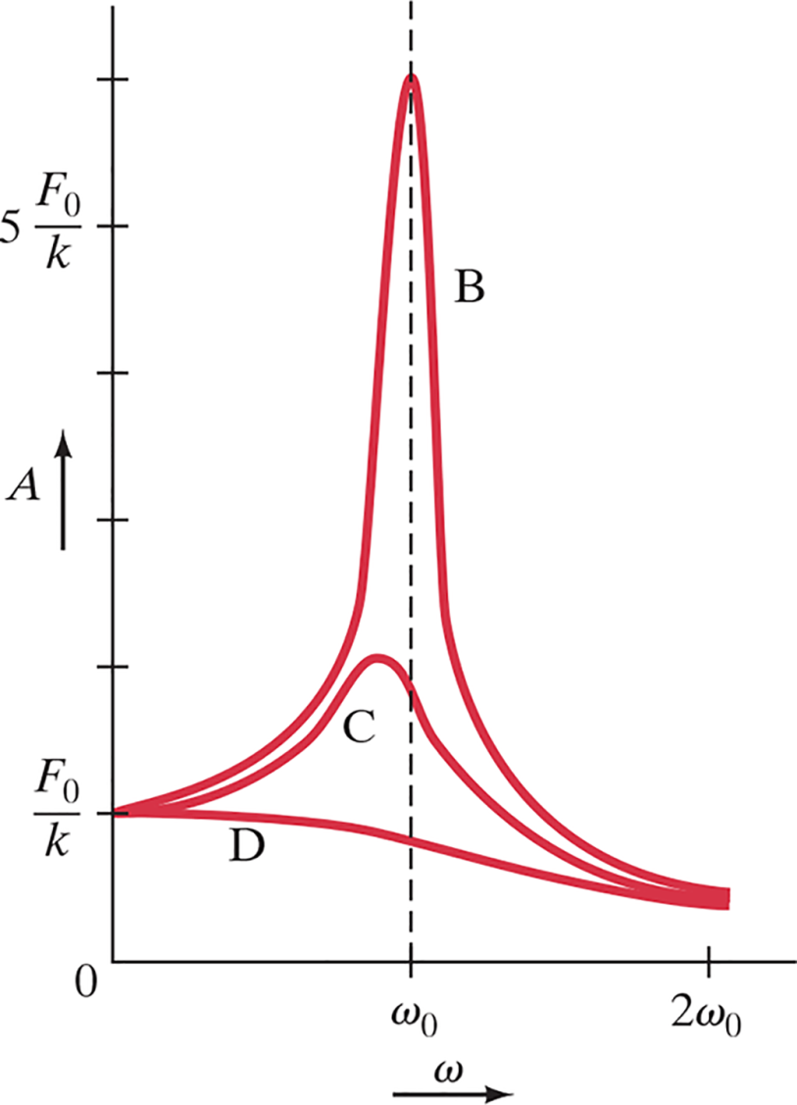

14-8 Forced Oscillations; Resonance (4 of 4)
The width of the resonant peak can be characterized by the Q factor:
Notes:
Figure 14-27. Caption: Amplitude of a forced harmonic oscillator as a function of ω. Curves B, C, and D correspond to light, heavy, and overdamped systems, respectively (Q = mω0/b = 6, 2, 0.71).
LD: The graph is drawn on a coordinate plane. The horizontal axis is labeled omega and ranges from 0 to 2 omega subscript 0 in interval of one unit. The vertical axis is labeled “A” and ranges from 0 to 6 StartFraction F subscript 0 over k EndFraction in interval of one unit. The first division on the vertical axis is labeled StartFraction F subscript 0 over k EndFraction. The fifth division on the vertical axis is labeled 5 StartFraction F subscript 0 over k EndFraction. A vertical dashed line starts from omega subscript 0 on the horizontal axis and goes up, parallel to the vertical axis till it reaches the end point of the vertical axis. Three curves start from a point (0, StartFraction F subscript 0 over k EndFraction). The first curve labeled D starts from this point and goes down gradually to the right till it reaches a point below the starting point on the positive vertical axis to meet at 2 omega subscript 0, a little above the horizontal axis. The second curve labeled C starts from the same point as D, moves up to the right, peaks up to a point where y equals 2 StartFraction F subscript 0 over k EndFraction to the left of the dashed line and moves down to the right till it reaches the same end point as D. The third curve labeled B starts from the same point as D, moves up to the right above the second curve, peaks at point (omega subscript 0,6 StartFraction F subscript 0 over k EndFraction) on the vertical dashed line, and moves down to the right till it reaches the same end point as D.

Slide 47

Summary of Chapter 14 (1 of 2)
For S H M, the restoring force is proportional to the displacement.
The period is the time required for one cycle, and the frequency is the number of cycles per second.
Period for a mass on a spring:
SHM is sinusoidal.
During S H M, the total energy is continually changing from kinetic to potential and back.

Slide 48

Summary of Chapter 14 (2 of 2)
A simple pendulum approximates S H M if its amplitude is not large. Its period in that case is:
When friction is present, the motion is damped.
If an oscillating force is applied to a S H O, its amplitude depends on how close to the natural frequency the driving frequency is. If it is close, the amplitude becomes quite large. This is called resonance.

Slide 49

Copyright
This work is protected by United States copyright laws and is provided solely for the use of instructors in teaching their courses and assessing student learning. Dissemination or sale of any part of this work (including on the World Wide Web) will destroy the integrity of the work and is not permitted. The work and materials from it should never be made available to students except by instructors using the accompanying text in their classes. All recipients of this work are expected to abide by these restrictions and to honor the intended pedagogical purposes and the needs of other instructors who rely on these materials.

