Slide 1


Physics for Scientists and Engineers with Modern Physics
Fifth Edition
Chapter 15
Wave Motion
Copyright © 2023 Pearson Education, Inc. All Rights Reserved
Notes:
If this PowerPoint presentation contains mathematical equations, you may need to check that your computer has the following installed:
1) MathType Plugin
2) Math Player (free versions available)
3) NVDA Reader (free versions available)

Slide 2
Units of Chapter 15 (1 of 2)
Characteristics of Wave Motion
Types of Waves: Transverse and Longitudinal
Energy Transported by Waves
Mathematical Representation of a Traveling Wave
The Wave Equation
The Principle of Superposition
Reflection and Transmission

Slide 3
Units of Chapter 15 (2 of 2)
Interference
Standing Waves; Resonance
Refraction
Diffraction

Slide 4
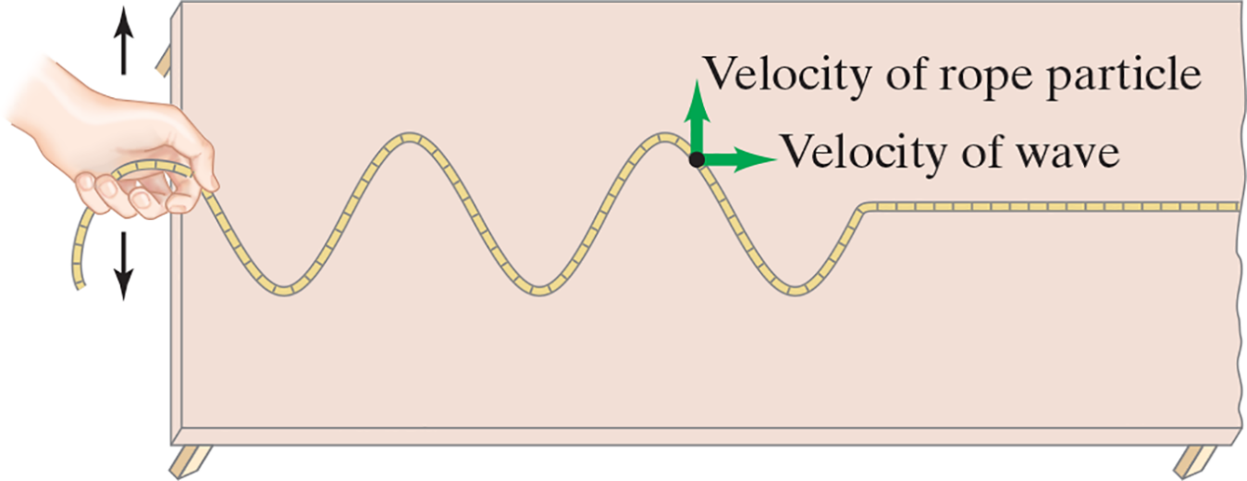
Chapter 15 Wave Motion
Example 15-1: Wave vs. particle velocity.
Is the velocity of a wave moving along a rope the same as the velocity of a particle on the rope? See the figure.
Notes:
Figure 15 – 1 Wave traveling on a rope or cord. The wave travels to the right along the rope. Particles of the rope oscillate back and forth on the tabletop.
LD: The left end of the rope is held by a hand and the right end of the rope is fixed to the right end of the table at the center. Two arrows, facing the opposite sides are shown at the top and bottom of the hand, respectively. The arrows depict the upward and downward motion of the hand. The transverse wave made by the hand movement is seen in the form of three troughs and two crests on the rope followed by a straight line. A point is marked on the second crest and two velocity vector arrows are shown on the point. The velocity vector arrow labeled Velocity of rope particle points upward and the velocity vector arrow labeled Velocity of wave points to the right.

Slide 5
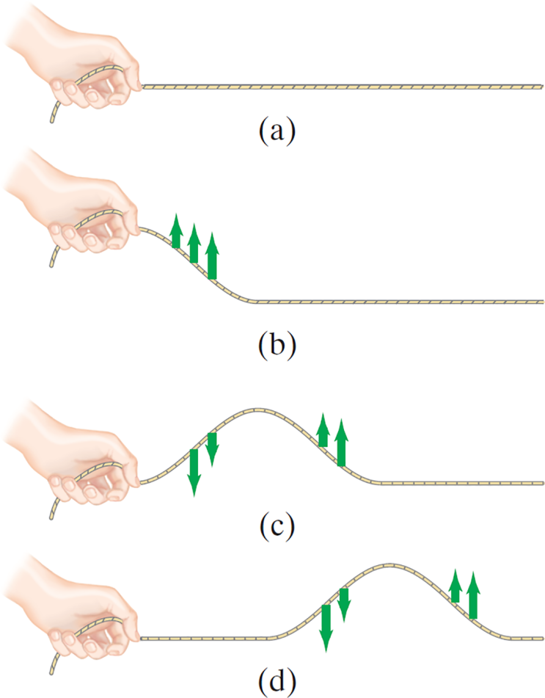
15-1 Characteristics of Wave Motion (1 of 2)
All types of traveling waves transport energy.
Study of a single wave pulse shows that it is begun with a vibration and is transmitted through internal forces in the medium.
Continuous waves start with vibrations, too. If the vibration is SHM, then the wave will be sinusoidal.
Notes:
Figure 15-2. A wave pulse is generated by a hand holding the end of a cord and moving up and down once. Motion of the wave pulse is to the right. Arrows indicate velocity of cord particles.
LD: In part (“a”), a horizontal straight cord is held by a hand from the left. In part (b), the hand holding the cord is moved up so the cord is lifted at the left end. After the hand, a downward slope to the right is seen on the cord and the slope has three velocity vector arrows pointing upward. The rest of the cord remains straight. The magnitude of the velocity vectors increases as the slope moves downward. In part (c), the hand holding the cord is moved down, which forms a crest of a wave on the cord. After the wave, the rest of the cord remains straight on the right side. Two velocity vector arrows pointing downward are seen on the left side of the crest and two velocity vector arrows pointing upward are seen on the right side of the crest. The magnitude of the velocity vectors decrease toward the top of the crest. In part (d), the hand holding the cord remains stationary. The crest of the wave is seen at the right end of the cord. Two velocity vector arrows pointing downward are seen on the left side of the crest and two velocity vector arrows pointing upward are seen on the right side of the crest. The magnitude of the velocity vectors decrease toward the top of the crest. The cord becomes straight after the wave on the right.

Slide 6


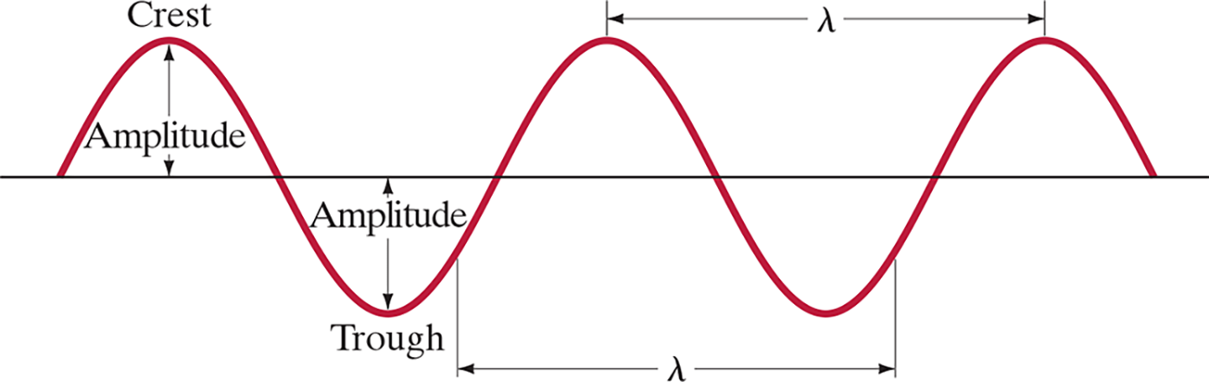
15-1 Characteristics of Wave Motion (2 of 2)
Wave characteristics:
Amplitude, A
Wavelength,
Frequency, f and period, T
Wave velocity,
Notes:
Figure 15-3. Characteristics of a single-frequency continuous wave moving through space.
LD: The wave has two cycles. In the first cycle, a curve starts at a point on the horizontal plane, moves upward to the right to form a crest, moves downward to the right, crosses the horizontal plane, forms a trough, and moves upward to the right till intercepts the horizontal plane. This repeats for the second cycle. A double-headed arrow labeled Amplitude is placed between the first crest labeled Crest and the horizontal plane. Similarly, a double-headed arrow labeled Amplitude is placed between the horizontal plane and the first trough labeled Trough. A double-headed arrow labeled lambda indicates the distance of one wavelength, which is from a point on the first trough to a point on the second trough. Similarly, a double-headed arrow labeled lambda indicates the distance of one wavelength, which is from a point at the center of the second crest to a point at the center of the third trough.

Slide 7
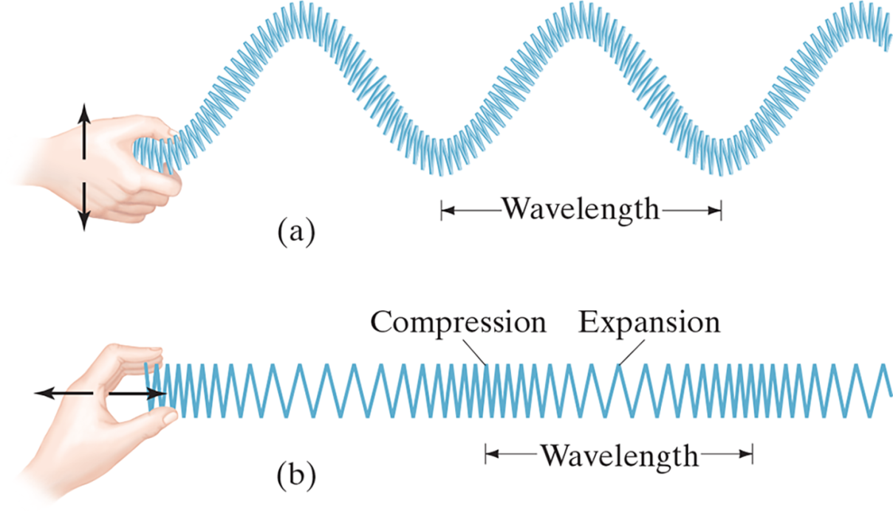
15-2 Types of Waves: Transverse and Longitudinal (1 of 8)
The motion of particles in a wave can be either perpendicular to the wave direction (transverse) or parallel to it (longitudinal).
Notes:
Figure 15-4. (a) A transverse wave, and (b) a longitudinal wave, on a Slinky.
LD: In part (“a”), a hand is holding the Slinky’s left end. Two vertical arrows, opposite to each other and placed one below the other, are shown on the hand to depict the upward and downward motion of the hand. The Slinky is forming a transverse wave pattern due to the hand’s motion to create troughs. The distance between the peaks of two consecutive troughs is marked and labeled Wavelength by a horizontal double-headed arrow placed below the Slinky. In part (b), a hand is holding the Slinky’s left end. Two arrows, opposite to each other and placed one after the other in the horizontal direction, are shown on the hand to depict the sideward motion of the hand. The Slinky is forming a longitudinal wave pattern due to the hand’s motion to create a series of compressed and expanded coil patterns. A portion of the compressed coil pattern is labeled Compression and marked by a vertical dash above the Slinky. A portion of the expanded coil pattern is labeled Expansion and marked by a vertical dash above the Slinky. The distance between two consecutive compressed coil patterns of the Slinky is marked and labeled Wavelength by a horizontal double-headed arrow placed below the Slinky.

Slide 8
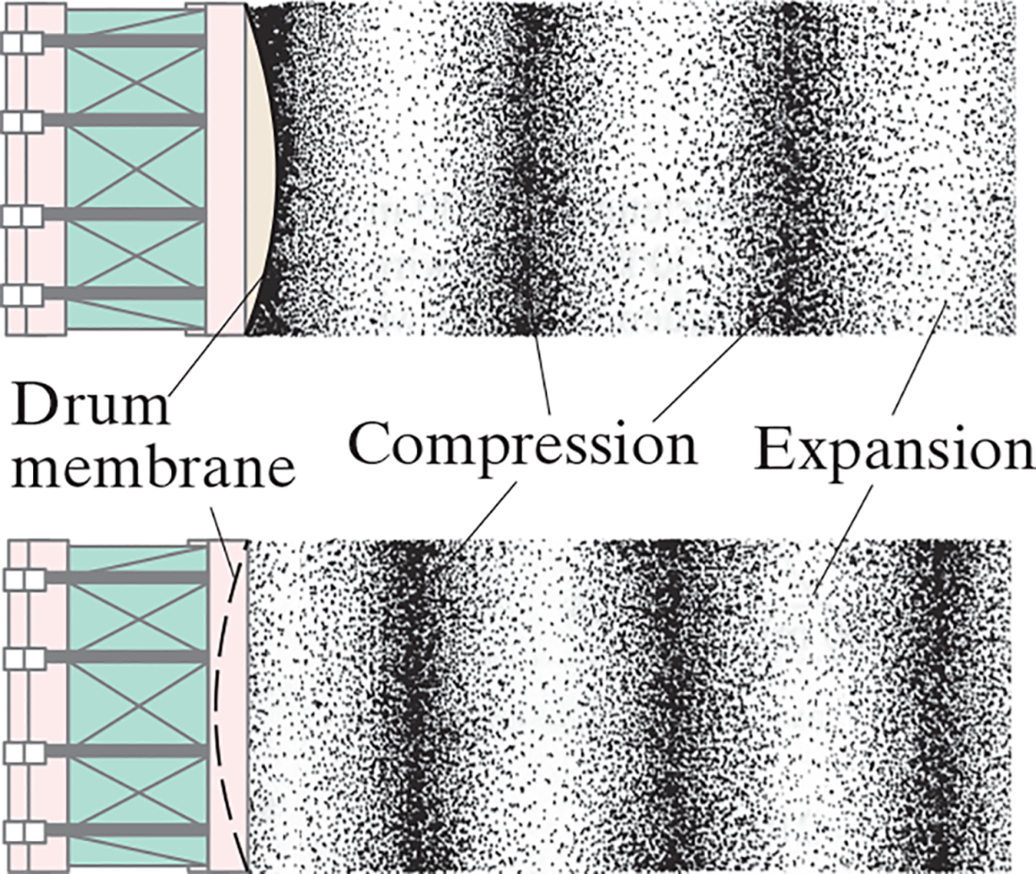
15-2 Types of Waves: Transverse and Longitudinal (2 of 8)
Sound waves are longitudinal waves:
Notes:
Figure 15-5. Production of a sound wave, which is longitudinal, shown at two moments in time about a half period (1/2 T) apart. (An “expansion” is often called a rarefaction of the air.) The dots represent air molecules.
LD: The figure consists of two parts representing the movement of a sound wave at two different moments of time, about a half period apart. In both parts, a drum is shown on the left side of the figure. A drum membrane is shown at the right end of the drum in the form of a semi-circle having the drum length as its diameter. Air molecules are represented by dots. The dots are arranged in two patterns, closely arranged thick patterns labeled Compression and sparsely arranged thin patterns labeled Expansion, respectively. Both patterns are formed consecutively from the drum membrane to the right side of the figure. In the first moment, the semi-circular drum membrane appears to bulge away from the right side of the drum. It represents a state when the drum membrane compresses the air in contact with it. In this state, the dots start from Compression pattern followed by Expansion pattern, and this pattern is followed until the right side of the figure. In the second moment, the semi-circular drum membrane appears to bulge inward from the right side of the drum. It represents a state when the drum membrane expands the air in contact with it. In this state, the dots start from Expansion pattern followed by Compression pattern, and this pattern is followed until the right side of the figure.

Slide 9

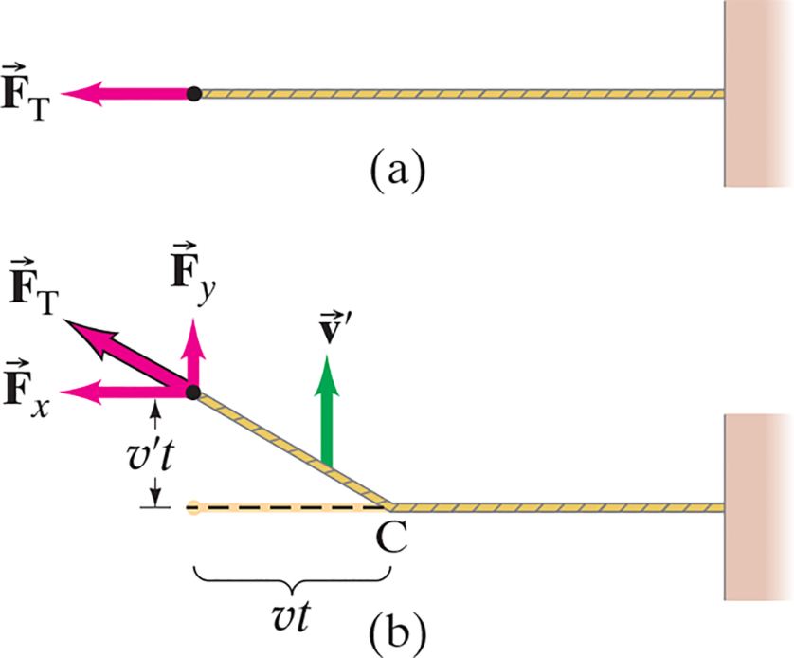
15-2 Types of Waves: Transverse and Longitudinal (3 of 8)
The speed of a transverse wave on a cord is given by:
As expected, the speed increases when the tension increases, and decreases when the mass increases.
Notes:
Figure 15-7. Diagram of simple wave pulse on a cord for derivation of Eq. 15-2. (Diagram is not to scale: we assume v ‘<<v, and Fx ~~ F T . The upward angle of the cord is exaggerated for visibility.)
LD: In part (“a”), the cord appears straight and has a force-field vector arrow labeled vector F subscript T that points to the left at the left end of the cord. In part (b), the cord slants downward to the right till a point C and then remains horizontal till the wall. A dashed straight line extends to the left from point C till the original position of the cord in part (“a”). The distance between C and the original position of the cord in part (“a”) is labeled v t. A velocity vector arrow labeled vector v prime is placed near the middle of the projected slope. The vector arrow points upward. The free end of the cord at the beginning of the slope has three force-field vector arrows that are labeled and positioned as follows: force-field vector arrow labeled vector F subscript y points upward, force-field vector arrow labeled F subscript x points to the left, and force-field vector arrow labeled vector F subscript T points diagonally to the upper left. A vertical double-headed arrow labeled v prime t represents the height between the force-field vector F subscript x and the dashed straight line at the bottom.

Slide 10
15-2 Types of Waves: Transverse and Longitudinal (4 of 8)
Example 15-2: Wave along a wire.
A wave whose wavelength is 0.30 m is traveling down a 300-m-long wire whose total mass is 15 k g. If the wire is under a tension of 1000 N, what are the speed and frequency of this wave?

Slide 11
15-2 Types of Waves: Transverse and Longitudinal (5 of 8)
Example 15-3: Pulse on a wire.
An 80.0-m-long, 2.10-m m-diameter copper wire is stretched between two poles. A bird lands at the center point of the wire, sending a small wave pulse out in both directions. The pulses reflect at the ends and arrive back at the bird’s location 0.750 seconds after it landed. Determine the tension in the wire.

Slide 12


15-2 Types of Waves: Transverse and Longitudinal (6 of 8)
The speed of a longitudinal wave depends on the elastic restoring force of the medium and on the mass density.
or

Slide 13
15-2 Types of Waves: Transverse and Longitudinal (7 of 8)
Example 15-4: Echolocation.
Echolocation is a form of perception used by animals such as bats, toothed whales, and dolphins. The animal emits a pulse of sound (a longitudinal wave) which, after reflection from objects, returns and is detected by the animal. Echolocation waves can have frequencies of about 100,000 Hz.
(a) Estimate the wavelength of a sea animal’s echolocation wave.
(b) If an obstacle is 100 m from the animal, how long after the animal emits a wave is its reflection detected?

Slide 14
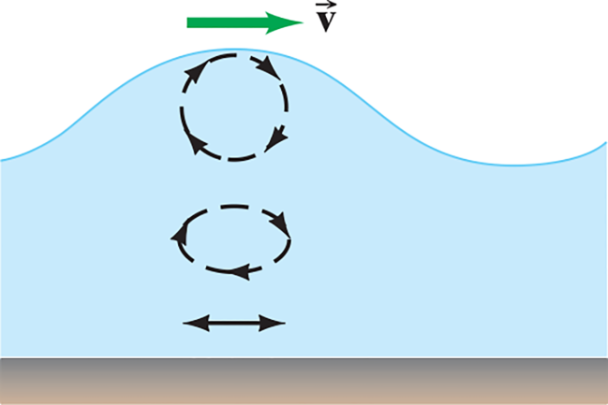
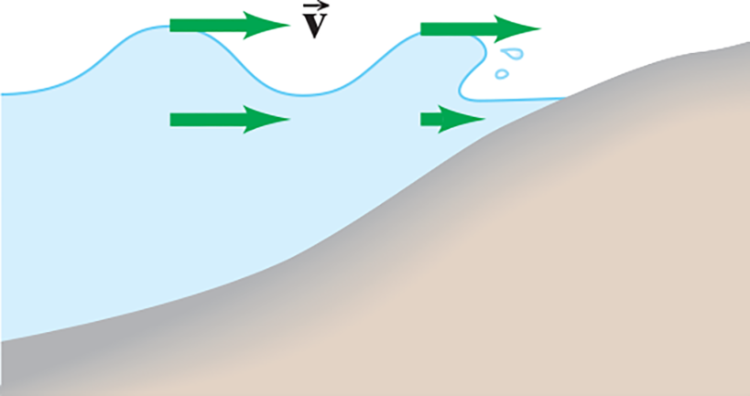
15-2 Types of Waves: Transverse and Longitudinal (8 of 8)
Earthquakes produce both longitudinal and transverse waves. Both types can travel through solid material, but only longitudinal waves can propagate through a fluid—in the transverse direction, a fluid has no restoring force.
Surface waves are waves that travel along the boundary between two media.
Notes:
Figure 15-9: A shallow water wave is an example of a surface wave, which is a combination of vertical and horizontal motions.
Figure 15-10: How a water wave breaks. The green arrows represent the local velocity of water molecules.
LD: A transverse shallow water wave is represented in the figure. A velocity vector arrow labeled vector v is placed on top of the wave pointing right. At the top of the wave, the motion of the wave appears to be both vertical and horizontal. The horizontal, and vertical motion is again represented by two types. The first type shows arrows in a dashed circular path pointing in the clockwise direction and placed underneath the top of the wave. The second type is represented by arrows in a dashed elliptical path pointing in the clockwise direction and placed in the middle of the wave, underneath the dashed circular arrows. At the bottom of the wave, the motion is only horizontal as depicted by a horizontal double-headed arrow.
LD: Two water waves are crashing on the ocean shore present on the right side of the figure. The water waves are transverse in nature. Four velocity vector arrows are shown in the figure. A velocity vector arrow labeled vector v starts from the top of the left water wave and points right. A second velocity vector arrow is placed in parallel to the first velocity vector arrow and points right, at the bottom of the left water wave. A third velocity vector arrow starts from the top of the right water wave and points right. A fourth velocity vector arrow is placed in parallel to the third velocity vector arrow and points right, at the bottom of the right water wave near the ocean shore. The magnitude of the fourth velocity vector is quite small.

Slide 15
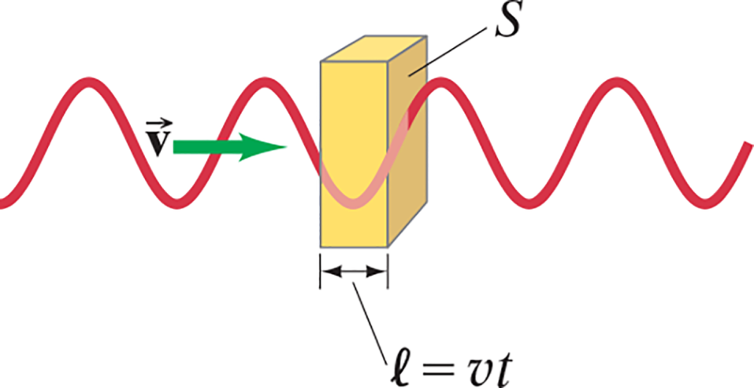


15-3 Energy Transported by Waves (1 of 3)
By looking at the energy of a particle of matter in the medium of a wave, we find:
Then, assuming the entire medium has the same density, we find:
Therefore, the intensity is proportional to the square of the frequency and to the square of the amplitude.
Notes:
Figure 15-11. Calculating the energy carried by a wave moving with speed v.
LD A vertical rectangular box labeled S is shown in the middle of the figure. A wave with four crests and three troughs passes through the box at exactly the second trough. A double-headed arrow labeled l equals v t indicates the breadth of the box.

Slide 16
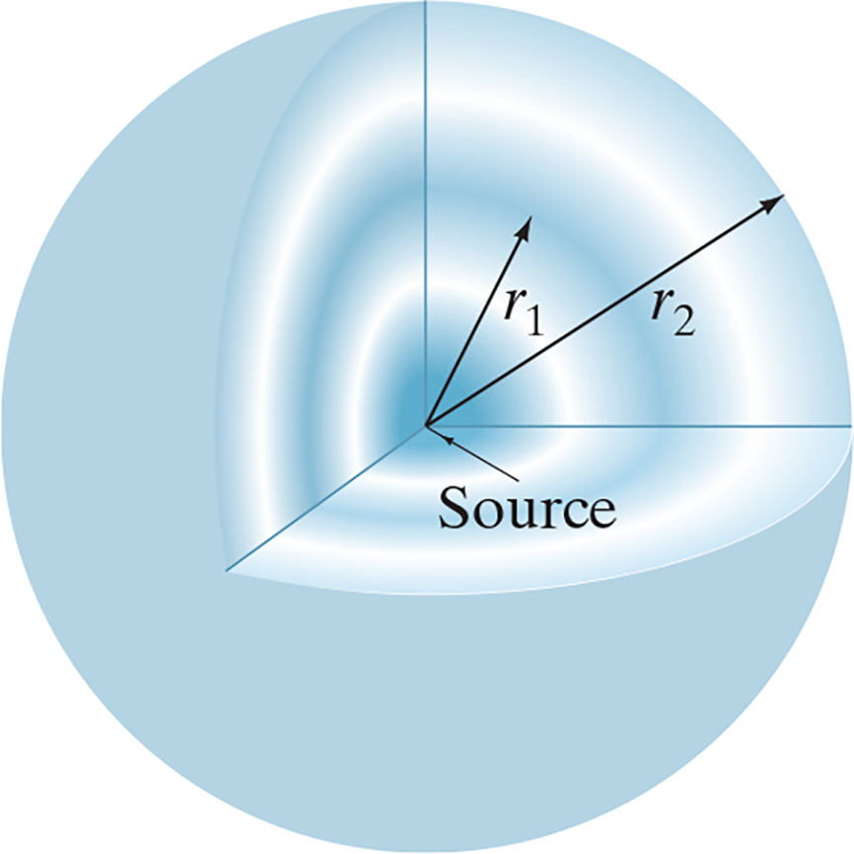
15-3 Energy Transported by Waves (2 of 3)
If a wave is able to spread out three-dimensionally from its source, and the medium is uniform, the wave is spherical.
Just from geometrical considerations, as long as the power output is constant, we see:
Notes:
Figure 15-12. A wave traveling uniformly outward in three dimensions from a source is spherical. Two crests (or compressions) are shown, of radii r1 and r2.
LD: A quadrant is carved out from the upper right side of a sphere in the three-dimensional coordinate space having two crests and troughs, respectively. The dark blue curve patches represent crest and the white curve patches on the wall represent trough. The origin or the intersection of the axes is named Source. A wave originates from Source and travels along the inner walls of the sphere. An arrow labeled r subscript 1 originates from the source and extends in the upper right direction till the first crest. Another arrow labeled r subscript 2 originates from Source and extends as a diagonal line to the upper right till the second crest. Both r subscript 1 and r subscript 2 represent the radii of two different crests. The length of the radii r subscript 2 is greater than that of r subscript 1.

Slide 17
15-3 Energy Transported by Waves (3 of 3)
Example 15-5: Earthquake intensity.
The intensity of an earthquake P wave traveling through the Earth and detected 100 k m from the source is
What is the intensity of that wave if
if detected 400 k m from the source?

Slide 18

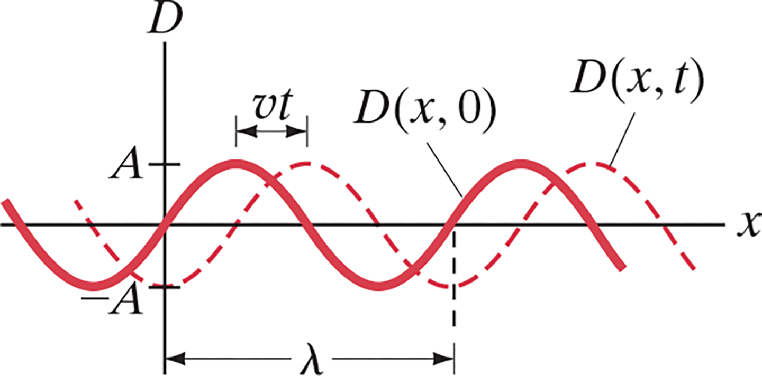
15-4 Mathematical Representation of a Traveling Wave (1 of 3)
Suppose the shape of a wave is given by:
Notes:
Figure 15-13. A traveling wave. In time t, the wave moves a distance v t. The solid line represents the wave at t = 0. The dashed line is D(x, t), the wave displacement as a function of x at time t.
LD: The horizontal axis is labeled x. The vertical axis is labeled D and has the markings negative "A" on the negative vertical axis and "A" on the positive vertical axis. The graph consists of two curves. One curve is graphed in solid line, while the other is graphed in dashed line. The solid line curve consists of 2.25 cycles. The first cycle begins from a point above the negative x axis. The curve decreases to the x axis and intercepts the x axis. The curve further decreases to a point at x equals negative “A” to form a trough and increases till the negative x axis. The curve passes through the intersection of axes. The curve further increases to a point at x equals “A” to form a crest. The curve decreases from “A” till the x axis. The cycle continues in the same manner. The curve is labeled D of x, 0. The dashed line curve consists of 2.25 cycles. The first cycle begins from a point above negative x axis. The curve decreases to the negative x axis. The curve further decreases to a point at (negative “A”, 0) to form a trough on the vertical D axis and increases till the positive x axis. The curve further increases to a point at x equals “A” to form a crest. The curve decreases from “A” till the positive x axis. The cycle continues in the same manner. The curve is labeled D of x, t. A double headed arrow between the first crest of the solid line curve and the first crest of the dashed line curve is labeled v t. A second double headed arrow between the first and the second trough of the dashed line curve is labeled lambda.

Slide 19





15-4 Mathematical Representation of a Traveling Wave (2 of 3)
After a time t, the wave crest has traveled a distance
so we write:
Or:
with

Slide 20
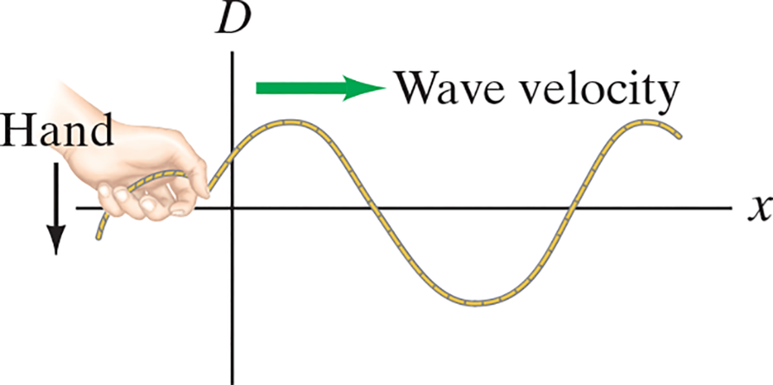
15-4 Mathematical Representation of a Traveling Wave (3 of 3)
Example 15-6: A traveling wave.
The left-hand end of a long horizontal stretched cord
oscillates transversely in S H M with frequency
and amplitude 2.6 c m. The cord is under a tension of
140 N and has a linear density
the end of the cord has an upward displacement of 1.6 c m and is falling. Determine (a) the wavelength of waves produced, (b) the equation for the traveling wave, and (c) the speed v′ of a
particle of cord at
Notes:
Figure 15-14. Example 15-6. The wave at t = 0 (the hand is falling). Not to scale.
LD: Figure 2: The left end of the cord is held by a hand. The hand is placed in the second quadrant and an arrow pointing downward starts from behind the hand to depict the motion of the hand. Transverse waves move along the cord to the right, starting with a crest from the hand that continues to the first quadrant, followed by a trough in the fourth quadrant, ending with a crest in the first quadrant. A velocity vector arrow labeled Wave velocity that points from left to right is placed on the y axis and above the first crest.

Slide 21
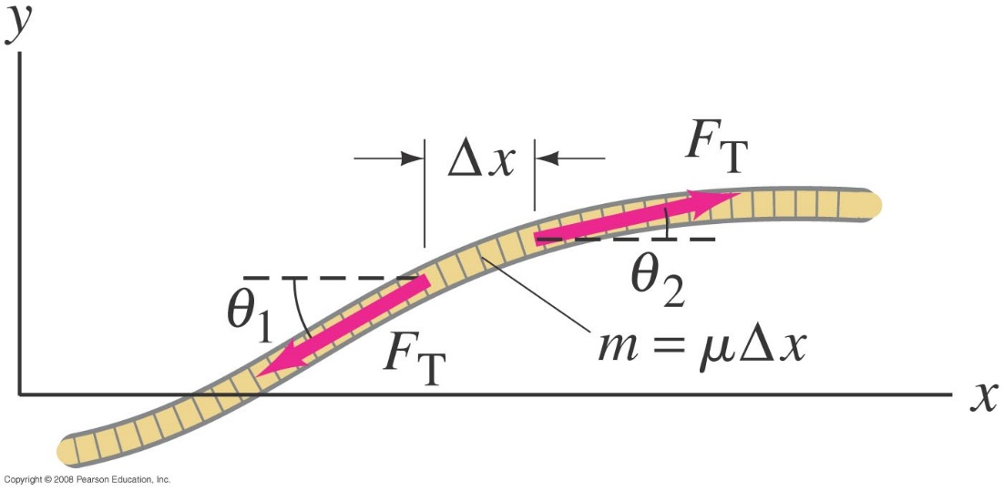
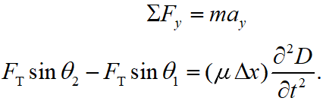
15-5 The Wave Equation (1 of 3)
Look at a segment of string under tension:
Newton’s second law gives:
Notes:
Figure 15-15. Deriving the wave equation from Newton’s second law: a segment of string under tension FT.
LD: The segment of the string is present slightly away from the intersection of the axes. The string starts as a curve from the negative D axis, moves up to the right and becomes flat in the end. The mass of the string is labeled m equals mu Delta x. The string segment has two force-field vector arrows with equal magnitude. The first force-field vector arrow labeled vector F subscript T is present on the left slope near x axis and points down to the left. The second force-field vector arrow labeled vector F subscript T is present on the right slope parallel to x axis and points up to the right. A horizontal dashed line is extended to the left from the base of the first vector F subscript T. The angle between the first vector F subscript T and the dashed line is labeled theta subscript 1. A horizontal dashed line is extended to the right from the base of the second vector F subscript T. The angle between the second vector F subscript T and the dashed line is labeled theta subscript 2. The distance between the two bases of the vectors F subscript T, respectively, is labeled Delta x.

Slide 22

15-5 The Wave Equation (2 of 3)
Assuming small angles, and taking the limit
gives (after some manipulation):
This is the one-dimensional wave equation; it is a linear second-order partial differential equation in x and t. Its solutions are sinusoidal waves.

Slide 23
15-5 The Wave Equation (3 of 3)
Example 15-7: Wave equation solution.
Verify that the sinusoidal wave
satisfies the wave equation.

Slide 24
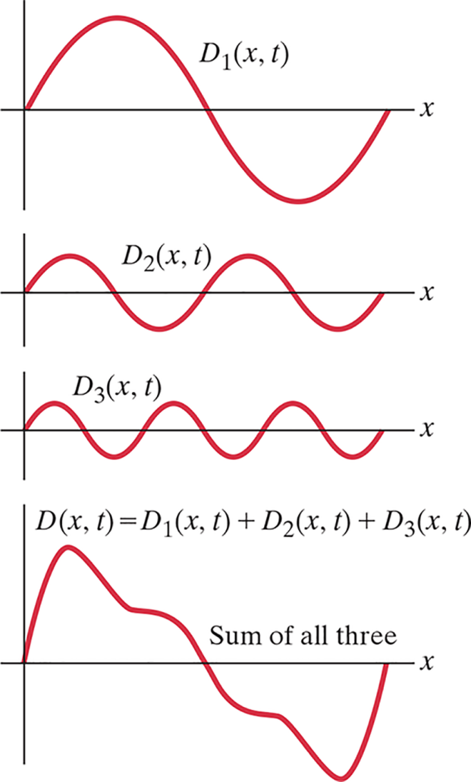
15-6 The Principle of Superposition (1 of 2)
Superposition: The displacement at any point is the vector sum of the displacements of all waves passing through that point at that instant.
Fourier’s theorem: Any complex periodic wave can be written as the sum of sinusoidal waves of different amplitudes, frequencies, and phases.
Notes:
Figure 15-16. The superposition principle for one-dimensional waves. The composite wave formed from three sinusoidal waves of different amplitudes and frequencies (f0, 2f0, 3f0) is shown at the bottom at a certain instant n time. The displacement of the composite wave at each point in space, at any time, is the algebraic sum of the displacements of the component waves. Amplitudes are shown exaggerated; for the superposition principle to hold, they must be small compared to the wavelengths.
LD: The horizontal axis of the coordinate planes is x in all the four graphs. The first curve is labeled D subscript 1 of x, t. The curve consists of 1 cycle. The curve increases from the origin to form a crest and decreases till the x axis. The curve intercepts the x axis and further decreases to form a trough. The curve increases from the trough to the x axis and intercepts the x axis. The second curve is labeled D subscript 2 of x, t. The curve consists of 2 cycles. The curve increases from the origin to form a crest and decreases till the x axis. The curve intercepts the x axis and further decreases to form a trough. The curve increases from the trough to the x axis and intercepts the x axis. The cycle continues in the same manner as x increases. The third curve is labeled D subscript 3 of x, t. The curve consists of 3 cycles. The curve increases from the origin to form a crest and decreases till the x axis. The curve intercepts the x axis and further decreases to form a trough. The curve increases from the trough to the x axis and intercepts the x axis. The cycle continues in the same manner as x increases. The fourth curve is labeled D of x, t equals D subscript 1 Baseline (x, t) plus D subscript 2 Baseline (x, t) plus D subscript 3 Baseline (x, t). The curve consists of 1 cycle. The curve is the summation of all three curves from the previous graphs. The curve consists of 1 cycle. The curve increases from the origin to form a crest, decreases and bends to the right, and further decreases till the x axis. The curve intercepts the x axis, decreases and bends to the right, and further decreases to form a trough. The curve increases from the trough till the x axis and intercepts the x axis.

Slide 25
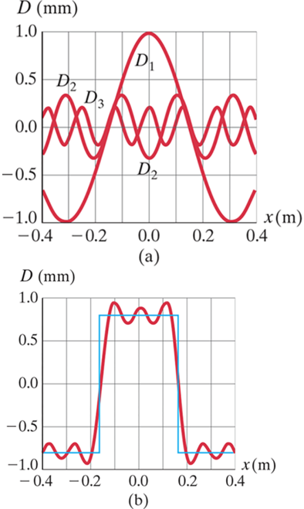
15-6 The Principle of Superposition (2 of 2)
Conceptual Example 15-8: Making a square wave.
At
three waves are given by
and
where
Plot the sum of the three waves
from
(These three waves are the first three Fourier components of a “square wave.”)
Notes:
Figure 15–17: Example 15-8. Making a square wave.
LD: Part (“a”): The graph is drawn on the x y coordinate plane. The horizontal axis labeled x (m) ranges from negative 0.4 to 0.4 in increments of 0.2 units. The vertical axis labeled D (m m) ranges from negative 1.0 to 1.0 in increments of 0.5 units. Three curves are drawn on the same coordinate plane. The first curve labeled D subscript 1 starts from the vertical axis at point (negative 0.4, negative 0.7), moves downward to the right, intercepts the horizontal axis at point (negative 0.3, negative 1.0), moves upward to the right till it reaches (0.0, 1.0). Then the curve moves downward to the right, intercepts the horizontal axis at point (0.3, negative 1.0), moves upward to the right and ends approximately at point (0.4, negative 0.7).The second curve labeled D subscript 2 starts from the point (negative 0.4, negative 0.3), moves upward to the right and forms at crest approximately at point (negative 0.3, 0.4), moves downward to the right and forms a trough approximately at point (negative 0.2, negative 0.4). Then the curve moves upward to the right and forms a crest approximately at point (negative 0.1, 0.4), moves downward to the right and forms a trough approximately at point (0.0, negative 0.3), moves upward to the right and forms a crest approximately at point (0.1, 0.4). The curve moves further downward to the right and forms a trough approximately at point (0.2, negative 0.4), moves upward to the right and forms a crest approximately at point (0.3, 0.4), moves downward to the right and exits the viewing window approximately at point (0.4, negative 0.3).The third curve labeled D subscript 3 starts from the point (negative 0.4, 0.1), moves upward and downward to form multiple crests and troughs, respectively. The crests are formed approximately at points (negative 0.4, 0.3), (negative 0.25, 0.3), (negative 0.15, 0.3), (0.0, 0.3), (0.15, 0.3), (0.25, 0.3), and (0.35, 0.2). The troughs are formed approximately at points (negative 0.3, negative 0.3), (negative 0.19, negative 0.3), (negative 0.08, negative 0.3), (0.05, negative 0.3), (0.2, negative 0.3), and (0.3, negative 0.3). The curve from the crest (0.35, 0.2) moves downward to the right and exits the viewing window approximately at point (0.4, 0.1).Part (b): The graph is drawn on the x y coordinate plane. The horizontal axis labeled x (m) ranges from negative 0.4 to 0.4 in increments of 0.2 units. The vertical axis labeled D (m m) ranges from negative 1.0 to 1.0 in increments of 0.5 units. Two curves are drawn in the same coordinate plane. The first curve starts at point (negative 0.4, negative 0.75), moves upward to the right and forms a peak approximately at point (negative 0.4, negative 0.7), moves downward to the right and dips approximately at point (negative 0.3, negative 0.8), moves upward to the right and forms a peak approximately at point (negative 0.35, negative 0.7), moves downward to the right and dips approximately at point (negative 0.2, negative 1.2). Then the curve moves upward to the right and forms a peak approximately at point (negative 0.1, 0.9), moves downward to the right and dips approximately at point (0.15, 0.75), moves upward to the right and forms a peak approximately at point (0.0, 0.8), moves downward to the right and dips approximately at point (0.05, 0.75), moves upward to the right and forms a peak approximately at point (0.1, 0.9). The curve further moves downward to the right and dips approximately at point (0.2, negative 0.9), moves upward to the right and forms a peak approximately at point (0.25, negative 0.75), moves downward to the right and dips approximately at point (0.3, negative 0.8), moves upward to the right and forms a peak approximately at point (0.35, negative 0.75), moves downward to the right and exits the viewing window approximately at point (0.4, 0.7.The second curve has a straight line that starts approximately at point (negative 0.4, negative 0.75), moves to the right parallel to the horizontal axis and reaches approximately at point (negative 0.25, negative 0.75). The curve moves upward parallel to the vertical axis and reaches approximately at point (negative 0.15, 0.75), moves to the right and reaches approximately at point (0.15, 0.75), bends sharply to the right and moves downward till approximately point (0.15, negative 0.75), moves to the right and reaches approximately at point (0.4, negative 0.75) and exits the viewing window.

Slide 26
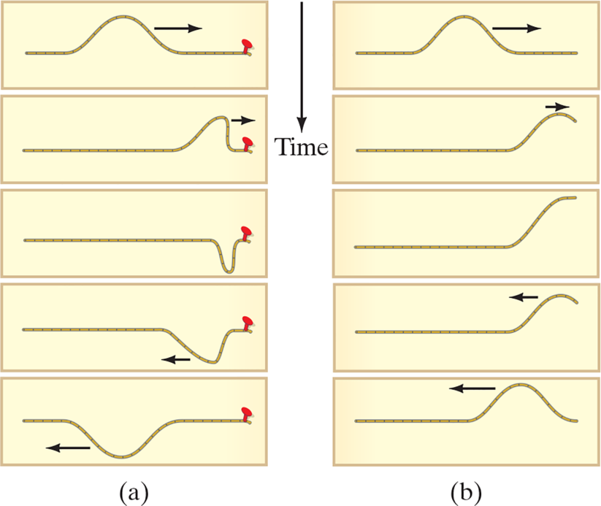
15-7 Reflection and Transmission (1 of 4)
A wave reaching the end of its medium, but where the medium is still free to move, will be reflected (b), and its reflection will be upright.
A wave hitting an obstacle will be reflected (a), and its reflection will be inverted.
Notes:
Figure 15-18. Reflection of a wave pulse traveling along a cord lying on a table. (Time increases going down.) (a) The end of the cord is fixed to a peg. (b) The end of the cord is free to move.
LD: A vertical arrow labeled Time starting from the top and pointing down is placed between the two parts on the figure. In part (“a”), five instances of a wave traveling along a cord on a table are positioned from one below the other. Each instance involves a wave pulse traveling along a cord tied to a peg on the right. In the first instance, an inverted U-shaped wave pulse is shown at the center of the cord. An arrow that points to the right is shown on the right side of the wave pulse to depict the movement of the pulse. In the second instance, an inverted U-shaped wave pulse is shown to the left of the peg. A small arrow that points to the right is shown on the right side of the pulse to depict the movement of the pulse. In the third instance, a steep U-shaped wave pulse is shown to the left of the peg. In the fourth instance, a U-shaped wave pulse that is extended to the left is shown to the left of the peg. A small arrow that points to the left is shown on the left side of the pulse to depict the movement of the pulse. In the fifth instance, an U-shaped wave pulse is shown at the center of the cord. An arrow that points to the left is shown on the left side of the pulse to depict the movement of the pulse. In part (b), five instances of a wave traveling along a cord on a table are positioned one below the other. Each instance involves a wave pulse traveling along a free cord. In the first instance, an inverted U-shaped wave pulse is shown at the center of the cord. An arrow that points to the right is shown on the right side of the pulse to depict the movement of the pulse. In the second instance, one half of an inverted U-shaped wave pulse is shown on the right end. A small arrow that points to the right is shown on top of the pulse to depict the movement of the pulse. In the third instance, a steep half of an inverted U-shaped wave pulse is shown on the right end. In the fourth instance, one half of an inverted U-shaped wave pulse is shown on the right end. A small arrow that points to the left is shown on the left side of the pulse to depict the movement of the pulse. In the fifth instance, an inverted U-shaped wave pulse is shown on the right end just before the end of the cord. An arrow that points to the left is shown on the left side of the pulse to depict the movement of the pulse.

Slide 27
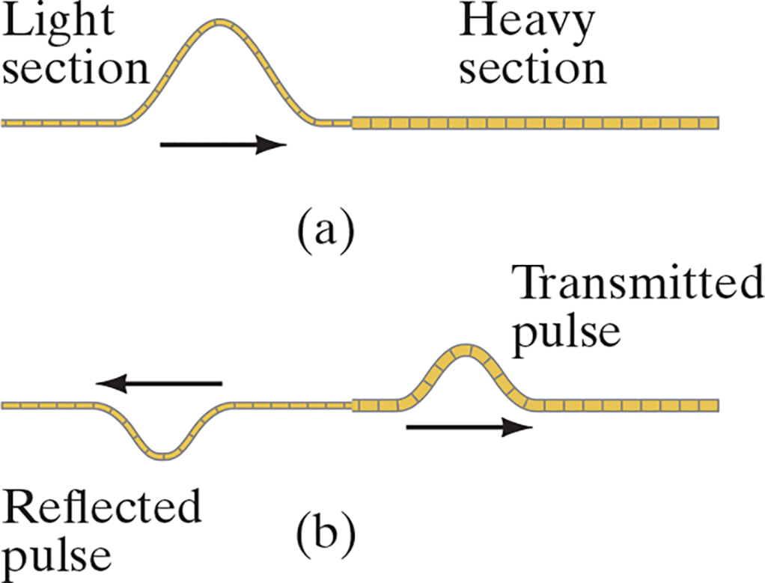
15-7 Reflection and Transmission (2 of 4)
A wave encountering a denser medium will be partly reflected and partly transmitted; if the wave speed is less in the denser medium, the wavelength will be shorter.
Notes:
Figure 15-19. When a wave pulse traveling to the right along a thin cord (a) reaches a discontinuity where the cord becomes thicker and heavier, then part is reflected and part is transmitted (b).
LD: In part (“a”), an inverted U-shaped wave pulse is shown on the thin left portion and the right portion of the cord remains straight. The right end of the inverted U-shaped pulse is connected to the thick portion of the cord. An arrow that points to the right is shown below the curve to depict the movement of the pulse. The left portion of the cord, which is the thin portion, is labeled Light section and the right portion of the cord, which is the thick portion, is labeled Heavy section. In part (“b”), a U-shaped wave pulse is shown at the center of the thin portion of the cord. This is labeled Reflected pulse. An arrow that points to the left is shown above the wave to depict the movement of the pulse. An inverted U-shaped wave pulse is shown near the left side of the thick portion of the cord and is labeled Transmitted pulse. An arrow that points to the right is shown below the wave to depict the movement of the pulse.

Slide 28
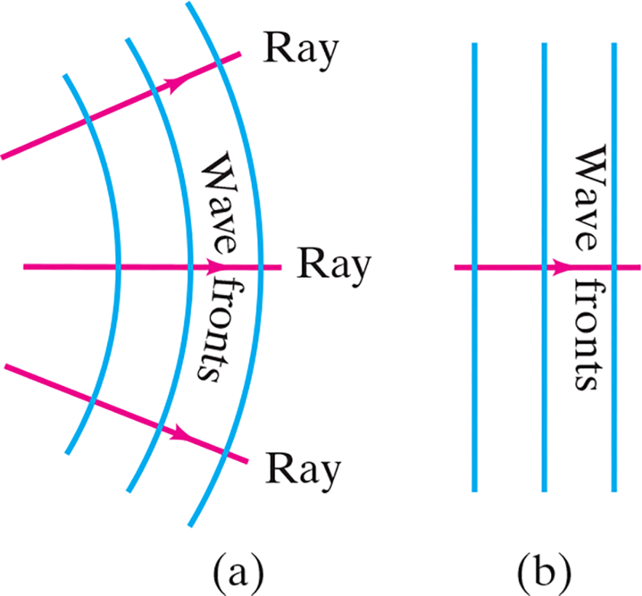
15-7 Reflection and Transmission (3 of 4)
Two- or three-dimensional waves can be represented by wave fronts, which are curves of surfaces where all the waves have the same phase.
Lines perpendicular to the wave fronts are called rays; they point in the direction of propagation of the wave.
Notes:
Figure 15-20. Rays, signifying the direction of wave motion, are always perpendicular to the wave fronts (wave crests). (a) Circular or spherical waves near the source. (b) Far from the source, the wave fronts are nearly traight or flat, and are called plane waves.
LD: In part (“a”), three equidistant arcs are placed adjacent to each other and labeled Wave fronts, respectively. The source of Wave fronts is present on the left side of the figure. Wave fronts are curved because they are placed near the source. Three arrows, each labeled Ray, originate from the source on the left, pass through Wave fronts and extend to the right. Arrow Ray signifies the direction of the wave motion and is always perpendicular to Wave fronts. The first arrow starts from some point on top of the source and moves slightly upward to the right. The second arrow starts from some central point of the source and moves horizontally to the right. The third arrow starts from some point at the bottom of the source and moves slightly downward to the right. In part (b), three vertical lines are placed parallel to each other and labeled Wave fronts. Here, Wave fronts are flat as they are placed far from the source and are also known as plane waves. An arrow starts from the left side, passes through Wave fronts in the middle, cuts across Wave fronts, and points right. This arrow signifies the direction of the wave motion and is always perpendicular to Wave fronts.

Slide 29
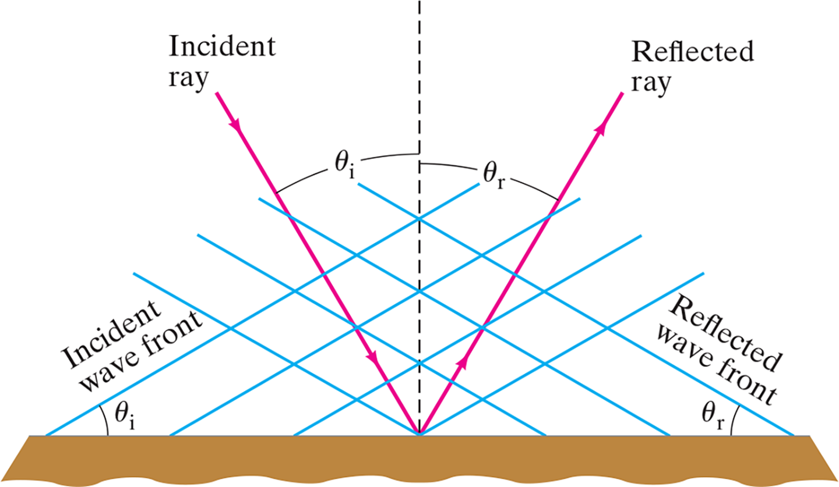
15-7 Reflection and Transmission (4 of 4)
The law of reflection: The angle of incidence equals the angle of reflection.
Notes:
Figure 15-21. Law of reflection: θ r = θ i.
LD: A vertical dashed line is drawn in the middle of a horizontal reflective surface. A vertical arrow labeled Incident ray is projected from the upper left of the vertical dashed line to a point where the vertical dashed line intercepts the horizontal reflective surface at an angle theta subscript i. Another similar arrow labeled Reflected ray is projected from the point in the middle of the horizontal reflective surface to the upper right at an angle theta subscript r with the dashed line. Four parallel inclined lines originate from the upper right side of the figure making an angle theta subscript i with the horizontal reflective surface on the left and is labeled Incident wave front. Four parallel inclined lines originate from the upper left side of the figure making an angle theta subscript r with the horizontal reflective surface on the right side and is labeled Reflected wave front.

Slide 30
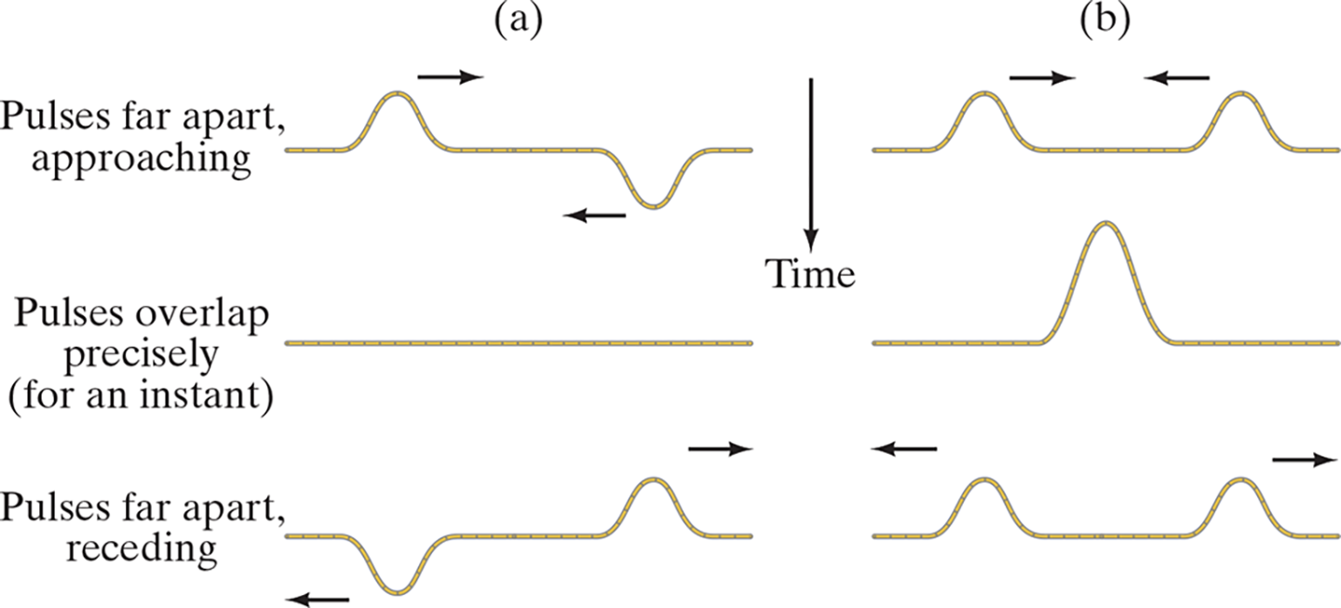
15-8 Interference (1 of 2)
The superposition principle says that when two waves pass through the same point, the displacement is the arithmetic sum of the individual displacements.
In the figure below, (a) exhibits destructive interference and (b) exhibits constructive interference.
Notes:
Figure 15-22. Two wave pulses pass each other. Where they overlap, interference occurs: (a) destructive, and (b) constructive. Read (a) and (b) downward (increasing time).
LD: In part (“a”), three instances of the wave traveling along a cord are shown one below the other. The first and the third instances have two wave pulses traveling along the cord. The first instance is labeled Pulses far apart, approaching. In the first instance, two wave pulses, a U-shaped wave pulse and an inverted U-shaped wave pulse are shown at the left and right ends of the cord, respectively. An arrow that points to the right is shown on the top of the first wave pulse. An arrow that points to the left is shown near the peak of the second wave pulse. The second instance is labeled Pulses overlap precisely (for an instant). A horizontal cord is shown. The third instance is labeled Pulses far apart, receding. In the third instance, an inverted U-shaped wave pulse and a U-shaped wave pulse are shown at the left and right ends of the cord, respectively. An arrow that points to the left is shown on the left side of the first wave pulse. An arrow that points to the right is shown on the right side of the second wave pulse. In part (b), three instances of the wave traveling along a cord are shown one below the other. The first and the third instances involve two wave pulses traveling along the cord. In the first instance, two inverted U-shaped wave pulses are shown near the extreme ends of the cord. An arrow that points to the right is shown above the first wave pulse. An arrow that points to the left is shown above the second wave pulse. In the second instance, an inverted U-shaped pulse is shown at the center of the cord. In the third instance, two inverted U-shaped wave pulses are shown near the extreme ends of the cord. An arrow that points to the left is shown above the first wave pulse. An arrow that points to the right is shown above the second wave pulse.

Slide 31
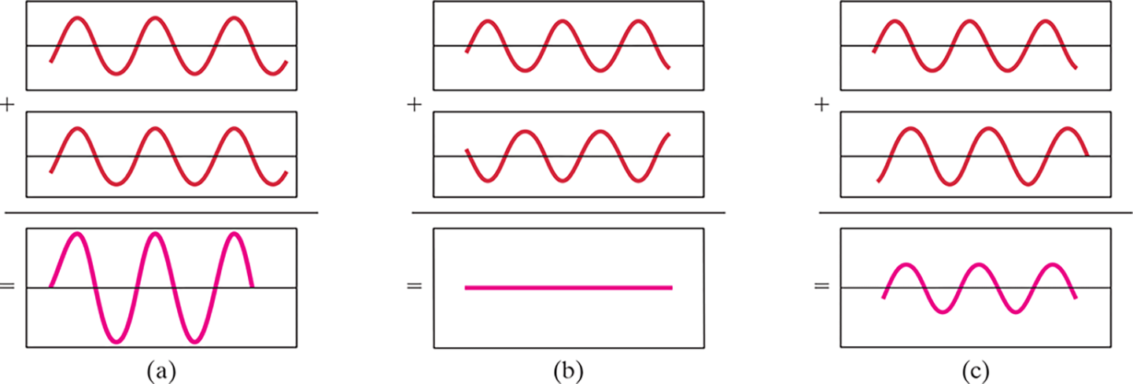
15-8 Interference (2 of 2)
These graphs show the sum of two waves. In (a) they add constructively; in (b) they add destructively; and in (c) they add partially destructively.
Notes:
Figure 15-24. Graphs showing two identical waves, and their sum, as a function of time at three locations. In (a) the two waves interfere constructively, in (b) destructively, and in (c) partially destructively.
LD: Graph (“a”): Three curves are shown. The first curve has three cycles. The first cycle begins from a point below the horizontal axis. The curve increases toward the horizontal axis. The curve further increases to form a crest and decreases till the horizontal axis. The curve further decreases to forma a trough. The curve increases from the trough till the horizontal axis. The cycle continues in the same manner. The second curve begins from a point below the horizontal axis. The curve increases toward the horizontal axis. The curve further increases to form a crest and decreases till the horizontal axis. The curve further decreases to form a trough. The curve increases from the trough till the horizontal axis. The cycle continues in the same manner. The third curve begins from the horizontal axis. The curve increases to form a crest and decreases till the horizontal axis. The curve further decreases to form a trough. The curve increases from the trough till the horizontal axis. The cycle continues in the same manner. The third curve is the summation of the first curve and the second curve. Graph (b): Three curves are shown. The first curve begins from a point below the horizontal axis. The curve increases toward the horizontal axis. The curve further increases to form a crest and decreases till the horizontal axis. The curve further decreases to form a trough. The curve increases from the trough till the horizontal axis. The cycle continues in the same manner. The second curve begins from a point above the horizontal axis. The curve decreases toward the horizontal axis. The curve further decreases to form a trough and increases till the horizontal axis. The curve further increases to form a crest. The curve decreases from the crest till the horizontal axis. The cycle continues in the same manner. The curve is a straight line and is the summation of the first curve and the second curve. Graph (c): Three curves are shown. The first curve begins from a point below the horizontal axis. The curve increases toward the horizontal axis. The curve further increases to form a crest and decreases till the horizontal axis. The curve further decreases to form a trough. The curve increases from the trough till the horizontal axis. The cycle continues in the same manner. The second curve begins from a point below the horizontal axis. The curve increases toward the horizontal axis. The curve further increases to form a crest and decreases till the horizontal axis. The curve further decreases to form a trough. The curve increases from the trough till the horizontal axis. The cycle continues in the same manner. The third curve begins from a point below the horizontal axis. The curve increases toward the horizontal axis. The curve further increases to form a crest and decreases till the horizontal axis. The curve further decreases to form a trough. The curve increases from the trough till the horizontal axis. The cycle continues in the same manner. The third curve is the summation of the first curve and the second curve.

Slide 32
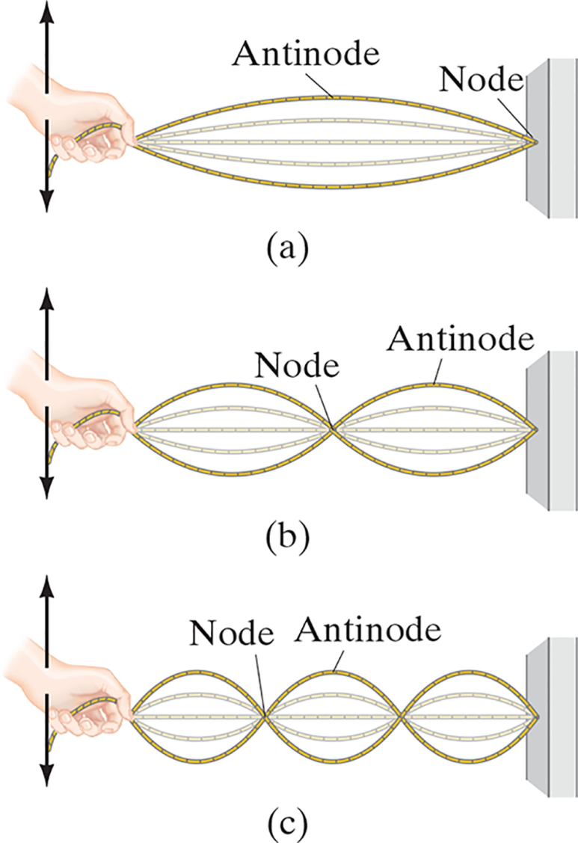
15-9 Standing Waves; Resonance (1 of 5)
Standing waves occur when both ends of a string are fixed. In that case, only waves which are motionless at the ends of the string can persist. There are nodes, where the amplitude is always zero, and antinodes, where the amplitude varies from zero to the maximum value.
Notes:
Figure 15-25. Standing waves corresponding to three resonant frequencies.
LD: A cord held by a hand on the left is tied to a vertical surface on the right. Two arrows, in opposite directions are shown on the top and bottom of the hand, respectively, to depict the upward and downward motion of the hand. In part (“a”), due to the oscillation of the cord, a standing wave with a single loop is shown. Three curved lines are drawn inside the loop that joins from one end to the other end. The curvature of the wave is labeled Antinode and the point of the cord attached to the wall is labeled Node. In part (b), the frequency is two times that of part (“a”) leading to a standing wave with two loops. The loops are placed adjacent to each other and are joined by a common point labeled Node. Three curved lines are drawn inside each loop that joins from one end of the loop to the other end. The curvature of the wave is labeled Antinode. In part (c), the frequency is three times that of part (“a”) leading to a standing wave with three loops. The loops are placed adjacent to each other and are joined by points labeled Node. Three curved lines are drawn inside each loop that joins from one end of the loop to the other end. The curvature of the wave in the second loop is labeled Antinode.

Slide 33
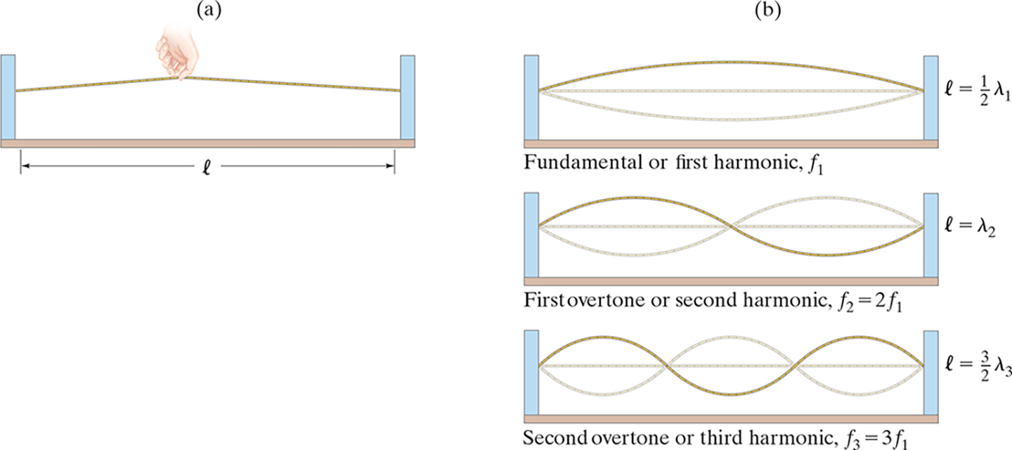
15-9 Standing Waves; Resonance (2 of 5)
The frequencies of the standing waves on a particular string are called resonant frequencies.
They are also referred to as the fundamental and harmonics.
Notes:
Figure 15-26. (a) A string is plucked. (b) Only standing waves corresponding to resonant frequencies persist for long.
LD: In part (“a”), the string is connected to the two vertical supports at each end and a hand is plucking the string in the middle. A horizontal double-headed arrow labeled l depicts the length of the string between the supports. LD: In part (b), three instances are shown one below the other. The first instance is labeled Fundamental or first harmonic, f subscript 1. In the first instance, the string connected to the vertical supports is resonating with a standing wave with a single loop. The initial position of the string before resonating is represented as a horizontal straight line in the middle of the standing wave between the two nodes of the loop. Note: l equals one-half of lambda subscript 1. The second instance is labeled First overtone or second harmonic, f subscript 2 equals 2 f subscript 1. In the second instance, the string is resonating with a standing wave with two loops. The loops are placed next to each other connected by a common point. The initial position of the string before resonating is represented as a horizontal straight line in the middle of the standing wave between the nodes of the loops. Note: l equals lambda subscript 2. The third instance is labeled Second overtone or third harmonic, f subscript 3 equals 3 f subscript 1. In the third instance, the string is resonating with a standing wave with three loops. The loops are placed next to each other, where the left end of the second loop connects to the right end of the first loop and the right end of the second loop connects to the left end of the third loop. The initial position of the string before resonating is represented as a horizontal straight line in the middle of the standing wave between the nodes of the loops. Note: l equals StartFraction 3 over 2 EndFraction lambda subscript 3.

Slide 34

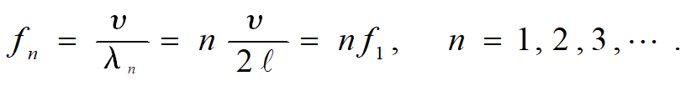
15-9 Standing Waves; Resonance (3 of 5)
The wavelengths and frequencies of standing waves are:
and

Slide 35
15-9 Standing Waves; Resonance (4 of 5)
Example 15-9: Piano string.
A piano string is 1.10 m long and has a mass of 9.00 g. (a) How much tension must the string be under if it is to vibrate at a fundamental frequency of 131 Hz? (b) What are the frequencies of the first four harmonics?

Slide 36
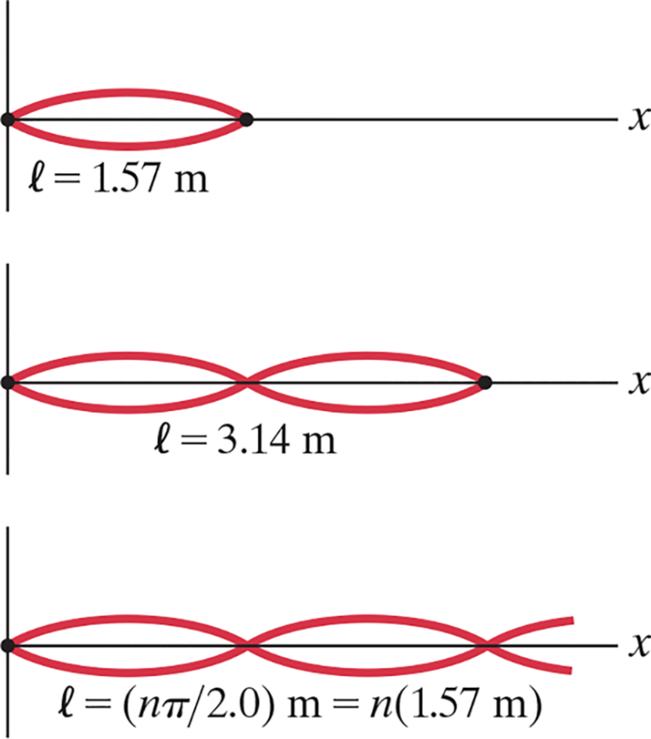
15-9 Standing Waves; Resonance (5 of 5)
Example 15-10: Wave forms.
Two waves traveling in opposite
directions on a string fixed at
are described by the functions
and
(where x is in m, t is in s), and they produce a standing wave pattern. Determine (a) the function for the standing wave, (b) the maximum
amplitude at
(c) the length
of the string, (d) the maximum amplitude and where it occurs.
Notes:
Figure 15-27. Example 15-10: possible lengths for the string.
LD: The figure has three different resonating strings placed one below the other. The first string is placed on the horizontal axis labeled x. The string resonates into a standing wave with a single loop. The shape of the loop of the standing wave is similar to a compressed ellipse. The loop is placed at the left end of the plane. The length of the string is labeled l equals 1.57 m. The second string is placed on the horizontal axis labeled x. The string resonates into a standing wave with two adjacent loops. The shape of a single loop of the standing wave is similar to a compressed ellipse. The loops are placed from the left end of the plane. The length of the string is labeled l equals 3.14 m. The third string is placed on the horizontal axis labeled x. The string is resonates into a standing wave with three adjacent loops and the third loop from the left is partially displayed in the figure. The shape of a single loop of the standing wave is similar to a compressed ellipse. The loops are placed from the left end of the plane. The length of the string is labeled l equals (StartFraction n pi over 2.0 EndFraction) m equals n (1.57 m).

Slide 37
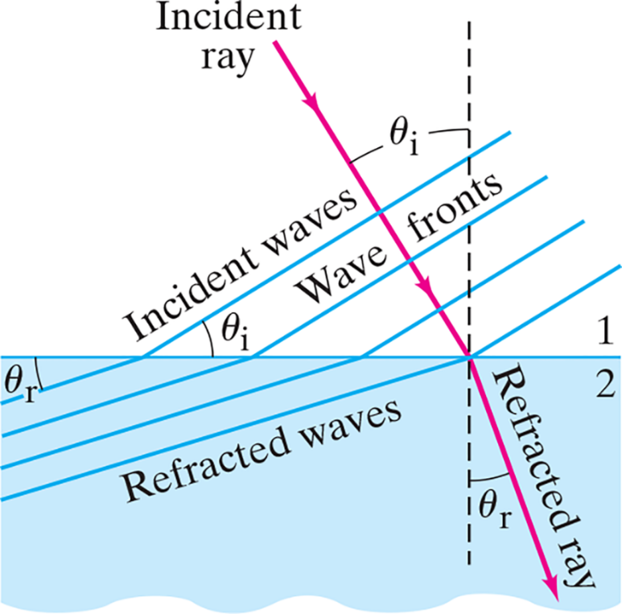

15-10 Refraction (1 of 3)
If the wave enters a medium where the wave speed is different, it will be refracted—its wave fronts and rays will change direction.
We can calculate the angle of refraction, which depends on both wave speeds:
Notes:
Figure 15-28. Refraction of waves passing a boundary.
LD: There are two mediums present in the figure labeled 1 and 2, respectively. The intersection of both mediums in the form of a horizontal straight line is called a boundary. A vertical dashed line is present on the right side of the figure cutting across both mediums and making an intersection at the boundary. A ray labeled Incident ray starts from the upper left side of the medium 1, makes an angle of incidence labeled theta subscript i with the vertical dashed line, passes through the boundary via the intersection, and moves to the lower right corner of the medium 2. The Incident ray is refracted after it passes through the boundary at the intersection of medium 2, making an angle of refraction labeled theta subscript r with the vertical dashed line in medium 2. This ray in medium 2 is labeled Refracted ray. The angle of refraction is shown less than the angle of incidence. A group of four parallel lines labeled Incident waves originate from the upper right corner of medium 1, form wave fronts and reach the boundary on the left side of medium 1. These wave fronts are labeled Wave fronts in the figure. The topmost or the first line of Wave front is incident on the far left side of the boundary to make an angle of incidence labeled theta subscript i with the boundary. This first Incident wave bends with an angle of refraction labeled theta subscript r after passing through the boundary to reach the upper left corner of medium 2. The second line of Wave front from the top is incident on the center of the boundary and gets refracted at an angle to reach at some point lower than the first wave in medium 2. The third line of Wave front from the top is incident on some point closer to the intersection and gets refracted at an angle to reach at some point lower than the second wave in medium 2. The fourth line of Wave front from the top is incident on the intersection and gets refracted at an angle to reach at some point lower than the third refracted wave in medium 2. These waves in medium 2 are labeled Refracted waves. The incident wave fronts and the refracted wave fronts are shown parallel to each other.

Slide 38
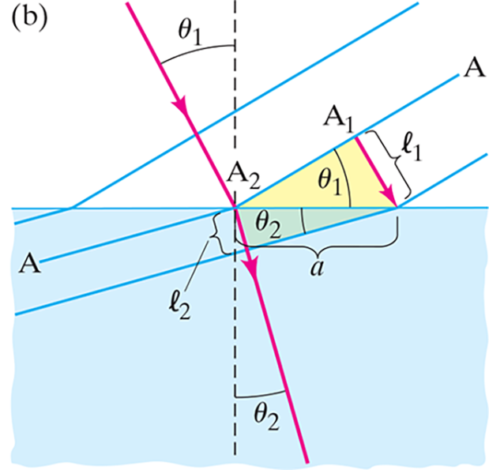
15-10 Refraction (2 of 3)
The law of refraction works both ways—a wave going from a slower medium to a faster one would follow the red line in the other direction.
Notes:
Figure 15-30 (b) the law of refraction for waves.
LD: In part (b), two mediums labeled Firm ground and Mud are shown on the top left corner and the bottom right corner of the figure, respectively. The intersection of both mediums in the form of a horizontal straight line is labeled boundary. A vertical dashed line is present at the center of the figure cutting across both mediums and making an intersection at the boundary. An incident ray starts from the upper left side of Firm ground medium, makes an angle of incidence labeled theta subscript 1 with the vertical dashed line, passes through the boundary via the intersection, and moves to the lower right corner of Mud medium. The incident ray is refracted after it passes through the boundary at the intersection of Mud medium, making an angle of refraction labeled theta subscript 2 with the vertical dashed line in the mud medium. The angle theta subscript 2 is shown smaller then the angle theta subscript 1. A set of three inclined lines represent wave fronts and originate from the upper right corner of Firm ground passing through the boundary to reach the top left corner of Mud. The first line of the wave front is incident on the far left side of the boundary and gets refracted at an angle. The middle line on the wave front labeled “A” falls on the intersection making an angle of incidence labeled theta subscript 1 with the boundary. There are two points marked on the line “A” and labeled “A” subscript 1 and “A” subscript 2, respectively. The point “A” subscript 2 is marked on the point of intersection and the point “A” subscript 1 is marked in between the points “A” subscript 2 and “A”. The parallel distance between the lines of the wave front in Firm ground is labeled l subscript 1. The last line incident on the far right side on the boundary is refracted at an angle theta subscript 2. The length between the intersection and incidence of the last line is named “a”. The parallel distance between two lines of the wave front after refraction on Mud is labeled l subscript 2.

Slide 39
15-10 Refraction (3 of 3)
Example 15-11: Refraction of an earthquake wave.
An earthquake P wave passes across a boundary in rock where its speed increases from 6.5 k m/s to 8.0 k m/s. If it
strikes this boundary at
what is the angle of
refraction?

Slide 40
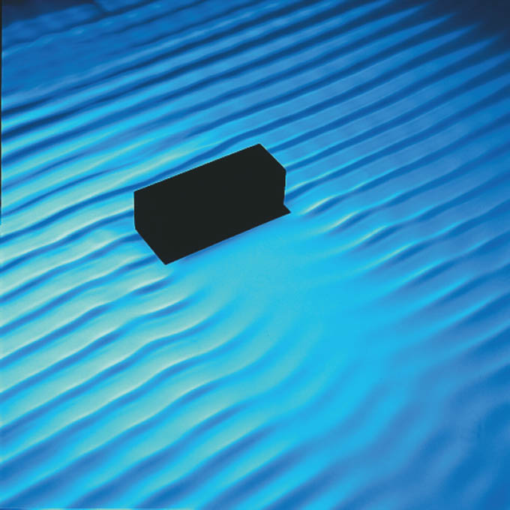
15-11 Diffraction (1 of 3)
When waves encounter an obstacle, they bend around it, leaving a “shadow region.” This is called diffraction.
Notes:
Figure 15-31. Wave diffraction. The waves are coming from the upper left. Note how the waves, as they pass the obstacle, bend around it, into the “shadow region” behind the obstacle.
LD: A rectangular block has been placed in the middle of a plane as an obstacle. This obstacle is visible on the upper left side of the photograph. Horizontal waves come from the upper left part of the plane and seem to be consistent till they reach the obstacle. The waves start to bend around the obstacle as they pass the obstacle. Wave diffraction creates a region behind the obstacle having no waves for some distance. This region is called the shadow region.

Slide 41
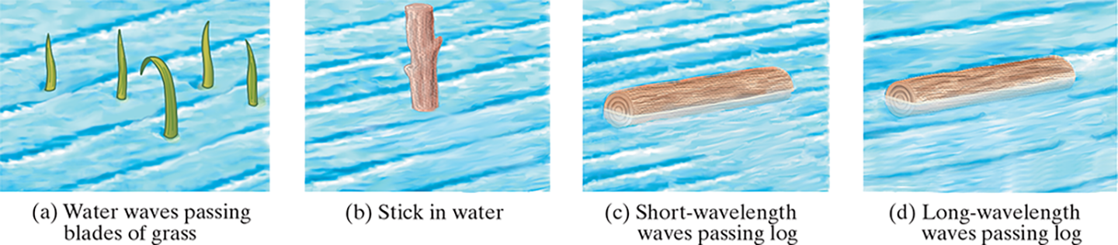
15-11 Diffraction (2 of 3)
The amount of diffraction depends on the size of the obstacle compared to the wavelength. If the obstacle is much smaller than the wavelength, the wave is barely affected (a). If the object is comparable to, or larger than, the wavelength, diffraction is much more significant (b, c, d).
Notes:
Figure 15-32. Water waves coming from upper left, pass objects of various sizes. Note that the longer the wavelength compared to the size of the object, the more diffraction there is into the “shadow region.”
LD: Part (“a”): A label Water waves passing blades of grass is shown at the bottom of the figure. Water waves originate from the upper left part of the figure passing through blades of grass present in the middle of the figure. The wave diffraction appears minimal around the blades of grass. Part (b): A label Stick in water is shown at the bottom of the figure. Water waves originate from the upper left part of the figure passing through a stick present in the middle of the figure. The diffraction of the water wave appears slightly prominent than that of part (“a”). Part (c): A label Short-wavelength waves passing log is shown at the bottom of the figure. Short-wavelength water waves originate from the upper left part of the figure passing through a horizontal wooden log present in the middle of the figure. The diffraction of the water wave appears to be prominent with a shadow region behind the log. Part (d): A label Long-wavelength waves passing log is shown at the bottom of the figure. Long-wavelength water waves originate from the upper left part of the figure passing through a horizontal wooden log present in the middle of the figure. The diffraction of the water wave and the shadow region behind the log appears less prominent than that of Part (c).

Slide 42
15-11 Diffraction (3 of 3)
Example 15-12: Cell phones.
Cellular phones operate by radio waves with
frequencies of about 1 or 2 GHz
These waves cannot penetrate objects that conduct electricity, such as a sheet of metal or a tree trunk. The sound quality is best if the transmitting antenna is within clear view of the handset. Yet it is possible to carry on a phone conversation even if the tower is blocked by trees, or if the handset is inside a car. Why?

Slide 43

Summary of Chapter 15 (1 of 3)
Vibrating objects are sources of waves, which may be either pulses or continuous.
Wavelength: distance between successive crests
Frequency: number of crests that pass a given point per unit time
Amplitude: maximum height of crest
Wave speed:

Slide 44
Summary of Chapter 15 (2 of 3)
Transverse wave: oscillations perpendicular to direction of wave motion
Longitudinal wave: oscillations parallel to direction of wave motion
Intensity: energy per unit time crossing unit area
Angle of reflection is equal to angle of incidence

Slide 45
Summary of Chapter 15 (3 of 3)
When two waves pass through the same region of space, they interfere. Interference may be either constructive or destructive.
Standing waves can be produced on a string with both ends fixed. The waves that persist are at the resonant frequencies.
Nodes occur where there is no motion; antinodes where the amplitude is maximum.
Waves refract when entering a medium of different wave speed, and diffract around obstacles.

Slide 46

Copyright
This work is protected by United States copyright laws and is provided solely for the use of instructors in teaching their courses and assessing student learning. Dissemination or sale of any part of this work (including on the World Wide Web) will destroy the integrity of the work and is not permitted. The work and materials from it should never be made available to students except by instructors using the accompanying text in their classes. All recipients of this work are expected to abide by these restrictions and to honor the intended pedagogical purposes and the needs of other instructors who rely on these materials.

