Slide 1


Physics for Scientists and Engineers with Modern Physics
Fifth Edition
Chapter 16
Sound
Copyright © 2023 Pearson Education, Inc. All Rights Reserved
Notes:
If this PowerPoint presentation contains mathematical equations, you may need to check that your computer has the following installed:
1) MathType Plugin
2) Math Player (free versions available)
3) NVDA Reader (free versions available)

Slide 2
Units of Chapter 16 (1 of 2)
Characteristics of Sound
Mathematical Representation of Longitudinal Waves
Intensity of Sound: Decibels
Sources of Sound: Vibrating Strings and Air Columns
Quality of Sound, and Noise; Superposition
Interference of Sound Waves; Beats

Slide 3
Units of Chapter 16 (2 of 2)
Doppler Effect
Shock Waves and the Sonic Boom
Applications: Sonar, Ultrasound, and Medical Imaging

Slide 4
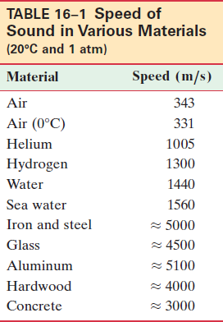
16-1 Characteristics of Sound (1 of 4)
Sound can travel through any kind of matter, but not through a vacuum.
The speed of sound is different in different materials; in general, it is slowest in gases, faster in liquids, and the fastest in solids.
The speed depends somewhat on temperature, especially for gases.
Notes:
LD: The table consists of 2 columns and 11 rows. The headings of the columns, from left to right, are as follows: Material and Speed (m per s). The row entries are as follows. First row: Material column, Air. Speed (m per s) column, 343. Next row: Material column, Air (0.C). Speed (m per s) column, 331. Next row: Material column, Helium. Speed (m per s) column, 1005. Next row: Material column, Hydrogen. Speed (m per s) column, 1300. Next row: Material column, Water. Speed (m per s) column, 1440. Next row: Material column, Sea water. Speed (m per s) column, 1560. Next row: Material column, Iron and steel. Speed (m per s) column, approximately 5000. Next row: Material column, Glass. Speed (m per s) column, approximately 4500. Next row: Material column, Aluminum. Speed (m per s) column, approximately 5100. Next row: Material column, Hardwood. Speed (m per s) column, approximately 4000. Last row: Material column, Concrete. Speed (m per s) column, approximately 3000.

Slide 5
16-1 Characteristics of Sound (2 of 4)
Conceptual Example 16-1: Distance from a lightning strike.
A rule of thumb that tells how close lightning has struck is “one mile for every five seconds before the thunder is heard.” Explain why this works, noting that
the speed of light is so high
almost
a million times faster than sound) that the time for light to travel to us is negligible compared to the time for the sound.

Slide 6
16-1 Characteristics of Sound (3 of 4)
Loudness: related to intensity of the sound wave
Pitch: related to frequency
Audible range: about 20 Hz to 20,000 Hz; upper limit decreases with age
Ultrasound: above 20,000 Hz; see ultrasonic camera focusing in following example

Slide 7
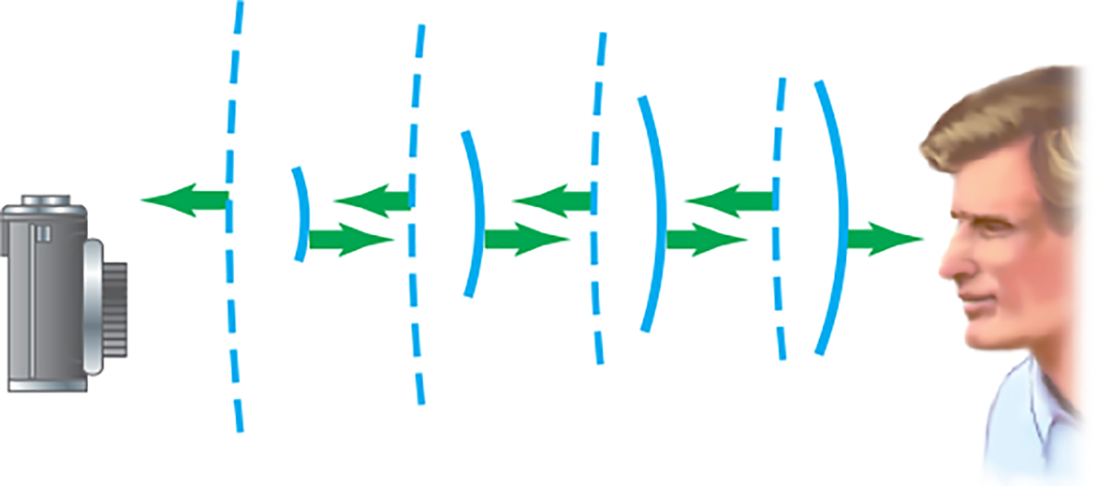
16-1 Characteristics of Sound (4 of 4)
Example 16-2: Autofocusing with sound waves.
Autofocusing cameras can use very high frequency (ultrasonic) sound that is emitted and travels to the object being photographed. A sensor on the camera detects the returning reflected sound. To get an idea of the time sensitivity of the detector, calculate the travel time of the pulse for an object
(a) 1.0 m away, and (b) 20 m away.
Notes:
Figure 16-1. Example 16-2. Autofocusing camera that emits an ultrasonic pulse. Solid curved lines represent the wave front of the outgoing wave pulse moving to the right; dashed lines represent the wave front of the pulse effected off the person’s face, returning to the camera. The time between emission and reception by the camera of these waves provides the object distance and allows the camera mechanism to adjust the lens to focus at the proper distance.
LD: The autofocusing camera is shown on the left and a man’s face is shown on the right, at the same level. The wave front of the high frequency (ultrasonic) sound pulses emitted from the autofocusing camera are shown as a series of four equally spaced parallel arcs. The size of the arcs appear to increase from the camera to the man’s face. A velocity vector arrow is shown from each arc pointing right toward the man’s face. The wave front of the high frequency (ultrasonic) sound pulses reflected from the man’s face are shown as a series of four equally spaced dashed arcs. The size of the dashed arcs appear to increase from the man’s face to the camera. A velocity vector arrow is shown from each dashed arc pointing left toward the autofocusing camera.

Slide 8
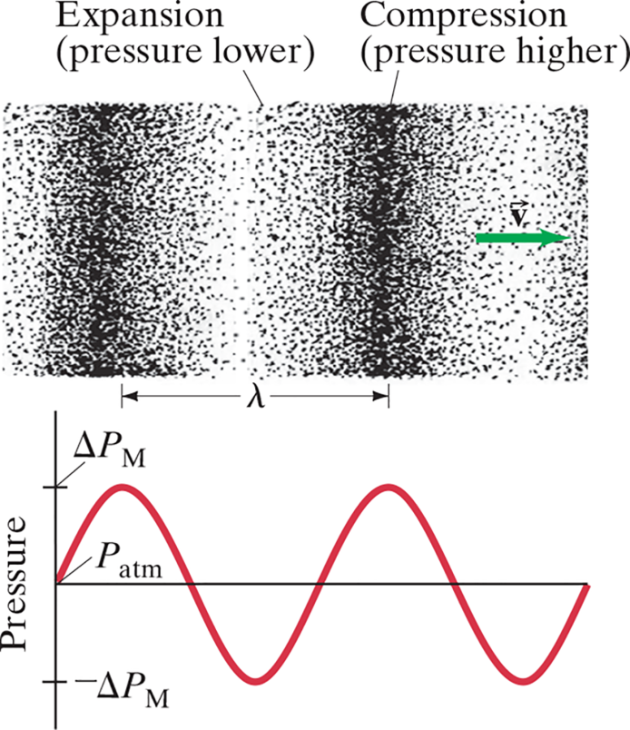
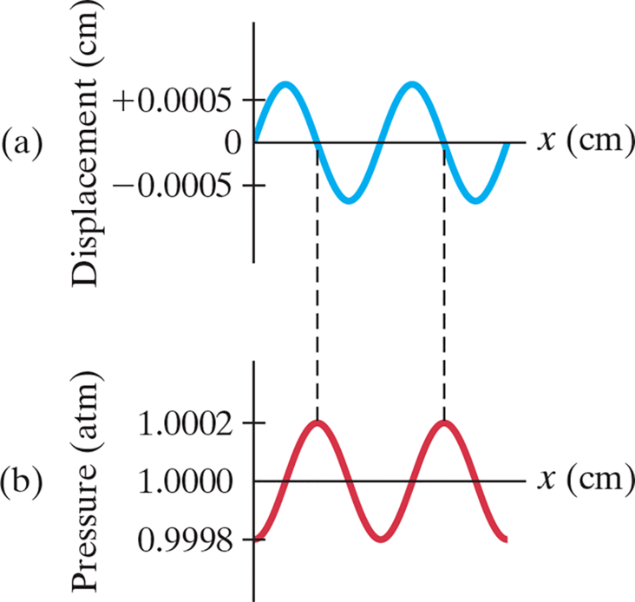
16-2 Mathematical Representation of Longitudinal Waves (1 of 3)
Longitudinal waves are often called pressure waves. The
displacement is
out of
phase with the pressure.
Notes:
Figure 16-2. Longitudinal sound wave traveling to the right, and its graphical representation in terms of pressure (ΔP relative to normal air pressure).
Figure 16-3. Representation of a sound wave in space at a given instant in terms of (a) displacement, and (b) pressure.
LD: In the top figure, the air molecules are represented by dots. The dots are arranged in two vertical patterns, sparsely arranged white vertical patterns labeled Expansion (pressure lower) and closely arranged dark vertical patterns labeled Compression (pressure higher), respectively. The dots start from Expansion pattern followed by Compression pattern, and this pattern is followed till the right side of the figure. The distance from the middle of one compression pattern to the middle of the next compression pattern on the right is marked by a double-headed arrow labeled lambda. At the right end of the figure, a velocity vector arrow labeled vector V starts from Expansion pattern and points to the right.In the bottom figure, the vertical axis is labeled Pressure, which ranges from minus Delta P subscript M to Delta P subscript M. The point of intersection of the horizontal axis and the vertical axis is labeled P subscript a t m. Two similar cycles of the pressure wave are shown. One cycle of the pressure wave is as follows: the wave starts from P subscript a t m, increases gradually as the wave moves to the right, reaches a maximum value of Delta P subscript M and decreases gradually till it intersects the horizontal axis. This wave now reaches a minimum value of minus Delta P subscript M, increases gradually to the right and intersects the horizontal axis to complete one cycle. The distance between two successive peaks corresponds to Lambda in the top figure.
LD: Part (“a”): The horizontal axis is labeled x (c m). The vertical axis is labeled Displacement (c m) and ranges from minus 0.0005 to plus 0.0005 in increments of 0.0005 c m. The point of intersection of the horizontal axis and the vertical axis is labeled 0. Two cycles of the displacement wave are shown. The wave starts from 0, increases gradually as the wave moves to the right, reaches a maximum value, decreases gradually, and intersects the horizontal axis. A vertical dashed line is drawn down from the point where the curve intersects the horizontal axis. The curve further decreases, reaches a minimum value, increases gradually to the right, and intersects the horizontal axis. The curve further increases gradually as the wave moves to the right, reaches a maximum value, decreases gradually, and intersects the horizontal axis. Another vertical dashed line is drawn down from the point where the curve intersects the horizontal axis. The curve further decreases, reaches a minimum value, increases gradually to the right, and ends on the horizontal axis. Part (b): The horizontal axis is labeled x (c m). The vertical axis is labeled Pressure (a t m, and ranges from 0.9998 to 1.0002 in increments of 0.0002 a t m. The point of intersection of the horizontal axis and the vertical axis is labeled 1.0000. Two cycles of the pressure wave are shown. The wave starts from 0.9998, increases gradually as x increases, intersects the x axis, increases gradually, and reaches the maximum value of 1.0002. The first vertical dashed line drawn from the displacement curve intersects at this maximum value. The curve decreases gradually as x increases, intersects the x axis, decreases to a minimum value of 0.9998, increases further, intersects the x axis, and reaches the maximum value of 1.0002. The second vertical dashed line drawn from the displacement curve intersects at this maximum value. The curve further decreases, intersects the x axis, and decreases to the minimum value of 0.9998.

Slide 9
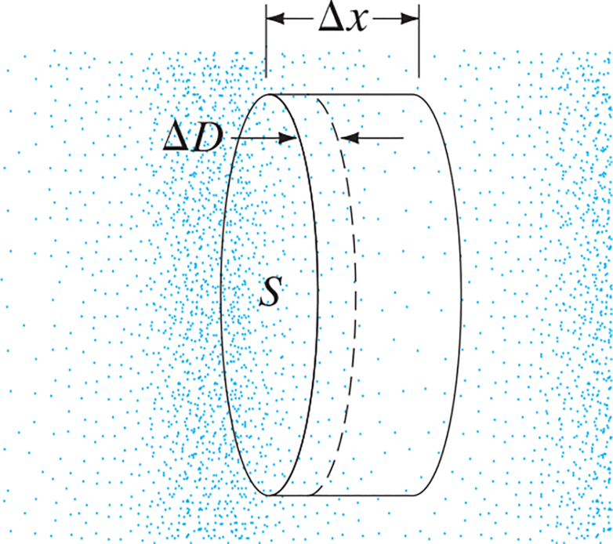
16-2 Mathematical Representation of Longitudinal Waves (2 of 3)
By considering a small cylinder within the fluid, we see that the change in pressure is given by (B is the bulk modulus):
Notes:
Figure 16-4. Longitudinal wave in a fluid moves to the right. A thin layer of fluid, in a thin imaginary cylinder of area S and thickness Δ x, changes in volume as a result of pressure variation as the wave passes. At the moment shown, the pressure will increase as the wave moves to the right, so the thickness of our layer will decrease, by an amount ΔD.
LD: Longitudinal waves are represented as dots in the figure and they appear to move toward the right. A thin imaginary layer of fluid having a cylindrical shape with an area labeled S and a thickness labeled Delta x, present on top of the cylinder as a double-headed arrow, is shown in the middle of the figure. The movement of longitudinal waves toward the right increases the pressure on the thin cylinder resulting in a reduction in the thickness of the cylinder by an amount labeled Delta D, represented by a dashed curve placed close to the outer surface of the imaginary cylinder. A double-headed arrow pointing between the outer surface of the imaginary cylinder and the dashed curve is marked Delta D.

Slide 10



16-2 Mathematical Representation of Longitudinal Waves (3 of 3)
If the displacement is sinusoidal, we have
where
and

Slide 11
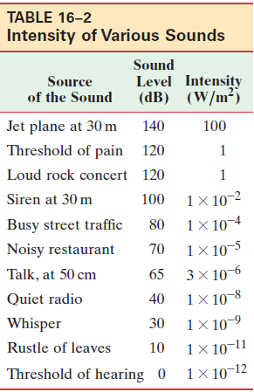
16-3 Intensity of Sound: Decibels (1 of 10)
The intensity of a wave is the energy transported per unit time across a unit area.
The human ear can detect sounds with an intensity as low
as
and as high as
Perceived loudness, however, is not proportional to the intensity.
Notes:
LD: The table consists of 3 columns and 12 rows. The headings of the columns, from left to right, are as follows: Source of the Sound, Sound Level (d B), and Intensity (W per m squared). The row entries are as follows. First row: Source of the Sound column, Jet plane at 30 m. Sound Level (d B) column , 140. Sound Intensity (W per m squared) column, 100. Next row: Source of the Sound column, Threshold of pain. Sound Level (d B) column , 120. Sound Intensity (W per m squared) column, 1. Next row: Source of the Sound column, Loud rock concert. Sound Level (d B) column , 120. Next row: Source of the Sound column, Siren at 30 m. Sound Level (d B) column , 100. Sound Intensity (W per m squared) column, 1 multiplied by 10 to the negative 2 power. Next row: Source of the Sound column, Truck traffic. Sound Level (d B) column , 90. Sound Intensity (W per m squared) column, 1 multiplied by 10 to the negative 3 power. Next row: Source of the Sound column, Busy street traffic. Sound Level (d B) column , 80. Sound Intensity (W per m squared) column, 1 multiplied by 10 to the negative 4 power. Next row: Source of the Sound column, Noisy restaurant. Sound Level (d B) column , 70. Sound Intensity (W per m squared) column, 1 multiplied by 10 to the negative 5 power. Next row: Source of the Sound column, Talk, at 50 cm. Sound Level (d B) column , 65. Sound Intensity (W per m squared) column, 3 multiplied by 10 to the negative 6 power. Next row: Source of the Sound column, Quiet radio. Sound Level (d B) column , 40. Sound Intensity (W per m squared) column, 1 multiplied by 10 to the negative 8 power. Next row: Source of the Sound column, Whisper. Sound Level (d B) column , 30. Sound Intensity (W per m squared) column, 1 multiplied by 10 to the negative 9 power. Next row: Source of the Sound column, Rustle of leaves. Sound Level (d B) column , 10. Sound Intensity (W per m squared) column, 1 multiplied by 10 to the negative 11 power. Last row: Source of the Sound column, Threshold of hearing. Sound Level (d B) column , 0. Sound Intensity (W per m squared) column, 1 multiplied by 10 to the negative 12 power.

Slide 12
16-3 Intensity of Sound: Decibels (2 of 10)
The loudness of a sound is much more closely related to the logarithm of the intensity.
Sound level is measured in decibels (d B) and is defined as:
is taken to be the threshold of hearing:

Slide 13
16-3 Intensity of Sound: Decibels (3 of 10)
Example 16-3: Sound intensity on the street.
At a busy street corner, the sound level is 75 d B. What is the intensity of sound there?

Slide 14
16-3 Intensity of Sound: Decibels (4 of 10)
Example 16-4: Loudspeaker output.
A high-quality loudspeaker is advertised to reproduce, at full volume, frequencies from 30 Hz to 18,000 Hz with
uniform sound level
That is, over this frequency
range, the sound level output does not vary by more than 3 d B for a given input level. By what factor does the intensity change for a 3 d B change in output level?

Slide 15
16-3 Intensity of Sound: Decibels (5 of 10)
An increase in sound level of 3 d B, which is a doubling in intensity, is a very small change in loudness.
In open areas, the intensity of sound diminishes with distance:
However, in enclosed spaces this is complicated by reflections, and if sound travels through air, the higher frequencies get preferentially absorbed.

Slide 16
16-3 Intensity of Sound: Decibels (6 of 10)
Conceptual Example 16-5: Trumpet players.
A trumpeter plays at a sound level of 75 d B. Three equally loud trumpeters join in. What is the new sound level?

Slide 17

16-3 Intensity of Sound: Decibels (7 of 10)
Example 16-6: Airplane roar.
The sound level measured 30 m from a jet plane is 140 d B. What is the sound level at 300 m? (Ignore reflections from the ground.)
Notes:
Figure 16-5. Example 16-6. Airport worker with sound-intensity reducing ear covers (headphones).

Slide 18
16-3 Intensity of Sound: Decibels (8 of 10)
Example 16-7: How tiny the displacement is.
(a) Calculate the displacement of air molecules for a sound having a frequency of 1000 Hz at the threshold of hearing.
(b) Determine the maximum pressure variation in such a sound wave.

Slide 19
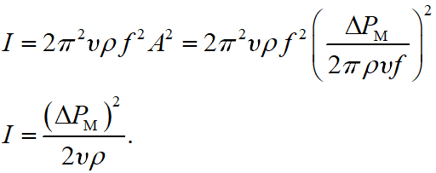
16-3 Intensity of Sound: Decibels (9 of 10)
The intensity can be written in terms of the maximum pressure variation. With some algebraic manipulation, we find:

Slide 20
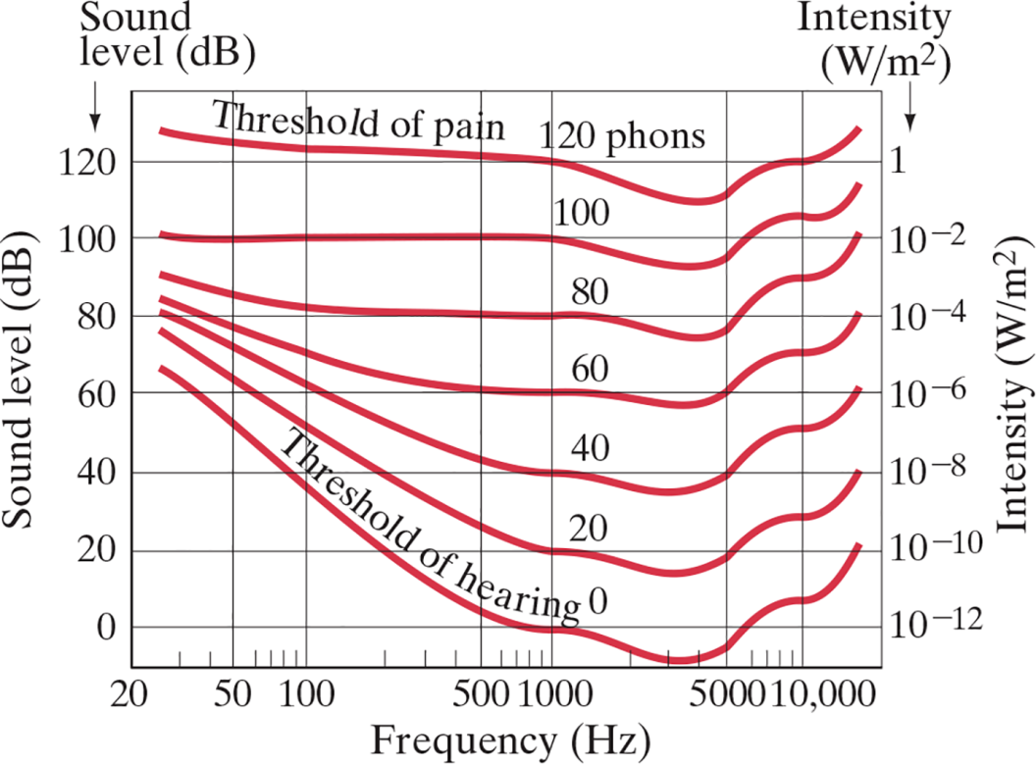
16-3 Intensity of Sound:
Decibels (10 of 10)
The ear’s sensitivity varies with frequency. These curves translate the intensity into sound level at different frequencies.
Notes:
Figure 16-6. Sensitivity of the human ear as a function of frequency (see text). Note that the frequency scale is “logarithmic” in order to cover a wide range of frequencies. We can see that at lower sound levels our ears are less sensitive to high and low frequencies relative to mid-range frequencies (which we hear better).
LD: The graph is drawn on the x y coordinate plane. The horizontal axis is labeled Frequency (Hz) and has the marking 20, 50, 100, 500, 1000, 5000, and 10,000. The left vertical axis is labeled Sound level (dB) and ranges from 0 to 120 in increments of 20 units. The right vertical axis is labeled Intensity (W per m square) and ranges from ten raised to the negative twelfth power to 1 in increments of ten raised to the negative second power units. Seven curves are shown in the same coordinate axis. The first curve labeled Threshold of pain 120 phons is placed at the top and starts near the left vertical axis at approximately (30, 125), moves downward to the right, dips near the marking 115 on the left vertical axis, moves upward to the right, and ends near the right vertical axis at approximately (10,000, 5).The second curve labeled 100 is placed below the first curve and starts near the left vertical axis at approximately (30, 100), moves downward to the right, dips near the marking 95 on the left vertical axis, moves upward to the right and ends near the right vertical axis at approximately (10,000, 1).The third curve labeled 80 is placed below the second curve and starts near the left vertical axis at approximately (30, 90), moves downward to the right, dips near the marking 75 on the left vertical axis, moves upward to the right, and ends near the right vertical axis at approximately (10,000, ten raised to the negative second power).The fourth curve labeled 60 is placed below the third curve and starts near the left vertical axis at approximately (30, 85), moves downward to the right, dips near the marking 60 on the left vertical axis, moves upward to the right and ends near the right vertical axis at approximately (10,000, ten raised to the negative fourth power).The fifth curve labeled 40 is placed below the fourth curve and starts near the left vertical axis at approximately (30, 80), moves downward to the right, dips near the marking 35 on the left vertical axis, moves upward to the right and ends near the right vertical axis at approximately (10,000, ten raised to the negative sixth power).The sixth curve labeled 20 is placed below the fifth curve and starts near the left vertical axis at approximately (30, 75), moves downward to the right, dips near the marking 25 on the left vertical axis, moves upward to the right and ends near the right vertical axis at approximately (10,000, ten raised to the negative eighth power).The seventh curve labeled Threshold of hearing 0 is placed below the sixth curve and starts near the left vertical axis at approximately (30, 75), moves downward to the right, dips near the marking 5000 on the horizontal axis, moves upward to the right and ends near the right vertical axis at approximately (10,000, ten raised to the negative tenth power).

Slide 21
16-4 Sources of Sound: Vibrating Strings and Air Columns (1 of 12)
Musical instruments produce sounds in various ways—vibrating strings, vibrating membranes, vibrating metal or wood shapes, vibrating air columns.
The vibration may be started by plucking, striking, bowing, or blowing. The vibrations are transmitted to the air and then to our ears.

Slide 22
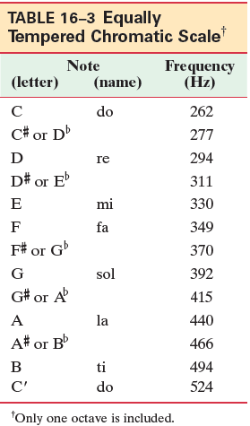
16-4 Sources of Sound: Vibrating Strings and Air Columns (2 of 12)
This table gives frequencies for the octave beginning with middle C. The equally tempered scale is designed so that music sounds the same regardless of what key it is transposed into.
Notes:
LD: The table consists of 2 columns and 13 rows. The headings of the columns, from left to right, are as follows: Note and Frequency (H z). The row entries are as follows. First row: Note column, C. Frequency (H z) column, 262. Next row: Note column, C sharp or D superscript b. Frequency (H z) column, 277. Next row: Note column, D. Frequency (H z) column, 294. Next row: Note column, D sharp or E superscript b. Frequency (H z) column, 311. Next row: Note column, E. Frequency (H z) column, 330. Next row: Note column, F. Frequency (H z) column, 349. Next row: Note column, F sharp or G superscript b. Frequency (H z) column, 370. Next row: Note column, G. Frequency (H z) column, 392. Next row: Note column, G sharp or A superscript b. Frequency (H z) column, 415. Next row: Note column, A. Frequency (H z) column, 440. Next row: Note column, A sharp or B superscript b. Frequency (H z) column, 466. Next row: Note column, B. Frequency (H z) column, 494. Last row: Note column, C prime. Frequency (H z) column, 524.

Slide 23
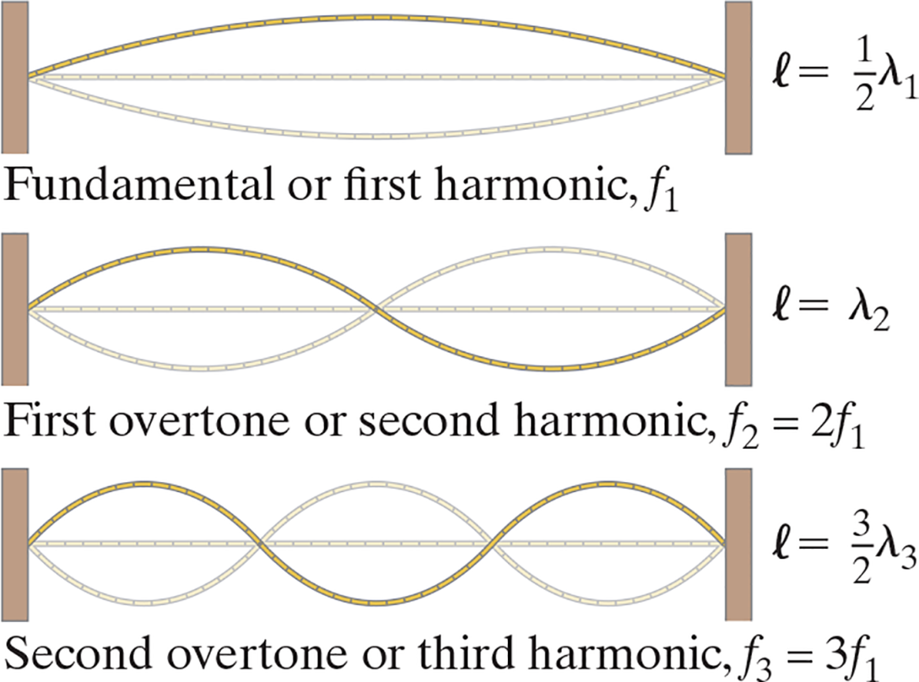
16-4 Sources of Sound: Vibrating Strings and Air Columns (3 of 12)
This figure shows the first three standing waves, or harmonics, on a fixed string.
Notes:
Figure 16-7. Standing waves on a string—only the lowest three frequencies are shown.
LD: There are three instances illustrated in the figure placed one below the other. The first instance is labeled Fundamental or first harmonic, f subscript 1. In the first instance, the string connected to the vertical supports is resonating with a standing wave with a single loop. The standing wave is in the shape of a compressed ellipse with a horizontal line that connects to its ends. The initial position of the string before resonating is represented as a horizontal straight line in the middle of the loop between the two nodes. A legend labeled l equals one by 2 of lambda subscript 1 is placed at the right side of the right support. The second instance is labeled First overtone or second harmonic, f subscript 2 equals 2 f subscript 1. In the second instance, the string is resonating with a standing wave with two loops. The standing wave is in the shape of a compressed ellipse. The two loops are placed adjacent to each other. The initial position of the string before resonating is represented as a horizontal straight line in the middle of the standing wave between the nodes. A legend labeled l equals lambda subscript 2 is placed at the right side of the right support. The third instance is labeled Second overtone or third harmonic, f subscript 3 equals 3 f subscript 1. In the third instance, the string is resonating with a standing wave with three loops. The standing wave is in the shape of a compressed ellipse. The three loops are placed adjacent to each other. The initial position of the string before resonating is represented as a horizontal straight line in the middle of the standing wave between the nodes. A legend labeled l equals 3 by 2 lambda subscript 3 is placed at the right side of the right support.

Slide 24
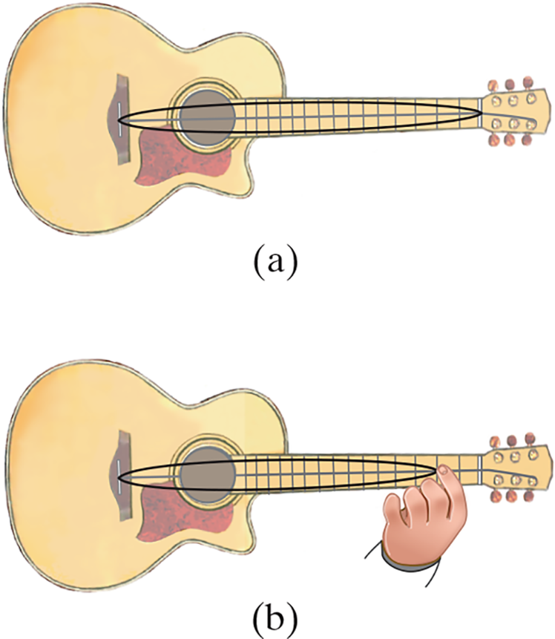
16-4 Sources of Sound: Vibrating Strings and Air Columns (4 of 12)
The strings on a guitar can be effectively shortened by fingering, raising the fundamental pitch.
The pitch of a string of a given length can also be altered by using a string of different density.
Notes:
Figure 16-8. The wavelength of (a) an unfingered string is longer than that of (b) a fingered string. Hence, the frequency of the fingered string is higher. Only one string is shown on this guitar, and only the simplest standing wave, the fundamental, is shown.
LD: In part (“a”), an unfingered string is shown highlighting an extended black convex shape of the single string. This position represents a higher wavelength, and subsequently a lower frequency. In part (b), a fingered string is shown highlighting a reduced black convex shape of the single string. This position represents a lower wavelength, and subsequently a higher frequency.

Slide 25
16-4 Sources of Sound: Vibrating Strings and Air Columns (5 of 12)
Example 16-8: Piano strings.
The highest key on a piano corresponds to a frequency about 150 times that of the lowest key. If the string for the highest note is 5.0 c m long, how long would the string for the lowest note have to be if it had the same mass per unit length and was under the same tension?

Slide 26
16-4 Sources of Sound: Vibrating Strings and Air Columns (6 of 12)
Example 16-9: Frequencies and wavelengths in the violin.
A 0.32-m-long violin string is tuned to play A above middle C at 440 Hz.
(a) What is the wavelength of the fundamental string vibration?
(b) What are the frequency and wavelength of the sound wave produced?
(c) Why is there a difference?

Slide 27
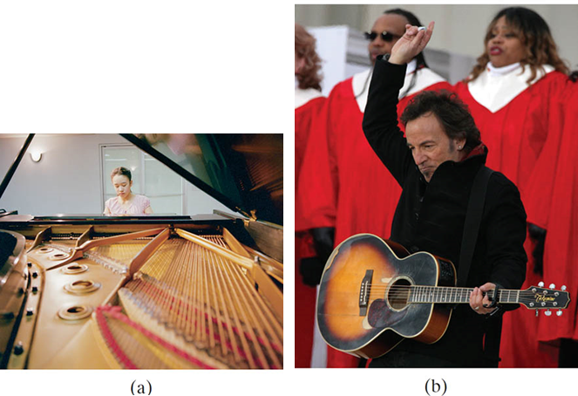
16-4 Sources of Sound: Vibrating Strings and Air Columns (7 of 12)
The sound waves from vibrating strings need to be amplified in order to be of a practical loudness; this is done in acoustical instruments by using a sounding board or box, creating a resonant chamber. The sound can also be amplified electronically.
Notes:
Figure16-9. (a) Piano, showing sounding board to which strings are attached; (b) sounding box (guitar).

Slide 28
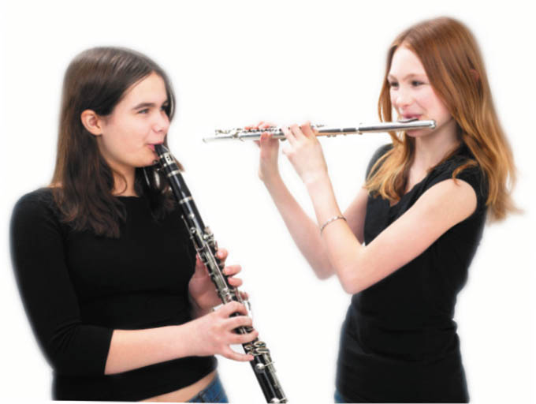
16-4 Sources of Sound: Vibrating Strings and Air Columns (8 of 12)
Wind instruments create sound through standing waves in a column of air.
Notes:
Figure 16-10. Wind instruments: flute (left) and clarinet.

Slide 29
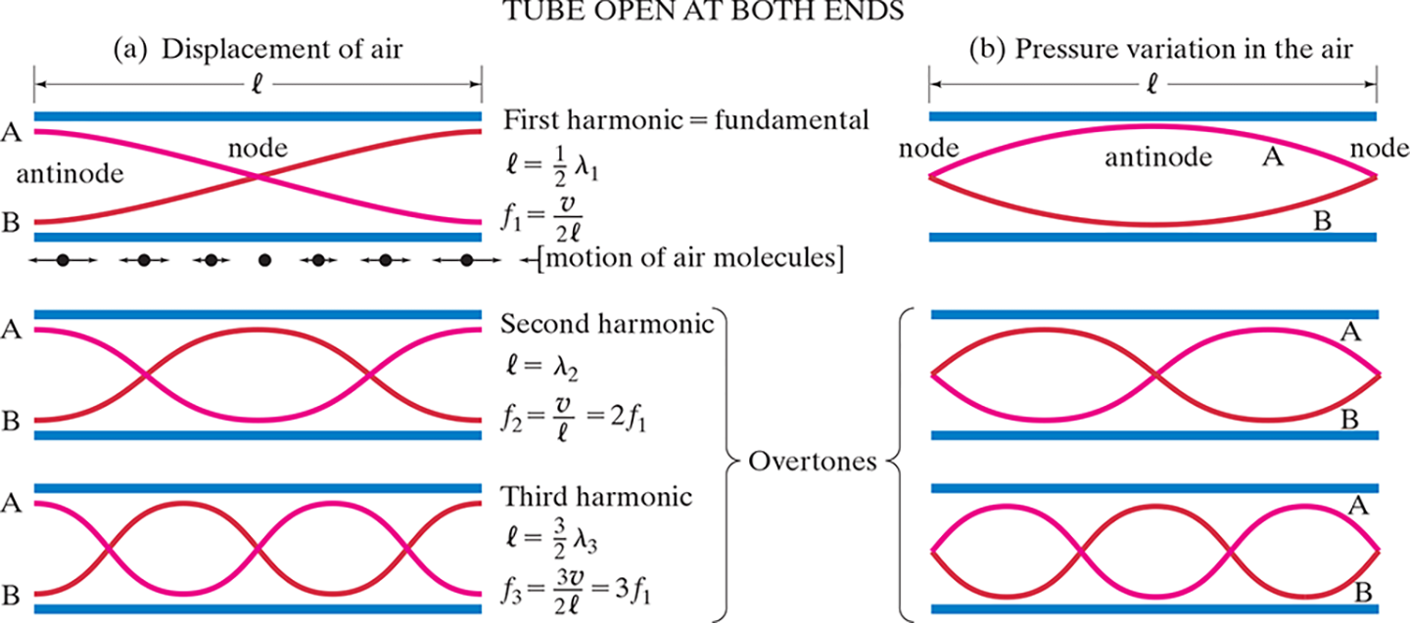
16-4 Sources of Sound: Vibrating Strings and Air Columns (9 of 12)
A tube open at both ends (most wind instruments) has pressure nodes, and therefore displacement antinodes, at the ends.
Notes:
Figure 16-11. Graphs of the three simplest modes of vibration (standing waves) for a uniform tube open at both ends (“open tube”). These simplest modes of vibration are graphed in (a), on the left, in terms of the motion of the air (displacement), and in (b), on the right, in terms of air pressure. Each graph shows the wave form at two times, A and B, a half period apart. The actual motion of molecules for one case, the fundamental, is shown just below the tube at top left.
LD: Part (“a”) Displacement of air: Three instances are shown one below the other. A horizontal double-headed arrow labeled l at the top of the horizontal tube represents the length of the tube. The first instance is labeled First harmonic equals fundamental on the right side. A graph of a resonating standing wave with a single loop in the form of alphabet x is shown inside the open tube. The upper arm on the left side is labeled “A” and the lower arm on the left side is labeled B. The region between the two arms on the left is labeled antinode and the intersection of x in the middle of the tube is labeled node. A label l equals 1 by 2 of lambda subscript 1 is placed near the upper arm of x on the right side. Another label f subscript 1 equals StartFraction v over 2 l EndFraction is placed near the lower arm of x on the right side. Below the tube, seven dots are placed from left to right on the same horizontal plane. Except for the fourth dot from left, six of the dots have a double-headed horizontal arrow placed at the center and are labeled motion of air molecules. The arrows on dots one and seven have similar magnitude. The arrows on dots two and six have similar magnitude. The arrows on dots three and five have similar magnitude. The second instance is labeled Second harmonic on the right side. In the second instance, a graph of a resonating standing wave with two loops in the form of two consecutive alphabet x is shown inside the open tube. The upper arm on the left side is labeled “A” and the lower arm on the left side is labeled B. A label l equals lambda subscript 2 is placed near the upper arm of x on the right side. Another label f subscript 2 equals StartFraction v over l EndFraction equals 2 f subscript 1 is placed near the lower arm of x on the right side. The third instance is labeled Third harmonic on the right side. In the third instance, a graph of a resonating standing wave with three loops in the form of three consecutive alphabet x is shown inside the open tube. The upper arm on the left side is labeled “A” and the lower arm on the left side is labeled B. A label l equals 3 by 2 lambda subscript 3 is placed near the upper arm of x on the right side. Another label f subscript 3 equals StartFraction 3 v over 2 l EndFraction equals 3 f subscript 1 is placed near the lower arm of x on the right side. Part (b) Pressure variation in the air: Three instances are shown one below the other. A horizontal double-headed arrow labeled l at the top of the horizontal tube represents the length of the tube. The first instance is labeled First harmonic equals fundamental on the left side. A graph of a resonating standing wave with a single loop in the form of a compressed ellipse is shown inside the open tube. The left and right endpoints of the graph are labeled node, respectively. The upper arc of the graph is labeled “A” and the lower arc of the graph is labeled B. The inner region between “A” and B is labeled antinode. The second instance is labeled Second harmonic on the left side. In the second instance, a graph of a resonating standing wave with two loops in the form of a compressed ellipse placed adjacent to each other is shown inside the open tube. The upper arc of the loop on the right end of the tube is labeled “A” and the lower arc of the loop on the right end of the tube is labeled B. The third instance is labeled Third harmonic on the left side. In the third instance, a graph of a resonating standing wave with three loops in the form of a compressed ellipse placed adjacent to each other is shown inside the open tube. The upper arc of the loop on the right end of the tube is labeled “A” and the lower arc of the loop on the right end of the tube is labeled B. The second and third instances of both the parts are collectively labeled Overtones.

Slide 30
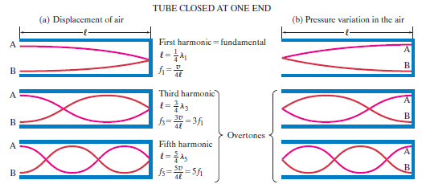
16-4 Sources of Sound: Vibrating Strings and Air Columns (10 of 12)
A tube closed at one end (some organ pipes) has a displacement node (and pressure antinode) at the closed end.
Notes:
Figure 16-12. Modes of vibration (standing waves) for a tube closed at one end (“closed tube”). See caption for Fig. 16-11.
LD: Part (“a”) Displacement of air: Three instances are shown one below the other. A horizontal double-headed arrow labeled l at the top of the horizontal tube represents the length of the tube. The first instance is labeled First harmonic equals fundamental on the right side. A graph of a resonating standing wave with a single loop in the form of a parabola with an open left end is shown inside the tube. The upper arm on the left side is labeled “A” and the lower arm on the left side is labeled B. A label l equals 1 by 4 lambda subscript 1 is placed on the right side. Another label f subscript 1 equals StartFraction v over 4 l EndFraction is placed on the right side. The second instance is labeled Third harmonic on the right side. In the second instance, a graph of a resonating standing wave with two loops in the form of two consecutive compressed ellipses are shown inside the tube such that the first loop is missing its left half portion and has two open arms on the left. The upper arm on the left side is labeled “A” and the lower arm on the left side is labeled B. A label l equals 3 by 4 lambda subscript 3 is placed on the right side. Another label f subscript 3 equals StartFraction 3 v over 4 l EndFraction equals 3 f subscript 1 is placed on the right side. The third instance is labeled Fifth harmonic on the right side. In the third instance, a graph of a resonating standing wave with three loops in the form of three compressed ellipses are shown inside the tube such that the first loop is missing its left half portion and has two open arms on the left. The upper arm on the left side is labeled “A” and the lower arm on the left side is labeled B. A label l equals 5 by 4 lambda subscript 5 is placed on the right side. Another label f subscript 5 equals StartFraction 5 v over 4 l EndFraction equals 5 f subscript 1 is placed on the right side. Part (b) Pressure variation in the air: Three instances are shown one below the other. A horizontal double-headed arrow labeled l at the top of the horizontal tube represents the length of the tube. The first instance is labeled First harmonic equals fundamental on the left side. A graph of a resonating standing wave with a single loop in the form of a parabola with an open right end is shown inside the tube. The upper arm on the right side is labeled “A” and the lower arm on the right side is labeled B. The second instance is labeled Third harmonic on the left side. In the second instance, a graph of a resonating standing wave with two loops in the form of two consecutive compressed ellipses are shown inside the tube such that the second loop is missing its right half portion and has two open arms on the right. The upper arm on the right side is labeled “A” and the lower arm on the right side is labeled B. The third instance is labeled Fifth harmonic on the left side. In the third instance, a graph of a resonating standing wave with three loops in the form of three compressed ellipses are shown inside the tube such that the last loop is missing its right half portion and has two open arms on the right. The upper arm on the right side is labeled “A” and the lower arm on the right side is labeled B. The second and third instances of both the parts are collectively labeled Overtones.

Slide 31
16-4 Sources of Sound: Vibrating Strings and Air Columns (11 of 12)
Example 16-10: Organ pipes.
What will be the fundamental frequency and first three
overtones for a 26-c m-long organ pipe at
if it is
(a) open and (b) closed?

Slide 32
16-4 Sources of Sound: Vibrating Strings and Air Columns (12 of 12)
Example 16-11: Flute.
A flute is designed to play middle C (262 Hz) as the fundamental frequency when all the holes are covered. Approximately how long should the distance be from the mouthpiece to the far end of the flute? (This is only approximate since the antinode does not occur precisely at the
mouthpiece.) Assume the temperature is

Slide 33
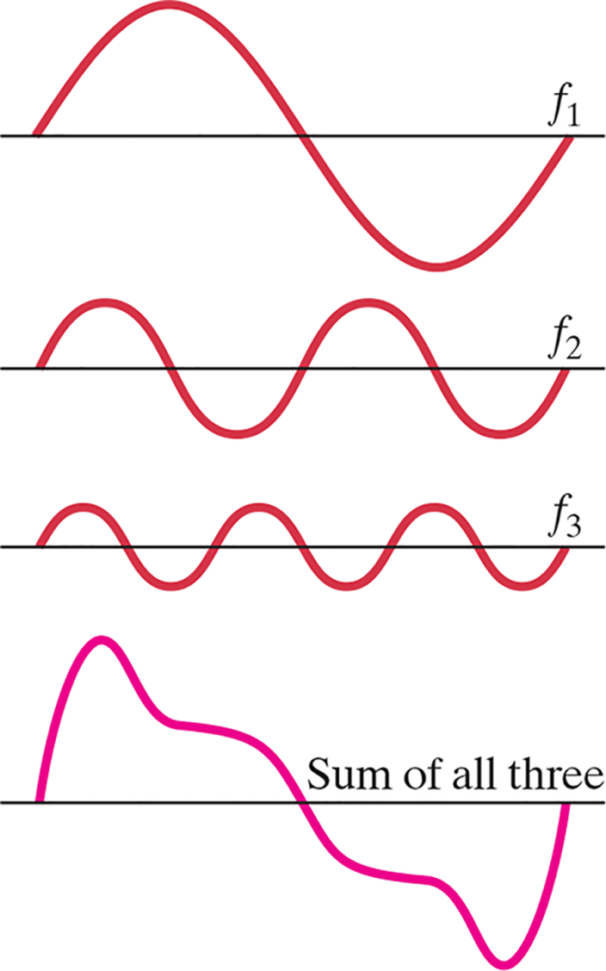
16-5 Quality of Sound, and Noise; Superposition (1 of 2)
So why does a trumpet sound different from a flute? The answer lies in overtones—which ones are present, and how strong they are, makes a big difference. The sound wave is the superposition of the fundamental and all the harmonics.
Notes:
Figure 16-13. In the example shown here, the displacements of the fundamental and first two overtones are added at each point to get the “sum,” or composite waveform. Normally many overtones are present.
LD: The top figure shows the fundamental waveform labeled f subscript 1 on a horizontal axis. One cycle of the wave is shown. The wave starts from the left with zero amplitude, its amplitude increases gradually as the wave moves to the right, reaches a maximum, its amplitude then gradually decreases, and crosses the horizontal axis. Its amplitude decreases further as the wave moves to the right, reaches a minimum, then increases, and ends on the horizontal axis. The second figure from top shows the first overtone of the same wave labeled f subscript 2 on a horizontal axis. Two similar cycles of the wave is shown. The first overtone completes two cycles in the same horizontal interval where the fundamental frequency completes one cycle. The first cycle is described as follows: the wave starts from the left with zero amplitude, its amplitude increases gradually as the wave moves to the right, reaches a maximum, its amplitude then gradually decreases, and crosses the horizontal axis. Its amplitude decreases further as the wave moves to the right, reaches a minimum, then increases, and crosses the horizontal axis. This waveform completes the first cycle corresponding to the point where the fundamental waveform crosses the x axis after reaching its maximum. The maximum and minimum of the first overtone, respectively, is less than that of the fundamental frequency. The third figure from top shows the second overtone of the same wave labeled f subscript 3 on a horizontal axis. Three similar cycles of the wave is shown. The second overtone completes three cycles in the same horizontal interval where the fundamental frequency completes one cycle. The first cycle is described as follows: the wave starts from the left with zero amplitude, its amplitude increases gradually as the wave moves to the right, reaches a maximum, its amplitude then gradually decreases, and crosses the horizontal axis. Its amplitude decreases further as the wave moves to the right, reaches a minimum, then increases, and crosses the horizontal axis. This waveform completes 1.5 cycles corresponding to the point where the fundamental waveform crosses the x axis after reaching its maximum, and also where the first overtone completes one cycle. The maximum and minimum of the second overtone, respectively, is less than that of the first overtone. The bottom figure labeled Sum of all three, shows the sum of the amplitudes of the three overtones at the corresponding points on the horizontal axis. The wave starts from the left with zero amplitude, its amplitude increases gradually as the wave moves to the right, reaches a maximum, its amplitude gradually decreases, and reaches a point of inflection. This point corresponds to the point on the horizontal axis where the fundamental wave reaches the maximum, where the first overtone crosses the horizontal axis after reaching the maximum in its first cycle, and where the second overtone reaches the minimum in its first cycle. The curve further decreases in amplitude and has a point of inflection on the horizontal axis. This point corresponds to the point on the horizontal axis where the fundamental wave crosses the axis after reaching the maximum, where the first overtone completes its first cycle, and where the second overtone crosses the axis after reaching the maximum in its second cycle. The curve further decreases in amplitude and reaches a point of inflection. This point corresponds to the point on the horizontal axis where the fundamental wave reaches the minimum, where the first overtone crosses the horizontal axis after reaching the maximum in its second cycle, and where the second overtone reaches the maximum in its second cycle. The curve further decreases, reaches a minimum, increases, and ends at the horizontal axis. This point corresponds to the point on the horizontal axis where the fundamental wave completes the first cycle, where the first overtone completes its second cycle, and where the third overtone completes its third cycle.

Slide 34
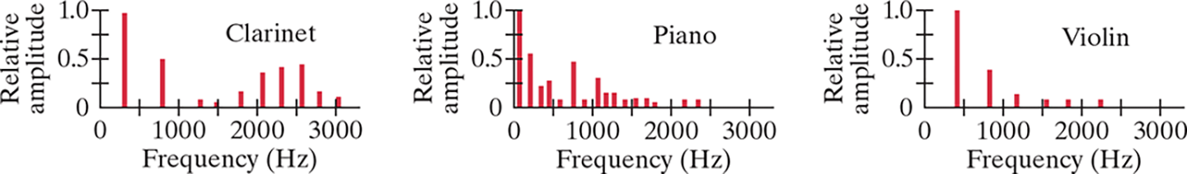
16-5 Quality of Sound, and Noise; Superposition (2 of 2)
This plot shows frequency spectra for a clarinet, a piano, and a violin. The differences in overtone strength are apparent.
Notes:
Figure 16-14. Sound spectra for different instruments for a specific note in each case. The spectra will change when the instruments play other notes. The clarinet is a bit complicated: it acts like a closed tube at lower frequencies, having only odd harmonics, but at higher frequencies all harmonics occur as for an open tube.
LD: Three graphs are drawn separately on the x y coordinate plane. The first graph is labeled Clarinet. The horizontal axis is labeled Frequency (H z) and ranges from 0 to 3000 in increments of 500 units. The vertical axis is labeled Relative amplitude and ranges from 0 to 1.0 in increments of 0.25 units. The graph has ten vertical lines. The first vertical line starts from a point near the marking 500 on the horizontal axis, goes upward and ends near the marking 1.0 on the vertical axis. The second vertical line starts from a point near the marking 850 on the horizontal axis, goes upward and ends near the marking 0.5 on the vertical axis. The third vertical line starts from a point near the marking 1250 on the horizontal axis, goes upward and ends near the vertical axis. The fourth vertical line starts from a point near the marking 1500 on the horizontal axis, goes upward and ends near the vertical axis. The fifth vertical line starts from a point near the marking 1750 on the horizontal axis, goes upward and ends near the marking 0.5 on the vertical axis. The sixth vertical line starts from a point near the marking 2000 on the horizontal axis, goes upward and ends near the marking 0.35 on the vertical axis. The seventh vertical line starts from a point near the marking 2250 on the horizontal axis, goes upward and ends near the marking 0.4 on the vertical axis. The eighth vertical line starts from a point near the marking 2500 on the horizontal axis, goes upward and ends near the marking 0.5 on the vertical axis. The ninth vertical line starts from a point near the marking 2750 on the horizontal axis, goes upward and ends near the marking 0.125 on the vertical axis. The tenth vertical line starts from a point near the marking 3000 on the horizontal axis, goes upward and ends near the vertical axis. The second graph is labeled Piano. The horizontal axis is labeled Frequency (Hz) and ranges from 0 to 3000 in increments of 500 units. The vertical axis is labeled Relative amplitude and ranges from 0 to 1.0 in increments of 0.25 units. The graph has sixteen vertical lines. The first vertical line starts from a point near the marking 0 on the horizontal axis, goes upward and ends near the marking 1.0 on the vertical axis. The second vertical line starts from a point near the marking 250 on the horizontal axis, goes upward and ends near the marking 0.5 on the vertical axis. The third vertical line starts from a point near the marking 400 on the horizontal axis, goes upward and ends near the marking 0.25 vertical axis. The fourth vertical line starts from a point near the marking 500 on the horizontal axis, goes upward and ends at marking 0.5 on the vertical axis. The fifth vertical line starts from a point near the marking 600 on the horizontal axis, goes upward and ends near the vertical axis. The sixth vertical line starts from a point near the marking 750 on the horizontal axis, goes upward and ends near the marking 0.5 on the vertical axis. The seventh vertical line starts from a point near the marking 800 on the horizontal axis, goes upward and ends near the vertical axis. The eighth vertical line starts from a point near the marking 1100 on the horizontal axis, goes upward and ends near the marking 0.25 on the vertical axis. The ninth vertical line starts from a point near the marking 1200 on the horizontal axis, goes upward and ends near the marking 0.125 on the vertical axis. The tenth vertical line starts from a point near the marking 1300 on the horizontal axis, goes upward and ends near the near the marking 0.125 on the vertical axis. The eleventh vertical line starts from a point near the marking 1400 on the horizontal axis goes upward and ends near the vertical axis. The twelfth vertical line starts from a point near the marking 1600 on the horizontal axis, goes upward and ends near the vertical axis. The thirteenth vertical line starts from a point near the marking 1750 on the horizontal axis, goes upward and ends near the vertical axis. The fourteenth vertical line starts from a point near the marking 1800 on the horizontal axis, goes upward and ends near the vertical axis. The fifteenth vertical line starts from a point near the marking 2250 on the horizontal axis, goes upward and ends near the vertical axis. The sixteenth vertical line starts from a point near the marking 2400 on the horizontal axis, goes upward and ends near the vertical axis. The third graph is labeled Violin. The horizontal axis is labeled Frequency (Hz) and ranges from 0 to 3000 in increments of 500 units. The vertical axis is labeled Relative amplitude and ranges from 0 to 1.0 in increments of 0.25 units. The graph has six vertical lines. The first vertical line starts from a point near the marking 400 on the horizontal axis, goes upward and ends near the marking 1.0 on the vertical axis. The second vertical line starts from a point near the marking 800 on the horizontal axis, goes upward and ends near the marking 0.4 on the vertical axis. The third vertical line starts from a point near the marking 1200 on the horizontal axis, goes upward and ends near the vertical axis. The fourth vertical line starts from a point near the marking 1600 on the horizontal axis, goes upward and ends at marking 0.5 on the vertical axis. The fifth vertical line starts from a point near the marking 1800 on the horizontal axis, goes upward and ends near the vertical axis. The sixth vertical line starts from a point near the marking 2250 on the horizontal axis, goes upward and ends near the marking 0.5 on the vertical axis.

Slide 35
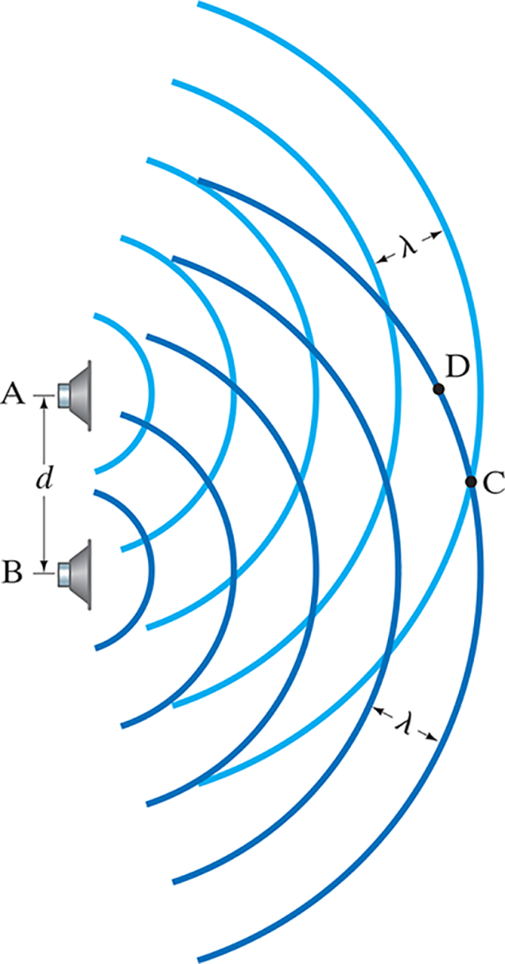
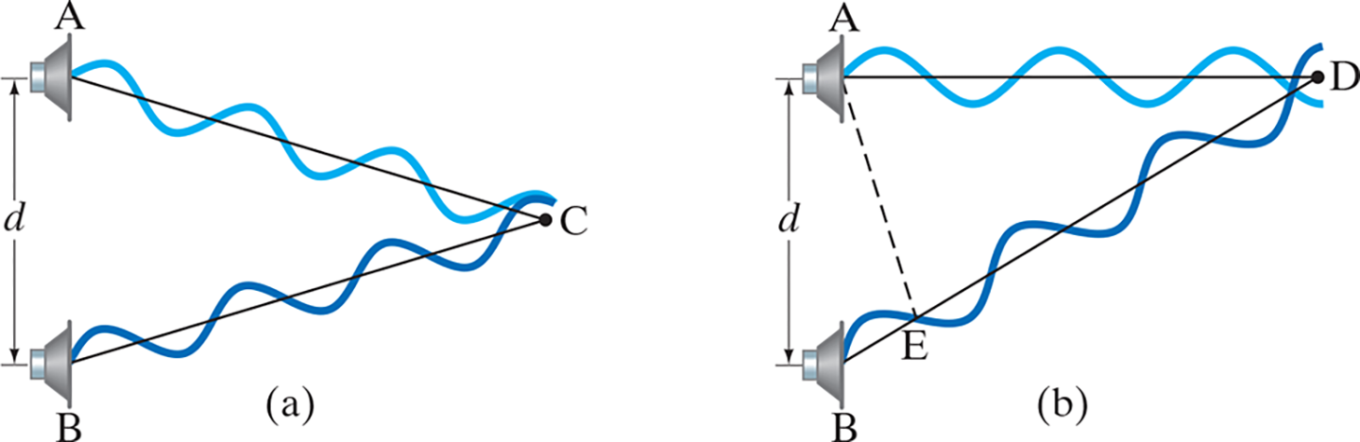
16-6 Interference of Sound Waves; Beats (1 of 5)
Sound waves interfere in the same way that other waves do in space.
Notes:
Figure 16-15. Sound waves of a single frequency emitted by two loudspeakers interfere.
Figure 16-16. Sound waves of a single frequency from loudspeakers A and B (see Fig. 16-15) constructively interfere at C and destructively interfere at D. Shown here are graphical representations, not the actual longitudinal sound waves.
LD: Two loudspeakers labeled “A” and B, respectively, are placed one above the other on the left of the figure separated by a vertical distance labeled d, represented by a double-headed arrow. Loudspeaker “A” is on top while loudspeaker B is at the bottom. Both emit sound waves with the same single frequency depicted by respective curved lines from each loudspeaker. The curved lines of “A” and B are shown interfering with each other in the form of arcs cutting the respective curved lines in their respective paths. The curved lines represent the crest of the sound waves while a trough is a region between two crests. A point C is marked on the outermost curved line emitted from B when it interferes with the outermost curved line emitted from that of “A”. The point C is marked such that the distance from both loudspeakers is equal and placed at a horizontal plane lying in the middle of the distance d. Another point D is marked on the outermost curved line emitted from B on the outermost trough emitted from “A” and placed in the horizontal plane closer to “A”. The distance between two outermost crests emitted from both “A” and B, respectively, are depicted using horizontal double-headed arrows and labeled lambda.
LD: Part (“a”): Two loudspeakers labeled “A” and B, respectively, are placed one above the other on the left of the figure. The speakers are separated by a vertical distance labeled d, represented by a double-headed arrow. “A” is placed on the top of the figure, while B is placed below "A". Both emit sound waves with the same frequency represented by curved lines from each loudspeaker to the right. The sound waves are represented as transverse waves having crests and troughs. A point labeled C is present to the right of both the speakers. The sound waves emitted from “A” are inclined downward to the right to point C and the sound waves emitted from B are inclined upward to the right to point C. Both the waves interfere at a point before reaching point C. An inclined line is drawn from “A” and B, respectively, to point C. Part (b): Two loudspeakers labeled “A” and B are placed one above the other on the left of the figure. The speakers are separated by a vertical distance labeled d, represented by a double-headed arrow. “A” is placed on the top of the figure, while B is placed below "A". Both emit sound waves with the same frequency represented by curved lines from each loudspeaker to the right. The sound waves are represented as transverse waves having crests and troughs. A point labeled D is present to the right of “A”. The sound waves emitted from “A” travel horizontally to the right to point D and the sound waves emitted from B is inclined upward to the right to point D. Both the sound waves intersect with each other at a point before reaching point D. A straight line is drawn from “A” and an inclined line is drawn from B, respectively, to point D. A point labeled E is marked on the right node of the first crest of B. An inclined dashed line is drawn between “A” and point E.

Slide 36
16-6 Interference of Sound Waves; Beats (2 of 5)
Example 16-12: Loudspeakers’ interference.
Two loudspeakers are 1.00 m apart. A person stands 4.00 m from one speaker. How far must this person be from the second speaker to detect destructive interference when the speakers emit an 1150-Hz
sound? Assume the temperature is

Slide 37
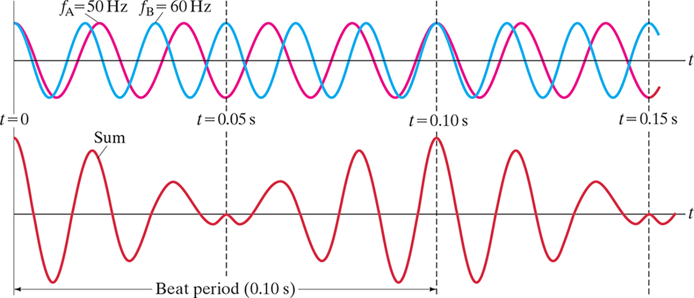
16-6 Interference of Sound Waves; Beats (3 of 5)
Waves can also interfere in time, causing a phenomenon called beats. Beats are the slow “envelope” around two waves that are relatively close in frequency.
Notes:
Figure 16-17. Beats occur as a result of the superposition of two sound waves of slightly different frequency.
LD: The figure on the top shows two waveforms drawn on a coordinate plane. The horizontal axis is labeled t. The vertical axis is labeled t equals 0. Three dashed vertical lines are drawn, and labeled t equals 0.05 s, t equals 0.10 s, and t equals 0.15 s, respectively. The dashed line labeled t equals 0.05 s is closer to the vertical axis. The dashed line labeled t equals 0.1 s is drawn in between the dashed lines labeled t equals 0.05 s, and t equals 0.15 s. The first waveform is labeled f subscript B equals 60 Hertz and 4.5 similar cycles of this wave form is shown. One cycle of this waveform from t equals 0 is as follows: the waveform starts from a point on the positive vertical axis, decreases as t increases, crosses the t axis, decreases further to a minimum, increases further, crosses the t axis, increases further, and reaches a maximum. It decreases as t increases further, crosses the t axis, decreases further to a minimum, increases further, crosses the t axis, increases further, and reaches a maximum. The second waveform is labeled f subscript "A” equals 50 Hertz and 4.5 similar cycles of this wave form is shown. One cycle of this waveform from t equals 0 is as follows: the waveform starts from the same point on the positive vertical axis as the first waveform, decreases as t increases, crosses the t axis, to the right of the first waveform. It decreases further to a minimum, to the right of the first waveform, increases further, crosses the t axis to the right of the first waveform. It increases further, and reaches a maximum to the right of the first waveform. It decreases as t increases further, crosses the t axis to the right of the first waveform, decreases further to a minimum to the right of the first waveform. It further increases, crosses the t axis to the right of the first waveform, increases further, and reaches a maximum to the right of the first waveform. The entire second waveform is drawn shifted right to the first waveform, and the shift increases as t increases. The maximum and minimum of the two waveforms are equal. At t equals 0.05 s and t equals 0.15 s, the waveform for 60 Hertz is at its maximum, and the waveform for 50 Hertz is at its minimum. At t equals 0 s and t equals 0.10 s, the waveform for 60 Hertz and 50 Hertz, respectively, are at their maximum. The figure below shows the superposition of the two sound waves of slightly different frequencies shown above. The horizontal axis is labeled t. The vertical axis is labeled t equals 0. Three dashed vertical lines are drawn, and labeled t equals 0.05 s, t equals 0.1 s, and t equals 0.15 s, respectively. The dashed line labeled t equals 0.05 s is closer to the vertical axis. The dashed line labeled t equals 0.1 s is drawn between the dashed lines labeled t equals 0.05 s and t equals 0.15 s, respectively. The waveform labeled Sum starts from a point on the positive vertical axis, the amplitude being the sum of the amplitudes of the two waves. The amplitude decreases gradually as t increases and reaches a point of inflection with 0 amplitude at t equals 0.05 s and t equals 0.15 s, respectively. After this time, the amplitude increases gradually as t increases, and reaches the maximum at t equals 0.10 s. The distance in the t axis between t equals 0 and t equals 0.10 s is marked by a double-headed arrow and labeled Beat period (0.15 s).

Slide 38

16-6 Interference of Sound Waves; Beats (4 of 5)
If we consider two waves of the same amplitude and phase, with different frequencies, we can find the beat frequency when we add them:
This represents a wave vibrating at the average frequency, with an “envelope” at the difference of the frequencies.

Slide 39
16-6 Interference of Sound Waves; Beats (5 of 5)
Example 16-13: Beats.
A tuning fork produces a steady 494-Hz tone. When this tuning fork is struck and held near a vibrating guitar string, twenty beats are counted in five seconds. What are the possible frequencies produced by the guitar string?

Slide 40
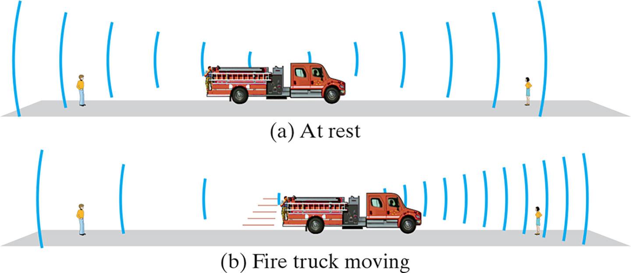
16-7 Doppler Effect (1 of 8)
The Doppler effect occurs when a source of sound is moving with respect to an observer.
A source moving toward an observer appears to have a higher frequency and shorter wavelength; a source moving away from an observer appears to have a lower frequency and longer wavelength.
Notes:
Figure 16-18. (a) Both observers on the sidewalk hear the same frequency from the fire truck at rest. (b) Doppler effect: the observer who sees the fire truck coming towards her hears a higher-frequency sound, and the observer behind the fire truck hears a lower frequency sound.
LD: Two observers are shown on respective sidewalks at the opposite ends of a road or path, where a fire truck is placed in the middle of the road. In part (“a”), the fire truck is parked with its siren kept on. Sound waves from the siren of the fire truck are depicted by uniform curves in the form of echo emitted from both ends of the fire truck. The intensity of the sound waves is the same on both ends of the truck. Since the distance between the fire truck and each observer is the same, both observers tend to hear the siren sound with the same frequency at the same time. A label At rest is placed at the bottom of the figure. In part (b), the fire truck is moving toward the right from its rest position with its siren kept on. As the truck is moving toward the right the intensity and the frequency of sound waves will get higher toward the right. Hence, the observer on the far right tends to hear the sound first with a higher pitch as depicted by continuous curved lines in the form of echo emitted from the truck. The observer on the far left end tends to hear the sound a little later with a much lower pitch as the fire truck keeps moving toward the right, as depicted by sparse curved lines in the form of echo emitted from the fire truck. A label Fire truck moving is placed at the bottom of the figure.

Slide 41
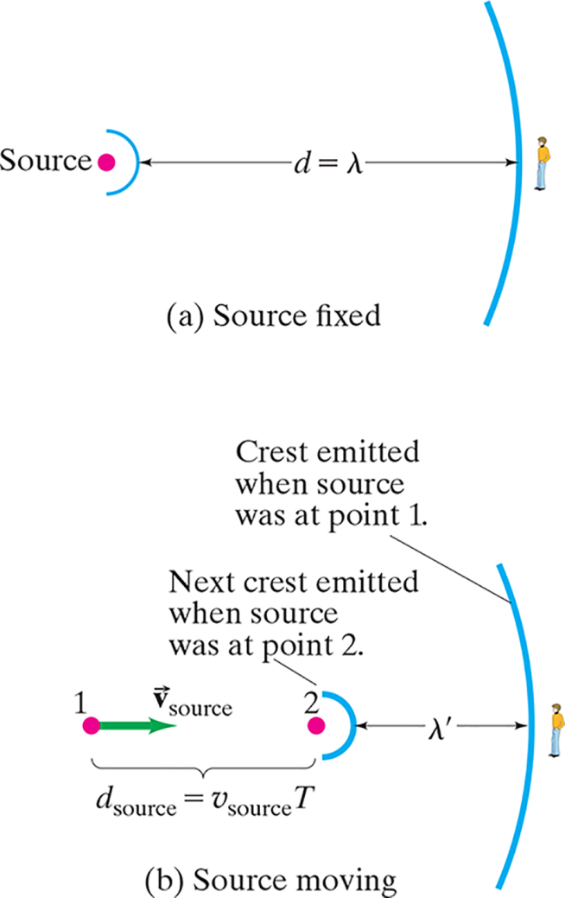
16-7 Doppler Effect (2 of 8)
If we can figure out what the change in the wavelength is, we also know the change in the frequency.
Notes:
Figure 16-19. Determination of the frequency shift in the Doppler effect (see text). The red dot is the source. The observer is on the far right. (a) Source fixed. (b) Source moving toward observer.
LD: In part (“a”), a stationary source is placed on the far left depicted by a red dot, and a stationary observer is placed on the far right. Waves emitted from the stationary source are represented by curves and called crests. Two crests are shown in this part of the figure with one crest placed close to the source and the other placed near the observer. The crest close to the source appears small while the crest close to the observer appears fairly large. The distance between the two crests is shown using a horizontal double-headed arrow labeled d equals lambda. In part (b), the source appears to move toward the right from a point labeled 1 placed at the far left to another point labeled 2 placed in between point 1 and the stationary observer, placed at the far right. The distance between point 2 and the observer is depicted using a horizontal double-headed arrow labeled lambda superscript dash. A velocity vector arrow labeled vector v subscript source starts from point 1 on the left and points right. The distance between points 1 and 2 is marked and labeled d subscript source equals v subscript source T. Two crests are shown in this part of the figure with one crest placed close to the source at point 2, and the other placed close to the observer. The crest near point 2 is labeled Next crest emitted when the source was at point 2 and the crest near the observer is labeled Crest emitted when the source was at point 1.

Slide 42
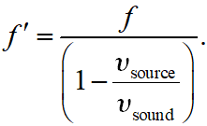
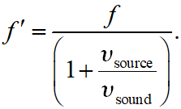
16-7 Doppler Effect (3 of 8)
The change in the frequency is given by:
If the source is moving away from the observer:

Slide 43
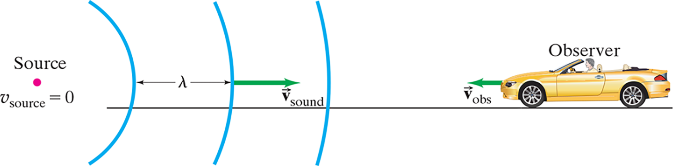
16-7 Doppler Effect (4 of 8)
If the observer is moving with respect to the source, things are a bit different. The wavelength remains the same, but the wave speed is different for the observer.
Notes:
Figure 16-20. Observer moving with speed v obs toward a stationary source detects wave crests passing at speed v’ = v sound + v obs, where v sound is the speed of the sound waves in air.
LD: The person in the car labeled Observer is traveling on a horizontal surface from right to left. A source of sound labeled Source is placed on the left end of the figure and is represented as a dot. A label v subscript source equals zero is placed below the Source. The sound waves emitted from the Source are represented as three equally spaced parallel arcs traveling to the right. A horizontal double-headed arrow labeled lambda represents the distance between two adjacent parallel arcs or two adjacent sound waves. A velocity vector arrow labeled vector v subscript sound starts from the center of the second sound wave from the left and points to the right. A velocity vector arrow labeled vector v subscript obs starts from the front of the car and points to the left. The velocity vector v subscript sound has a higher magnitude than the velocity vector v subscript obs.

Slide 44


16-7 Doppler Effect (5 of 8)
We find, for an observer moving toward a stationary source:
And if the observer is moving away:

Slide 45
16-7 Doppler Effect (6 of 8)
Example 16-14: A police siren.
The siren of a police car at rest emits at a predominant frequency of 1600 Hz. (a) What frequency will you hear if you are at rest and the police car moves at 25.0 m/s toward you? (b) What frequency do you hear if you drive 25.0 m/s toward the police car which is at rest?

Slide 46
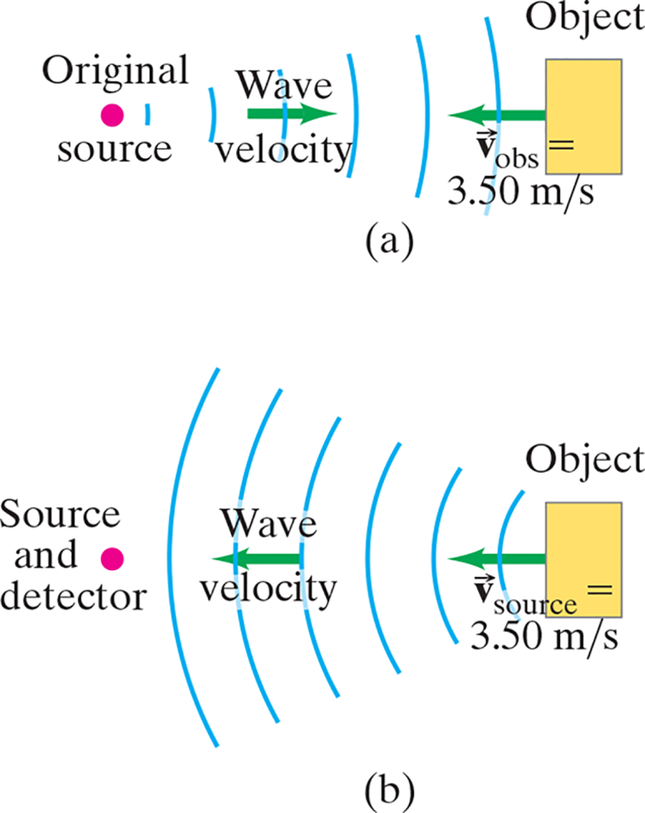
16-7 Doppler Effect (7 of 8)
Example 16-15: Two Doppler shifts.
A pure 5000-Hz sound wave is emitted by a stationary source. This sound wave reflects from an object moving 3.50 m/s toward the source. What is the frequency of the wave reflected by the moving object as detected by a detector at rest near the source?
Notes:
Figure 16-21. Example 16-15.
LD: In part (“a”), a source emitting sound waves labeled Original source is placed on the left side of the figure and is represented as a dot. A rectangular object labeled Object is placed on the right. Sound waves are emitted from the Original source as a series of equally spaced six parallel arcs. The size of the arcs appear to increase from left to right. A velocity vector arrow labeled vector Wave velocity starts before the third arc from left and points to the right. Another velocity vector arrow labeled vector v subscript obs equals 3.50 m per s starts from the middle of the Object and points to the left. In part (b), a dot labeled Source and detector is placed on the left side of the figure. A rectangular object labeled Object is placed on the right. A series of equally spaced six parallel arcs start from the Object on the right. The size of the arcs appear to increase from right to left. A velocity vector arrow labeled vector v subscript source equals 3.50 m per s starts from the middle of the Object and points to the left. Another velocity vector arrow labeled vector Wave velocity starts from the fourth arc from the right and points to the left.

Slide 47

16-7 Doppler Effect (8 of 8)
All four equations for the Doppler effect can be combined into one; you just have to keep track of the signs!

Slide 48

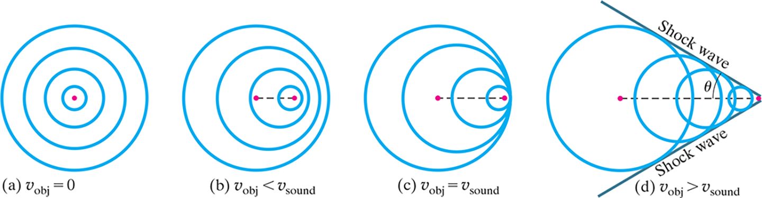
16-8 Shock Waves and the Sonic Boom (1 of 3)
If a source is moving faster than the wave speed in a medium, waves cannot keep up and a shock wave is
formed.
The angle of the cone is:
Notes:
Figure 16-23. Sound waves emitted by an object, the red dot, (a) at rest or (b, c, and d) moving. (b) If the object’s velocity is less than the velocity of sound, the Doppler effect occurs (note wavelength changes in front of and behind the moving object, as in Fig. 16-18b). (c) At v obj = v sound, the waves pile up in front, forming a “sound barrier.” (d) If the object’s velocity is greater than the velocity of sound, a shock wave is produced.
LD: In part (“a”), the object represented by a red dot is at rest. Sound waves emitted by the object are shown as four concentric and equidistant circles drawn outward around the red dot as its center point. A legend at the bottom states v subscript obj equals zero. In part (b), the object is moved slightly to the right. The initial and the displaced positions of the object are marked with red dots. A horizontal dashed line is drawn between these two red dots. Sound waves emitted by the moving object tend to move closer to the displaced position on the right and away from its initial position. Sound waves are shown as four concentric circles drawn around the displaced position such that their right sides appear tightly packed while their left sides appear loosely spaced to the left. The red dot representing the initial position of the object is placed on the left side of the second concentric circle from inside. The red dot representing the displaced position of the object is placed on the right side of the first concentric circle from inside. A legend at the bottom states v subscript obj less than v subscript sound. In part (c), the object is moved further to the right. The initial and the displaced positions of the object are marked with red dots. A horizontal dashed line is drawn between these two red dots. Sound waves emitted by the moving object pile up in front and form a “sound barrier”. Sound waves are shown as four concentric circles drawn around the displaced position such that their far-right arcs are lying to the right of the red dot representing the displaced position of the object and start from the same plane. The left sides of the four concentric circles appear more loosely spaced to the left. The red dot representing the initial position of the object is placed on the left side of the third concentric circle from inside and appears to be the center point for the outermost concentric circle. A legend at the bottom states v subscript obj equals v subscript sound. In part (d), the object is moved to the far right. The initial and the displaced positions of the object are marked with red dots. A horizontal dashed line is drawn between these two red dots. Sound waves emitted by the moving object pile up on one another along the sides and are sent as shock waves. Shock waves are shown as four circles drawn from right to left with an increasing radius. All four circles have overlapping positions. The smallest first circle on the far right overlaps with the second circle on its left side. The second circle overlaps with the first and the third circle, respectively, on its right side and the fourth circle on its left. The third circle overlaps with the second and the fourth circle, respectively, on its right side. The fourth circle overlaps with the second and the third circle, respectively, on its right side as well. The red dot representing the displaced position of the object is placed to the right of the smallest circle on the far right. Two slanting lines extend from the right of this red dot and point upward and downward, respectively, to the left. Both lines are drawn such that they touch the circumferences of all four circles on either side and are labeled Shock wave, respectively. The red dot representing the initial position is placed to the left of the third circle from the right and appears to be the center point for the fourth circle. The angle between the upward slanting line to the left and the horizontal dashed line is labeled theta. A legend at the bottom states v subscript obj greater than v subscript sound.

Slide 49
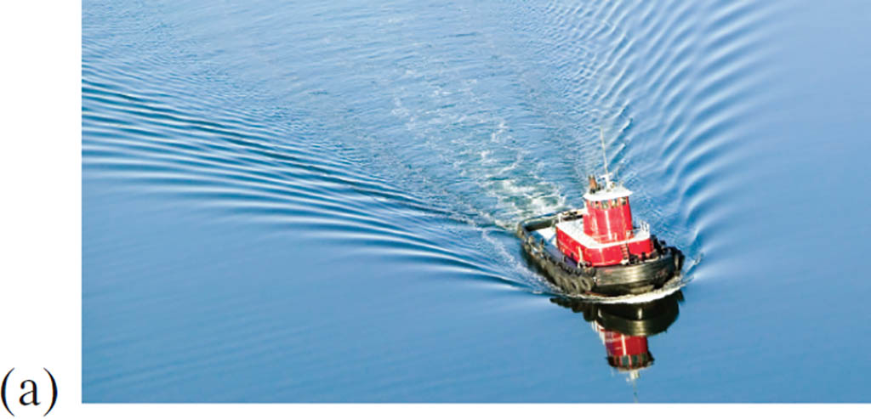
16-8 Shock Waves and the Sonic Boom (2 of 3)
Shock waves are analogous to the bow waves produced by a boat going faster than the wave speed in water.
Notes:
Figure 16-24. Bow waves produced by (a) a boat
LD: Both photographs show bow waves emerging from the back of the boat and the duck, respectively, as a trail.

Slide 50
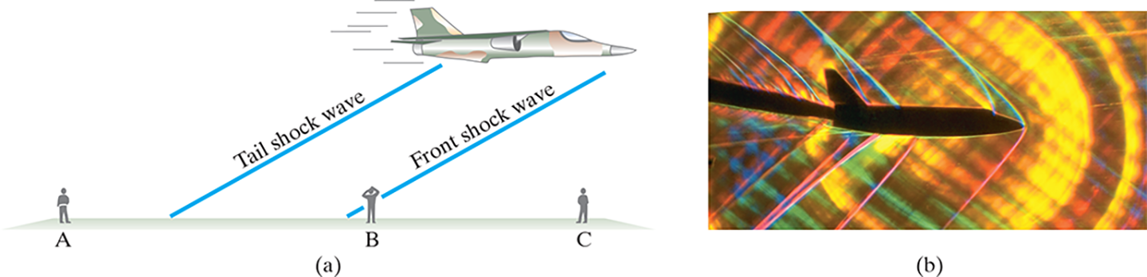
16-8 Shock Waves and the Sonic Boom (3 of 3)
Aircraft exceeding the speed of sound in air will produce two sonic booms, one from the front and one from the tail.
Notes:
Figure 16-25. (a) The (double) sonic boom has already been heard by person A on the left. The front shock wave is just being heard by person B in the center. And both shock waves will shortly be heard by person C on the right. (b) Special photo of supersonic aircraft showing shock waves produced by different parts of the aircraft in the air.
LD: Part (“a”): The figure illustrates an airplane on the upper right flying to the right. Three persons labeled “A”, B, and C, respectively, are standing on the ground in three different positions from the flying plane. Person “A” is standing on the far left, person B in the middle, and person C on the far right of the picture. The airplane is seen flying between person B and person C. Two shock waves or sonic booms are produced by the tail and the front of the airplane, respectively. A slanted line appears from underneath the back of the airplane and moves down to the left to reach the ground between person “A” and person B and labeled Tail shock wave. Another slanted line appears from underneath the front of the airplane and moves down to the left to reach the ground before person B and labeled Front shock wave. Person “A” appears to have heard both sonic booms created by the flying airplane as it has completely passed over him. Person B appears to hear only the sonic boom created by the front of the airplane as it has not completely passed over him. Person C is yet to hear the two sonic booms created by the airplane as it has not yet arrived near him. Part (b): A special photograph of shock waves produced by different parts of a supersonic aircraft in the air is shown.

Slide 51
16-9 Applications: Sonar, Ultrasound, and Medical Imaging (1 of 3)
Sonar is used to locate objects underwater by measuring the time it takes a sound pulse to reflect back to the receiver.
Similar techniques can be used to learn about the internal structure of the Earth.
Sonar usually uses ultrasound waves, as the shorter wavelengths are less likely to be diffracted by obstacles.

Slide 52
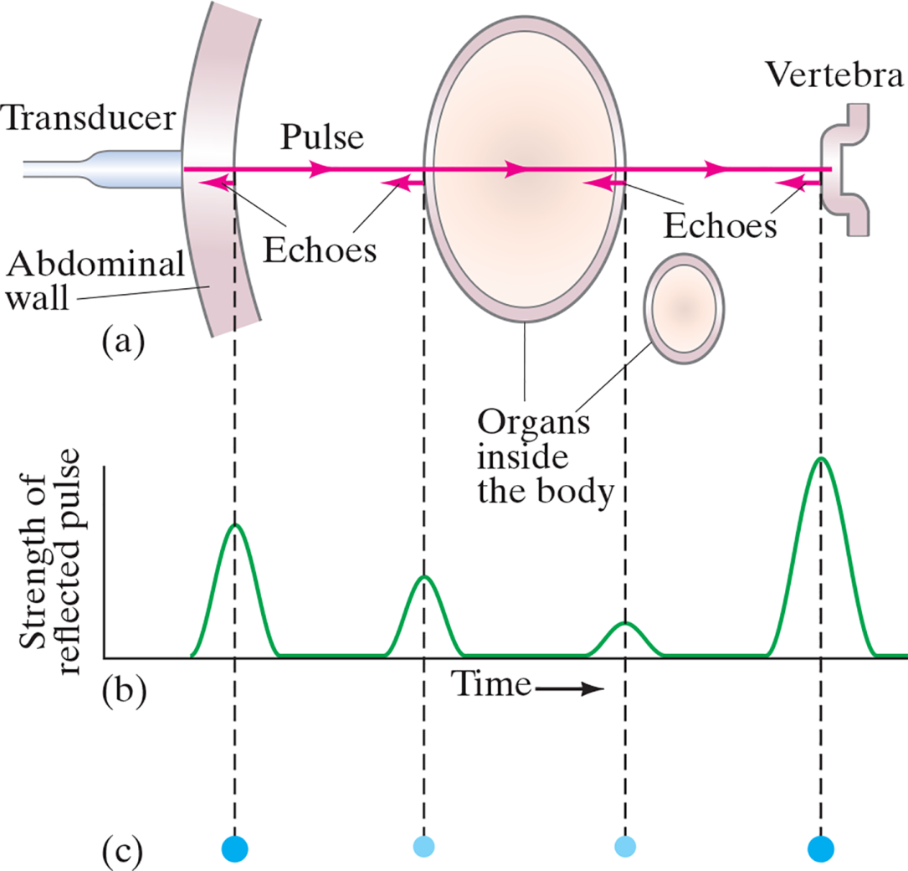
16-9 Applications: Sonar, Ultrasound, and Medical Imaging (2 of 3)
Ultrasound is also used for medical imaging. Repeated traces are made as the transducer is moved, and a complete picture is built.
Notes:
Figure 16-27. (a) Ultrasound pulse passes through the abdomen, reflecting from surfaces in its path. (b) Reflected pulses plotted as a function of time when received by transducer. The vertical dashed lines point out which reflected pulse goes with which surface. (c) “Dot display” for the same echoes: brightness of each dot is related to signal strength.
LD: In part (“a”), an ultrasound transducer is placed to the left of the abdomen wall in the figure and labeled Transducer. A cross-sectional view of the abdomen wall is shown as two inward curving arcs placed on the far left of the figure and labeled Abdominal wall. An outward-facing handle-like figure is placed on the far right of the figure and labeled Vertebra. A spherical body is placed between the Abdominal wall and Vertebra with all three figures kept on the same horizontal plane. Another spherical body is placed below the first spherical body on the right and both spherical bodies are labeled Organs inside the body. The Transducer emits pulses that pass through the Abdomen wall, the first spherical body, and reaches Vertebra. The emitted pulses labeled Pulse are shown as a long horizontal line starting from Transducer and ending at Vertebra with right-pointing arrows on it. The emitted pulses are echoed back to the Transducer when the pulses are incident on the inner organs. Four emitted pulses are shown and labeled Echoes. The first arrow or Echo starts from Vertebra and points left. The second arrow or Echo starts from the right outer border of the first spherical body and points left. The third arrow or Echo starts from the left outer body of the first spherical body and points left. The fourth arrow or Echo starts from the right of the Abdominal wall and points left. Four vertical dashed lines are extended from the tip of four Echoes on top to pass through part (b) and part (c), respectively. Part (b) is a graphical representation of ultrasound echoes in a two-dimensional coordinate plane with the horizontal axis labeled Time and the vertical axis labeled Strength of reflected pulse. The four vertical dashed lines pass through this graph to highlight the association of reflected echo with a specific organ shown in part (“a”). The pulse caused due to the fourth echo from the inside edge of the abdomen has a large inverted U shape having the first vertical dashed line from the vertical axis pass through its center. The pulse caused due to the third echo from the left edge of the inner organ has a small inverted U shape having the second vertical dashed line from the vertical axis pass through its center. The pulse caused due to the second echo from the right side edge of the inner organ has a very small inverted U shape having the third vertical dashed line passing through its center. The pulse caused due to the first echo from the left side edge of the vertebra has a very large inverted U shape having the fourth vertical dashed line passing through its center. Part (c) is in a “Dot display” format that uses a color intensity technique to display the signal strength of Echoes. Four dots are connected to the four vertical dashed lines and correspond to the echo present on part (b) from left to right, respectively. The intensity of dots from left to right are as follows: bright, dim, dim, and bright, respectively.

Slide 53
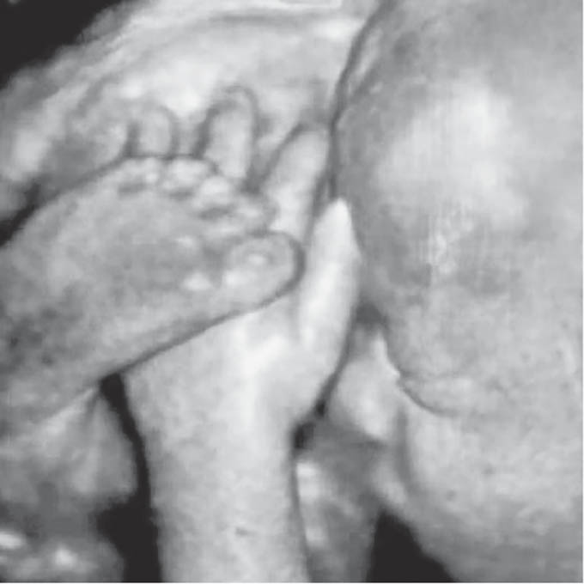
16-9 Applications: Sonar, Ultrasound, and Medical Imaging (3 of 3)
This is an ultrasound image of a human fetus, showing great detail.
Notes:
Figure 16-26. Ultrasound image of a human fetus within the uterus.

Slide 54
Summary of Chapter 16 (1 of 2)
Sound is a longitudinal wave in a medium.
The pitch of the sound depends on the frequency.
The loudness of the sound depends on the intensity and also on the sensitivity of the ear.
The strings on stringed instruments produce a fundamental tone whose wavelength is twice the length of the string; there are also various harmonics present.

Slide 55
Summary of Chapter 16 (2 of 2)
Wind instruments have a vibrating column of air when played. If the tube is open, the fundamental is twice its length; if it is closed, the fundamental is four times the tube length.
Sound waves exhibit interference; if two sounds are at slightly different frequencies, they produce beats.
The Doppler effect is the shift in frequency of a sound due to motion of the source or the observer.

Slide 56

Copyright
This work is protected by United States copyright laws and is provided solely for the use of instructors in teaching their courses and assessing student learning. Dissemination or sale of any part of this work (including on the World Wide Web) will destroy the integrity of the work and is not permitted. The work and materials from it should never be made available to students except by instructors using the accompanying text in their classes. All recipients of this work are expected to abide by these restrictions and to honor the intended pedagogical purposes and the needs of other instructors who rely on these materials.

