Slide 1
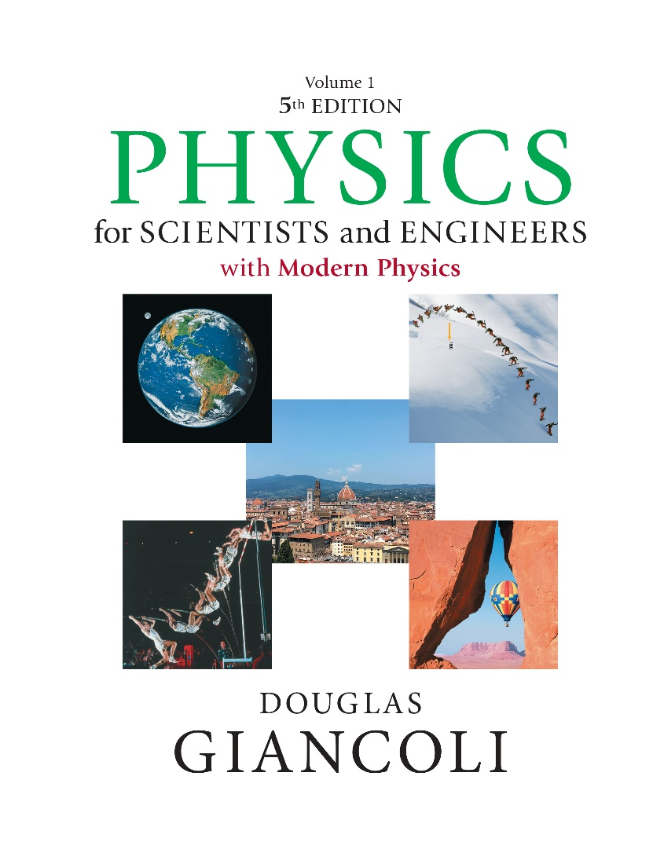

Physics for Scientists and Engineers with Modern Physics
Fifth Edition
Chapter 31
Maxwell’s Equations and Electromagnetic Waves
Copyright © 2023 Pearson Education, Inc. All Rights Reserved
Notes:
If this PowerPoint presentation contains mathematical equations, you may need to check that your computer has the following installed:
1) MathType Plugin
2) Math Player (free versions available)
3) NVDA Reader (free versions available)

Slide 2
Units of Chapter 31 (1 of 2)
Changing Electric Fields Produce Magnetic Fields; Displacement Current
Gauss’s Law for Magnetism
Maxwell’s Equations
Production of Electromagnetic Waves
Electromagnetic Waves, and Their Speed, Derived from Maxwell’s Equations
Light as an Electromagnetic Wave and the Electromagnetic Spectrum

Slide 3
Units of Chapter 31 (2 of 2)
Measuring the Speed of Light
Energy in E M Waves; the Poynting Vector
Radiation Pressure
Radio and Television; Wireless Communication

Slide 4

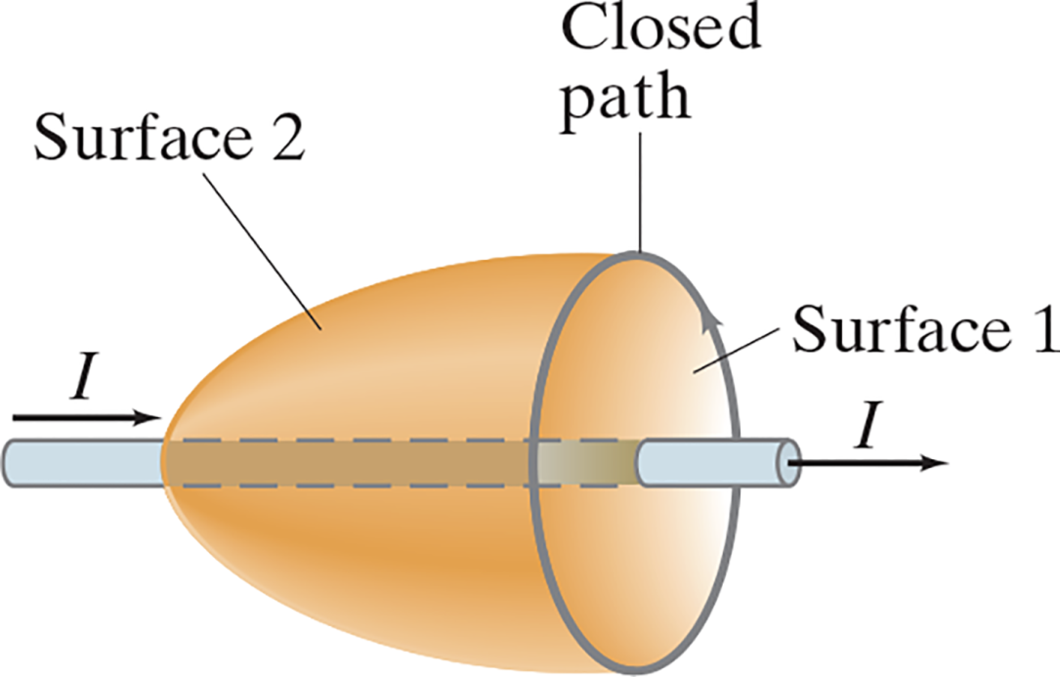
31-1 Changing Electric Fields Produce Magnetic Fields; Displacement Current (1 of 5)
Ampère’s law relates the magnetic field around a current to the current through surface 1.
Notes:
Figure 31-2. Ampère’s law applied to two different surfaces bounded by the same closed path.
LD: Together, the two surfaces resemble a paraboloid opening toward the right. The flat circular base of the paraboloid is labeled Surface 1 and the parabolic curve paraboloidal surface is labeled Surface 2. A loop labeled Closed path is shown along the circumference of the circular base. The loop seems to be revolving in the counterclockwise direction. The wire passes along the axis of the paraboloid. An arrow labeled I is shown above the left end of the wire behind the surfaces and points to the right. Another arrow labeled I from the center of the right face of the wire points to the right.

Slide 5
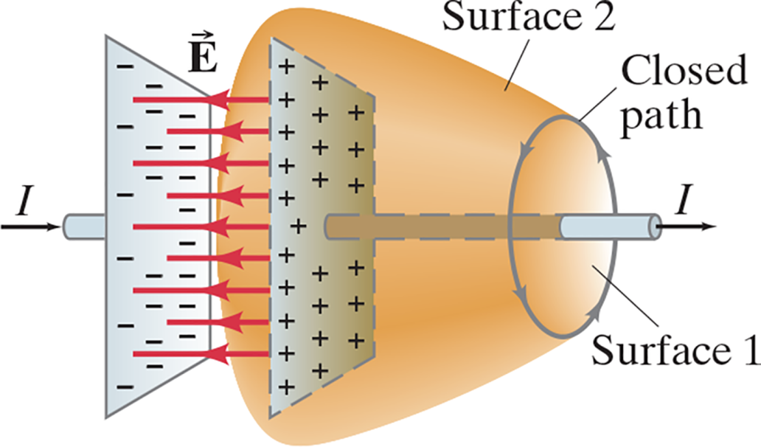
31-1 Changing Electric Fields Produce Magnetic Fields; Displacement Current (2 of 5)
Ampère’s law relates the magnetic field around a current to the current through surface 2.
Notes:
Figure 31-3. A capacitor discharging. A conduction current passes through surface 1, but no conduction current passes through the sack-like surface 2. An extra term is needed in Ampere’s law.
LD: Together, the two surfaces resemble a frustrum with its smaller circular base on the right. The smaller circular base of the frustum is labeled Surface 1 and the cone is labeled Surface 2. A loop labeled Closed path is shown along the circumference of the smaller circular base. The loop seems to be revolving in the counterclockwise direction. The capacitor is shown as two parallel plates that are oriented vertically and parallel to the larger base of the frustrum. The right plate is of the capacitor is embedded within the frustum. The left plate has a negative charge while the right plate has a positive charge. Parallel horizontal electric field lines labeled vector E seem to pass from the positive plate on the right to the negative plate on the left. The wire passes through the centers of the capacitor plates and along the axis of the frustum.. Two arrows labeled I are shown at the two ends of the wire and are pointing to the right indicating the direction of the current.

Slide 6

31-1 Changing Electric Fields Produce Magnetic Fields; Displacement Current (3 of 5)
Therefore, Ampère’s law is modified to include the creation of a magnetic field by a changing electric field—the field between the plates of the capacitor in this example:

Slide 7


31-1 Changing Electric Fields Produce Magnetic Fields; Displacement Current (4 of 5)
Example 31-1: Maxwell’s extra term: charging capacitor.
A 30-p F air-gap capacitor has circular plates of area
It is charged by a 70-V battery through a
resistor. At the instant the battery is connected,
the
electric field between the plates is changing most rapidly. At this instant, calculate (a) the current in the R C circuit, and
(b) the rate of change of electric field between the plates.
(c) Determine the magnetic field induced between the plates.
Assume
is uniform between the plates at any instant and
is zero at all points beyond the edges of the plates.
(d) Determine
beyond the edges of the plates.

Slide 8


31-1 Changing Electric Fields Produce Magnetic Fields; Displacement Current (5 of 5)
The second term in Ampère’s law has the dimensions of a
current (after factoring out the
), and is sometimes called the
displacement current:
where

Slide 9

31-2 Gauss’s Law for Magnetism
Gauss’s law relates the electric field on a closed surface to the net charge enclosed by that surface. The analogous law for magnetic fields is different, as there are no single magnetic point charges (monopoles):

Slide 10
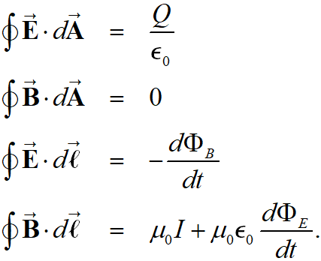
31-3 Maxwell’s Equations
We now have a complete set of equations that describe electric and magnetic fields, called Maxwell’s equations. In the absence of dielectric or magnetic materials, they are:

Slide 11
31-4 Production of Electromagnetic Waves (1 of 5)
Since a changing electric field produces a magnetic field, and a changing magnetic field produces an electric field, once sinusoidal fields are created, they can propagate on their own.
These propagating fields are called electromagnetic waves.

Slide 12
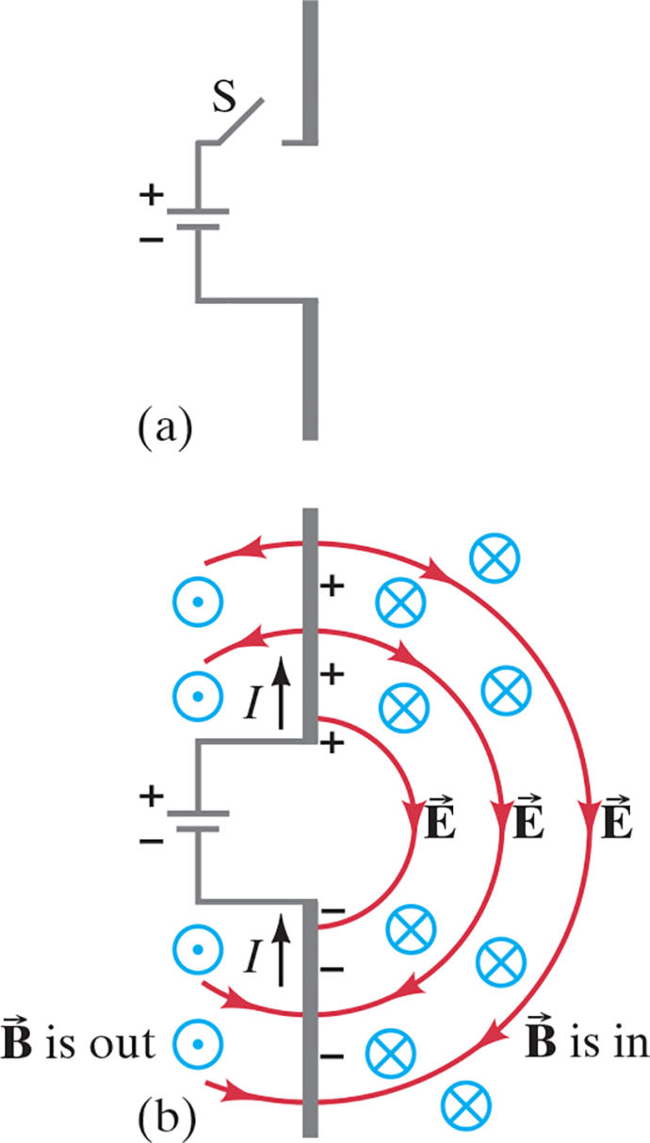
31-4 Production of Electromagnetic Waves (2 of 5)
Oscillating charges will produce electromagnetic waves:
Notes:
Figure 31-6. Fields produced by charge flowing into conductors. It takes time for the E and B fields to travel outward to distant points. The fields are shown to the right of the antenna, but they move out in all directions, symmetrically about the (vertical) antenna.
LD: The rods are oriented vertically one above the other and are separated by a distance. The lower rod is connected to the negative terminal of the battery. The positive terminal of the battery is connected to the upper rod through a wire with the switch S. Part (“a”): The switch is open and no current passes through the circuit. Part (b): The switch is closed. The upper rod is positively charged, and the lower rod is negatively charged. The current moves from the lower rod to the upper rod and is indicated by two vertical arrows labeled I pointing upward shown next to the two rods. Semicircular electric field lines labeled vector E emerge from the upper positive rod and end at the lower negative rod. The field lines resemble concentric semicircles. Arrowheads on the semicircular electric field lines to the right of the rods point in the clockwise direction, while arrowheads on the semicircular electric field lines to the left of the rods point in the counterclockwise direction. Tiny blue circles with cross marks are shown to the right of the rods and are labeled vector B is in. Tiny blue circles with a dot at their centers are shown to the left of the rods and are labeled vector B is out.

Slide 13
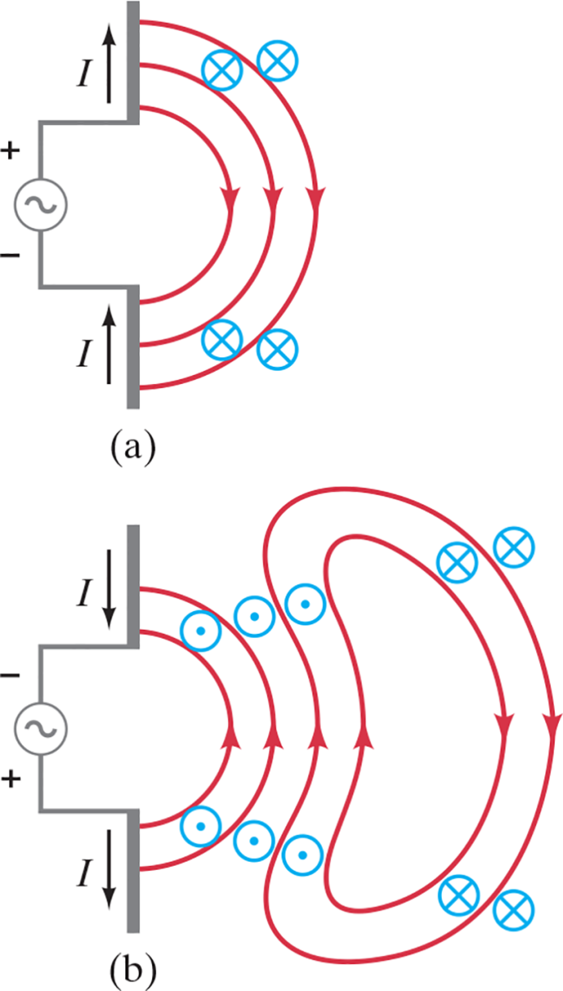
31-4 Production of Electromagnetic Waves (3 of 5)
Close to the antenna, the fields are complicated, and are called the near field:
Notes:
Figure 31-7. Sequence showing electric and magnetic fields that spread outward from oscillating charges on two conductors (the antenna) connected to an ac source (see the text).
LD: The rods are oriented vertically one above the other and are separated by a distance. The lower and upper rods are connected to the “a” c generator. Part (“a”): The upper rod is positively charged, and the lower rod is negatively charged. The current moves from the lower rod to the upper rod and is indicated by two vertical arrows labeled I pointing upward shown next to the two rods. Semicircular electric field lines shown on the right of the rods emerge from the upper positive rod and end at the lower negative rod. The field lines resemble concentric semicircles. Arrowheads on the semicircular electric field lines point in the clockwise direction. Tiny blue circles with cross marks representing the magnetic field lines going in are shown around the electric field lines to the right of the rods. Part (b): The “a” c current is reversed. The upper rod is negatively charged, and the lower rod is positively charged. The current moves from the upper rod to the lower rod and is indicated by two vertical arrows labeled I pointing downward shown next to the two rods. Semicircular electric field lines shown on the right of the rods emerge from the lower positive rod and end at the upper negative rod. The field lines resemble concentric semicircles. Arrowheads on the semicircular electric field lines point in the counterclockwise direction. Tiny blue circles with a dot at their centers represent the magnetic field lines coming out and are shown around the electric field lines to the right of the rods. The electric field lines from part (“a”) form concentric kidney bean shaped closed loops and are shown to the right of the semicircular field lines in part (b). Arrowheads on the closed loops point in the counterclockwise direction. Tiny blue circles with a dot at their centers represent the magnetic field lines coming out and are shown around the left portion of the looped electric field lines that are close to the semicircular electric field lines. Tiny blue circles with cross marks representing the magnetic field lines going in are shown around the right portion of the looped electric field lines that are away from the semicircular field lines.

Slide 14
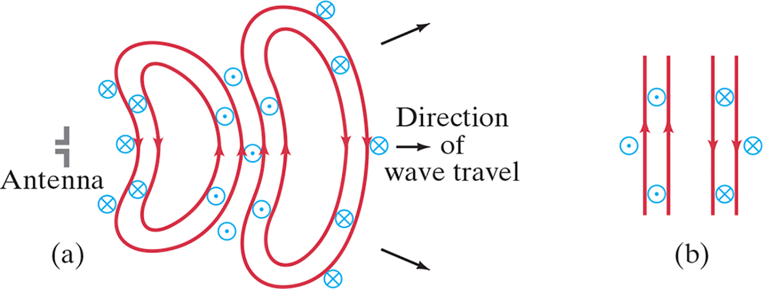
31-4 Production of Electromagnetic Waves (4 of 5)
Far from the source, the waves are plane waves:
Notes:
Figure 31-8. (a) The radiation fields (far from the antenna) produced by a sinusoidal signal on the antenna. The red closed loops represent electric field lines. The magnetic field lines, perpendicular to the page and represented by blue and , also form closed loops. (b) Very far from the antenna the wave fronts (field lines) are essentially flat over a fairly large area, and are referred to as plane waves.
LD: Part (“a”): The Antenna represented as mirror images of the letter L with its longer leg to the right are placed one above the other and are separated by a small distance. Two electric field lines are shown as kidney bean concentric loops with arrowheads pointing in the counterclockwise direction to the right of the antenna. Tiny blue circles with cross marks representing the magnetic field lines going in are shown around the left portion of the looped electric field lines that are close to the antenna. Tiny blue circles with a dot at their centers represent the magnetic field lines coming out and are shown around the right portion of the looped electric field lines that are away from the antenna. Two more electric field lines with a slightly higher magnitude are shown as kidney bean shaped concentric loops with arrowheads pointing in the clockwise direction to the right of the previous electric field lines. Tiny blue circles with a dot at their centers represent the magnetic field lines coming out and are shown around the left portion of the looped electric field lines that are close to the previous looped electric field lines. Tiny blue circles with cross marks representing the magnetic field lines going in are shown around the right portion of the looped electric field lines that are away from the previous looped electric field lines. Three arrows labeled Direction of wave travel are shown to the right of the second looped electric field lines. The first arrow points to the upper right, the second arrow points horizontally to the right, and the third arrow points to the lower right. Part (b): The looped electric field lines from part (“a”) are shown as straight lines in part (b). Two electric field lines shown on the left have arrowheads pointing upward. Tiny blue circles with a dot at their centers represent the magnetic field lines coming out and are shown around these electric field lines. Two more electric field lines shown on the right have arrowheads pointing downward. Tiny blue circles with cross marks representing the magnetic field lines going in are shown around these electric field lines.

Slide 15
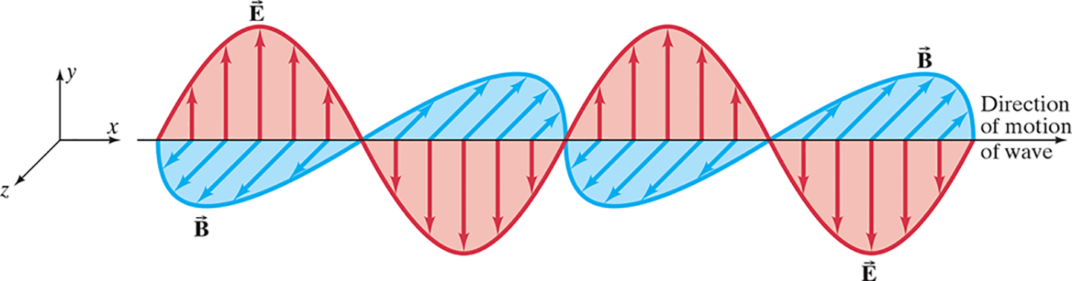
31-4 Production of Electromagnetic Waves (5 of 5)
The electric and magnetic waves are perpendicular to each other, and to the direction of propagation.
Notes:
Figure 31-9. Electric and magnetic field strengths in an electromagnetic wave. E and B are at right angles to each other. The entire pattern moves in a direction perpendicular to both E and B.
LD: A horizontal arrow labeled Direction of motion of wave points to the right, spans across the figure, and is along the horizontal x axis of the x y z plane, where the positive y axis points vertically upward. The electric field of the electromagnetic wave resembles a sine wave drawn on the x y plane. The wave is labeled vector E. It starts at the left end of the horizontal arrow and ends at the right end of the horizontal arrow. Two cycles of the wave are shown. The region between the wave and the horizontal arrow is shaded red. Multiple vertical electric field arrows are drawn from the horizontal arrow to the curve of the wave. The arrows are perpendicular to the x axis and are on the x y plane. The magnetic field of the electromagnetic wave also resembles a sine wave but is drawn on the x z plane. The wave is labeled vector B. It starts and ends at the at the same points as the wave for electric field. Two cycles of the wave are shown. The region between the wave and the horizontal arrow is shaded blue. Multiple vertical magnetic field arrows are drawn from the horizontal arrow to the curve of the wave. The arrows are perpendicular to the x axis and are on the x z plane. The wave for electric field and the wave for magnetic field are identical but perpendicular to each other. The two waves intercept the horizontal arrow at the same points.

Slide 16
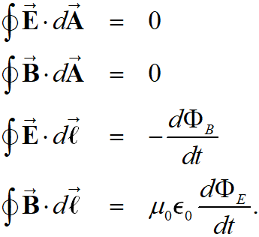
31-5 Electromagnetic Waves, and Their Speed, Derived from Maxwell’s Equations (1 of 7)
In the absence of currents and charges, Maxwell’s equations become:

Slide 17
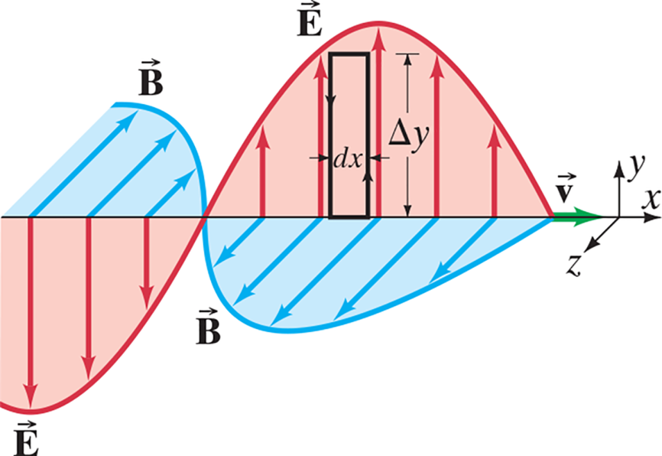


31-5 Electromagnetic Waves, and Their Speed, Derived from Maxwell’s Equations (2 of 7)
This figure shows an electromagnetic wave of
wavelength
and frequency f. The electric and
magnetic fields are given by
where
Notes:
Figure 31-10. Applying Faraday’s law to the rectangle (Δy)(dx).
LD A horizontal arrow spans across the figure along the horizontal x axis of the x y z plane, where the positive y axis points vertically upward. The waves resemble a sine wave. They are identical but perpendicular to each other and intercept the horizontal arrow at the same points. A portion of the waves for electric field and magnetic field is shown. The wave for electric field is labeled vector E, and the wave for magnetic field is labeled vector B. The wave for electric field is drawn along the x y plane, and the region between the wave and the horizontal arrow is shaded red. The wave for magnetic field is drawn along the x z plane, and the region between the wave and the horizontal arrow is shaded blue. Multiple vertical electric field arrows are drawn from the horizontal arrow to the curve of the wave for electric field. These arrows are perpendicular to the x axis and are on the x y plane. Similarly, multiple magnetic field arrows are drawn from the horizontal arrow to the curve of the wave for magnetic field. These arrows are perpendicular to the x axis and are on the x z plane. A rectangle is drawn on the wave for electric field on the x y plane such that its base lies on the horizontal arrow and its upper left corner is in contact with the curve of the wave. The height of the rectangle is delta y and its width is d x. A velocity vector arrow labeled vector v is drawn toward the right end of the horizontal arrow. It starts from the point where the two waves meet on the horizontal axis and extends to the right in the direction of the positive x axis.

Slide 18
31-5 Electromagnetic Waves, and Their Speed, Derived from Maxwell’s Equations (3 of 7)
Applying Faraday’s law to the rectangle of height
and width d x in the previous figure gives a relationship between E and B:

Slide 19
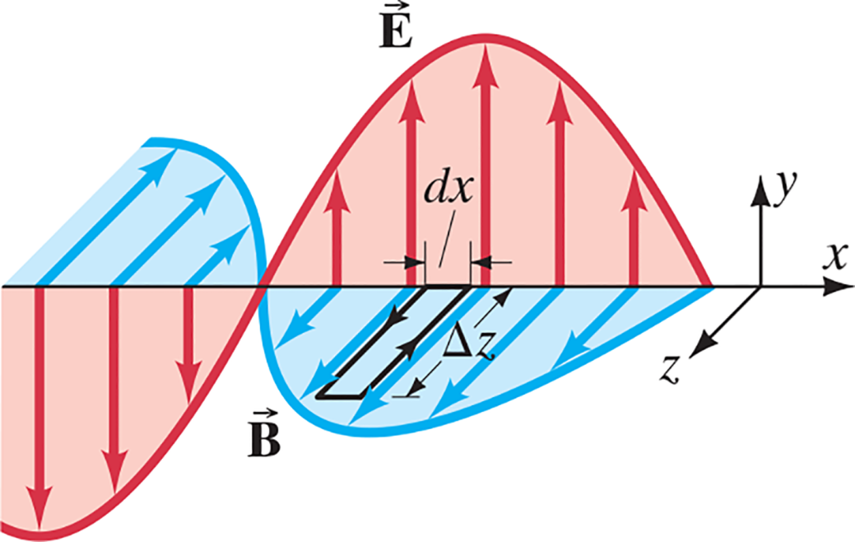

31-5 Electromagnetic Waves, and Their Speed, Derived from Maxwell’s Equations (4 of 7)
Similarly, we apply Maxwell’s fourth equation to the rectangle of length
and width d x, which gives
Notes:
Figure 31-11. Applying Maxwell’s fourth equation to the rectangle (Δz)(dx).
LD A horizontal arrow spans across the figure along the horizontal x axis of the x y z plane, where the positive y axis points vertically upward. The waves resemble a sine wave. They are identical but perpendicular to each other and intercept the horizontal arrow at the same points. A portion of the waves for electric field and magnetic field is shown. The wave for electric field is labeled vector E, and the wave for magnetic field is labeled vector B. The wave for electric field is drawn along the x y plane, and the region between the wave and the horizontal arrow is shaded red. The wave for magnetic field is drawn along the x z plane, and the region between the wave and the horizontal arrow is shaded blue. Multiple vertical electric field arrows are drawn from the horizontal arrow to the curve of the wave for electric field. These arrows are perpendicular to the x axis and are on the x y plane. Similarly, multiple magnetic field arrows are drawn from the horizontal arrow to the curve of the wave for magnetic field. These arrows are perpendicular to the x axis and are on the x z plane. A rectangle is drawn on the wave for magnetic field on the x z plane such that its base lies on the horizontal arrow and its upper left corner is in contact with the curve of the wave. The height of the rectangle is delta z and its width is d x.

Slide 20



31-5 Electromagnetic Waves, and Their Speed, Derived from Maxwell’s Equations (5 of 7)
Using these two equations and the equations for B and E as a function of time gives
Here,
is the velocity of the wave. Substituting,

Slide 21
31-5 Electromagnetic Waves, and Their Speed, Derived from Maxwell’s Equations (6 of 7)
The magnitude of this speed is
—precisely equal to the measured speed of light.

Slide 22
31-5 Electromagnetic Waves, and Their Speed, Derived from Maxwell’s Equations (7 of 7)
Example 31-2: Determining
and
in E M waves.
Assume a 60.0-Hz E M wave is a sinusoidal wave
propagating in the z direction with
pointing in the x
direction, and
Write vector expressions for
and
as functions of position and time.

Slide 23

31-6 Light as an Electromagnetic Wave and the Electromagnetic Spectrum (1 of 5)
The frequency of an electromagnetic wave is related to its wavelength and to the speed of light:

Slide 24
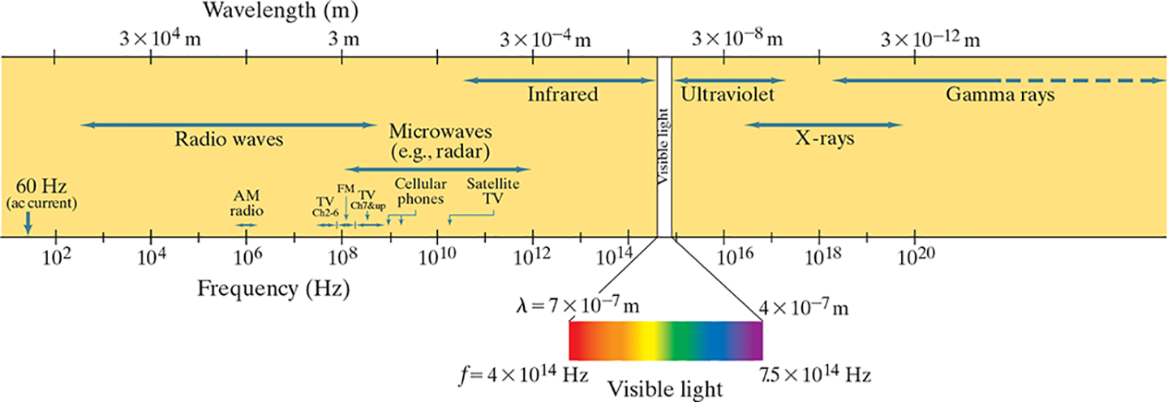
31-6 Light as an Electromagnetic Wave and the Electromagnetic Spectrum (2 of 5)
Electromagnetic waves can have any wavelength; we have given different names to different parts of the wavelength spectrum.
Notes:
Figure 31-12. Electromagnetic spectrum.
LD: The spectrum is shown on a horizontal strip. The wavelengths are marked on the top edge of the strip labeled Wavelength (m). The wavelength ranges from 3 multiplied by 10 raised to the power of 6 m to 3 multiplied by 10 raised to the power of negative 12 m in increments of 10 raised to the power of negative 2 m. The frequencies are marked on the bottom edge of the strip labeled Frequency (H z). The frequency ranges from 10 raised to the power of 2 Hz to 10 raised to the power of 20 H z in increments of 10 raised to the power of 1 H z . The wavelengths correspond to the frequencies as follows: 3 multiplied by 10 raised to the power of 6 m, 3 multiplied by 10 raised to the power of 4 m, 3 multiplied by 10 raised to the power of 2 m, 3 m, 3 multiplied by 10 raised to the power of negative 2 m, 3 multiplied by 10 raised to the power of negative 4 m, 3 multiplied by 10 raised to the power of negative 6 m, 3 multiplied by 10 raised to the power of negative 8 m, 3 multiplied by 10 raised to the power of negative 10 m, and 3 multiplied by 10 raised to the power of negative 12 m correspond to 10 raised to the power of 2 H z, 10 raised to the power of 4 H z, 10 raised to the power of 6 H z, 10 raised to the power of 8 H z, 10 raised to the power of 10 H z, 10 raised to the power of 12 H z, 10 raised to the power of 14 H z, 10 raised to the power of 16 H z, 10 raised to the power of 18 H z, and 10 raised to the power of 20 H z, respectively. An arrow labeled 60 H z (“a” c current) is shown on the left pointing at the frequency scale to the left of 10 raised to the power of 2 H z marking. A horizontal double-headed arrow labeled Radio waves is shown between 10 raised to the power of 2 H z and 10 raised to the power of 9 H z. A small horizontal double-headed arrow labeled “A” M radio is shown above , and on both sides of 10 raised to the power of 6 H z. A small horizontal double-headed arrow labeled T V Ch 2 to 6 is shown above and to the left of 10 raised to the power of 8 H z. A small horizontal double-headed arrow labeled F M is shown above 10 raised to the power of 8 H z from the end of T V Ch 2 to 6 to the right of 10 raised to the power of 8 H z. A small horizontal double-headed arrow labeled T V Ch 7 and up is shown to the right of F M. A horizontal double-headed arrow labeled Microwaves (e.g., radar) is shown between 10 raised to the power of 8 H z and 10 raised to the power of 12 H z. The frequency range close to 10 raised to the power of 9 H z is labeled Cellular phones. The frequency range slightly greater than 10 raised to the power of 10 H z is labeled Satellite TV. A horizontal double-headed arrow labeled Infrared is shown between 10 raised to the power of 10 H z and 4 multiplied by 10 raised to the power of 14 H z. A vertical strip labeled Visible light is shown to the left of between 4 multiplied by 10 raised to the power of 14 H z and 7.5 multiplied by 10 raised to the power of 14 H z. This strip is magnified below the horizontal strip and is shown as visible light spectrum with VIBGYOR, where red is on the left end and violet is on the right end of the spectrum. The left end of the spectrum near red is labeled lambda equals 7 multiplied by 10 raised to the power of negative 7 m and f equals 4 multiplied by 10 raised to the power of 14 H z. The right end of the spectrum near violet is labeled lambda equals 4 multiplied by 10 raised to the power of negative 7 m and f equals 7.5 multiplied by 10 raised to the power of 14 H z. A horizontal double-headed arrow labeled Ultraviolet is shown between 7.5 multiplied by 10 raised to the power of 14 H z and 10 raised to the power of 18 H z. A horizontal double-headed arrow labeled X-rays is shown between 10 raised to the power of 16 H z and 10 raised to the power of 19 H z. A horizontal double-headed arrow labeled Gamma rays starts from 10 raised to the power of 18 H z and extends as a dashed arrow beyond approximately 10 raised to the power of 22 H z.

Slide 25
31-6 Light as an Electromagnetic Wave and the Electromagnetic Spectrum (3 of 5)
Example 31-3: Wavelengths of E M waves.
Calculate the wavelength
(a) of a 60-Hz E M wave,
(b) of a 93.3-M H z F M radio wave, and
(c) of a beam of visible red light from a laser at
frequency

Slide 26
31-6 Light as an Electromagnetic Wave and the Electromagnetic Spectrum (4 of 5)
Example 31-4: Cell phone antenna.
The antenna of a cell phone is often
wavelength long.
A particular cell phone has an 8.5-c m-long straight rod for its antenna. Estimate the operating frequency of this phone.

Slide 27
31-6 Light as an Electromagnetic Wave and the Electromagnetic Spectrum (5 of 5)
Example 31-5: Phone call time lag.
You make a telephone call from New York to a friend in London. Estimate how long it will take the electrical signal generated by your voice to reach London, assuming the signal is (a) carried on a telephone cable under the Atlantic Ocean, and (b) sent via satellite 36,000 k m above the ocean. Would this cause a noticeable delay in either case?

Slide 28
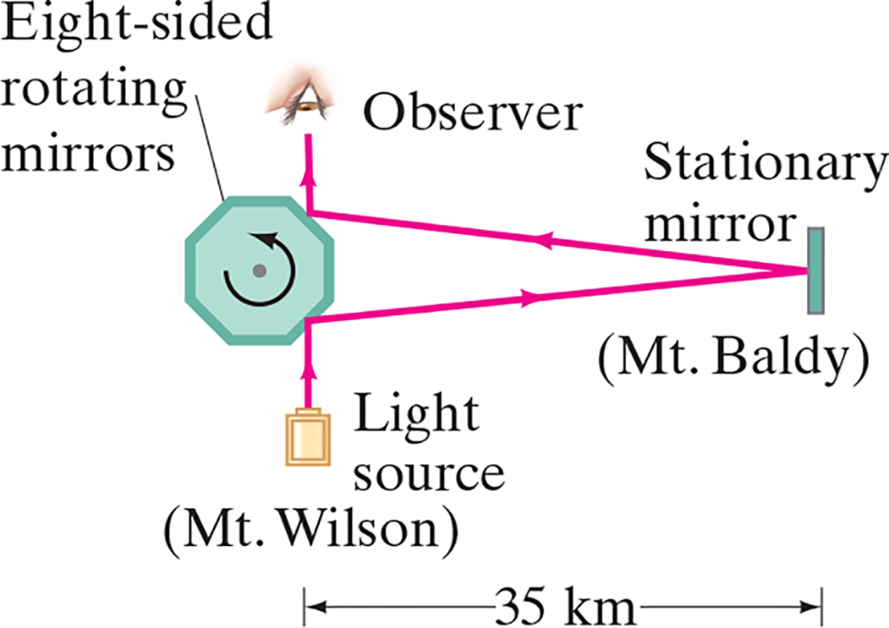
31-7 Measuring the Speed of Light (1 of 2)
The speed of light was known to be very large, although careful studies of the orbits of Jupiter’s moons showed that it is finite.
One important measurement, by Michelson, used a rotating mirror:
Notes:
Figure 31-14. Michelson’s speed-of-light apparatus (not to scale).
LD: An octagon labeled Eight-sided rotating mirrors is shown on the left. The mirror seems to be rotating in the counterclockwise direction. A small and thin rectangle labeled Stationary mirror (Mount Baldy) is shown vertically to the right of the octagon. A small rectangle labeled Light source (Mount Wilson) is below the octagon. An eye labeled Observer is shown above the octagon and is in line with the light source. A vertical ray of light from the source strikes the inclined edge to the right of the base of the octagon, gets deflected to the upper right, strikes the center of the stationary mirror, gets reflected to the upper left, strikes the inclined edge to the right of the upper edge of the octagon, gets deflected vertically upward, and meets the eye. The horizontal distance between the light source and the stationary mirror is 35 kilometers.

Slide 29
31-7 Measuring the Speed of Light (2 of 2)
Over the years, measurements have become more and more precise; now the speed of light is defined to be
This is then used to define the meter.

Slide 30


31-8 Energy in E M Waves; the Poynting Vector (1 of 5)
Energy is stored in both electric and magnetic fields, giving the total energy density of an electromagnetic wave:
Each field contributes half the total energy density:

Slide 31
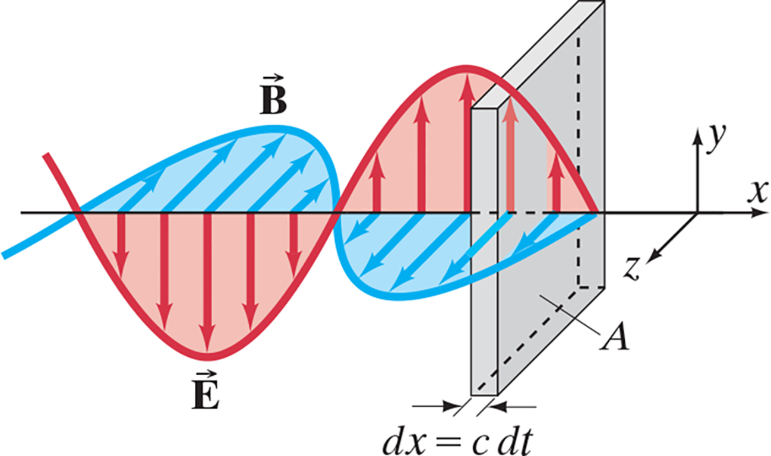
31-8 Energy in E M Waves; the Poynting Vector (2 of 5)
This energy is transported by the wave.
Notes:
Figure 31-15. Electromagnetic wave carrying energy through area A.
LD: A horizontal arrow spans across the figure along the horizontal x axis of the x y z plane, where the positive y axis points vertically upward. The waves resemble a sine wave. They are identical but perpendicular to each other and intercept the horizontal arrow at the same points. A portion of the waves for electric field and magnetic field is shown. The wave for electric field is labeled vector E, and the wave for magnetic field is labeled vector B. The wave for electric field is drawn along the x y plane, and the region between the wave and the horizontal arrow is shaded red. The wave for magnetic field is drawn along the x z plane, and the region between the wave and the horizontal arrow is shaded blue. Multiple vertical electric field arrows are drawn from the horizontal arrow to the curve of the wave for electric field. These arrows are perpendicular to the x axis and are on the x y plane. Similarly, multiple magnetic field arrows are drawn from the horizontal arrow to the curve of the wave for magnetic field. These arrows are perpendicular to the x axis and are on the x z plane. A vertically oriented rectangular plate having an area A and thickness d x equals c multiplied by d t is shown. The plate is aligned such that the horizontal arrow is perpendicular to the face of the plate and passes through the center of the plate.

Slide 32


31-8 Energy in E M Waves; the Poynting Vector (3 of 5)
The energy transported through a unit area per unit time is called the intensity:
Its vector form is the Poynting vector:

Slide 33



31-8 Energy in E M Waves; the Poynting Vector (4 of 5)
Typically, we are interested in the average value of

Slide 34
31-8 Energy in E M Waves; the Poynting Vector (5 of 5)
Example 31-6: E and B from the Sun.
Radiation from the Sun reaches the Earth (above the atmosphere) at a rate of about
Assume that this
is a single E M wave, and calculate the maximum values of E and B.

Slide 35
31-9 Radiation Pressure (1 of 3)
In addition to carrying energy, electromagnetic waves also carry momentum. This means that a force will be exerted by the wave.
The radiation pressure is related to the average intensity. It is a minimum if the wave is fully absorbed:
and a maximum if it is fully reflected:

Slide 36
Summary of Chapter 31 (1 of 3)
Maxwell’s equations are the basic equations of electromagnetism:

Slide 37
Summary of Chapter 31 (2 of 3)
Electromagnetic waves are produced by accelerating charges; the propagation speed is given by
The fields are perpendicular to each other and to the direction of propagation.

Slide 38

Summary of Chapter 31 (3 of 3)
The wavelength and frequency of E M waves are related:
The electromagnetic spectrum includes all wavelengths, from radio waves through visible light to gamma rays.
The Poynting vector describes the energy carried by E M waves:

Slide 39

Copyright
This work is protected by United States copyright laws and is provided solely for the use of instructors in teaching their courses and assessing student learning. Dissemination or sale of any part of this work (including on the World Wide Web) will destroy the integrity of the work and is not permitted. The work and materials from it should never be made available to students except by instructors using the accompanying text in their classes. All recipients of this work are expected to abide by these restrictions and to honor the intended pedagogical purposes and the needs of other instructors who rely on these materials.

