Slide 1
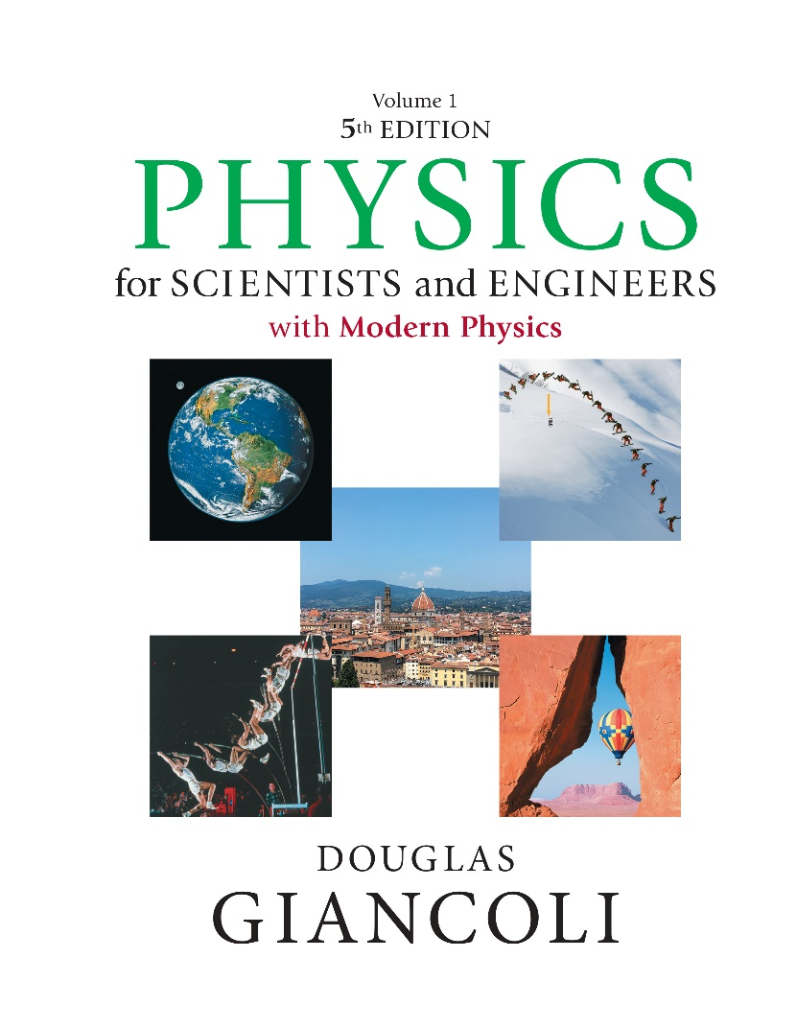

Physics for Scientists and Engineers with Modern Physics
Fifth Edition
Chapter 32
Light: Reflection and Refraction
Copyright © 2023 Pearson Education, Inc. All Rights Reserved
Notes:
If this PowerPoint presentation contains mathematical equations, you may need to check that your computer has the following installed:
1) MathType Plugin
2) Math Player (free versions available)
3) NVDA Reader (free versions available)

Slide 2
Units of Chapter 32 (1 of 2)
The Ray Model of Light
Reflection; Image Formation by a Plane Mirror
Formation of Images by Spherical Mirrors
Seeing Yourself in a Magnifying Mirror (Concave)
Convex (Rearview) Mirrors

Slide 3
Units of Chapter 32 (2 of 2)
Index of Refraction
Refraction: Snell’s Law
Visible Spectrum and Dispersion
Total Internal Reflection; Fiber Optics
Refraction at a Spherical Surface

Slide 4
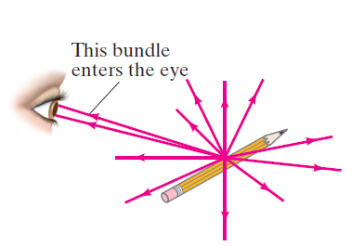
32-1 The Ray Model of Light
Light very often travels in straight lines. We represent light using rays, which are straight lines emanating from an object. This is an idealization, but is very useful for geometric optics.
Notes:
Figure 32-1. Light rays come from each single point on an object. A small bundle of rays leaving one point is shown entering a person’s eye. This is a fundamental diagram. It will help us understand how we see images made by mirrors and lenses. Rays entering the eye are diverging. Our eyes would be useless if they could not focus diverging rays!
LD: A human eye is at the left side of the figure and the pencil is at the right side. The light rays are shown propagating outward radially from a point at the center of the pencil.Two light rays from this point propagate upward to the left to meet the eye. The two light rays are labeled This bundle enters the eye.

Slide 5

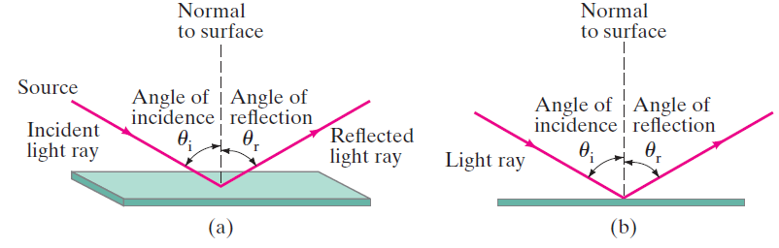
32-2 Reflection; Image Formation by a Plane Mirror (1 of 8)
Law of reflection: the angle of reflection (that the ray makes with the normal to a surface) equals the angle of
incidence,
Notes:
Figure 32-2. Law of reflection: (a) shows a 3-D view of an incident ray being reflected at the top of a flat surface; (b) shows a side or “end-on” view, which we will usually use because of its clarity.
LD: Part (“a”): A light ray from a point labeled Source propagates toward the lower right and is incident on a flat rectangular surface at an angle theta subscript i with the normal to the surface. Theta subscript i is labeled Angle of incidence. The light ray is labeled Incident light Ray. The light ray gets reflected upward to the right at an angle theta subscript r with the normal to the surface. Theta subscript r is labeled Angle of reflection. The reflected ray is labeled Reflected light ray. The normal line to the surface is depicted as a dashed vertical line labeled Normal to surface. Part (b): A side view of the rectangular flat surface is shown as a rectangle with a smaller width. A light ray labeled Light ray propagates toward the lower right and is incident at the center of the surface at an angle theta subscript i with the normal to the surface. Theta subscript i is labeled Angle of incidence. The light ray gets reflected upward to the right at an angle theta subscript r with the normal to the surface. Theta subscript r is labeled Angle of reflection. The normal line to the surface is depicted as a dashed vertical line labeled Normal to surface.

Slide 6
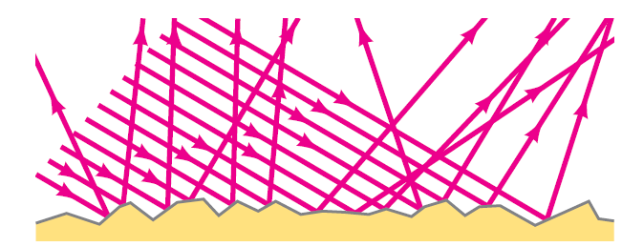
32-2 Reflection; Image Formation by a Plane Mirror (2 of 8)
When light reflects from a rough surface, the law of reflection still holds, but the angle of incidence varies. This is called diffuse reflection.
Notes:
Figure 32-3. Diffuse reflection from a rough surface.
LD: Multiple parallel light rays are incident upon an irregular surface. The light rays are reflected in different directions and some intersect each other.

Slide 7
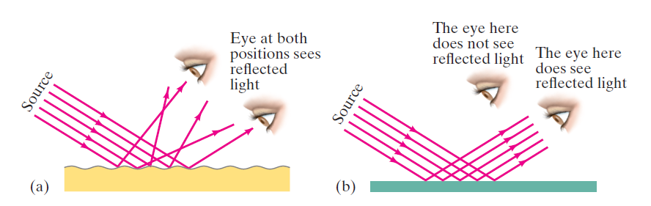
32-2 Reflection; Image Formation by a Plane Mirror (3 of 8)
With diffuse reflection, your eye sees reflected light at all angles. With specular reflection (from a mirror), your eye must be in the correct position.
Notes:
Figure 32-4. A narrow beam of light shines on (a) white paper, and (b) a mirror. In part (a), you can see with your eye the white light reflected at various positions because of diffuse reflection. But in part (b), you see the reflected light only when your eye is placed correctly (θr = θi). Mirror reflection is also known as specular reflection. (Galileo, using similar arguments, showed that the Moon must have a rough surface rather than a highly polished surface like a mirror, as some people thought.)
LD: Part (‘a”): Five parallel light rays labeled Source are incident on an irregular surface from the top left of the figure. The light rays are reflected in different directions toward the upper right to meet two eyes at different positions. Note: The eye at both positions sees reflected light. Part (b): Five parallel light rays labeled Source are incident on a plane mirror placed horizontally from the top left of the figure. The light rays are reflected toward the upper right to meet an eye. Another eye is placed to upper left of the first eye. Note 1: The eye here does see reflected light is written above the first eye. Note 2: The eye here does not see reflected light is written above the second eye.

Slide 8
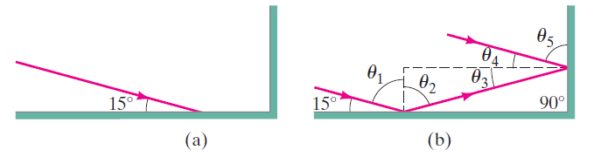
32-2 Reflection; Image Formation by a Plane Mirror (4 of 8)
Example 32-1: Reflection from flat mirrors.
Two flat mirrors are perpendicular to each other. An
incoming beam of light makes an angle of
with the first mirror as shown. What angle will the outgoing beam make with the second mirror?
Notes:
Figure 32-5. Example 32-1.
LD: Part (“a”): A horizontal mirror connected to a vertical mirror on the right end is shown. A light ray is incident on the horizontal mirror at an angle of 15 degrees to the horizontal. Part (b): A horizontal mirror connected to a vertical mirror on the right end is shown. A light ray is incident on the horizontal mirror and makes an angle of 15 degrees with the horizontal mirror. The incident ray makes an angle theta subscript 1 to the normal of the horizontal mirror. The light ray gets reflected upward to the right at an angle theta subscript 2 to the normal of the horizontal mirrorto meet the vertical mirror at an angle theta subscript 3 to the normal of the vertical mirror. The light ray then gets reflected upward to the left at an angle theta subscript 4 to the normal of the vertical mirror. The final reflected ray is parallel to the incident ray and makes an angle theta subscript 5 with the vertical mirror

Slide 9
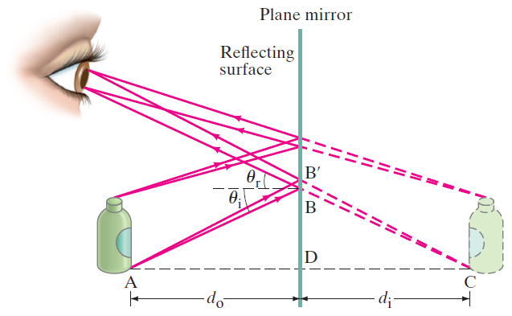
32-2 Reflection; Image Formation by a Plane Mirror (5 of 8)
What you see when you look into a plane (flat) mirror is an image, which appears to be behind the mirror.
Notes:
Figure 32-7. Formation of a virtual image by a plane (flat) mirror. Only the bundle of rays from the top and bottom of the object which reach the eye is shown. (We will usually show images using dashed lines or paler colours.)
LD: A human eye is shown on the left side of the figure and faces a plane mirror on the right. The mirror is shown as a vertical line. The reflecting surface of the mirror faces the eye. A bottle is placed below the eye. The reflection of the bottle is shown on the right side of the mirror as a bottle with dashed lines. Two light rays from the top of the bottle falls on the mirror and is reflected back to a point at the top and bottom of the pupil of the eye. The reflected light rays are extended backward using dashed lines to meet the top of the reflection of the bottle. Two light rays from a point labeled “A” at the bottom of the bottle falls on the mirror at points B and B prime, and is reflected back to the same point at the top and bottom of the pupil of the eye. Point B prime is at the top and point B is below it. A horizontal dashed line is drawn from point B toward the left. The angle between the incident ray “A” B and the horizontal dashed line is labeled theta subscript i. The angle between the reflected ray of “A” B and the horizontal dashed line is labeled theta subscript r. The reflected light rays of “A” B and “A” B prime are extended backward using dashed lines to meet the bottom of the reflection of the bottle at point C. A horizontal dashed line extends from “A” to C and passes through a point D on the mirror. The distance from “A” to D is labeled d subscript o, marked with a double headed arrow. The distance from D to C is labeled d subscript i, marked with a double headed arrow.

Slide 10
32-2 Reflection; Image Formation by a Plane Mirror (6 of 8)
This is called a virtual image, as the light does not go through it. The distance of the image from the mirror is
equal to the distance of the object from the mirror,

Slide 11
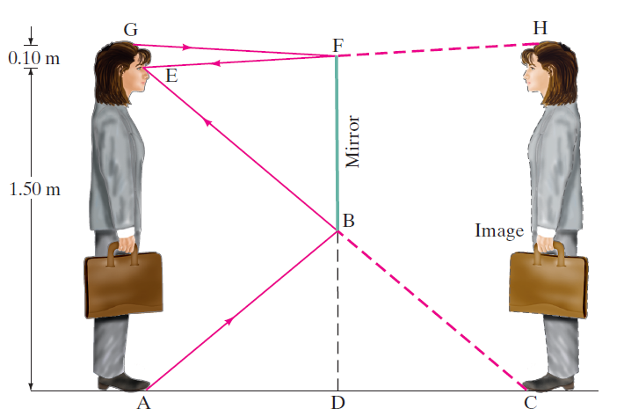
32-2 Reflection; Image Formation by a Plane Mirror (7 of 8)
Example 32-2: How tall must a full-length mirror be?
A woman 1.60 m tall stands in front of a vertical plane mirror. What is the minimum height of the mirror, and how high must its lower edge be above the floor, if she is to be able to see her whole body? Assume her eyes are 10 c m below the top of her head.
Notes:
Figure 32-8. Seeing oneself in a mirror. Example 32-2.
LD: The woman holding a briefcase is shown on the left of the figure, facing toward the right. A vertical line labeled Mirror represents the mirror and is placed to the right of the woman. The reflection of the woman holding the briefcase, which is facing toward the left, is shown on the right side of the mirror. The woman and her reflection face each other. The height of the woman’s eyes from the ground is 1.5 m, marked with a double headed arrow. The distance of the woman’s eyes from the top of her head is 0.1 m, marked with a double headed arrow. A point labeled G is marked on the woman’s head. A point labeled E is marked on the woman’s eyes. A point labeled “A” is marked on the ground near the woman’s feet. The mirror starts at a point labeled F, at approximately the eye level of the woman and ends at a point labeled B above the ground. A dashed line from point B ends to a point labeled D on the ground. A light ray from point G meets the mirror at F and reflects back toward the woman at point E. The ray FE is extended to the right using dashed lines to meet the head of the reflection of the woman at point H. A light ray from point “A” meets the mirror at B and reflects back toward the woman at point E. The ray BE is extended to the right using dashed lines to meet the feet of the reflection of the woman at point C.

Slide 12

32-2 Reflection; Image Formation by a Plane Mirror (8 of 8)
Conceptual Example 32-3: Is the photo upside down?
Close examination of the photograph on the first page of this chapter, page 926, reveals that in the top portion the Sun is seen clearly, whereas in the lower portion the Sun is partially blocked by the tree branches. Show why the reflection is not the same as the real scene by drawing a sketch of this situation, showing the Sun, the camera, the branch, and two rays going from the Sun to the camera, one ray direct and one reflected. Is the photograph right side up?

Slide 13
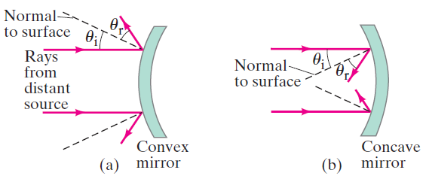
32-3 Formation of Images by Spherical Mirrors (1 of 13)
Spherical mirrors are shaped like sections of a sphere, and may be reflective on either the inside (concave) or outside (convex).
Notes:
Figure 32-10. Mirrors with convex and concave spherical surfaces. Note that theta r = theta i for each ray. (The black dashed lines are perpendicular to the mirror surface at each point shown).
LD: Part (a): Two horizontal light rays labeled Rays from distant source emerge from the left of the figure till the mirror on the right, which is labeled Convex mirror. Then the top and bottom light rays get reflected toward the upper left and lower left, respectively, such that the reflected rays appear to diverge. The incident light ray makes an angle theta subscript i with the normal to the mirror. The reflected light ray makes an angle theta subscript r with the normal to the mirror. The normal lines at the points of deflection of the light rays are depicted as dashed lines and are labeled Normal to surface. Theta subscript i is greater than theta subscript r. Part (b): Two horizontal light rays emerge from the left of the figure till the mirror on the right, which is labeled Concave mirror. Then the top and bottom light rays get reflected toward the lower left and upper left, respectively, such that the reflected rays appear to converge. The incident light ray makes an angle theta subscript i with the normal to the mirror. The reflected light ray makes an angle theta subscript r with the normal to the mirror. The normal lines at the points of deflection of the light rays are depicted as dashed lines and are labeled Normal to surface. Theta subscript i is greater than theta subscript r.

Slide 14
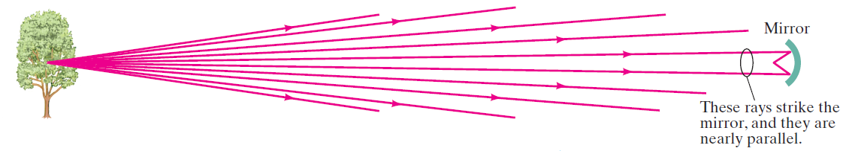
32-3 Formation of Images by Spherical Mirrors (2 of 13)
Rays coming from a faraway object are effectively parallel.
Notes:
Figure 32-12. If the object’s distance is large compared to the size of the mirror (or lens), the rays arrive nearly parallel. They are parallel for an object at infinity (∞).
LD: The tree is shown on the far left of the concave mirror. The concave mirror is labeled Mirror. Ten light rays emerge from a point on the tree. The first, second, third, and fourth rays propagate toward the upper right. The fifth and sixth rays propagate horizontally, strikes the mirror, and gets reflected toward the lower left and upper left, respectively. The reflected rays intercept with each other. The fifth and sixth light rays are together labeled These rays strike the mirror, and they are nearly parallel. The seventh, eighth, ninth and tenth rays propagate toward the lower right.

Slide 15
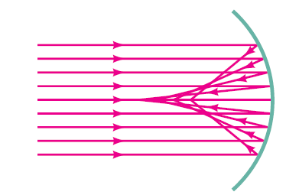
32-3 Formation of Images by Spherical Mirrors (3 of 13)
Parallel rays striking a spherical mirror do not all converge at exactly the same place if the curvature of the mirror is large; this is called spherical aberration.
Notes:
Figure 32-13. Parallel rays striking a concave spherical mirror do not intersect (or focus) at precisely a single point. (This “defect” is referred to as “spherical aberration.”)
LD: Nine horizontal light rays emerge from the left of the figure and strike the concave mirror on the right. The first, second, third, and fourth rays get reflected toward the lower right and the sixth, seventh, eighth, and ninth rays get reflected toward the upper right, such that the reflected rays converge at different points on the fifth ray.

Slide 16
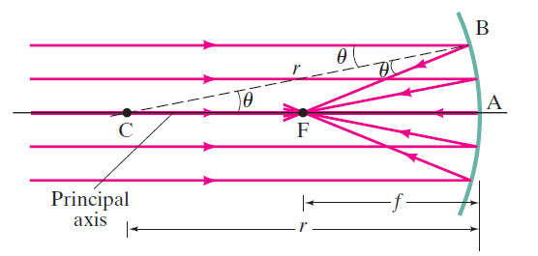
32-3 Formation of Images by Spherical Mirrors (4 of 13)
If the curvature is small, the focus is much more precise; the focal point is where the rays converge.
Notes:
Figure 32-14. Rays parallel to the principal axis of a concave spherical mirror come to a focus at F, the focal point, as long as the mirror is small in width as compared to its radius of curvature, r, so that the rays are “paraxial”
—that is, make only small angles with the horizontal axis. The smaller the angles, the better the approximation.
LD: A horizontal line labeled Principal axis is drawn across the center of the concave mirror, which is placed at the right side of the figure. The intersection point of the line and the concave mirror is labeled “A”. A point labeled F is marked on the horizontal line to the left of the concave mirror. A point labeled C is marked on the horizontal line to the left of F, such that the distance from C to “A” is twice the distance from F to “A”. A double-headed arrow labeled f indicates the distance between F and “A”. A double-headed arrow labeled r indicates the distance between C and “A”. A dashed line labeled r extends to the upper right from C to a point labeled B on the concave mirror and makes an angle labeled theta with the principal axis. Five light rays parallel to the principal axis are incident on the concave mirror. The first and second light rays strike the mirror at points above the principal axis. The first light ray strikes the mirror at point B and makes an angle labeled theta with the dashed line B C. Then the light ray gets reflected toward the lower left and intersects the principal axis at F making an angle theta with the line BF. The second light ray strikes the mirror at a point below B, gets reflected toward the lower left, and intersects the principal axis at F. The third light ray propagates along the principal axis, strikes the mirror at “A”, gets reflected such that it retraces it path along the principal axis. The fourth and fifth light rays strike the mirror at points below the principal axis. The fourth and fifth light rays strike the mirror, gets reflected toward the upper left, and intersects the principal axis at F.

Slide 17
32-3 Formation of Images by Spherical Mirrors (5 of 13)
Using geometry, we find that the focal length is half the radius of curvature:
Spherical aberration can be avoided by using a parabolic reflector; these are more difficult and expensive to make, and so are used only when necessary, such as in research telescopes.

Slide 18
32-3 Formation of Images by Spherical Mirrors (6 of 13)
We use ray diagrams to determine where an image will be. For mirrors, we use three key rays, all of which begin on the object:
A ray parallel to the axis; after reflection it passes through the focal point.
A ray through the focal point; after reflection it is parallel to the axis.
A ray perpendicular to the mirror; it reflects back on itself.

Slide 19
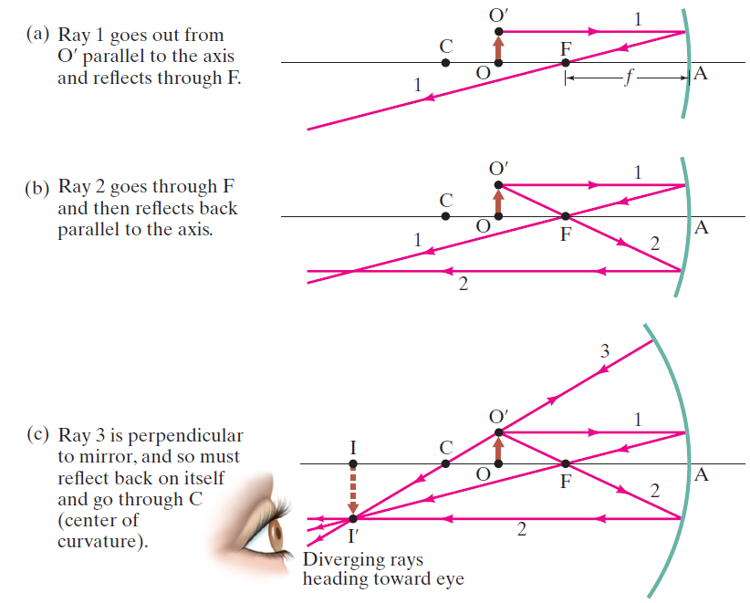
32-3 Formation of Images by Spherical Mirrors (7 of 13)
Notes:
Figure 32-15. Rays leave point O’ on the object (a brown arrow). Shown are the three most useful rays for determining where the image I is formed. The image is shown as a dashed brown arrow. [Note that our mirror is not small compared to f , so the rays shown are not actually paraxial and our diagram will not give the precise position of the image.]
LD: A horizontal line is drawn across the center of the concave mirror, which is placed at the right. The intersection point of the line and the concave mirror is labeled “A”. An upward arrow depicts an object placed at a point labeled O on the horizontal line to the left of the concave mirror. A point labeled O prime is placed at the tip of the object arrow. A point labeled C is marked on the horizontal line to the left of the object arrow. A point labeled F is marked on the horizontal line to the right of the object arrow. Part (“a”), Ray 1 goes out from O prime parallel to the axis and reflects through F: A double-headed arrow labeled f indicates the distance from F to “A”. A horizontal light ray labeled 1 propagates from O prime till the concave mirror. Then the light ray gets reflected toward the lower left intersecting the horizontal line at F. Part (b), Ray 2 goes through F and then reflects back parallel to the axis: A horizontal light ray labeled 1 propagates from O prime till the concave mirror. Then the light ray gets reflected toward the lower left intersecting the horizontal line at F. A light ray labeled 2 propagates from O prime toward the lower right, passes through F, and is incident at a point on the concave mirror below the horizontal line. Then the light ray gets reflected toward the left in a horizontal path. Part (c), Ray 3 is perpendicular to mirror, and so must reflect back on itself and go through C (center of curvature): A point labeled I is marked on the horizontal line to the left of C. A human eye that faces toward the right is placed at the lower left of the horizontal line. A horizontal light ray labeled 1 propagates from O prime till the concave mirror. Then the light ray gets reflected toward the lower left intersecting the horizontal line at F. A light ray labeled 2 propagates from O prime toward the lower right, passes through F, and moves toward a point on the concave mirror below the horizontal line. Then the light ray gets reflected toward the left in a horizontal path. A light ray labeled 3 propagates from O prime toward the upper right till the concave mirror. The light ray gets reflected, retraces its path, and passes through C. The three reflected rays of 1, 2, and 3 converge at a point labeled I prime, which is vertically below point I. The three reflected rays diverge to meet the eye. A real image arrow points from I to I prime and is longer than the object arrow. Note: Diverging rays heading toward eye is written below I prime.

Slide 20
32-3 Formation of Images by Spherical Mirrors (8 of 13)
The intersection of these three rays gives the position of the image of that point on the object. To get a full image, we can do the same with other points (two points suffice for many purposes).

Slide 21
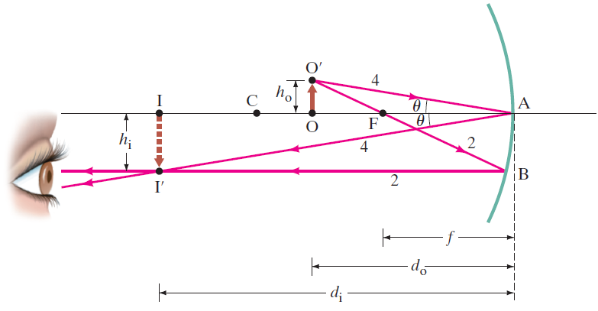
32-3 Formation of Images by Spherical Mirrors (9 of 13)
Geometrically, we can derive an equation that relates the object distance, image distance, and focal length of the mirror:
Notes:
Figure 32-16. Diagram for deriving the mirror equation. For the derivation, we assume the mirror size is small compared to its radius of curvature.
LD: A horizontal line is drawn across the center of the concave mirror, which is placed at the right side of the figure. The intersection point of the line and the concave mirror is labeled “A”. A human eye that faces to the right is placed at the lower left of the horizontal line. An upward arrow depicts an object placed at a point labeled O on the horizontal line to the left of the concave mirror. A point labeled O prime is placed at the tip of the object arrow. A double-headed arrow labeled h subscript o indicates the height of the object O O prime. A point labeled C is marked on the horizontal line to the left of the object arrow. A point labeled F is marked on the horizontal line to the right of the object arrow. A point labeled I is marked on the horizontal line to the left of C. A double-headed arrow labeled f indicates the distance between F and “A”. A double-headed arrow labeled d subscript o indicates the distance between O and “A”. A light ray labeled 2 propagates from O prime toward the lower right, passes through F, and is incident at a point labeled B on the concave mirror below the horizontal line. Then the light ray gets reflected toward the left in a horizontal path. Another light ray labeled 4 propagates from O prime toward the lower right and is incident at point “A” at an angle theta with the horizontal line. Then the light ray gets reflected toward the lower left at an angle theta with the horizontal line. The reflected rays of 2 and 4 converge at a point labeled I prime, which is placed vertically below point I. The two reflected rays diverge to meet the eye. A real image arrow points from I to I prime and is longer than the object arrow. A double-headed arrow labeled h subscript i indicates the height of the image I I prime. A double-headed arrow labeled d subscript i indicates the distance between I and “A”.

Slide 22
32-3 Formation of Images by Spherical Mirrors (10 of 13)
We can also find the magnification (ratio of image height to object height):
The negative sign indicates that the image is inverted. This object is between the center of curvature and the focal point, and its image is larger, inverted, and real.

Slide 23
32-3 Formation of Images by Spherical Mirrors (11 of 13)
Example 32-4: Image in a concave mirror.
A 1.50-c m-high object is placed 20.0 c m from a concave mirror with radius of curvature 30.0 c m. Determine (a) the position of the image, and (b) its size.

Slide 24
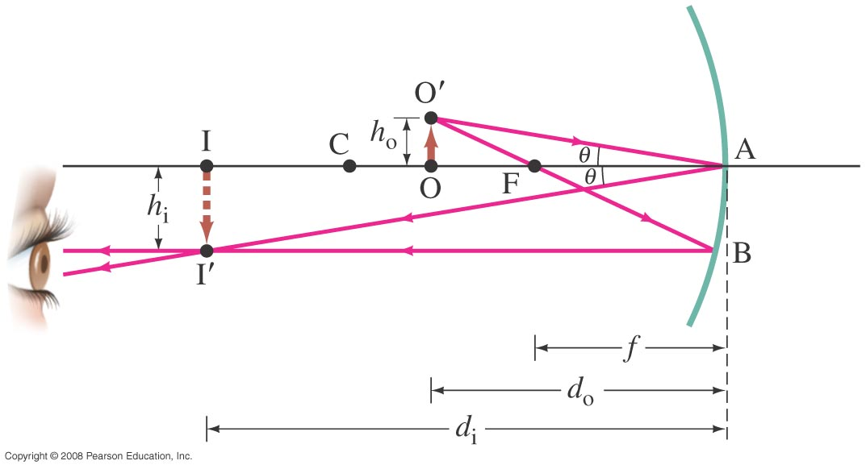
32-3 Formation of Images by Spherical Mirrors (12 of 13)
Conceptual Example 32-5: Reversible rays.
If the object in this figure is placed where the image is, where will the new image be?
Notes:
LD: A horizontal line is drawn across the center of the concave mirror, which is placed at the right side of the figure. The intersection point of the line and the concave mirror is labeled “A”. A human eye that faces to the right is placed at the lower left of the horizontal line. An upward arrow depicts an object placed at a point labeled O on the horizontal line to the left of the concave mirror. A point labeled O prime is placed at the tip of the object arrow. A double-headed arrow labeled h subscript o indicates the height of the object O O prime. A point labeled C is marked on the horizontal line to the left of the object arrow. A point labeled F is marked on the horizontal line to the right of the object arrow. A point labeled I is marked on the horizontal line to the left of C. A double-headed arrow labeled f indicates the distance between F and “A”. A double-headed arrow labeled d subscript o indicates the distance between O and “A”. A light ray labeled 2 propagates from O prime toward the lower right, passes through F, and is incident at a point labeled B on the concave mirror below the horizontal line. Then the light ray gets reflected toward the left in a horizontal path. Another light ray labeled 4 propagates from O prime toward the lower right and is incident at point “A” at an angle theta with the horizontal line. Then the light ray gets reflected toward the lower left at an angle theta with the horizontal line. The reflected rays of 2 and 4 converge at a point labeled I prime, which is placed vertically below point I. The two reflected rays diverge to meet the eye. A real image arrow points from I to I prime and is longer than the object arrow. A double-headed arrow labeled h subscript i indicates the height of the image I I prime. A double-headed arrow labeled d subscript i indicates the distance between I and “A”.

Slide 25
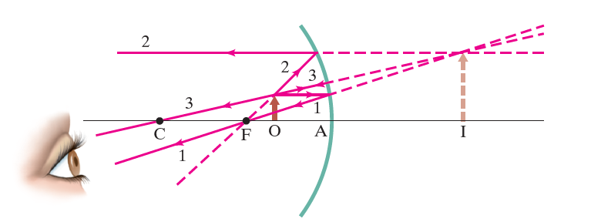
32-3 Formation of Images by Spherical Mirrors (13 of 13)
Example 32-6: Object closer to concave mirror than focal point.
A 1.00-c m-high object is placed 10.0 c m from a concave mirror whose radius of curvature is 30.0 c m. (a) Draw a ray diagram to locate (approximately) the position of the image. (b) Determine the position of the image and the lateral magnification analytically.
Notes:
Figure 32-17. Object placed within the focal point F. The image (dashed arrow) is behind the mirror and is virtual, Example 32 9 6. [Note that the vertical scale (height of object = 1.0 cm) is different from the horizontal (OA = 10.0 cm) for ease of drawing, and reduces the precision of the drawing.]
LD: A horizontal line is drawn across the center of the concave mirror, which is placed at the right side of the figure. The intersection point of the line and the concave mirror is labeled “A”. A human eye that faces to the right is placed at the lower left of the horizontal line. An upward arrow depicts an object placed at a point labeled O on the horizontal line to the left of the concave mirror. A point labeled C is marked on the horizontal line to the left of the object arrow. A point labeled F is marked on the horizontal line to the right of the object arrow. A horizontal light ray labeled 1 propagates from the tip of the object arrow till a point on the concave mirror. Then the light ray gets reflected toward the lower left and intersects the horizontal line at F. A light ray labeled 2 propagates from the tip of the object arrow toward the upper right till a point on the concave mirror. Then the light ray gets reflected toward the left in a horizontal path. A light ray labeled 3 propagates toward the upper right from the tip of the object arrow till a point on the concave mirror, which is below the point of incidence of ray 2. The light ray gets reflected, retraces its path, and passes through C. The reflected rays of 1 and 3 propagate toward the eye. Dashed lines extend backward from each of the reflected rays to converge at a point on the upper right of the concave mirror. A virtual image arrow extends upward to the point of convergence of the reflected light rays from a point labeled I on the horizontal line to the right of the concave mirror.

Slide 26
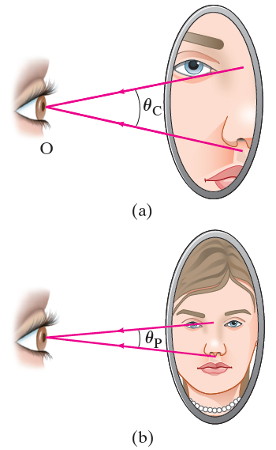
32-4 Seeing Yourself in a Magnifying Mirror (Concave)
A concave mirror’s magnifying ability is expressed through the angular magnification.
Notes:
Figure 32-18. Looking at your face (a) in a magnifying mirror, and (b) in a plane flat mirror. The eye on the left is yours (object O), looking at your image in the mirror.
LD: Part (“a”): A human eye labeled O is shown on the left of the figure. The eye faces an oval mirror on the right. The mirror shows a magnified reflection of one half of a face. Two light rays extend from above and below the nose, respectively, to meet at the center of the pupil of the eye on the left. The angle between the two light rays is labeled theta subscript C. Part (b): A human eye labeled O is shown on the left of the figure. The eye faces an oval mirror on the right. The mirror shows the reflection of a face. Two light rays extend from above and below the nose, respectively, to meet at the center of the pupil of the eye on the left. The angle between the two light rays is labeled theta subscript P. The angle theta subscript P is smaller than theta subscript C.

Slide 27
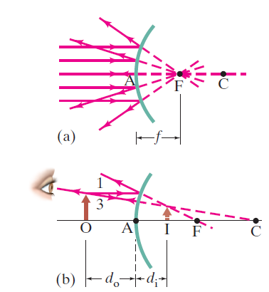
32-5 Convex (Rearview) Mirrors (1 of 2)
For a convex mirror, the image is always virtual, upright, and smaller.
Notes:
Figure 32-19. Convex mirror: (a) the focal point is at F, behind the mirror; (b) the image I of the object at O is virtual, upright, and smaller than the object. [Not to scale for Example 32-7.]
LD: Part (“a”): A horizontal dashed line is drawn across the center of the convex mirror. The intersection point of the line and the convex mirror is labeled “A”. Five horizontal light rays emerge from the left of the figure till the convex mirror and then get reflected in different directions. Dashed lines extend backward from all the reflected rays to intersect at a point labeled F on the horizontal dashed line. A point C is marked on the right of F. A double-headed arrow labeled f indicates the distance between F and “A”. Part (b): A horizontal dashed line is drawn across the center of the convex mirror. The intersection point of the line and the convex mirror is labeled “A”. An upward arrow depicts an object placed at a point labeled O on the horizontal line to the left of the mirror. A double-headed arrow labeled d subscript o indicates the distance between O and “A”. A point labeled F is marked on the horizontal line to the right of the mirror. Another point labeled C is marked on the horizontal line to the right of F. A horizontal light ray labeled 1 emerges from the tip of the object arrow, propagates slightly toward the right, and strikes the convex mirror. Then the light ray gets reflected toward the upper left. A light ray labeled 3 emerges from the tip of the object arrow, propagates toward the lower right, and strikes the convex mirror. Then the light ray gets reflected, retraces its own path, to meet the eye of an observer, which is placed to the left of the object arrow. The reflected light rays are extended backward using dashed lines, such that the reflected rays intersect at a point and continue to propagate in their respective directions. A virtual image arrow extends to the point of intersection of the extended reflected rays from a point labeled I on the horizontal line. The virtual image arrow is smaller than the object arrow. The extended reflected ray of ray 1 and ray 3 intersect the horizontal line at F and C, respectively. A double-headed arrow labeled d subscript i indicates the distance between I and “A”.

Slide 28

32-5 Convex (Rearview) Mirrors (2 of 2)
Example 32-7: Convex rearview mirror.
An external rearview car mirror is convex with a radius of curvature of 0.80 m. Determine the location of the image and its lateral magnification for a truck 10.0 m from the mirror.
Notes:
Figure 32-20. Example 32-7.

Slide 29
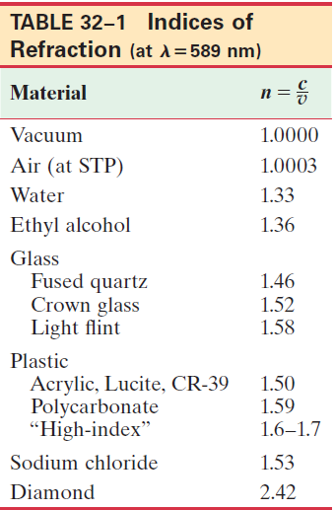

32-6 Index of Refraction
In general, light slows somewhat when traveling through a medium. The index of refraction of the medium is the ratio of the speed of light in vacuum to the speed of light in the medium:
Notes:
LD: The table consists of 2 columns and 14 rows. The headings of the columns, from left to right, are as follows: Material and n equals c divided by v. The row entries are as follows. First row: Material column, Vacuum. n equals c divided by v column, 1.0000. Next row: Material column, Air (at STP). n equals c divided by v column, 1.0003. Next row: Material column, Water. n equals c divided by v column, 1.33. Next row: Material column, Ethyl alcohol. n equals c divided by v column, 1.36. Next row: Material column, Glass. Next row: Material column, Fused quartz. n equals c divided by v column, 1.46. Next row: Material column, Crown glass. n equals c divided by v column, 1.52. Next row: Material column, Light flint. n equals c divided by v column, 1.58. Next row: Material column, Plastic. Next row: Material column, Acrylic, Lucite, CR-39, n equals c divided by v column, 1.50. Next row: Material column, Next row: Polycarbonate, n equals c divided by v column, 1.59. Next row: Material column, “High-index”, n equals c divided by v column, 1.6 to 1.7. Next row: Material column, Sodium chloride. n equals c divided by v column, 1.53. Last row: Material column, Diamond. n equals c divided by v column, 2.42. Note: lambda equals 589 n m.

Slide 30
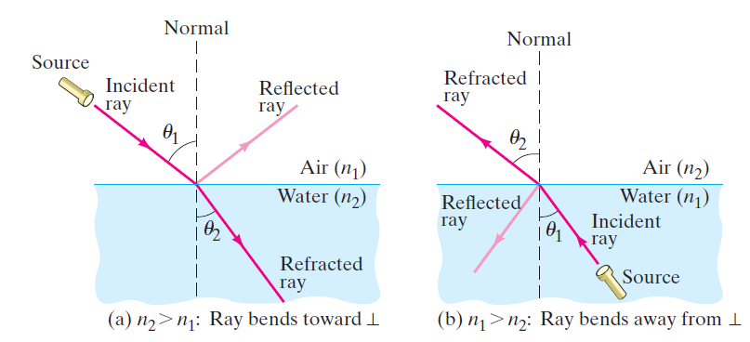
32-7 Refraction: Snell’s Law (1 of 5)
Light changes direction when crossing a boundary from one medium to another. This is called refraction, and the angle the outgoing ray makes with the normal is called the angle of refraction.
Notes:
Figure 32-21. Refraction. (a) Light refracted when passing from air (n1) into water (n2): n2 < n1. (b) Light refracted when passing from water (n1) into air (n2): n2 > n1.
LD: Part (“a”), n subscript 2 greater than n subscript 1: Ray bends toward perpendicular: The refractive index of air is labeled n subscript 1and the refractive index of water is labeled n subscript 2. The light ray emerges from a flashlight labeled Source, which is suspended in the air on the upper left of the figure. The light ray propagates toward the lower right and is incident on the air-water interface. The light ray makes an angle labeled theta subscript 1 with the normal and is labeled Incident ray. The normal labeled Normal is a vertical dashed line that is drawn from the air in to the water. A part of the incident ray reflects upward to the right in to the air and is labeled Reflected ray. The other part of the ray refracts toward the lower right in to the water to meet the bottom. The light ray inside the water makes an angle labeled theta subscript 2 with the normal and is labeled Refracted Ray. Theta subscript 2 is smaller than theta subscript 1. Part (b), n subscript 1 greater than n subscript 2: Ray bends away from perpendicular: The refractive index of water is labeled n subscript 1and the refractive index of air is labeled n subscript 2. The light ray emerges from a flashlight labeled Source, which is suspended in the water on the lower right of the figure. The light ray propagates toward the upper left and is incident on the air-water interface. The light ray makes an angle labeled theta subscript 1 with the normal and is labeled Incident ray. The normal labeled Normal is a vertical dashed line that is drawn from the air in to the water. A part of the incident ray reflects downward to the left in to the water and is labeled Reflected ray. The other part of the ray refracts toward the upper left in to the air. The light ray in the air makes an angle labeled theta subscript 2 with the normal and is labeled Refracted Ray. Theta subscript 1 is smaller than theta subscript 2

Slide 31
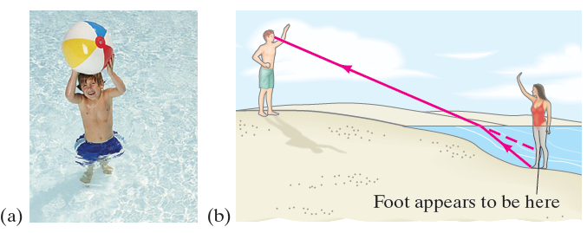
32-7 Refraction: Snell’s Law (2 of 5)
Refraction is what makes objects half-submerged in water look odd.
Notes:
Figure 32-22. (a) Photograph, and (b) ray diagram showing why a person’s legs look shorter standing in water: a ray from the bather’s foot to the observer’s eye bends at the water’s surface, and our brain interprets the light as traveling in a straight line, from higher up (dashed line).
LD: Part (“a”): A photograph of a boy standing in water is shown. He is holding an inflatable ball over his head. Part (b): A figure with a woman standing in water such that the body below the waist is completely immersed in water is shown on the right. She is waving at a man standing on the shore on the left. A light ray extends upward from the feet of the woman, bends to the left as it exits the water, and meets the man’s eyes. The ray is extended backward using dashed lines to meet the knee of the woman. A straight line labeled Foot appears to be here points at the woman’s knees.

Slide 32

32-7 Refraction: Snell’s Law (3 of 5)
The angle of refraction depends on the indices of refraction, and is given by Snell’s law:

Slide 33
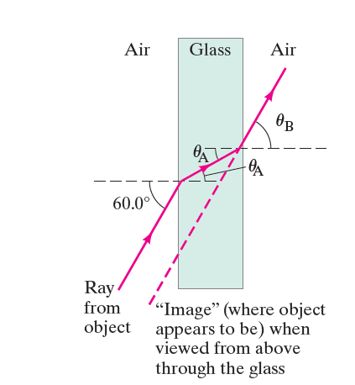
32-7 Refraction: Snell’s Law (4 of 5)
Example 32-8: Refraction through flat glass.
Light traveling in air strikes a flat piece of uniformly thick glass at an incident angle of
as shown. If the index of
refraction of the glass is 1.50, (a) what is the angle of
refraction
in the glass;
(b) what is the angle
at which the ray emerges from the glass?
Notes:
Figure 32-24. Light passing through a piece of glass (Example 32-8).
LD: A rectangular piece of glass that is vertically oriented labeled Glass is surrounded by a medium of air. The light ray labeled Ray from object is incident on the bottom-left side of the glass piece at angle of 60 degrees with the horizontal. The ray refracts toward the right and makes an angle theta subscript "A", which is less than 60 degrees, with the horizontal. The ray exits from the right side of the glass piece and refracts toward the upper left. The ray makes an angle of theta subscript "A" with the horizontal inside the glass piece and an angle of theta subscript B with the horizontal outside the glass piece. A diagonal dashed line extends downward from the exit point of the ray such that the dashed line is parallel to the incident ray, which is at the left side of the glass piece. The diagonal dashed line is labeled "Image" (where the object appears to be) when viewed from above through the glass.

Slide 34
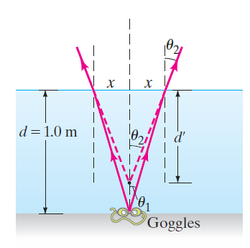
32-7 Refraction: Snell’s Law (5 of 5)
Example 32-9: Apparent depth of a pool.
A swimmer has dropped her goggles to the bottom of a pool at the shallow end, marked as 1.0 m deep. But the goggles don’t look that deep. Why? How deep do the goggles appear to be when you look straight down into the water?
Notes:
Figure 32-25. Example 32-9. Objects under water appear to be less deep than they actually are.
LD: Two light rays emerge from a point at center of the goggles at the bottom of the pool. A vertical dashed line passes through the point from the surface above the pool. The first light ray propagates toward the upper left to meet the surface of the pool, refracts slightly toward the upper left and exits the pool. The second light ray propagates toward the upper right at an angle labeled theta subscript 1 with the vertical dashed line to meet the surface of the pool, refracts slightly toward the upper right at an angle labeled theta subscript 2 with the normal and exits the pool. Dashed lines extend backward from both the refracted rays to meet at a point above the goggles on the vertical line. The extended refracted ray on the right makes an angle theta subscript 2 with the vertical line. Normal lines to the surface are drawn at the points of deflection of the light rays and are depicted as vertical dashed lines. The distance from each of the normal lines to the vertical line is labeled x. A double-headed arrow labeled d equals 1.0 m indicates the depth of the pool. A double-headed arrow labeled d prime indicates the distance between the surface of the pool and the point at which the extended refracted rays meet on the vertical line.

Slide 35
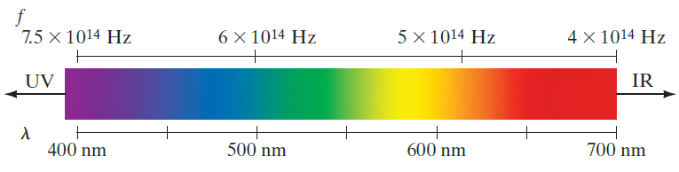
32-8 The Visible Spectrum and Dispersion (1 of 4)
The visible spectrum contains the full range of frequencies and wavelengths of light that are visible to the human eye.
Notes:
Figure 32-26. The spectrum of visible light, showing the range of frequencies and wavelengths in air for the various colors. Many colors, such as brown, do not appear in the spectrum; they are made from a mixture of wavelengths.
LD: The spectrum of colors is shown in a rectangular box. At the bottom of the box, the wavelengths labeled lambda are marked from 400 n m to 700 n m in increments of 100 n m. The frequencies labeled f, corresponding to the wavelengths are marked at the top of the box. The frequencies shown are 7.5 multiplied by 10 raised to the 14th power H z, 6 multiplied by 10 raised to the 14th power H z, 5 multiplied by 10 raised to the 14th power H z, and 4 multiplied by 10 raised to the 14th power. The colors shown in the box are violet, indigo, blue, green, yellow, orange, and red from left to right. The gradation from violet to blue is from 400 n m to 500 n m. The gradation from green to yellow is from 500 n m to 600 n m. The gradation from orange to red is from 600 n m to 700 n m. An arrow on the left end of the box points toward the left and is labeled UV. An arrow on the right end of the box points toward the right and is labeled IR.

Slide 36
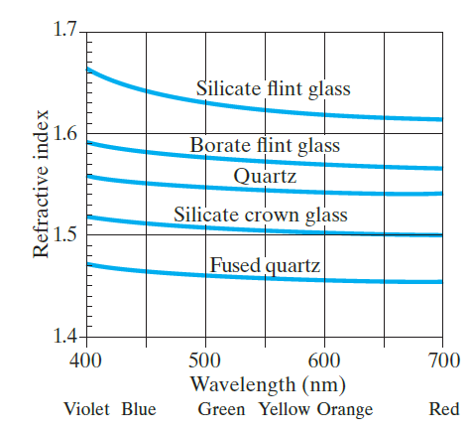
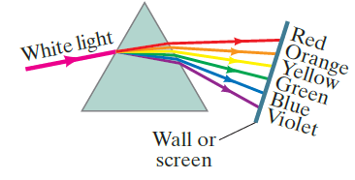
32-8 The Visible Spectrum and Dispersion (2 of 4)
The index of refraction of many transparent materials, such as glass and water, varies slightly with wavelength. This is how prisms and water droplets create rainbows from sunlight.
Notes:
Figure 32-28. Index of refraction as a function of wavelength for various transparent solids.
Figure 32-29. White light dispersed by a prism into the visible spectrum.
LD: The horizontal axis is labeled Wavelength (n m) and ranges from 400 to 700 in increments of 50 units. Colors are labeled corresponding to the wavelengths marked on the horizontal axis and are as follows: 400 n m, Violet. 450 n m, Blue. 500 n m, Green. 550 n m, Yellow. 600 n m, Orange. 700 n m, Red. The vertical axis is labeled Refractive Index and ranges from 1.4 to 1.7 in increments of 0.1 unit. Two horizontal lines are drawn to the right from the markings on the vertical axis and five vertical lines are drawn upward from the markings on the horizontal axis to show the grid of the graph. Five curves are shown on the graph. A curve labeled Fused Quartz starts from (400, 1.47) and decreases till approximately (700, 1.46). A curve labeled Silicate crown glass starts from (400, 1.52) and decreases till (700, 1.5). A curve labeled Quartz extends from (400, 1.56) and decreases till approximately (700, 1.55). A curve labeled Borate Flint Glass starts from (400, 1.59) and decreases till approximately (700, 1.57). A curve labeled Silicate Flint Glass starts from (400, 1.66) and decreases till approximately (700, 1.62).
LD A light ray labeled White light is incident upon the left edge of the triangular face of the prism. The white light is shown to split into seven light rays inside the prism, colored as follows from top to bottom: red, orange, yellow, green, blue, indigo, and violet. On exiting the right side of the triangular face of the prism, the light rays appear to bend and are incident upon a slant line labeled wall or screen. The red light ray bends the least and the violet light ray bends the most.

Slide 37
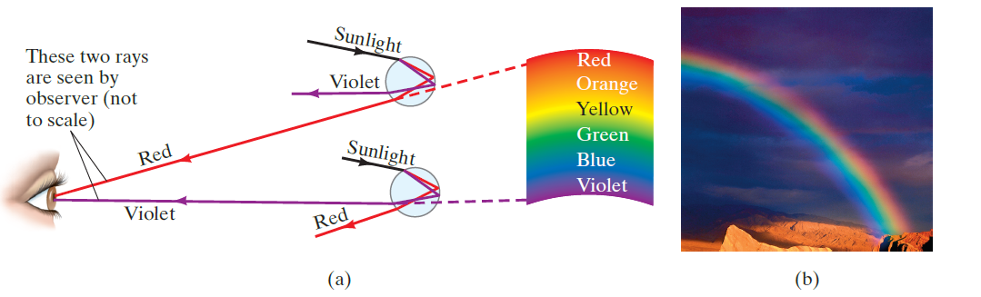
32-8 The Visible Spectrum and Dispersion (3 of 4)
This spreading of light into the full spectrum is called dispersion.
Notes:
Figure 32-30. (a) Ray diagram explaining how a rainbow (b) is formed.
LD: Part (‘a”): A ray diagram depicting how rainbows are formed is shown. Two spherical droplets represented as circles are placed one below the other at the center of the figure. A human eye on the left, faces the two droplets and a rainbow labeled Red, Orange, Yellow, Green, Blue, and Violet from top to bottom is shown at the right of the two droplets. A light ray labeled Sunlight, passes through the droplet at the top and splits into two light rays labeled Red and Violet, respectively. The red and violet rays are reflected from the droplet such that only the red light ray meets the pupil of the eye at the top. The reflected red ray is extended backward using a dashed line toward the red band of the rainbow at the right side of the droplets. Another light ray labeled Sunlight, passes through the droplet at the bottom and splits into two light rays labeled Red and Violet, respectively. The red and violet rays are reflected from the droplet such that only the violet light ray meets the pupil of the eye at the bottom. The reflected violet ray is extended backward using a dashed line toward the violet band of the rainbow. Part (b): A photograph of a rainbow is shown.

Slide 38


32-8 The Visible Spectrum and Dispersion (4 of 4)
Conceptual Example 32-10: Observed color of light under water.
We said that color depends on wavelength. For example, for an object emitting 650 n m light in air, we see red. But this is true only in air. If we observe this same object when under water, it still looks red. But the
wavelength in water
is
Light with wavelength 489 n m would
appear blue in air. Can you explain why the light appears red rather than blue when observed under water?

Slide 39
32-9 Total Internal Reflection; Fiber Optics (1 of 5)
If light passes into a medium with a smaller index of refraction, the angle of refraction is larger. There is an angle of incidence for which the angle of refraction will
be
this is called the critical angle:

Slide 40
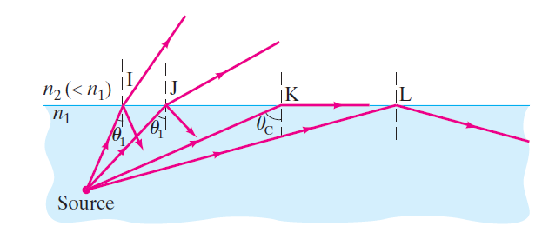
32-9 Total Internal Reflection; Fiber Optics (2 of 5)
If the angle of incidence is larger than this, no transmission occurs. This is called total internal reflection.
Notes:
Figure 32-31. Since n2 < n1, light rays are totally internally reflected if the incident angle θ1 > θc, as for ray L. If θ1 < θc, as for rays I and J, only a part of the light is reflected, and the rest is refracted.
LD: The refractive index of water is labeled n subscript 1, and the refractive index of air is labeled n subscript 2 (less than n subscript 1). A solid point labeled Source is marked inside the water at the bottom left of the figure. Four light rays labeled I, J, K, and L from left to right, emerge from the Source and propagate toward the upper right at different angles. Moving from left to right, the angle that each light ray makes with the vertical lines drawn across the water-air boundary appear to increase. The first light ray I starts from the source, propagates toward the upper right, and makes an angle theta subscript 1 with the vertical at the boundary. A part of the light ray refracts slightly toward the upper right in the air medium, and a part of the ray reflects back into the water. The second light ray J starts from the source, propagates toward the upper right, and makes an angle theta subscript 2 with the vertical at the boundary. A part of the light ray refracts more significantly toward the upper right in the air medium, and a part of the ray reflects back into the water. The third light ray K starts from the source, propagates toward the upper right till the boundary, and makes an angle theta subscript c with the vertical at the boundary. The light ray refracts toward the right along the surface of the water. The fourth light ray L starts from the source, propagates toward the upper right, and reflects completely back into the water.

Slide 41
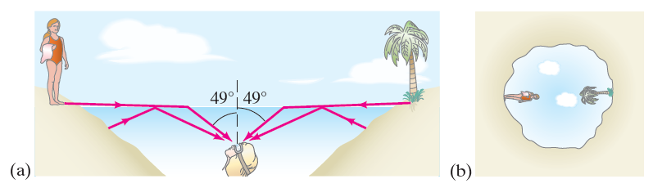
32-9 Total Internal Reflection; Fiber Optics (3 of 5)
Conceptual Example 32-11: View up from under water.
Describe what a person would see who looked up at the world from beneath the perfectly smooth surface of a lake or swimming pool.
Notes:
Figure 32-32. (a) Light rays entering submerged person’s eye, and (b) view looking upward from beneath the water (the surface of the water must be very smooth). Example 32-11.
LD: Part (“a”): A water body with a smooth surface is shown. The water body is surrounded by land on both sides. The land on the left and right side of the water body slopes downward to the right and left, respectively, with most of the land appearing to be below water. A woman is shown standing on the land at the left side of the water body. A tree is shown on the land at the right side of the water body. The head of a woman facing upward is shown at the bottom center of the water body. A light ray extends from the feet of the woman on the land toward the right, and on striking the water-air interface, refracts toward the lower right to meet the eyes of the woman under water. Another light ray extends toward the upper right from a point on the land below water at the left, and on striking the water-air interface, reflects toward the lower right to meet the eyes of the woman under water. Similarly, a light ray extends from the bottom of the tree toward the left, and on striking the water-air interface, refracts toward the lower left to meet the eyes of the woman under water. Another light ray extends toward the upper left from a point on the land below water at the right, and on striking the water-air interface, reflects toward the lower left to meet the eyes of the woman under water. A vertical dashed line that depicts the normal line is drawn from a little above the water-air interface to the eyes of the woman. The angle between each of the refracted rays with the normal is labeled 49 degrees. Part (b): The figure shows the view that the woman under water in Part (“a”) gets to see. An irregular closed curve is shown. The area surrounding the curve is shaded brown, which indicates land. Inside the curve, a woman is shown standing on the left and a tree is shown at the opposite right end such that the woman and the tree are inclined toward the center at an angle of 90 degrees from the ground. The sky is shown in the background.

Slide 42
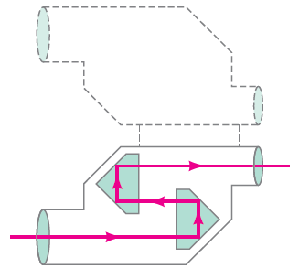
32-9 Total Internal Reflection; Fiber Optics (4 of 5)
Binoculars often use total internal reflection; this gives true 100% reflection, which even the best mirror cannot do.
Notes:
Figure 32-34. Total internal reflection of light by prisms in binoculars.
LD: The binoculars consist of two cylindrical chambers with an objective lens, eye piece, and a pair of prisms. The cylindrical chambers are placed horizontally withone at the bottom left and the other at the top right. The prisms are placed inside the binoculars with their flat surfaces facing toward each other such that the first prism is placed at the bottom right and the second prism is placed at the top left. A mirror image of the outline of the binoculars is drawn with dashed lines at the top and the same is connected to the top of the binoculars using dashed lines.The light ray enters the binoculars through the objective lens, which is at the opening of the bottom left cylindrical chamber. The light ray moves toward the right, enters the first prism through the flat side, strikes the lower edge of the pointed side of the prism, and gets reflected toward the top. Then the light ray strikes the upper edge of the pointed side of the prism and gets reflected to the left, where it becomes parallel to the incident ray but in opposite direction, and passes through the flat side of the prism. The ray exits the first prism and enters the second prism. The light ray enters the second prism through its flat surface, strikes the lower edge of the pointed side of the prism, and gets reflected toward the top. Then the light ray strikes the upper edge of the pointed side of the prism and gets reflected to the right, where it becomes parallel to the light ray incident on the first prism along the same direction, and passes through the flat surface of the second prism. Then the light ray passes through the eye piece, which is at theend of the cylindrical chamber at the top right, to exit the binoculars.

Slide 43

32-9 Total Internal Reflection; Fiber Optics (5 of 5)
Optical fibers also depend on total internal reflection; they are therefore able to transmit light signals with very small losses.
Notes:
Figure 32-35. Light reflected totally at the interior surface of a glass or transparent plastic fiber.
LD: The fiber is placed horizontally. The light ray starts from the left end of the fiber, propagates toward the lower right, and meets the bottom boundary of the fiber. The light ray reflects toward the upper right and propagates to meet the upper boundary of the fiber. The light ray then reflects toward the lower right and propagates to meet the bottom boundary of the fiber. The light ray reflects thrice again in the same manner before it exits the fiber toward the upper right.

Slide 44
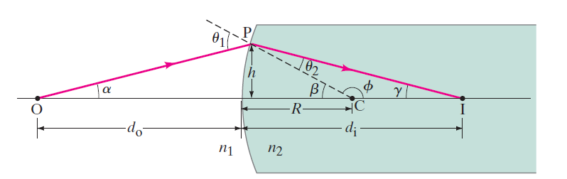
32-10 Refraction at a Spherical Surface (1 of 5)
Rays from a single point will be focused by a convex spherical interface with a medium of larger index of refraction to a single point, as long as the angles are not too large.
Notes:
Figure 32-38. Diagram for showing that all paraxial rays from O focus at the same point I (n2 > n1).
LD: The medium with refractive index n subscript 1 is shown on the left of the medium with refractive index n subscript 2. The medium with refractive index n subscript 2 is depicted as a rectangle with a curved edge at the left and an open end at the right. A point labeled O is marked at the left end of a line passing horizontally across the center of the two media. A point labeled C is marked on the horizontal line inside the medium on the right. A double-headed arrow labeled R indicates the distance between C and the boundary between the two media. A double-headed arrow labeled d subscript o indicates the distance between O and the boundary between the two media. The light ray starts from point O at an angle alpha with the horizontal line. The ray propagates toward the upper right and meets the curved edge of the rectangle at a point labeled P. A double-headed arrow labeled h indicates the vertical distance between the horizontal line and P. Then the light ray refracts toward the lower right till a point labeled I close to the right end of the horizontal line. The refracted ray makes an angle labeled gamma with the horizontal line. A double-headed arrow labeled d subscript i indicates the distance between I and the boundary of the two media. A dashed line is drawn toward the top left from C to a point beyond P and makes an angle labeled beta with the horizontal line. The dashed line makes an angle labeled theta subscript 1 with the light ray O P and an angle labeled theta subscript 2 with the light ray P I.

Slide 45
32-10 Refraction at a Spherical Surface (2 of 5)
Geometry gives the relationship between the indices of refraction, the object distance, the image distance, and the radius of curvature:

Slide 46
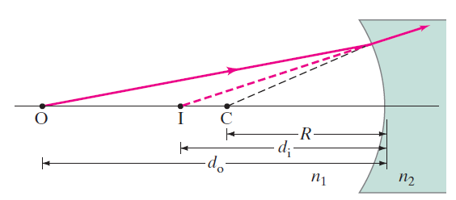
32-10 Refraction at a Spherical Surface (3 of 5)
For a concave spherical interface, the rays will diverge from a virtual image.
Notes:
Figure 32-39. Rays from O refracted by a concave surface form a virtual image (n2 > n1). Per our conventions, R < 0, di < 0, do > 0.
LD: A medium with refractive index n subscript 1 is shown on the left side of the concave surface. A point labeled O is marked at the left end of a line passing horizontally across the center of the two media. A point labeled C is marked on the horizontal line between O and the concave surface. A double-headed arrow labeled R indicates the distance between C and the concave boundary between the two media. A light ray emerges from O and propagates toward the upper right to meet a point on the top left of the concave boundary. A dashed line that moves toward the top right extends from C to the point of incidence of the light ray on the concave boundary. Then the light ray gets refracted toward the upper right inside the concave surface. The refracted ray is extended backward using dashed lines to meet at a point labeled I on the horizontal line. A double-headed arrow labeled d subscript o indicates the distance between O and the concave boundary. A double-headed arrow labeled d subscript i indicates the distance between I and the concave boundary.

Slide 47
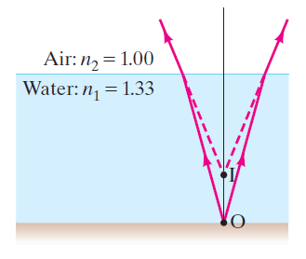
32-10 Refraction at a Spherical Surface (4 of 5)
Example 32-12: Apparent depth II.
A person looks vertically down into a 1.0-m-deep pool. How deep does the water appear to be?
Notes:
Figure 32-40. Example 32-12.
LD: The refractive index of Water is labeled n subscript 1 equals 1.33 and the refractive index of Air is labeled n subscript 2 equals 1.00. Two light rays emerge from a point labeled O at the bottom of the pool. A vertical line is drawn from point O to the medium of air. The first light ray propagates toward the upper left to meet the surface of the pool, refracts toward the upper left, and exits the pool to enter the air. The second light ray propagates toward the upper right to meet the surface of the pool, refracts toward the upper right, and exits the pool to enter the air. Dashed lines extend backward from both the refracted rays to meet at a point labeled I on the vertical line. Point I lies above point O on the vertical line.

Slide 48
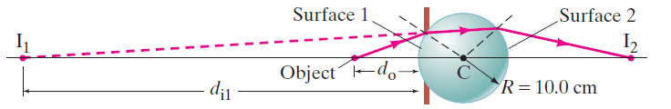
32-10 Refraction at a Spherical Surface (5 of 5)
Example 32-13: A spherical “lens.”
A point source of light is placed at a distance of 25.0 c m from
the center of a glass sphere
of radius 10.0 c m.
Find the image of the source
Notes:
Figure 32-41. Example 32-13.
LD: A horizontal line passes from left to right through the center of the sphere. The center of the sphere is labeled C and the radius is labeled R equals 10.0 c m. A point labeled Object is marked at the left side of the sphere on the horizontal line. Two thick vertical brown lines are each drawn on the top and bottom of the left boundary of the sphere. The left and right boundaries of the sphere that is not obstructed by the thick vertical brown lines are labeled Surface 1 and Surface 2, respectively. A double-headed arrow labeled d subscript o indicates the distance between the object and Surface 1. A light ray emerges from the object and propagates toward the upper right to meet Surface 1. The light ray then gets refracted slightly toward the upper right within the sphere and propagates to meet Surface 2. The refracted light ray at Surface 1 is extended backward using a dashed line to meet a point labeled I subscript 1 at the left side of the sphere on the horizontal line. A double-headed arrow labeled d subscript i 1 indicates the distance between I subscript 1 and Surface 1. The light ray at Surface 2 is refracted toward the lower right to meet a point labeled I subscript 2 at the right side of the sphere on the horizontal line. The normal lines at the points of deflection of the light ray are represented as dashed lines extending from the center of the circle.

Slide 49
Summary of Chapter 32 (1 of 3)
Light paths are called rays.
Angle of reflection equals angle of incidence.
Plane mirror: image is virtual, upright, and the same size as the object.
Spherical mirror can be concave or convex.
Focal length of the mirror:

Slide 50
Summary of Chapter 32 (2 of 3)
Mirror equation:
Magnification:
Real image: light passes through it.
Virtual image: light does not pass through.

Slide 51


Summary of Chapter 32 (3 of 3)
Index of refraction:
Law of refraction (Snell’s law):
Total internal reflection occurs when angle of incidence is greater than critical angle:

Slide 52

Copyright
This work is protected by United States copyright laws and is provided solely for the use of instructors in teaching their courses and assessing student learning. Dissemination or sale of any part of this work (including on the World Wide Web) will destroy the integrity of the work and is not permitted. The work and materials from it should never be made available to students except by instructors using the accompanying text in their classes. All recipients of this work are expected to abide by these restrictions and to honor the intended pedagogical purposes and the needs of other instructors who rely on these materials.

