Slide 1
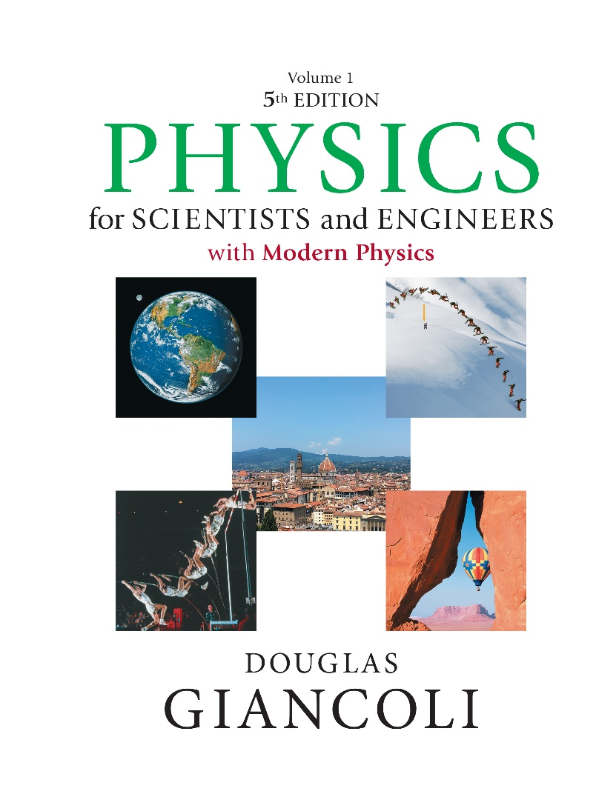

Physics for Scientists and Engineers with Modern Physics
Fifth Edition
Chapter 33
Lenses and Optical Instruments
Copyright © 2023 Pearson Education, Inc. All Rights Reserved
Notes:
If this PowerPoint presentation contains mathematical equations, you may need to check that your computer has the following installed:
1) MathType Plugin
2) Math Player (free versions available)
3) NVDA Reader (free versions available)

Slide 2
Units of Chapter 33 (1 of 2)
Thin Lenses; Ray Tracing and Focal Length
The Thin Lens Equation
Combinations of Lenses
Lensmaker’s Equation
Cameras: Film and Digital
The Human Eye; Corrective Lenses
Magnifying Glass

Slide 3
Units of Chapter 33 (2 of 2)
Telescopes
Compound Microscope
Aberrations of Lenses and Mirrors

Slide 4
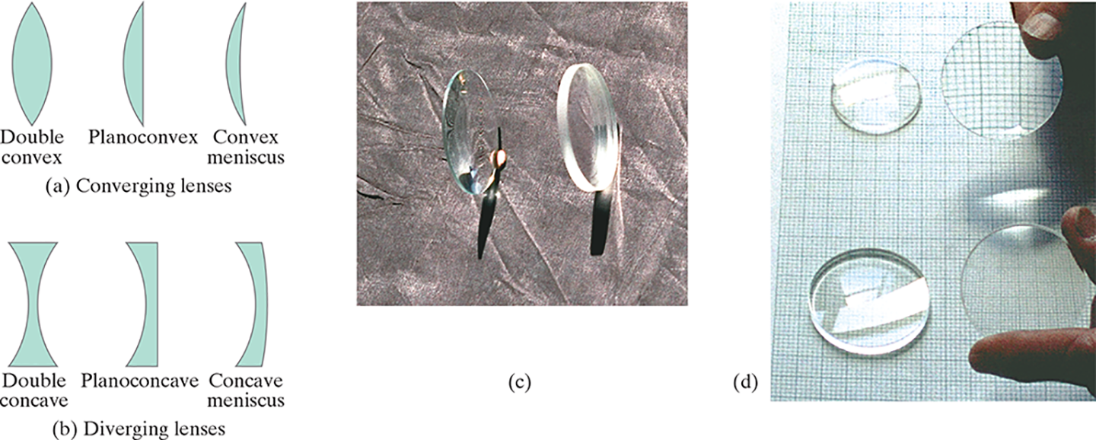
33-1 Thin Lenses; Ray Tracing and Focal Length (1 of 8)
Thin lenses are those whose diameter is small compared to the radii of curvature of the two lens surfaces. They may be either converging (a) or diverging (b).
Notes:
Figure 33-2. (a) Converging lenses and (b) diverging lenses, shown in cross section. Converging lenses are thicker at the center whereas diverging lenses are thicker at the edges. (c) Photo of a converging lens (on the left) and a diverging lens (right). (d) Converging lenses (top), and diverging lenses (below), lying flat, and raised off the paper to form images.
LD: Part (“a”) Converging Lenses: Three types of converging lenses are shown. On the left, a lens labeled Double convex with two convex surfaces is shown. The convex surface is bulged outward on the left and right. In the center, a lens labeled Planoconvex with a convex surface on the left side and a flat surface on the right side is shown. On the right, a lens labeled Convex meniscus with a convex surface on the left side and a concave surface on the right side is shown. Part (b) Diverging Lenses: Three types of diverging lenses are shown. On the left, a lens labeled Double concave with two concave surfaces is shown. The concave surface is bulged inward on the left and right side. In the center, a lens labeled Planoconcave with a concave surface on the left side and a flat surface on the right side is shown. On the right, a lens labeled Concave meniscus with a concave surface on the left side and a convex surface on the right side is shown. Part (c): A photograph of a circular converging lens on the left and a circular diverging lens on the right is shown. The converging lens is thicker at the center and the diverging lens is thicker at the edges. Part (d): A pair of converging lenses and a pair of diverging lenses placed one below the other are shown on a graph paper. On the top left, a converging lens is placed on the graph paper. On top right, a converging lens is held by a hand and the magnified image of the graph lines are shown through the lens. On the bottom left, a diverging lens is placed on the graph paper. On the bottom right, a diverging lens is held by a hand and a diminished image of the graph lines is shown through the lens.

Slide 5
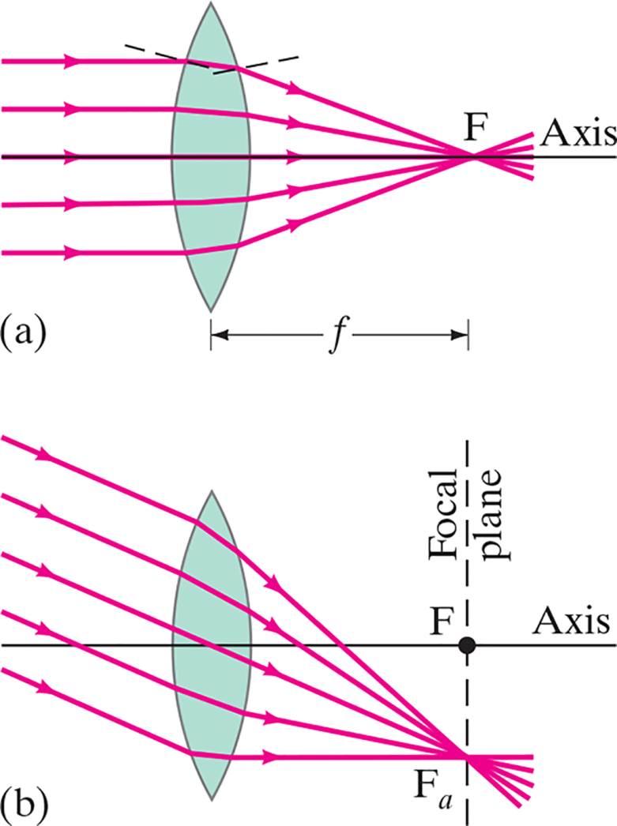
33-1 Thin Lenses; Ray Tracing and Focal Length (2 of 8)
Parallel rays are brought to a focus by a converging lens (one that is thicker in the center than it is at the edge).
Notes:
Figure 33-3. Parallel rays are brought to a focus by a converging thin lens.
LD: Part (“a”): Five horizontal light rays, parallel to the principal axis enter the viewing window from the left of the figure and strike the left boundary of the lens. Then the light rays get refracted to converge at a point labeled F on the principal axis labeled Axis. A double-headed arrow labeled f marks the distance of F from the optical center of the lens. Two dashed lines that depict the normal lines are drawn at the points of deflection of the first ray. Part (b): Five parallel light rays enter the viewing window from the top left of the figure till the left boundary of the lens. The light rays are inclined with respect to the principal axis labeled Axis. Then the light rays get refracted to converge at a point labeled F subscript “a” below the principal axis at the lower right side of the lens. A vertical dashed line labeled Focal plane is drawn from F subscript “a” to meet the principal axis at a point labeled F.

Slide 6
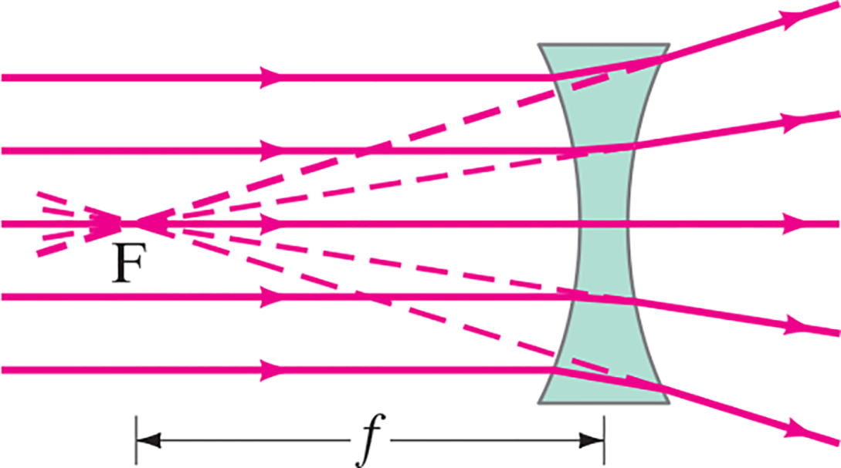
33-1 Thin Lenses; Ray Tracing and Focal Length (3 of 8)
A diverging lens (thicker at the edges than in the center) makes parallel light diverge; the focal point is that point where the diverging rays would converge if projected back.
Notes:
Figure 33-5. Diverging lens.
LD: Five horizontal light rays that are parallel to each other, enter the viewing window from the left and strike the left boundary of the lens. Then the light rays get refracted and diverge. Dashed lines extend backward from all five refracted rays to intersect at a point labeled F on the third light ray. A double-headed arrow labeled f marks the distance between the optical center of the lens and point F.

Slide 7
33-1 Thin Lenses; Ray Tracing and Focal Length (4 of 8)
The power of a lens is the inverse of its focal length:
Lens power is measured in diopters, D:

Slide 8
33-1 Thin Lenses; Ray Tracing and Focal Length (5 of 8)
Ray tracing for thin lenses is similar to that for mirrors. We have three key rays:
This ray comes in parallel to the axis and exits through the focal point.
This ray comes in through the focal point and exits parallel to the axis.
This ray goes through the center of the lens and is undeflected.

Slide 9
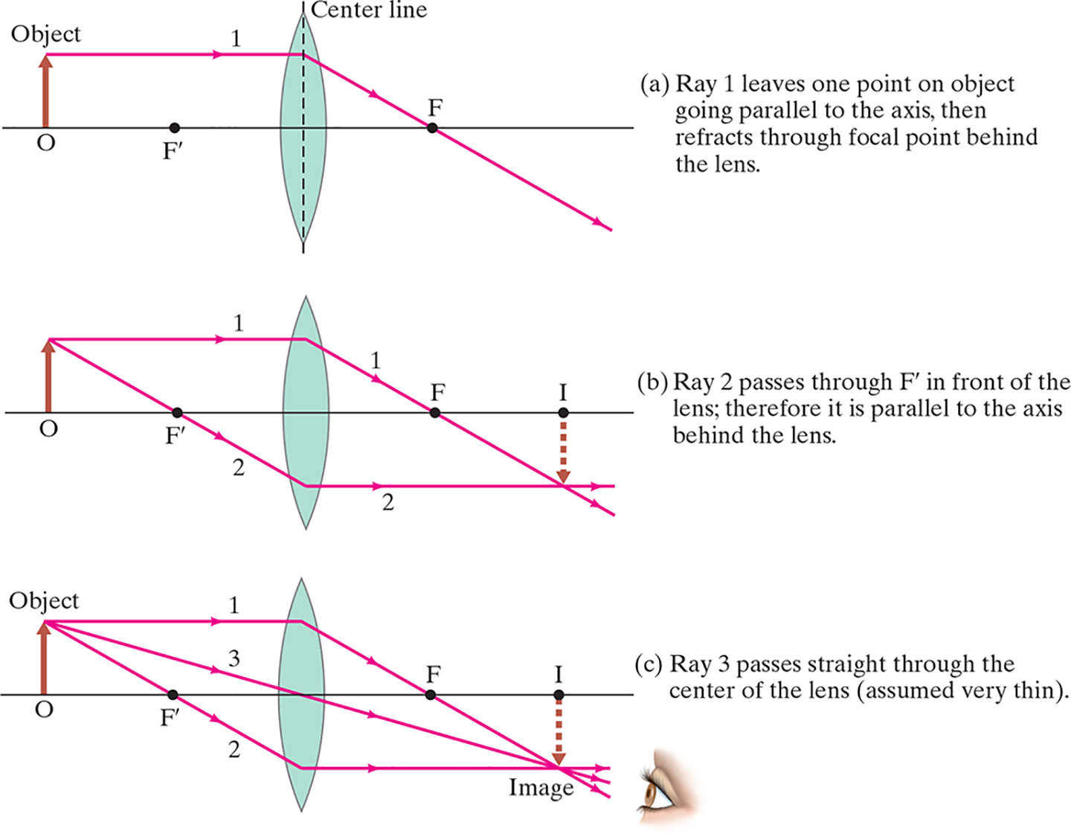
33-1 Thin Lenses; Ray Tracing and Focal Length (6 of 8)
Notes:
Figure 33-6. Finding the image by ray tracing for a converging lens. Rays are shown leaving one point on the object (an arrow). Shown are the three most useful rays, leaving the tip of the object, for determining where the image of that point is formed. (Note that the focal points F and F’ on either side of the lens are the same distance f from the center of the lens.)
LD: In all three parts, an upward arrow that depicts an object is placed at a point labeled O at the left end of a horizontal line that represents the principal axis of the convex lens. The double convex lens is placed to the right of the object. A point labeled F is at the right of the lens and a point labeled F prime is placed between the object arrow and the lens. The points F and F prime are equidistant from the midpoint of the lens. Part ("a") Ray 1 leaves one point on object going parallel to the axis, then refracts through focal point behind the lens: A vertical dashed line labeled Center line is drawn vertically across the lens. A horizontal light ray labeled 1 from the tip of the object arrow moves toward the right till Center line. Then the ray gets refracted and moves toward the lower right and passes through point F. Then the ray continues to propagate toward the lower right. Part (b) Ray 2 passes through F prime in front of the lens; therefore it is parallel to the axis behind the lens: A horizontal light ray labeled 1 from the tip of the object arrow moves toward the right till the midpoint of the lens. Then the ray gets refracted and moves toward the lower right and passes through point F. The ray continues to propagate toward the lower right. Another light ray labeled 2 from the tip of the object arrow is drawn toward the lower right and passes through F prime. The ray continues to propagate till it reaches the midpoint of the lens below the principal axis. Then the ray gets refracted and emerges as a horizontal ray. The refracted rays converge at a point below the principal axis corresponding to a point labeled I on the axis. An inverted real image arrow of the same height as the object arrow is drawn from point I till the point of intersection of rays 1 and 2. Part (c) Ray 3 passes straight through the center of the lens (assumed very thin): A horizontal light ray labeled 1 from the tip of the object arrow moves toward the right till the midpoint of the lens. Then the ray gets refracted and moves toward the lower right and passes through F. The ray continues to propagate toward the lower right. Another light ray labeled 2 from the tip of the object arrow moves toward the lower right and passes through F prime. The ray continues to propagate till it reaches the midpoint of the lens below the principal axis. Then the ray gets refracted and emerges as a horizontal ray. A third ray labeled 3 from the tip of the object moves diagonally toward the lower right till the optical center of the lens. The ray emerges as a straight line with no deviation in its path. The refracted rays converge at a point below the axis corresponding to a point labeled I on the axis. The point of intersection of the rays 1, 2, and 3 is labeled Image. An inverted real image arrow of the same height as the object arrow is drawn from point I till the point of intersection of rays 1, 2, and 3. The Image obtained is viewed as an inverted object by an observer on the lower right.

Slide 10
33-1 Thin Lenses; Ray Tracing and Focal Length (7 of 8)
Conceptual Example 33-1: Half-blocked lens.
What happens to the image of an object if the top half of a lens is covered by a piece of cardboard?

Slide 11
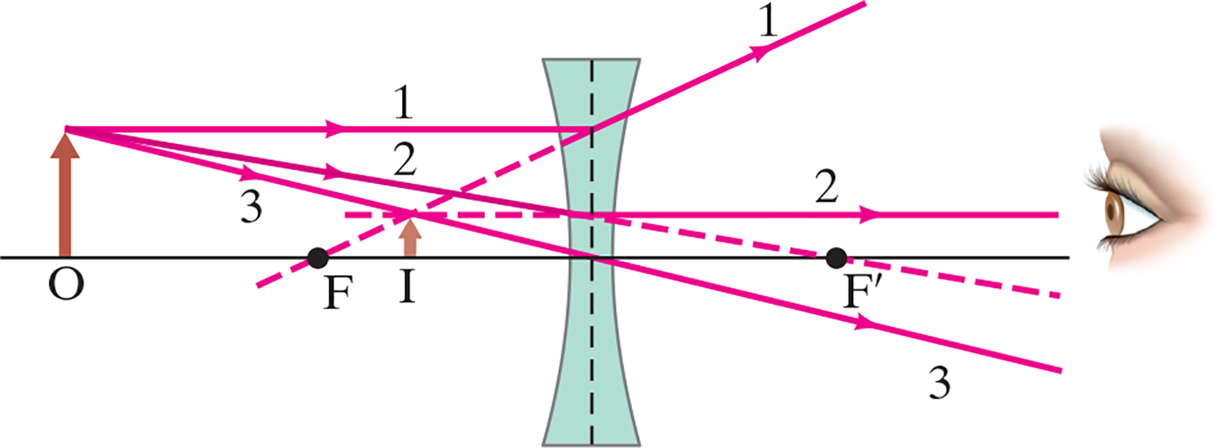
33-1 Thin Lenses; Ray Tracing and Focal Length (8 of 8)
For a diverging lens, we can use the same three rays; the image is upright and virtual.
Notes:
Figure 33-8. Finding the image by ray tracing for a diverging lens.
LD: A horizontal line that represents the principal axis passes through the midpoint of the concave lens. An upward arrow that depicts an object is placed at a point labeled O on the left end of the axis. A point labeled F is marked on the axis to the right of the object. Another point labeled F prime is marked on the axis to the right of the lens. The points F and F prime are equidistant from the midpoint of the lens. A vertical dashed line is drawn at the center of the lens. A horizontal light ray labeled 1 from the tip of the object arrow moves toward the right till the midpoint of the lens. Then the ray gets refracted upward to the right. The ray continues to propagate toward the upper right. Another light ray labeled 2 from the tip of the object arrow moves toward the lower right till the midpoint of the lens above the axis. Then the ray gets refracted toward the right and emerges as a horizontal ray to meet the eye of an observer on the right. A third ray labeled 3 from the tip of the object arrow moves toward the lower right and passes through the optical center of the lens and continues its motion toward the lower right. The ray emerges as a straight line with no deviation in its path. Dashed lines extend backward from all three refracted rays to intersect at a point at the tip of the real image arrow labeled I. The real image arrow I extends upward from the axis. The real image arrow is shorter than the object arrow.

Slide 12
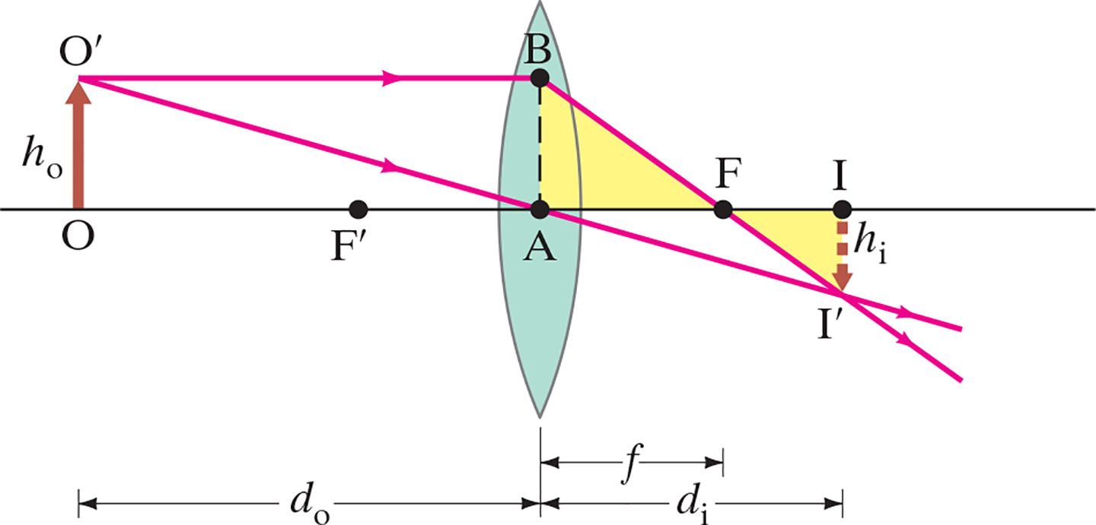
33-2 The Thin Lens Equation (1 of 7)
The thin lens equation is similar to the mirror equation:
Notes:
Figure 33-9. Deriving the lens equation for a converging lens.
LD: The convex lens is placed at a distance to the right of the object labeled O. Two points labeled F are marked on the principal axis on either sides of the lens. Both the F points are equidistant from the midpoint of the lens. A horizontal light ray from the tip of the object arrow labeled O prime moves toward the right to meet the lens at a point labeled B above the principal axis. Then the ray gets refracted and moves to the lower right, passes through F on the right of the lens and exits the viewing window below the axis. Another light ray from the tip of the object arrow moves toward the lower right and passes through the optical center of the lens labeled “A” and continues to propagate in the same direction. The second ray intersects the first ray at the tip of the inverted real image arrow labeled I prime below the axis. The base of the real image arrow is marked on the principal axis at a point labeled I. The point I is placed to the right of F. The height of the real image arrow is labeled h subscript i. Point “A” and B are joined by a vertical dashed line. The region enclosed by “A”, B, F, principal axis, and the first light ray is shaded. The region enclosed by F, I prime, I, first light ray, and the principal axis is shaded. A double-headed arrow labeled d subscript o marks the distance between O and “A”. A double-headed arrow labeled d subscript i marks the distance between I and “A”. A double-headed arrow labeled f marks the distance between F and “A”.

Slide 13
33-2 The Thin Lens Equation (2 of 7)
The sign conventions are slightly different than for mirrors:
The focal length is positive for converging lenses and negative for diverging lenses.
The object distance is positive if the object is on the side of the lens from which the light is coming. When lenses are used in combination, as in Example 33-6, the object is “virtual”, is behind the lens, and the object distance is negative.
The image distance is positive if the image is on the opposite side of the lens from where the light is coming; otherwise, it is negative.
The height of the image is positive if the image is upright and negative otherwise.

Slide 14
33-2 The Thin Lens Equation (3 of 7)
The magnification formula is also the same as that for a mirror:
The power of a lens is positive if it is converging and negative if it is diverging.

Slide 15
33-2 The Thin Lens Equation (4 of 7)
Problem Solving: Thin Lenses
Draw a ray diagram. The image is located where the key rays intersect.
Solve for unknowns.
Follow the sign conventions.
Check that your answers are consistent with the ray diagram.

Slide 16
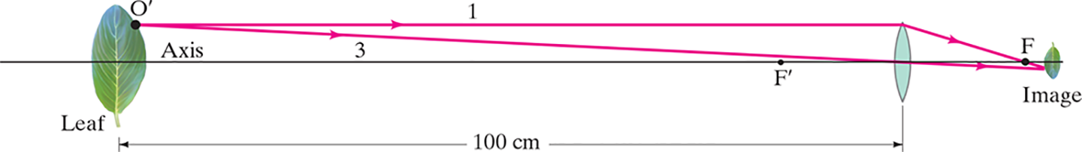
33-2 The Thin Lens Equation (5 of 7)
Example 33-2: Image formed by converging lens.
What is (a) the position, and (b) the size, of the image of a 7.6-c m-high leaf placed 1.00 m from a +50.0-m m-focal-length camera lens?
Notes:
Figure 33-11. Example 33-2. (Not to scale.)
LD: The leaf is present on the extreme left of the figure and the lens is placed to the right. A double-headed arrow labeled 100 c m marks the distance between the leaf and the optical center of the lens. A point labeled F prime is marked between the leaf and the lens on the principal axis, closer to the lens. A point labeled F is marked to the right of the lens on the principal axis. The points F and F prime are equidistant from the optical center of the lens. The image of the leaf is shown inverted and diminished to the right of F. A point O prime is marked on the tip of the leaf above the principal axis. Two rays emerge from the point O prime. The first ray labeled 1, which is parallel to the principal axis, strikes the lens at the top, refracts to the lower right, passes through F and ends at the tip of the inverted image below the principal axis. The second ray labeled 3 passes through the optical center of the lens and converges with the ray 1 at the tip of the image.

Slide 17
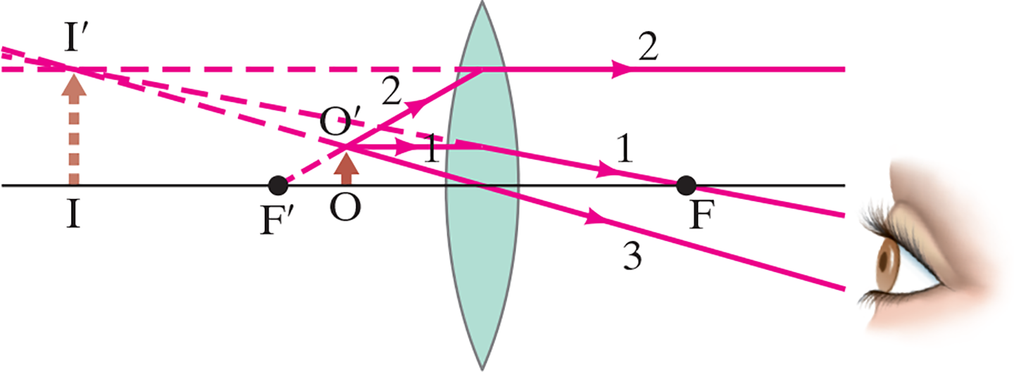
33-2 The Thin Lens Equation (6 of 7)
Example 33-3: Object close to converging lens.
An object is placed 10 c m from a 15-c m-focal-length converging lens. Determine the image position and size (a) analytically, and (b) using a ray diagram.
Notes:
Figure 33-12. An object placed within the focal point of a converging lens produces a virtual image. Example 33–3.
LD: An upward arrow that depicts an object is placed at a point labeled O on the principal axis to the left of the lens. The tip of the object arrow is labeled O prime. A point labeled F is marked on the principal axis at the right of the lens. Another point labeled F prime is marked on the principal axis at the left of O. The points F and F prime are equidistant from the midpoint of the lens. A horizontal light ray labeled 1 from O prime moves toward the right till the midpoint of the lens. The ray then gets refracted and moves toward the lower right and passes through F. The ray continues to propagate toward the lower right. Another light ray labeled 2 from O prime moves toward the upper right till the midpoint of the lens. Then the ray gets refracted toward the right and emerges as a horizontal ray. A third ray labeled 3 from O prime moves toward the lower right and passes through the optical center of the lens on the principal axis. The ray emerges as a straight line with no deviation in its path. Refracted rays from rays 1 and 3 propagate to meet the eye of an observer at the lower right of the figure. Dashed lines extend backward from all three refracted rays to intersect at a point labeled I prime at the left of F prime. I prime forms the tip of the virtual image arrow that extends from a point labeled I on the axis.

Slide 18
33-2 The Thin Lens Equation (7 of 7)
Example 33-4: Diverging lens.
Where must a small insect be placed if a
25-c m-focal-length diverging lens is to form a virtual image 20 c m from the lens, on the same side as the object?

Slide 19
33-3 Combinations of Lenses (1 of 3)
In lens combinations, the image formed by the first
lens becomes the object for the second lens (this is where object distances may be negative). The total magnification is the product of the magnification of
each lens.

Slide 20
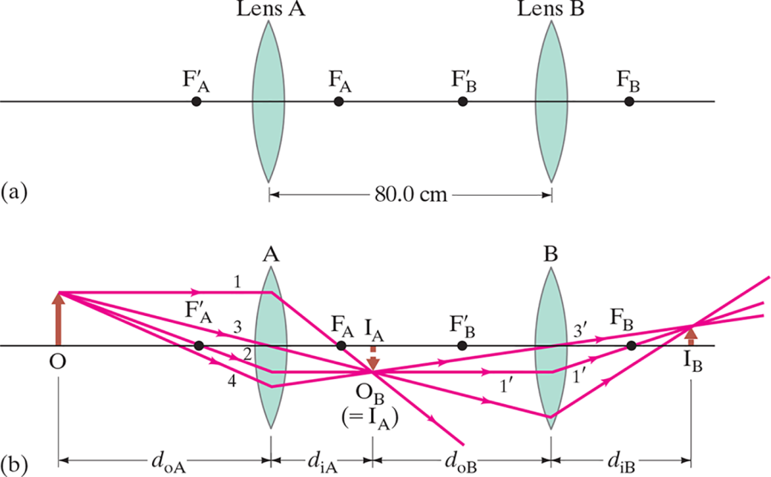
33-3 Combinations of Lenses (2 of 3)
Example 33-5: A two-lens system.
Two converging lenses, A and B, with focal lengths
and
are placed 80.0 c m apart. An object is placed
60.0 c m in front of the first lens. Determine (a) the position, and (b) the magnification, of the final image formed by the combination
of the two lenses.
Notes:
Figure 33-13. Two lenses, A and B, used in combination, Example 33 9 5. The small numbers refer to the easily drawn rays; those numbers have a prime (′) when referring to lens B.
LD: Part (“a”): Two converging lenses labeled Lens “A” and Lens B are placed on a common principal axis. Lens “A” is present on the left and Lens B is present on the right. A double-headed arrow labeled 80 c m marks the distance between the two lenses. A point labeled F prime subscript “A” is marked on the principal axis to the left of Lens “A”. A point labeled F subscript “A” is marked on the principal axis, between Lens “A” and Lens B. A point labeled F prime subscript “B” is marked on the principal axis between F subscript “A” and Lens B. A point labeled F subscript B is marked on the principal axis to the right of Lens B. Part (b): Two converging lens labeled “A” and B are placed on a common principal axis. “A” is present on the left and B is present on the right. A point labeled F prime subscript “A” is marked on the principal axis to the left of “A”. A point labeled F subscript “A” is marked on the principal axis, between “A” and B. A point labeled F prime subscript “B” is marked on the principal axis between F subscript “A” and B. A point labeled F subscript B is marked on the principal axis to the right of B. An upward arrow that depicts an object is placed at a point labeled O at the left end of the principal axis. A horizontal light ray labeled 1 from the tip of the object arrow moves horizontally toward the right till the midpoint of “A” above the principal axis. Then the ray gets refracted and moves to the lower right, and passes through F subscript “A”. The ray continues to propagate toward the lower right. Another light ray labeled 2 from the tip of the object arrow moves toward the lower right and passes through F prime subscript “A”. The ray continues to propagate till it reaches the midpoint of the lens below the principal axis. Then the ray gets refracted and emerges as a horizontal ray. A third ray labeled 3 from the tip of the object arrow moves toward the lower right. The ray passes through the optical center of the lens “A” and continues its path of motion with no deviation. A fourth ray labeled 4 from the tip of the object arrow passes the principal axis to the left of F prime subscript “A”, strikes “A” and bends slightly upward as it gets refracted. The refracted rays of 1, 2, 3, and 4 converge at the tip of an inverted real image arrow labeled I subscript “A”. The point of convergence is labeled O subscript B (equals I subscript “A”). From O subscript B, the light ray 1 exits the viewing window between “A” and B. The light ray 3 strikes B at a point below the principal axis, refracts upward exits the viewing window to the right of B. The light ray is renamed to 1 prime after O subscript B. 1 prime continues to propagate parallel to the principal axis, strikes B, and refracts upward to pass through F subscript B. The light ray 4 is renamed to 3 prime and passes through the optical center of B, and exits the viewing window to the right of B. The refracted rays converge at a point labeled I subscript B that indicates the tip of an object placed to the right of B on the principal axis. A double-headed arrow labeled d subscript o “A” marks the distance of O from the optical center of “A”. A double-headed arrow labeled d subscript i “A” marks the distance of I subscript “A” from the optical center of “A”. A double-headed arrow labeled d subscript o B marks the distance of I subscript “A” from the optical center of B. A double-headed arrow labeled d subscript i B marks the distance of I subscript B from the optical center of B.

Slide 21
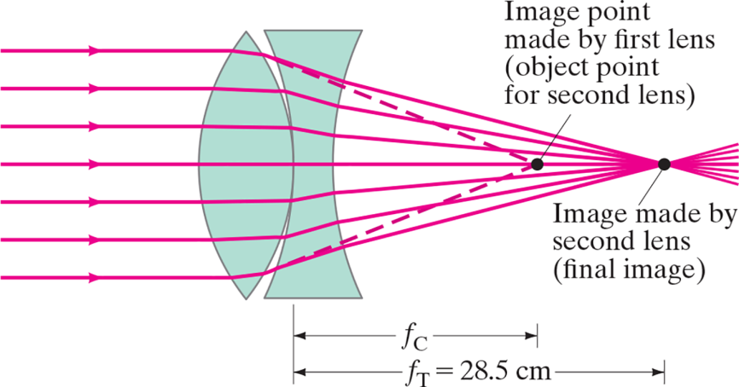
33-3 Combinations of Lenses (3 of 3)
Example 33-6: Measuring f for a diverging lens.
To measure the focal length of a diverging lens, a converging lens is placed in contact with it. The Sun’s rays are focused by this combination at a point 28.5 c m behind the lenses as shown. If the
converging lens has a focal length
of 16.0 c m, what is the focal
length
of the diverging lens? Assume both lenses are
thin and the space between them is negligible.
Notes:
Figure 33-14. Determining the focal length of a diverging lens. Example 33–6.
LD: The converging lens is on the left and the diverging lens is on the right, such that, the right boundary of the converging lens is in contact with the left boundary of the diverging lens. Seven horizontal light rays emerge from the left of the figure till the left boundary of the lens. Then the light rays get refracted to converge at a point labeled Image made by second lens (final image) on the right of the two lenses. Two dashed lines at the top and bottom from the right boundary of the converging lens converge at a point labeled Image point made by first lens (object point for second lens). The Image point made by first lens (object point for second lens) is placed between the diverging lens and the point Image made by second lens (final image). A double-headed arrow labeled f subscript C marks the distance between the point of contact of the two lenses and the Image point made by first lens (object point for second lens). A double-headed arrow labeled f subscript T equals 28.5 c m marks the distance between the point of contact of the two lenses and the point Image made by second lens (final image).

Slide 22
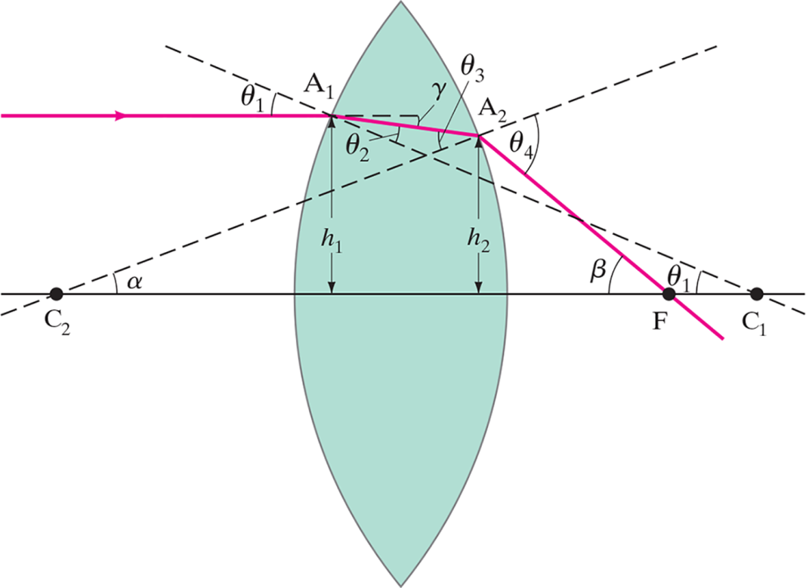
33-4 Lensmaker’s Equation (1 of 2)
This useful equation relates the radii of curvature of the two lens surfaces, and the index of refraction, to the focal length:
Notes:
Figure 33-16. Diagram of a ray passing through a lens for derivation of the lens maker’s equation.
LD: Two points labeled C subscript 1 and C subscript 2 are marked at the right and the left of the lens, respectively, on the principal axis. The light ray enters the viewing window parallel to the principal axis from the left and strikes the left boundary of the lens at a height of h subscript 1 from the principal axis. The ray refracts inside the lens slightly toward the bottom left, then again refracts outside the lens and passes through a point labeled F on the axis, at an angle beta. Inside the lens, the light ray makes an angle gamma with the horizontal at the left boundary of the lens. The refracted ray, exits the right boundary of the lens at a height labeled h subscript 2. A dashed line from C subscript 2 at an angle alpha with the axis, passes through the point of contact between the light ray and the right boundary of the lens. The dashed line makes an angle labeled theta subscript 4 with the refracted ray outside the lens and angle theta subscript 3 with the ray inside the lens. A dashed line from C subscript 1, at an angle theta subscript 1 with the axis, passes toward the top left through the point of contact between the incident light ray and the left boundary of the lens. The dashed line makes an angle labeled theta subscript 1 with the incident ray outside the lens and angle theta subscript 2 with the ray inside the lens.

Slide 23
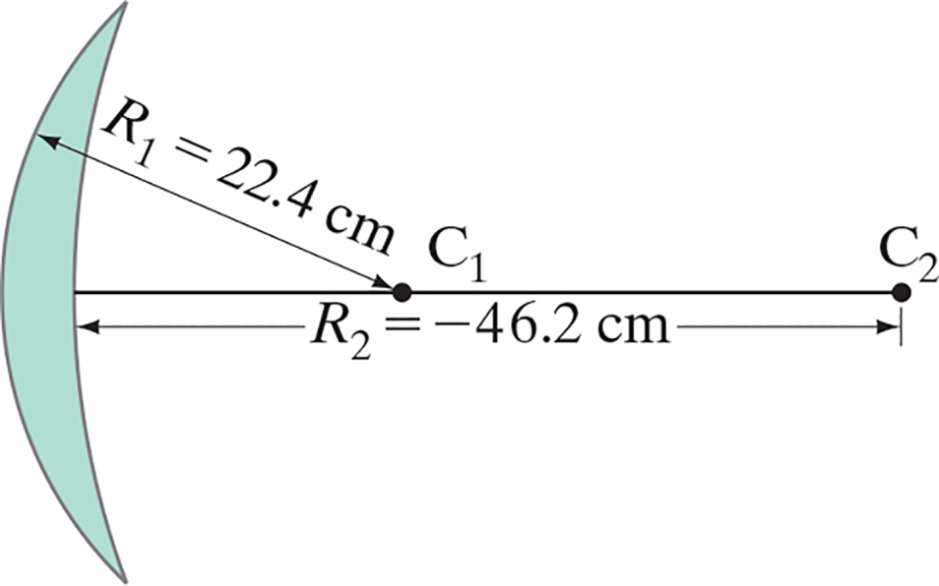
33-4 Lensmaker’s Equation (2 of 2)
Example 33-7: Calculating f for a converging lens.
A convex meniscus lens is made from glass with
The radius of curvature of the convex surface is 22.4 c m and that of the concave surface is 46.2 c m. (a) What is the focal length? (b) Where will the image be for an object 2.00 m away?
Notes:
Figure 33-15. Example 33–7.
LD: The lens is placed on the extreme left of the figure. A point labeled C subscript 1 is marked on the principal axis to the right of the midpoint of the lens. Another point labeled C subscript 2 is marked on the principal axis to the right of C subscript 1. A double-headed arrow labeled R subscript 1 Baseline equals 22.4 c m marks the distance of the outer surface of the lens from C subscript 1. A double-headed arrow labeled R subscript 2 Baseline equals negative 46.2 c m marks the distance of the inner surface of the lens from C subscript 2.

Slide 24
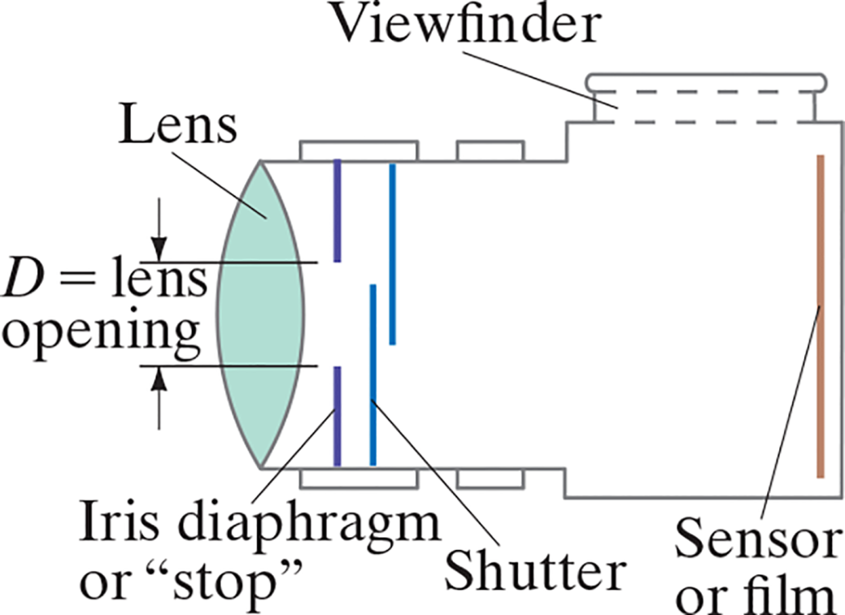
33-5 Cameras: Film and Digital (1 of 8)
Basic parts of a camera:
Lens
Light-tight box
Shutter
Film or electronic sensor
Notes:
Figure 33-17. A simple camera.
LD: The first half of the camera body is in the shape of a horizontal rectangle and the second half is shaped as a vertical rectangle. A convex lens labeled Lens is placed on the extreme left of the camera body. Behind the lens, two vertical lines labeled Iris diaphragm or “stop”, extend from the top and bottom, inside the camera with a slit between them. The slit is labeled D equals lens opening. The iris diaphragm is followed by two vertical lines labeled Shutter that extend from the top and bottom, inside the camera and are placed one after the other. A vertical line labeled Sensor or film, is shown on the right end of the camera. A small rectangular protrusion labeled Viewfinder is shown at the top of the vertically oriented portion of the camera.

Slide 25
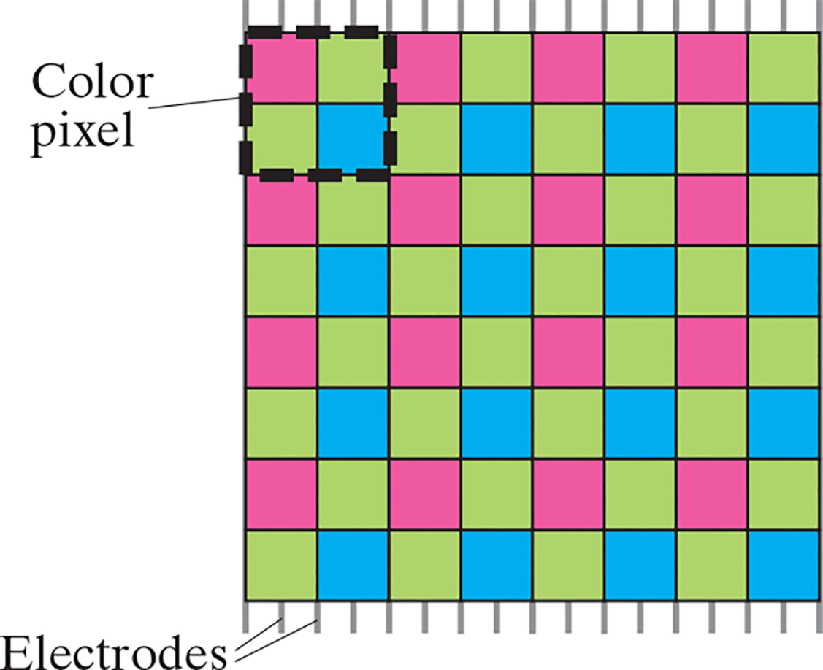
33-5 Cameras: Film and Digital (2 of 8)
A digital camera uses C C D sensors instead of film. The digitized image is sent to a processor for storage and later retrieval.
Notes:
Figure 33-18. Portion of a typical Bayer array sensor. A square group of four pixels RG GB is sometimes called a “color pixel.” (R is red, G green, B blue.)
LD: The portion of the sensor is shown as a square with gridlines on it. There are seven horizontal and vertical gridlines. The gridlines form sixty four squares arranged in eight rows and eight columns. The squares of the odd rows are colored pink and green alternatively from left to right. The squares of the even rows are colored green and blue alternatively from left to right. The first two squares from the first two rows on the top left corner are outlined as one square using solid dashed lines and is labeled Color pixel. Seventeen small line segments on the top and the bottom of the sensor plate are labeled Electrodes.

Slide 26
33-5 Cameras: Film and Digital (3 of 8)
Camera adjustments:
Shutter speed: controls the amount of time light enters the camera. A faster shutter speed makes a sharper picture.
f-stop: controls the maximum opening of the shutter. This allows the right amount of light to enter to properly expose the film, and must be adjusted for external light conditions.
Focusing: this adjusts the position of the lens so that the image is positioned on the film.

Slide 27
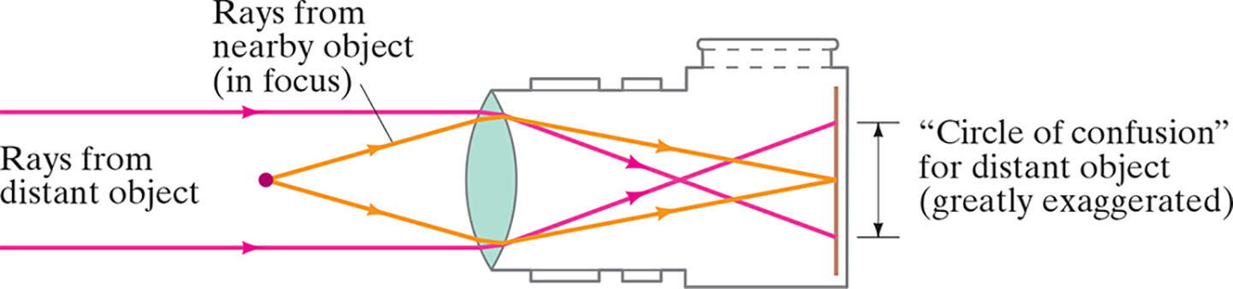
33-5 Cameras: Film and Digital (4 of 8)
There is a certain range of distances over which objects will be in focus; this is called the depth of field of the lens. Objects closer or farther will be blurred.
Notes:
Figure 33-23. When the lens is positioned to focus on a nearby object, points on a distant object produce circles and are therefore blurred. (The effect is shown greatly exaggerated.)
LD: An outline of a camera facing toward left is placed at the right of the figure. The first half of the camera body is in the shape of a horizontal rectangle and the second half is shaped as a vertical rectangle. A convex lens is placed on the left end of the camera body. A vertical line is shown inside the right end of the camera body. A point is marked on the left of the camera along the midpoint of the camera lens. Two light rays labeled Rays from nearby object (in focus) emerge from the point toward the upper right and lower right, respectively, till the right boundary of the lens. The light rays then get refracted toward the lower right and upper right, respectively, to converge at a point on the midpoint of the vertical line. Two horizontal light rays labeled Rays from distant object emerge from the left of the figure till the left boundary of the lens. The light rays then get refracted toward the lower right and upper right, respectively, to converge at a point at the center of the camera body. The refracted rays then continue to propagate toward the lower right and upper right and meet the vertical line at a point above and below the point of convergence of the refracted rays from the nearby object. A double-headed arrow labeled "Circle of Confusion" for distant object (greatly exaggerated) indicates the distance between the refracted rays from the distant object on the vertical line.

Slide 28
33-5 Cameras: Film and Digital (5 of 8)
Conceptual Example 33-8: Shutter speed.
To improve the depth of field, you “stop down” your camera lens by two f-stops from f/4 to f/8. What should you do to the shutter speed to maintain the same exposure?

Slide 29
33-5 Cameras: Film and Digital (6 of 8)
Example 33-9: Pixels and resolution.
A 12-M P (12-megapixel) digital camera offers a
maximum resolution of
pixels on a
sensor. How sharp should the lens
be to make use of this resolution in R A W?

Slide 30
33-5 Cameras: Film and Digital (7 of 8)
Example 33-10: Blown-up photograph.
A photograph looks sharp at normal viewing distances if the dots or lines are resolved to perhaps
10 dot/m m
Would an
enlargement of a photo taken by
the camera in Example 33-9 seem sharp?

Slide 31
33-5 Cameras: Film and Digital (8 of 8)
There are different types of lenses available for cameras, besides the normal lens.
Telephoto lens: longer focal length, magnified image
Wide-angle lens: shorter focal length, wider field of view, smaller image
Zoom lens: adjustable focal length
Digital zoom (in digital cameras): enlarges pixels with loss of resolution

Slide 32
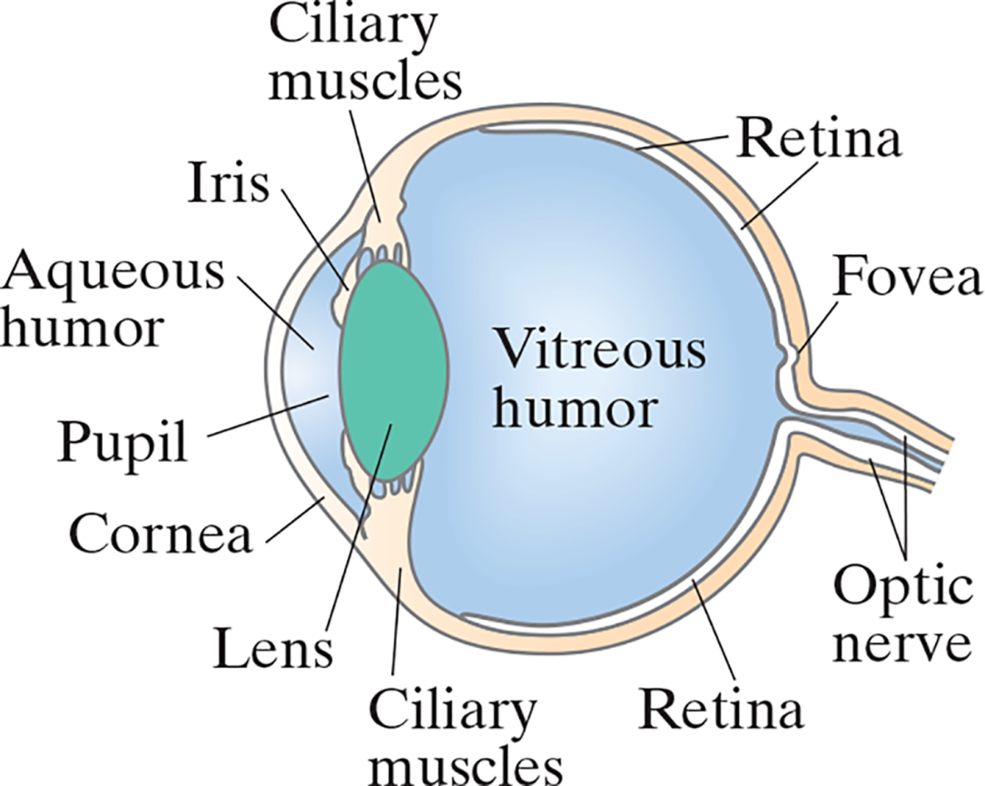
33-6 The Human Eye; Corrective Lenses (1 of 8)
The human eye resembles a camera in its basic functioning, with an adjustable lens, the iris, and the retina.
Notes:
Figure 33-25. Diagram of a human eye.
LD: The side view of the human eye is shown to have an almost spherical shape with a small bulge on the left. The small bulge has a convex curvature and is separated from the rest of the eye by the Ciliary muscles, iris and lens. The bulged area is labeled Cornea and is filled with a fluid labeled Aqueous humor. Ciliary muscles extend from the top and bottom ends. They hold convex shaped structure labeled Lens at the center. A structure labeled Iris extends from the Ciliary muscles and runs along the front side of the lens from both the ends. The space to the left of the lens that is not attached to the iris is labeled pupil. The spherical shape behind the bulge is filled with a fluid labeled Vitreous humor. The curved rear surface has an inner outline labeled Retina. A small pit in the retina is labeled Fovea. The rear surface extends to form a narrow path labeled Optic nerve.

Slide 33
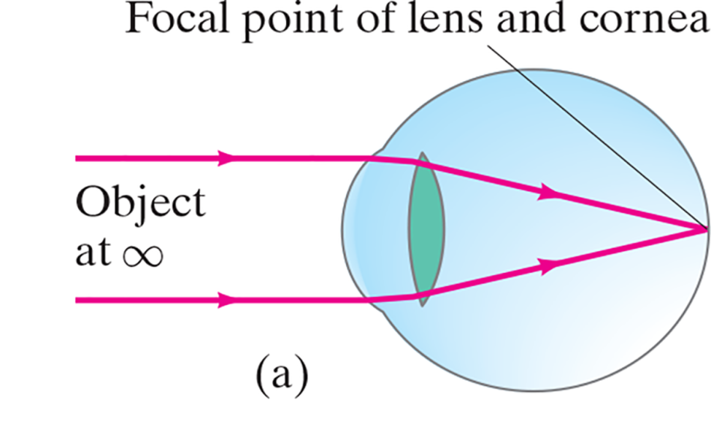

33-6 The Human Eye; Corrective Lenses (2 of 8)
Most of the refraction is done at the surface of the cornea; the lens makes small adjustments to focus at different distances.
Notes:
Figure 33-26. Accommodation by a normal eye: (a) lens relaxed, focused at infinity; (b) lens thickened, focused on a nearby object.
LD: Two horizontal parallel light rays emerge from an object at infinity. The light rays are incident on the lens of an eye placed at the right side of the figure. The rays then get refracted and converge at a point on the retina. The point of convergence is labeled Focal point of lens and cornea.
LD: Two divergent rays from a point labeled Object are incident on the lens of an eye placed at the right side of the figure. The lens of the eye appears to be broad at the center. The rays then get refracted and converge at a point on the retina. A point inside the eye, to the left of the retina is labeled Focal point of lens and cornea.

Slide 34
33-6 The Human Eye; Corrective Lenses (3 of 8)
Near point: closest distance at which eye can focus clearly. Normal is about 25 c m.
Far point: farthest distance at which object can be seen clearly. Normal is at infinity.
Nearsightedness: far point is too close.
Farsightedness: near point is too far away.

Slide 35
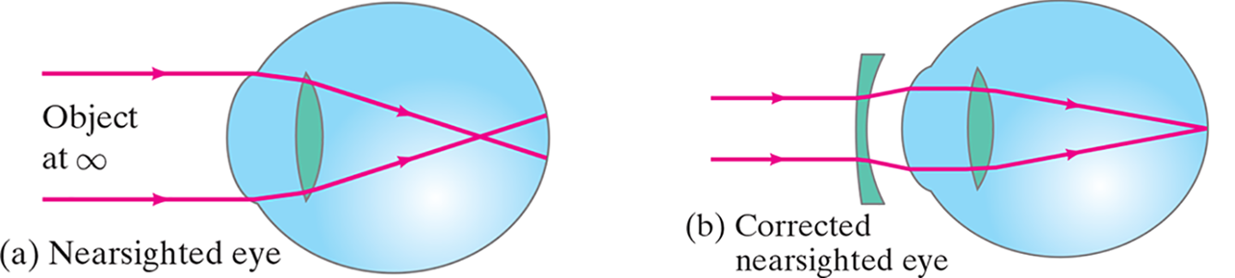
33-6 The Human Eye; Corrective Lenses (4 of 8)
Nearsightedness can be corrected with a diverging lens.
Notes:
Figure 33-27. Correcting eye defects with lenses. (a) A nearsighted eye, which cannot focus clearly on distant objects (focal point is in front of retina), can be corrected (b) by use of a diverging lens.
LD: Part ("a") Nearsighted eye: Two horizontal parallel light rays emerge from an object at infinity. The light rays are incident on the lens of an eye placed at the right side of the figure. The lens appears elongated. Then the rays get refracted and converge at a point before the retina. Part (b) Corrected nearsighted eye: Two horizontal parallel light rays are incident on a concave meniscus lens placed with the plane side facing toward the left. The concave meniscus lens is positioned at the left side of the lens of an eye placed at the right side of the figure. The lens of the eye appears elongated. The rays get refracted and slightly diverge till the surface of the eye. Then the rays get refracted and converge at a point on the retina passing through the top and bottom of the lens of the eye.

Slide 36
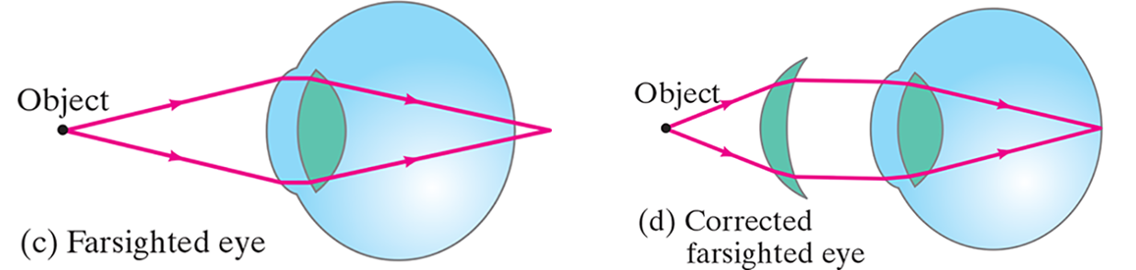
33-6 The Human Eye; Corrective Lenses (5 of 8)
And farsightedness with a diverging lens.
Notes:
Figure 33-27. Correcting eye defects with lenses. (c) A farsighted eye, which cannot focus clearly on nearby objects (image point behind retina), can be corrected (d) by use of a converging lens.
LD: Part (c) Farsighted eye: Two divergent rays from a point labeled Object are incident on the lens of an eye placed at the right side of the figure. The lens appears broad at the center. The rays then get refracted and converge at a point at the right side of the retina. Part (d) Corrected farsighted eye: Two divergent rays from a point labeled Object are incident on a convex meniscus lens positioned at the left side of the lens of an eye. The lens of the eye appears broad at the center. The rays then get refracted and emerge as horizontal parallel rays. The parallel rays are incident on the lens in the eye, which appears broad at the center. Then the rays refract again and converge at a point on the retina passing through the top and bottom of the lens of the eye.

Slide 37
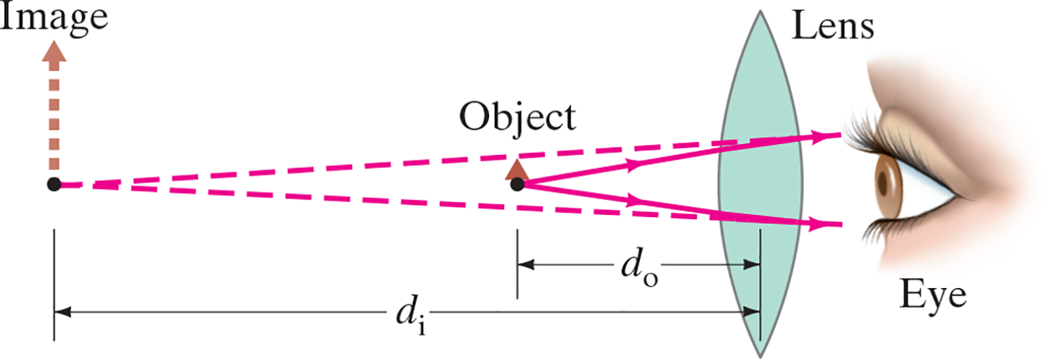
33-6 The Human Eye; Corrective Lenses (6 of 8)
Example 33-11: Farsighted eye.
A farsighted eye has a near point of 100 c m. Reading glasses must have what lens power so that a newspaper can be read at a distance of 25 c m? Assume the lens is very close to the eye.
Notes:
Figure 33-29. Lens of reading glasses (Example 33–11).
LD: A human eye that faces toward the left is present on the extreme right of the figure. A converging lens is present at the left of the eye. An object arrow labeled Object is placed at a point on the left of the lens. Two rays diverge from the object toward the lens. The rays refract and approach the top and bottom of the eye. The rays are extended backward using dashed lines. The dashed lines converge at a point on the extreme left from where a virtual image arrow extends to the top. The virtual image arrow is labeled Image. A double-headed arrow labeled d subscript i marks the distance between the optical center of the lens and the Image. A double-headed arrow labeled d subscript o marks the distance between the optical center of the lens and Object.

Slide 38
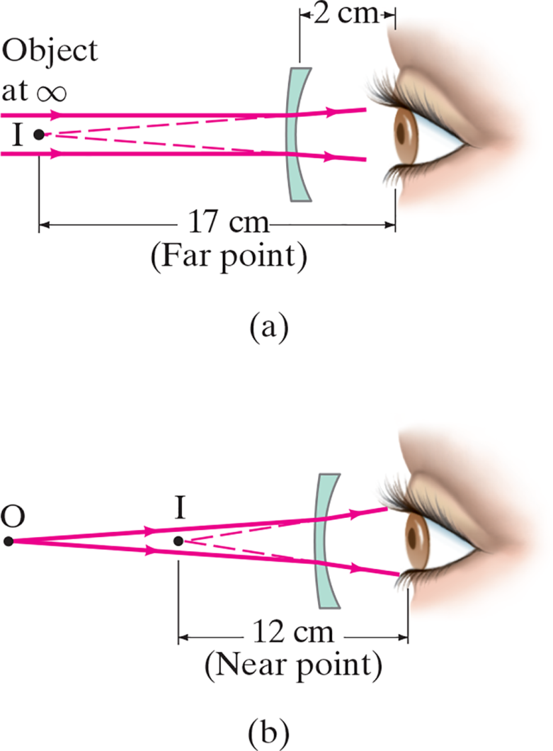
33-6 The Human Eye; Corrective Lenses (7 of 8)
Example 33-12: Nearsighted eye.
A nearsighted eye has near and far points of 12 c m and 17 c m, respectively. (a) What lens power is needed for this person to see distant objects clearly, and (b) what then will be the near point? Assume that the lens is 2.0 c m from the eye (which is typical).
Notes:
Figure 33-30. Example 33–12.
LD: Part (“a”): Two horizontal light rays parallel to each other emerge from an object placed at infinity at the left of the figure. The rays strike the left boundary of a thin meniscus lens, which is placed at the right. Then the light rays at the top and bottom get refracted toward the upper right and lower right, respectively. Dashed lines extend backward from the refracted rays to intersect at a point labeled I to the left of the lens. A double-headed arrow labeled 17 c m (Far point) marks the distance from point I to a human eye that is placed at the right of the lens. Part (b): Two light rays emerge from a point labeled O at the left of the figure. The rays move toward the upper right and lower right, respectively, till the left boundary of a thin meniscus lens placed at the right. Then the light rays get refracted toward the upper right and lower right, respectively. Dashed lines are extended backward from the refracted rays to intersect at a point labeled I to the left of the lens. A double-headed arrow labeled 12 c m (Near point) marks the distance from point I to a human eye that is placed at the right of the lens.

Slide 39
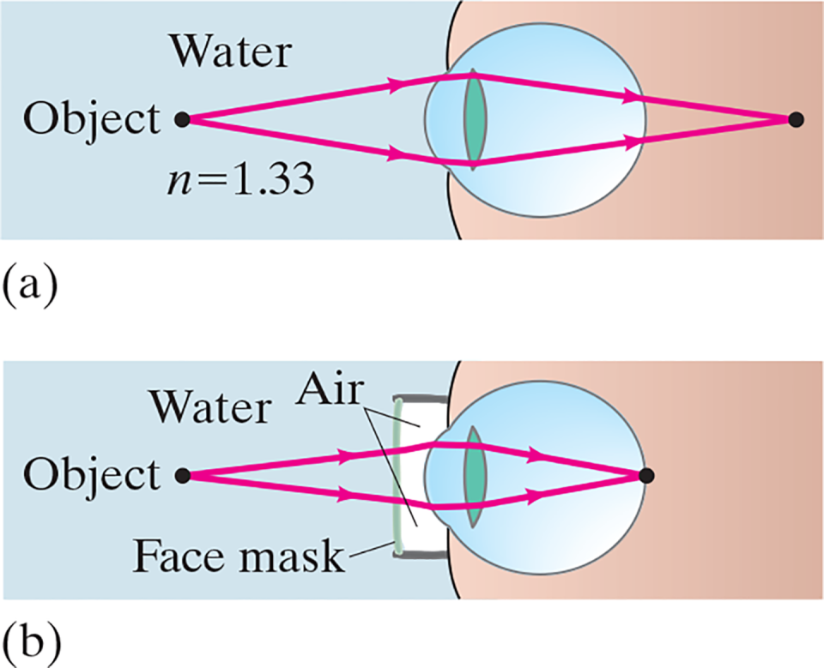
33-6 The Human Eye; Corrective Lenses (8 of 8)
Vision is blurry under water because light rays are bent much less than they would be if entering the eye from air. This can be avoided by wearing goggles.
Notes:
Figure 33-31. (a) Under water, we see a blurry image because light rays are bent much less than in air. (b) If we wear goggles, we again have an air 9 cornea interface and can see clearly.
LD: Part ("a"): The left side of the figure is the water medium. Two divergent rays from a point labeled Object at a point inside the water are incident on the lens of an eye at the right. Then the rays get refracted and converge at a point behind the retina. Note: n equals 1.33. Part (b): The left side of the figure is the water medium. A pair of underwater goggles is placed on the eye at the right. The goggles form an air medium between the eye and the water medium. Two divergent rays from a point labeled Object inside the water medium are incident on the lens of the eye. Then the rays get refracted and converge at a point on the retina.

Slide 40
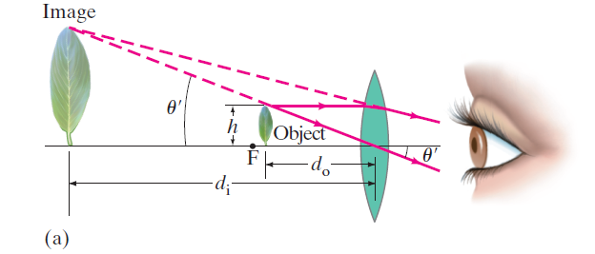
33-7 Magnifying Glass (1 of 3)
A magnifying glass (simple magnifier) is a converging lens. It allows us to focus on objects closer than the near point, so that they make a larger, and therefore clearer, image on the retina.
Notes:
Figure 33-33a. Leaf viewed (a) through a magnifying glass. The eye is focused at its near point.
LD: Part (“a”), Leaf viewed through a magnifying glass: The eye facing toward the left is shown at the extreme right of the figure. A convex lens is placed at the left of the eye. The object depicted as a leaf is placed on the left of the lens and the image of the leaf is placed to the left of the object. The height of the object from the principal axis is labeled h. A point F is marked on the principal axis to the left of the object. Two rays emerge from the object and approach two points at the top and bottom of the lens. The first ray is parallel to the axis. It refracts and bends slightly downward to the right, exits the lens, and stops at a point near the top of the eye. The second ray, passes through the optical center of the lens and propagate in the same path after refraction at an angle theta prime with the axis. The second ray stops at a point near the bottom of the eye. The two dashed lines converge at image above the principal axis, to the left of F. The dashed line corresponding to the second ray makes an angle labeled theta prime with the axis. A double-headed arrow labeled d subscript o marks the distance between the object and the optical center. A double-headed arrow labeled d subscript i marks the distance between Image and the optical center.

Slide 41
33-7 Magnifying Glass (2 of 3)
The power of a magnifying glass is described by its angular
magnification:
If the eye is relaxed (N is the near point distance and f is the
focal length):
If the eye is focused at the near point:

Slide 42
33-7 Magnifying Glass (3 of 3)
Example 33-13: A jeweler’s “loupe.”
An 8-c m-focal-length converging lens is used as a “jeweler’s loupe,” which is a magnifying glass.
Estimate (a) the magnification when the eye is
relaxed, and (b) the magnification if the eye is focused
at its near point

Slide 43
33-8 Telescopes (1 of 4)
A refracting telescope consists of two converging lenses at opposite ends of a long tube. The objective lens is closest to the object, and the eyepiece is closest to the eye.
The magnification is given by

Slide 44
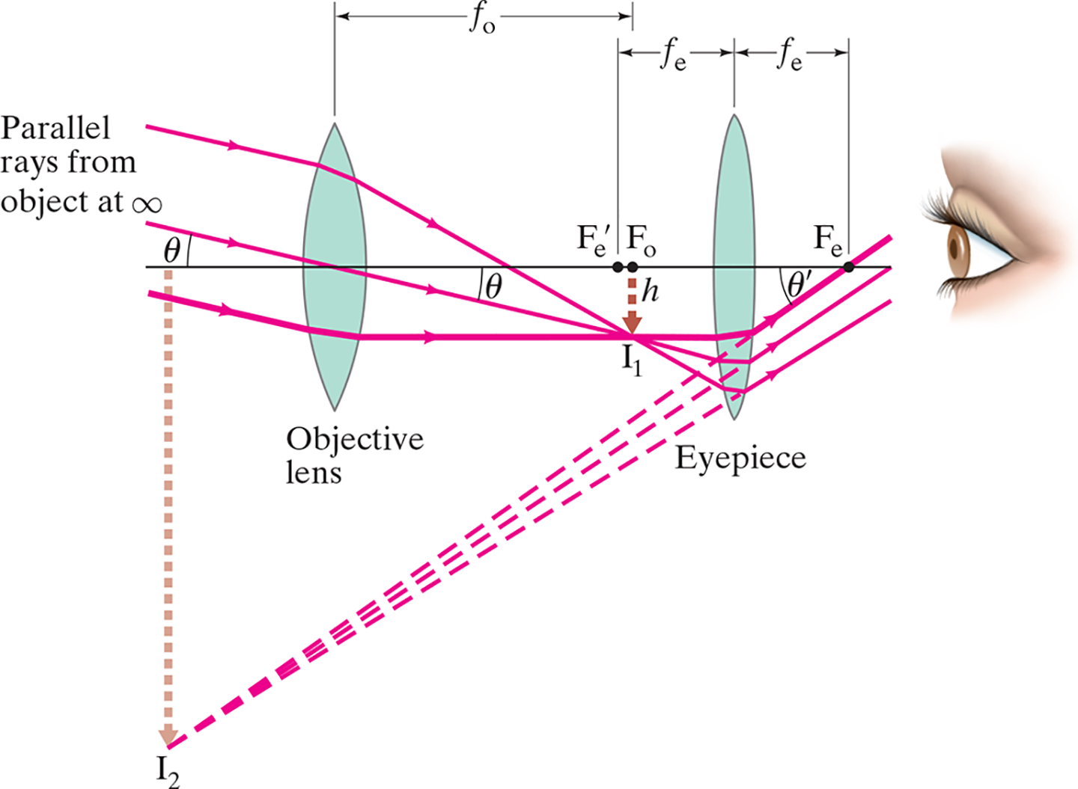
33-8 Telescopes (2 of 4)
Notes:
Figure 33-36. Astronomical telescope (refracting). Parallel light from one point on a distant object (do = ∞) is brought to a focus by the objective lens in its focal plane. This image (I1) is magnified by the eyepiece to form the final image I2, which is inverted (and not much use for viewing objects on Earth). Only two of the rays shown entering the objective lens are standard rays (2 and 3) as described in Fig. 33–6.
LD: Two converging lenses are shown. The lens on the left is labeled Objective lens and the lens on the right is labeled Eyepiece. A point labeled F subscript e is at the right of Eyepiece on the principal axis. A point labeled F subscript o is at the left of Eyepiece. A point labeled F prime subscript e is placed close to F subscript o at the left. A human eye that faces toward the left is placed at the right of Eyepiece. Three parallel light rays labeled Parallel rays from object at infinity strikes the left boundary of Objective lens. The rays get refracted toward the lower right and pass through Objective lens. The ray at the center makes an angle labeled theta with the principal axis. The rays continue to refract and meet at the tip of the inverted real image arrow labeled I subscript 1, drawn from the point F subscript o. The height of the real image arrow is labeled h. The light rays continue to move in the same direction and strike the lower left boundary of the eyepiece, reflect upward to the right toward the principal axis, and make an angle labeled theta prime with the horizontal. Then the rays move upward to meet the eye on the right. The topmost ray passes through the point F subscript e on the principal. The reflected rays are extended backward by dashed lines and appear to meet at the tip of an inverted virtual image arrow labeled I subscript 2. The arrow is placed to the left of the objective lens. The virtual image arrow is larger than the real image arrow. A double-headed arrow labeled f subscript o indicates the distance from Objective lens to F subscript o. A double-headed arrow labeled f subscript e indicates the distance from F prime subscript e to Eyepiece. Another double-headed arrow labeled f subscript e indicates the distance from Eyepiece to F subscript e.

Slide 45
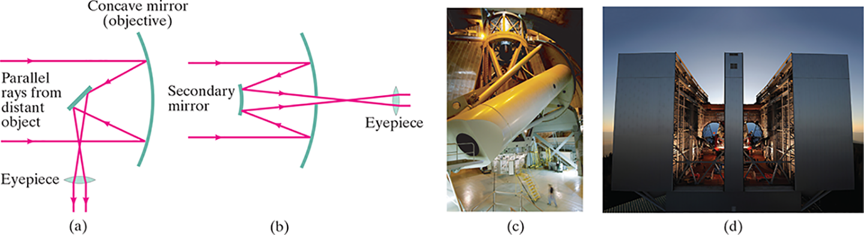
33-8 Telescopes (3 of 4)
Astronomical telescopes need to gather as much light as possible, meaning that the objective must be as large as possible. Hence, mirrors are used instead of lenses, as they can be made much larger and with more precision.
Notes:
Figure 33-38. A concave mirror can be used as the objective of an astronomical telescope. Arrangement (a) is called the Newtonian focus, and (b) the Cassegrainian focus. Other arrangements are also possible. (c) The 200-inch (mirror diameter) Hale telescope on Palomar Mountain in California. (d) The Large Binocular Telescope in Arizona uses two 8.4-m-diameter objective reflectors; it was constructed in Italy.
LD: Part (“a”): The concave mirror is placed on the right side and a tilted secondary mirror is placed in front of the reflecting surface of the concave mirror. The secondary mirror is tilted to the right approximately at an angle of 45 degrees. The eyepiece of the telescope is shown below the secondary mirror. Two light rays labeled Parallel rays from distant object, are projected on the concave mirror. The light rays reflect from the concave mirror and appear to converge at the secondary mirror. From the secondary mirror, the light rays reflect downward, converge each other and pass through the eyepiece of the telescope. The light rays become parallel to each other as they cross the eyepiece. The arrangement is called Newtonian focus. Part (b): A concave mirror used as an objective is shown. The concave mirror is placed on the right and a vertical secondary mirror is placed on the left of the figure, in front of the reflecting surface of the concave mirror. The eyepiece of the telescope is shown behind the concave mirror. Two parallel rays of light are projected on the concave mirror. The light rays reflect from the concave mirror and appear to converge at the secondary mirror. From the secondary mirror, the light rays reflect backward toward the eyepiece, converge with each other, and pass through the eyepiece of the telescope. The light rays become parallel to each other as they cross the eyepiece. The arrangement is called Cassegrainian focus. Part (c): A photograph of a 200-inch mirror diameter Hale telescope on Palomar Mountain in California is shown. Part (d): A photograph of the Large Binocular Telescope in Arizona that uses two 8.4-m-diameter objective reflectors is shown.

Slide 46
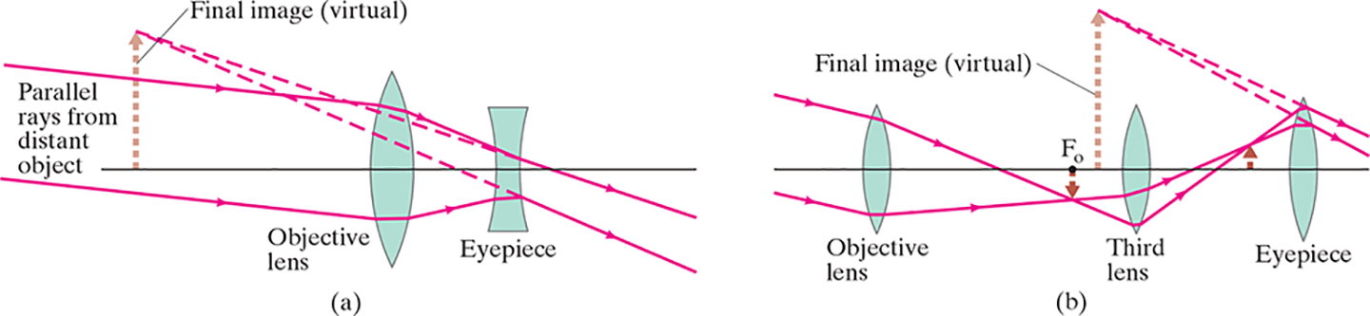
33-8 Telescopes (4 of 4)
A terrestrial telescope, used for viewing objects on Earth, should produce an upright image. Here are two models, a Galilean type and a spyglass:
Notes:
Figure 33-39. Terrestrial telescopes that produce an upright image: (a) Galilean; (b) spyglass, or erector type.
LD: Part (“a”): Image formed by a Galilean telescope is shown. A converging lens labeled Objective lens and a diverging lens labeled Eyepiece are shown. Objective lens is to the left of the Eyepiece. Two light rays labeled Parallel rays from distant object strike the left boundary of Objective lens, refract toward the principal axis, and then strike the left boundary of Eyepiece. The rays slightly diverge away from the principal axis as they exit Eyepiece. The projections of the diverged rays are extended backward using dashed lines and they meet at the tip of a dashed arrow labeled Final image (virtual) on the left side of the lenses. Part (b): Image formed by a spyglass is shown. Three converging lenses labeled Objective lens, Third lens, and Eyepiece are shown. The Objective lens is on the left, the third lens is in the center, and the eyepiece is on the right. Two light rays strike the left boundary of Objective lens at the top and bottom, refract toward the principal axis, meet below the principal axis, and then strike the left boundary of Third lens below the principal axis. Tip of an inverted real image arrow labeled F subscript o, from the principal axis meets the point of convergence of the light rays between Objective lens and the Third lens. The light rays refract upward from Third lens and again converge above the principal axis, and then strike the left boundary of Eyepiece at the top. The tip of a real image arrow from the principal axis meets the point of convergence of the light rays between Eyepiece and Third lens. Then the rays bend toward the principal axis as they exit Eye piece. The projections of the rays are extended backward by dashed lines and they meet at the tip of a virtual image arrow labeled Final image (virtual) to the right of F subscript o. The length of the virtual image arrow is greater than the real image arrows.

Slide 47
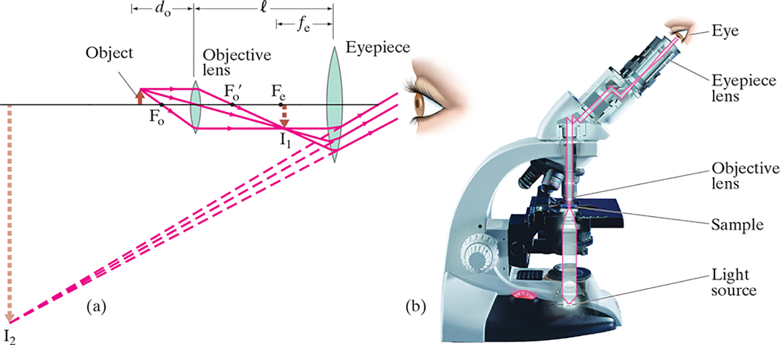
33-9 Compound Microscope (1 of 3)
A compound microscope also has an objective and an eyepiece; it is different from a telescope in that the object is placed very close to the eyepiece.
Notes:
Figure 33-40. Compound microscope: (a) ray diagram, (b) photograph (illumination comes from below, outlined in red, then up through the slide holding the sample or object).
LD: Part (“a”): An objective lens, an Eyepiece, and an eye of a person are shown from left to right on a straight line. A point labeled F subscript o is marked on the line at the left. A convex lens labeled Objective lens is placed to the right of the point with its center on the line. The distance of the point from the objective lens is labeled d subscript o, marked by a double headed arrow. A point labeled F prime subscript o is marked on the right of the objective lens. A second point labeled F subscript e is marked to the right of the point F prime subscript o. A bigger convex lens labeled Eyepiece is placed at a distance of f subscript e from the point F subscript e, with its center on the line. The distance is marked by a double headed arrow. The distance between the two lenses is labeled l, marked by a double headed arrow. An upward arrow labeled Object is placed to the left of the point F subscript o. Three light rays emerge from the tip of the Object. The first ray is parallel to the horizontal line and meets the top of the Objective lens. The second ray passes through the center of the objective lens. The third ray meets the Objective lens at its bottom, below the horizontal line. After passing through the objective lens, the first ray bends downward to the right, the second ray follows its path, and the third ray becomes parallel to the horizontal line. The three lenses converge at the tip of an inverted arrow labeled I subscript 1 placed below point F subscript e. The light rays continue their motion and meet the Eyepiece below the horizontal line near its bottom. After passing through the Eyepiece, the rays bend upward, toward the human eye. The three rays are projected backward, represented by dashed lines, and they converge at the tip of an inverted and enlarged arrow labeled I subscript 2 below the horizontal line. Part (b): A human eye is shown above the eyepiece of the microscope. The Eyepiece lens, Objective lens, Sample, and Light Source are marked on the microscope.

Slide 48
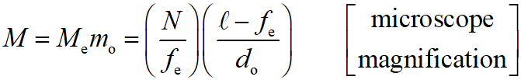

33-9 Compound Microscope (2 of 3)
The magnification is given by

Slide 49
33-9 Compound Microscope (3 of 3)
Example 33-15: Microscope.
A compound microscope consists of a 10 X eyepiece and a 50 X objective 17.0 c m apart. Determine (a) the overall magnification, (b) the focal length of each lens, and (c) the position of the object when the final image is in focus with the eye relaxed. Assume a normal eye, so

Slide 50
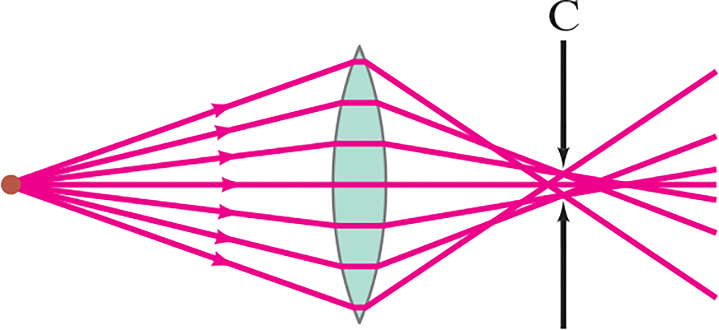
33-10 Aberrations of Lenses and Mirrors (1 of 4)
Spherical aberration: rays far from the lens axis do not focus at the focal point.
Solutions: compound-lens systems; use only central part of lens.
Notes:
Figure 33-41. Spherical aberration (exaggerated). Circle of least confusion is at C.
LD: A point is marked at a distance to the left of the convex lens along the principal axis. Seven equidistant light rays emerge from the point and propagate in different directions toward the lens. The first, second, and third light rays propagate toward the upper right to meet the upper left boundary of the lens. The fourth light ray passes through the principal axis of the lens. The fifth, sixth, and seventh light rays propagate toward the lower right to meet the lower left boundary of the lens. All seven light rays propagate parallel to the principal axis within the lens. Then the first and seventh light rays get refracted toward the lower right and upper right, respectively, to converge at a point on the fourth ray at the right of the lens. The rays continue to propagate in their respective directions. The second and third light rays get refracted toward the lower right, the fifth and sixth light rays get refracted toward the upper right, and the fourth light ray continues to propagate along the principal axis. These light rays converge at a point to the right of the point of convergence of the first and seventh refracted rays. Two arrows labeled C extend from the top and bottom of the axis toward the area between the two points of convergence.

Slide 51
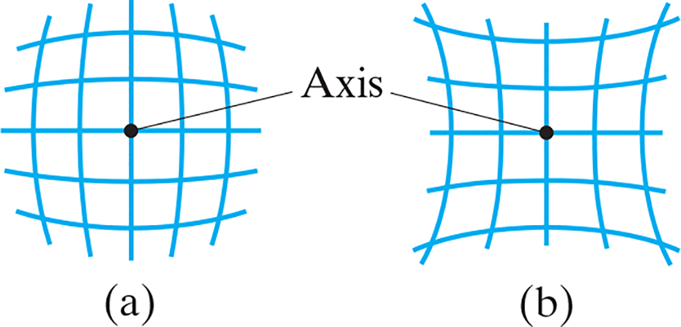
33-10 Aberrations of Lenses and Mirrors (2 of 4)
Distortion: caused by variation in magnification with distance from the lens. Barrel and pincushion distortion:
Notes:
Figure 33-42. Distortion: lenses may image a square grid of perpendicular lines to produce (a) barrel distortion or (b) pincushion distortion. These distortions can be seen in the photograph of Fig. 33–2d for a simple lens.
LD: Part (“a”): A square grid with 5 rows and 5 columns are shown. A point at the center of the grid is labeled Axis. The square grid is bulged outward, toward the observer, along its axis. Part (b): A square grid with 5 rows and 5 columns are shown. A point at the center of the grid is labeled Axis. The square grid is bulged inward, away from the observer, along its axis.

Slide 52
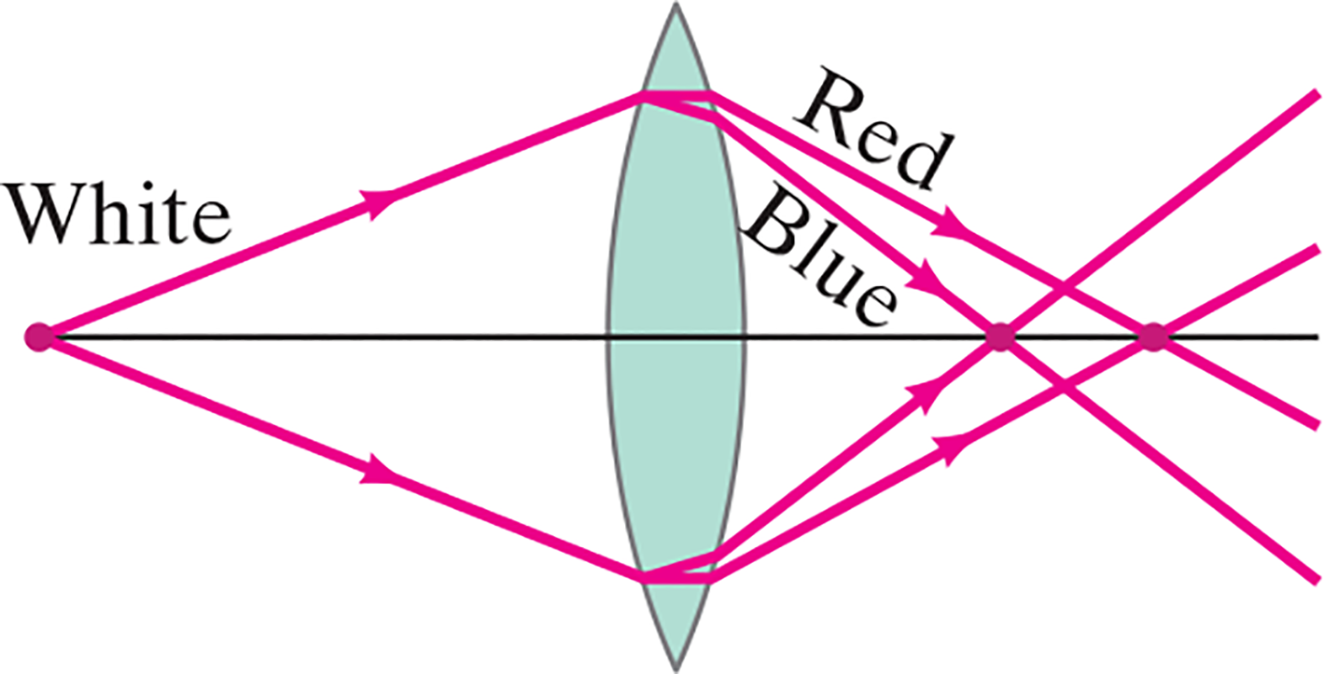
33-10 Aberrations of Lenses and Mirrors (3 of 4)
Chromatic aberration: light of different wavelengths has different indices of refraction and focuses at different points.
Notes:
Figure 33-43. Chromatic aberration. Different colors are focused at different points.
LD: A point is marked on the left end of the principal axis of the convex lens. The lens is placed at the right of the point. Two light rays labeled White emerge from the point and propagate toward the upper right and lower right, respectively, of the left boundary of the lens. Each light ray then splits into two rays labeled Red and Blue. The two Red light rays get refracted toward the lower right and upper right, respectively, and converge at a point on the axis. The two Blue light rays get refracted toward the lower right and upper right, respectively, and converge at a point on the axis, which is to the left of the point of convergence of the Red light rays.

Slide 53
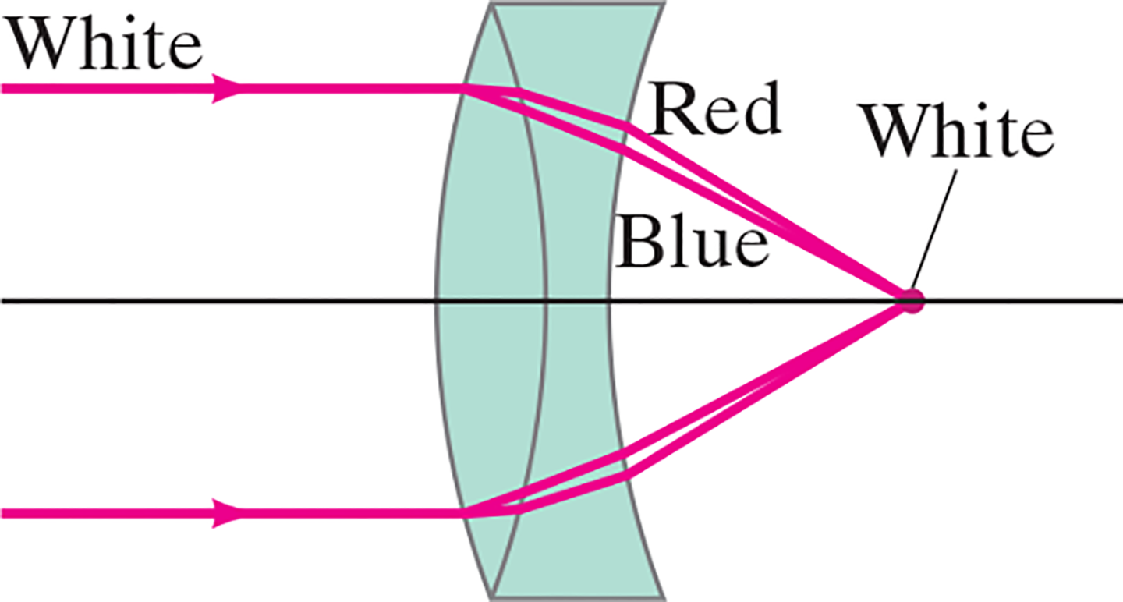
33-10 Aberrations of Lenses and Mirrors (4 of 4)
Solution: Achromatic doublet, made of lenses of two different materials
Notes:
Figure 33-44. Achromatic doublet.
LD: Two horizontal light rays, one above the axis and one below the axis emerge from the left of the figure till the left boundary of the lens. The light rays are labeled White and get refracted as two parts toward the lower right and upper right. The rays split into two rays each as they refract. The first part of the split ray is labeled Red and the other part is labeled Blue. The refracted rays converge at a point labeled White at the right of the lens on the horizontal axis.

Slide 54
Summary of Chapter 33 (1 of 5)
Lens uses refraction to form real or virtual image.
Converging lens: rays converge at focal point.
Diverging lens: rays appear to diverge from focal point.
Power is given in diopters

Slide 55
Summary of Chapter 33 (2 of 5)
Thin lens equation:
Magnification:

Slide 56
Summary of Chapter 33 (3 of 5)
Camera focuses image on film or electronic sensor; lens can be moved and size of opening adjusted (f-stop).
Human eye also makes adjustments, by changing shape of lens and size of pupil.
Nearsighted eye is corrected by diverging lens.
Farsighted eye is corrected by converging lens.

Slide 57
Summary of Chapter 33 (4 of 5)
Magnification of simple magnifier:
Telescope: objective lens or mirror plus eyepiece lens. Magnification:

Slide 58
Summary of Chapter 33 (5 of 5)
Microscope: objective lens plus eyepiece lens. Magnification:

Slide 59

Copyright
This work is protected by United States copyright laws and is provided solely for the use of instructors in teaching their courses and assessing student learning. Dissemination or sale of any part of this work (including on the World Wide Web) will destroy the integrity of the work and is not permitted. The work and materials from it should never be made available to students except by instructors using the accompanying text in their classes. All recipients of this work are expected to abide by these restrictions and to honor the intended pedagogical purposes and the needs of other instructors who rely on these materials.

