Slide 1
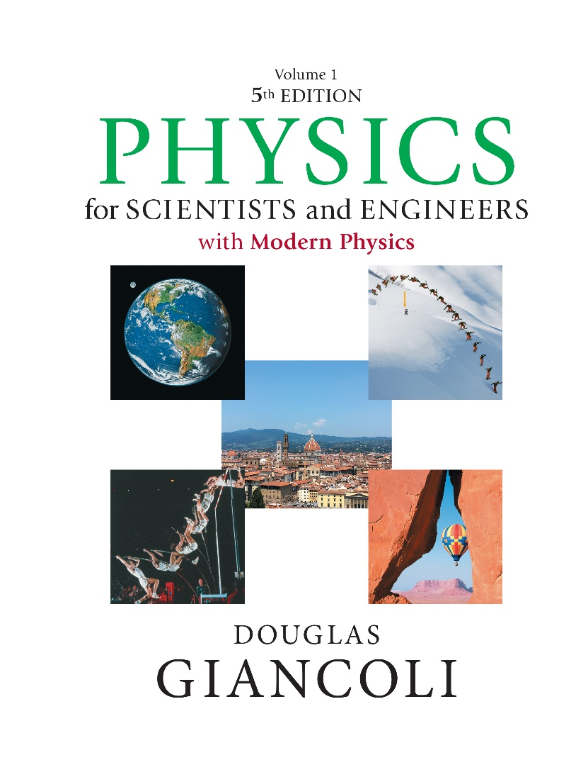

Physics for Scientists and Engineers with Modern Physics
Fifth Edition
Chapter 34
The Wave Nature of Light: Interference and Polarization
Copyright © 2023 Pearson Education, Inc. All Rights Reserved
Notes:
If this PowerPoint presentation contains mathematical equations, you may need to check that your computer has the following installed:
1) MathType Plugin
2) Math Player (free versions available)
3) NVDA Reader (free versions available)

Slide 2
Units of Chapter 34 (1 of 2)
Waves vs. Particles; Huygens’ Principle and Diffraction
Huygens’ Principle and the Law of Refraction; Mirages
Interference—Young’s Double-Slit Experiment
Intensity in the Double-Slit Interference Pattern
Interference in Thin Films
Michelson Interferometer

Slide 3
Units of Chapter 34 (2 of 2)
Polarization
Liquid Crystal Displays (L C D)
Scattering of Light by the Atmosphere
Brightness: Lumens and Luminous Intensity
Efficiency of Lightbulbs

Slide 4
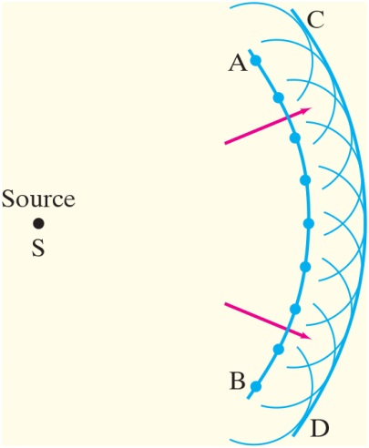
34-1 Waves vs. Particles; Huygens’ Principle and Diffraction (1 of 2)
Huygens’ principle: every point on a wave front acts as a point source; the wave front as it develops is tangent to all the wavelets.
Notes:
Figure 34-1. Huygens’ principle, used to determine wave front CD when wave front AB is given.
LD: Two concentric arcs open to the left are shown on the right of the figure. A point labeled Source S is shown on the left and is in line with the center of the arcs. The arc closer to Source is labeled A B. The arc on the right of A B is labeled C D. An arrow from Source points to the upper right and intersects A B. Similarly, another arrow from Source points to the lower right and intersects A B. Nine equidistant points are marked on A B. Nine overlapping semicircular arcs open to the left are drawn on C D such that the midpoint of each arc lies on CD and is in line with a point on A B.

Slide 5
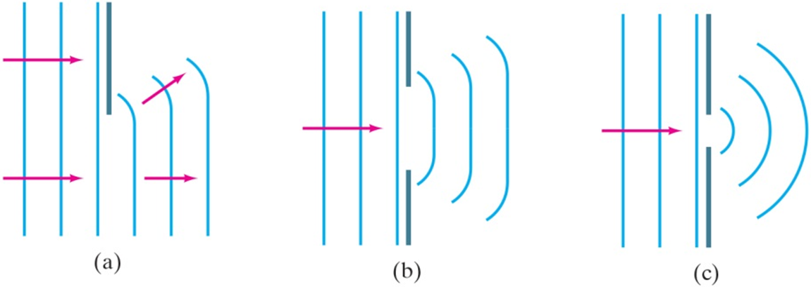
34-1 Waves vs. Particles; Huygens’ Principle and Diffraction (2 of 2)
Huygens’ principle is consistent with diffraction:
Notes:
Figure 34-2. Huygens’ principle is consistent with diffraction (a) around the edge of an obstacle, (b) through a large hole, (c) through a small hole whose size is on the order of the wavelength of the wave.
LD: In all three parts, three parallel vertical lines representing the wave fronts are shown on the left. In part (“a”), a short vertical line representing the obstacle is shown on the top. Two horizontal right-pointing arrows are shown on the three vertical lines. Three parallel, equidistant half curves resembling half parentheses open to the left are shown to the right of the obstacle. An arrow pointing toward the upper right is shown on the top and a horizontal arrow pointing right is shown on the three half curves. In part (b), a vertical grating with a single slit having a wide gap is shown to the right of the three vertical lines. A horizontal arrow pointing right at the center of the slit is shown on the left of the grating. Three parallel, equidistant concentric curves resembling parentheses open to the left are shown to the right of the slit. The size of the curves increases from left to right. In part (c), a vertical grating with a single slit having a narrow gap is shown to the right of the three vertical lines. A horizontal arrow pointing right at the center of the slit is shown on the left of the grating. Three parallel, equidistant concentric circular curves open to the left are shown to the right of the slit. The size of the curves increases from left to right.

Slide 6
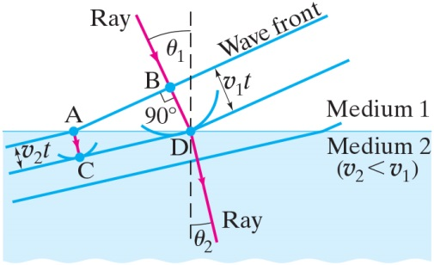
34-2 Huygens’ Principle and the Law of Refraction; Mirages (1 of 4)
Notes:
Figure 34-3. Refraction explained, using Huygens’ principle. Wave fronts are perpendicular to the rays.
LD: The figure is divided into two halves by a blue horizontal line. The upper half is labeled Medium 1. The bottom half of the figure is shaded blue and is labeled Medium 2 (v subscript 2 is less than v subscript 1). A diagonal ray of light from the upper left of the figure extends toward the lower right, meets the horizontal line at the center at a point labeled D, and gets refracted toward the lower right. A vertical dashed line is drawn from the point where the ray meets the horizontal line. The angle between the incident ray and the vertical dashed line is theta subscript 1, and the angle between the refracted ray and the vertical dashed line is theta subscript 2. Theta subscript 2 is lesser than theta subscript 1. Three parallel blue lines labeled Wave front start from the upper right of the figure, extend toward the lower left, strike the horizontal line, bend slightly toward the left, and continue to extend downward. The first line strikes the blue horizontal line at a point labeled “A” is marked to the left of D. The second line shown in the middle strikes the blue horizontal line at D. The third line strikes the blue horizontal line at a point marked to the right of D. The perpendicular distance between the lines striking “A” and D is labeled v subscript 1 t. A perpendicular arrow from “A” extends to the lower right and meets the line extending downward from D at a point labeled C. The distance between “A” and C is v subscript 2 t. A small upward open arc is drawn at D.

Slide 7
34-2 Huygens’ Principle and the Law of Refraction; Mirages (2 of 4)
Huygens’ principle can also explain the law of refraction.
As the wavelets propagate from each point, they propagate more slowly in the medium of higher index of refraction.
This leads to a bend in the wave front and therefore in the ray.

Slide 8


34-2 Huygens’ Principle and the Law of Refraction; Mirages (3 of 4)
The frequency of the light does not change, but the wavelength does as it travels into a new medium:

Slide 9
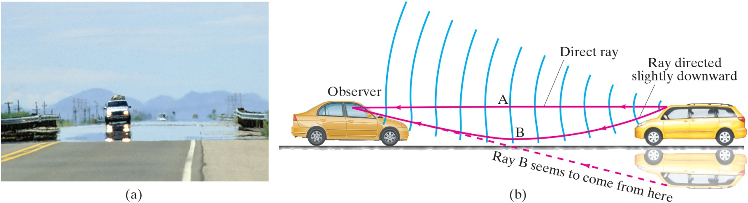
34-2 Huygens’ Principle and the Law of Refraction; Mirages (4 of 4)
Highway mirages are due to a gradually changing index of refraction in heated air.
Notes:
Figure 34-4. (a) A highway mirage (there is not really water on the road). (b) Drawing (greatly exaggerated) showing wave fronts and rays to explain highway mirages. Note how sections of the wave fronts near the ground are slightly farther apart, which means they are moving faster.
LD: In part (“a”), a photograph of a car at the far end of a road and traveling in the direction of the observer is shown. The headlights of the car are on. The road around the car appears glossy, and a reflection of the car is seen right below the car such that the wheels of the car are in contact with the wheels of its reflection. In part (b), the side view of two cars placed on a horizontal surface is shown. The car on the left appears to be traveling to the right, and the car on the right appears to be traveling to the left. The horizontal ray of light labeled “A”, a direct ray from the windshield of the car on the right points at the windshield of the car on the left. A curved ray of light labeled B, Ray directed slightly downward from the same start point as “A” on the windshield of the car on the right curves toward the lower right, rises, and ends at the same start point as “A” on the windshield of the car on the left. A diagonal dashed arrow labeled ray B seems to come from here is drawn from the windshield of the reflection of the car, extends to the upper right, and ends at the same start point as “A” on the windshield of the car on the left. The car on the right appears to be emitting wave fronts shown as concentric arcs open on the right that end at the car on the left. The length of the arcs increases in size from right to left.

Slide 10
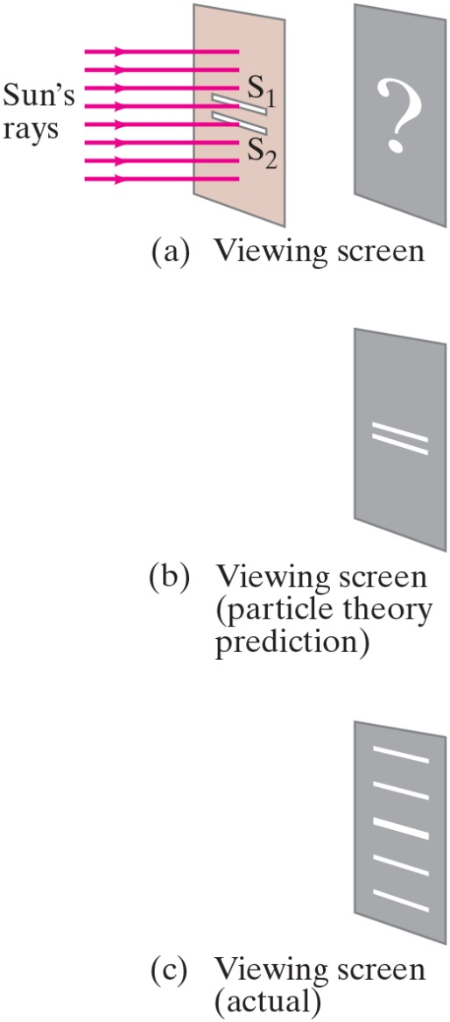
34-3 Interference—Young’s Double-Slit Experiment (1 of 10)
If light is a wave, interference effects will be seen, where one part of a wave front can interact with another part.
One way to study this is to do a double-slit experiment:
Notes:
Figure 34-5. (a) Young’s double slit experiment. The slits and their separation need to be very thin. (b) If light consists of particles, we would expect to see two bright lines on the screen behind the slits. (c) In fact, many lines are observed.
LD: The three parts are shown vertically one below the other. Part (“a”) is labeled Viewing screen. A vertically aligned rectangular screen with two thin horizontal parallel slits placed one below the other at the center is shown on the left. The slit on the top is labeled S subscript 1 and the slit below it is labeled S subscript 2. A beam of monochromatic light shown as horizontal parallel equidistant rays labeled Sun’s rays from left strike the face of the screen. Another vertically aligned rectangular screen is shown to the right. This screen is parallel to and horizontally in line with the screen on its left. A question mark is shown on the face of the screen on the right. Part (b) is labeled Viewing screen (particle theory prediction). Only the second screen that was on the right in part (“a”) is shown. Two thin horizontal parallel lines having dimensions similar to that of the slits on the screen on the left in part (“a”) are shown at the center of the screen. Part (c) is labeled Viewing screen (actual). Only the second screen that was on the right in part (“a”) is shown. Five thin horizontal parallel lines equidistant from each other are shown at the center of the screen. The line in the middle is the brightest, and the intensity of the lines reduces as we move away from the middle. The lines are slightly thicker than the slits shown on the left screen in part (“a”).

Slide 11
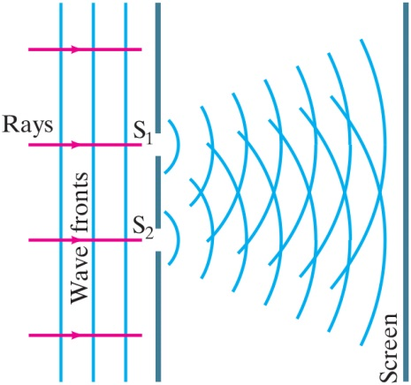
34-3 Interference—Young’s Double-Slit Experiment (2 of 10)
If light is a wave, there should be an interference pattern.
Notes:
Figure 34-6. Plane waves (parallel flat wave fronts) fall on two slits. If light is a wave, light passing through one of two slits should interfere with light passing through the other slit.
LD: The slit on the top is labeled S subscript 1 and the slit at the bottom is labeled S subscript 2. A vertical line labeled Screen is shown to the right of the grating. Four parallel horizontal arrows labeled Rays pointing right are shown to the left of the grating of which the middle two arrows are seen passing through the two slits. Three parallel equidistant vertical lines labeled Wave fronts are shown on the left of the grating. Concentric curves open to the left start from the right side of each slit and extend to the right till they reach Screen. The size of the curves increases from left to right. The curves produced by one slit overlaps the curves produced by the other slit.

Slide 12
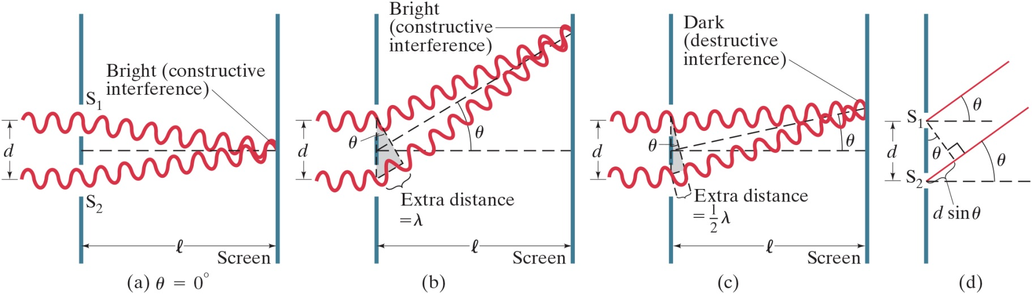
34-3 Interference—Young’s Double-Slit Experiment (3 of 10)
The interference occurs because each point on the screen is not the same distance from both slits. Depending on the path length difference, the wave can interfere constructively (bright spot) or destructively (dark spot).
Notes:
Figure 34-7. How the wave theory explains the pattern of lines seen on a viewing screen due to a double-slit experiment. (a) At the center of the screen, the waves from each slit travel the same distance and are in phase. [Assume l ⟩⟩ d.] (b) At this angle θ, the lower wave travels an extra distance of one whole wavelength, and the waves are in phase; note from the shaded triangle that the path difference equals d sin θ. (c) For this angle θ, the lower wave travels an extra distance equal to one-half wavelength, so the two waves arrive at the screen fully out of phase. (d) A more detailed diagram showing the geometry for parts (b) and (c).
LD: In parts (“a”), (b), and (c), a vertically oriented grating with two identical slits is shown on the left. The slit on the top is labeled S subscript 1 and the slit at the bottom is labeled S subscript 2. The distance between the centers of the two slits is labeled d. A vertical line labeled Screen is shown on the right of the grating. The distance between the grating and Screen is l. A horizontal dashed line from the center of the portion of the grating separating the two slits extends to the right till it reaches the screen. Two horizontal transverse waves of monochromatic light are seen passing through the two slits of the grating from the left. Initially, the waves are identical and appear to have the same amplitude, wavelength, and phase. The waves appear to bend upon reaching the slits. In part (“a”) labeled theta equals 0, the two waves bend inward and converge at the point where the horizontal dashed line meets the screen. This point is labeled Bright (constructive interference). In part (b), the two waves get deflected to the upper right, overlap slightly toward the end, and converge at a point on the screen. This point is labeled Bright (constructive interference). The two waves appear to be in phase throughout. The wave at the bottom appears to have an additional cycle. A vertical dashed line drawn over the slits connects the two waves. A diagonal from the upper end of the vertical dashed line in contact with the wave on the top extends toward the lower right and meets the wave at the bottom. The angle between the vertical dashed line and the diagonal dashed line is theta. A third dashed line labeled Extra distance equals lambda connects the lower end of the diagonal dashed line to the bottom end of the vertical dashed line and spans across one cycle of the wave at the bottom. A diagonal dashed line drawn from the point where the horizontal dashed line starts on the grating extends to the upper right till the point where the two waves converge on the screen. The angle between the horizontal dashed line and the diagonal dashed line is theta. In part (c), the two waves get deflected to the upper right, overlap slightly toward the end, and converge at a point on the screen. This point is labeled Dark (destructive interference) and is at a lower elevation than the point in part (b). The wave at the bottom appears to have an additional half cycle such that after deflection, the peaks of the upper wave appear to be in line with the troughs of the lower wave and vice versa. A vertical dashed line drawn over the slits connects the two waves. A diagonal from the upper end of the vertical dashed line in contact with the wave on the top extends toward the lower right and meets the wave at the bottom. The angle between the vertical dashed line and the diagonal dashed line is theta. A third dashed line labeled Extra distance equals one-half lambda connects the lower end of the diagonal dashed line to the bottom end of the vertical dashed line and spans across half a cycle of the wave at the bottom. A diagonal dashed line drawn from the point where the horizontal dashed line starts on the grating extends to the upper right till the point where the two waves converge on the screen. The angle between the horizontal dashed line and the diagonal dashed line is theta. Theta in part (c) is lesser than theta in part (b). In part (d), only the vertical grating with two slits shown in parts (“a”) to (c) is shown. Two horizontal dashed lines drawn from the centers of S subscript 1 and S subscript 2 extend to the right. The two waves are shown as straight diagonal lines starting at the centers of the slit and extending toward the upper right. The angle between each of the waves and their horizontal lines is theta. A line from the center of S subscript 1 extends toward the lower right such that it is perpendicular to the lower wave. The angle between the vertical grating and the diagonal dashed line is theta. The distance between the center of S subscript 2 and the point where the diagonal line meets the lower wave is labeled d sine theta.

Slide 13
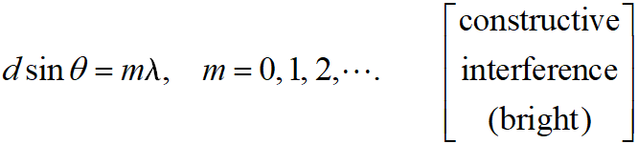
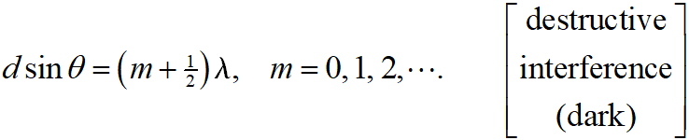
34-3 Interference—Young’s Double-Slit Experiment (4 of 10)
We can use geometry to find the conditions for constructive and destructive interference:
and

Slide 14
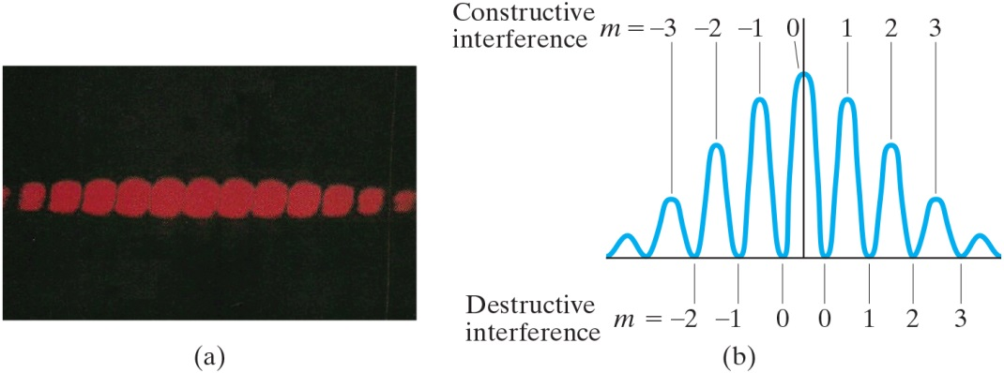
34-3 Interference—Young’s Double-Slit Experiment (5 of 10)
Between the maxima and the minima, the interference varies smoothly.
Notes:
Figure 34-9. (a) Interference fringes produced by a double-slit experiment and detected by photographic film placed on the viewing screen. (b) Graph of the intensity of light in the interference pattern. Also shown are values of m for Eq. 34–2a (constructive interference) and Eq. 34–2b (destructive interference).
LD: In part (“a”), a photograph of the interference fringes captured on a photographic film is shown. The pattern is shown as short red rods on a black background. The intensity of the fringe at the center is the highest. The intensity reduces as we move away from the center. In part (b), the graph of the intensity of light in the interference pattern is shown. The curve resembles a transverse wave drawn on a coordinate axis such that the troughs of the wave lie on the horizontal axis. The wave has nine peaks and eight troughs and has a consistent wavelength. The fifth peak at the center lies on the vertical axis, is labeled m equals 0, and has the highest amplitude. The size of the peaks gradually reduce as we move away from the central peak. From left to right, the peaks of the wave to the right of the central wave are labeled m equals 1, m equals 2, and m equals 3, respectively. The peak of the last wave on the right is not labeled. From left to right, the troughs to the right of the vertical axis are labeled m equals 0, m equals 1, m equals 2, and m equals 3, respectively. The trough of the last wave on the right is not labeled. From right to left, the peaks of the wave to the left of the central wave are labeled m equals negative 1, m equals negative 2, and m equals negative 3, respectively. The peak of the last wave on the left is not labeled. From right to left, the troughs to the left of the vertical axis are labeled m equals 0, m equals negative 1, and m equals negative 2, respectively. The trough of the last wave on the left is not labeled. The peaks at 1, 2, 3, and unlabeled are horizontally at the same level as the peaks at negative 1, negative 2, negative 3, and unlabeled, respectively. Together, all the crests are categorized as Constructive interference and all the troughs are categorized as Destructive interference.

Slide 15
34-3 Interference—Young’s Double-Slit Experiment (6 of 10)
Conceptual Example 34-1: Interference pattern lines.
(a) Will there be an infinite number of points on the viewing screen where constructive and destructive interference occur, or only a finite number of points? (b) Are neighboring points of constructive interference uniformly spaced, or is the spacing between neighboring points of constructive interference not uniform?

Slide 16

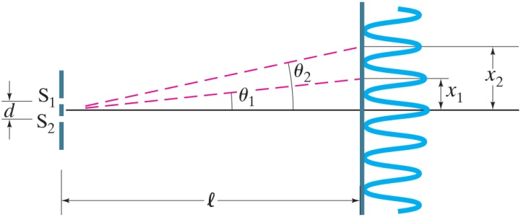
34-3 Interference—Young’s Double-Slit Experiment (7 of 10)
Example 34-2: Line spacing for double-slit interference.
A screen containing two slits 0.100 m m apart is 1.20 m
from the viewing screen. Light of wavelength
falls on the slits from a distant source. Approximately how far apart will adjacent bright interference fringes be on the screen?
Notes:
Figure 34-10. Examples 34–2 and 34–3. For small angles θ (give θ in radians), the interference fringes occur at distance x = θl above the center fringe (m = 0); θ1 and x1 are for the first-order fringe (m = 1); θ2 and x2 are for m = 2.
LD: A vertically oriented grating with two identical slits is shown on the left. The slit on the top is labeled S subscript 1 and the slit at the bottom is labeled S subscript 2. The distance between the centers of the two slits is labeled d. A vertical line representing the screen is shown on the right of the grating. The distance between the grating and the screen is l. A horizontal line from the center of the portion of the grating separating the two slits extends to the right till it reaches the screen. The interference pattern is shown as a vertically oriented transverse wave on the right of the screen drawn such that the central peak of the wave lies on the horizontal line and the troughs of waves lie on the screen. The wave appears to have the same wavelength and amplitude throughout. A diagonal dashed line from the center of the portion of the grating separating the two slits extends to the upper right, makes an angle theta subscript 2 with the horizontal line drawn from the center of the portion of the grating separating the two slits, and meets the screen at a point horizontally in line with the first peak above the central peak. A horizontal line from the point where this diagonal dashed line meets the screen extends to the right and passes through the first peak above the central peak. The vertical distance between this horizontal line and the horizontal line drawn from the center of the portion of the grating separating the two slits is labeled x subscript 1. A diagonal dashed line from the center of the portion of the grating separating the two slits extends to the upper right, makes an angle theta subscript 1 with the horizontal line drawn from the center of the portion of the grating separating the two slits, and meets the screen at a point horizontally in line with the second peak above the central peak. A horizontal line from the point where this diagonal dashed line meets the screen extends to the right and passes through the second peak above the central peak. The vertical distance between this horizontal line and the horizontal line drawn from the center of the portion of the grating separating the two slits is labeled x subscript 2.

Slide 17
34-3 Interference—Young’s Double-Slit Experiment (8 of 10)
Conceptual Example 34-3: Changing the wavelength.
(a) What happens to the interference pattern in the previous example if the incident light (500 n m) is replaced by light of wavelength 700 n m? (b) What happens instead if the wavelength stays at 500 n m, but the slits are moved farther apart?

Slide 18
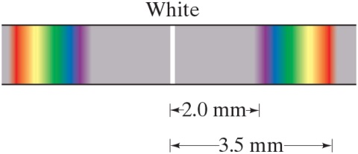
34-3 Interference—Young’s Double-Slit Experiment (9 of 10)
Since the position of the maxima (except the central one) depends on wavelength, the first- and higher-order fringes contain a spectrum of colors.
Notes:
Figure 34-11. First-order fringes for a double slit are a full spectrum, like a rainbow. Also Example 34–4.
LD: A horizontal thin stripe colored blue is shown. A thin white vertical line shown at the center is labeled White. To the left of the white line, a beam representing VIBGYOR (in the sequence mentioned) is seen. The distance between the white line and the violet light in the beam is 2.0 m m, and the distance between the white line and the red light in the beam is 3.5 m m. The portion on the left of the central line labeled White is a mirror reflection of the portion on the right.

Slide 19
34-3 Interference—Young’s Double-Slit Experiment (10 of 10)
Example 34-4: Wavelengths from double-slit interference.
White light passes through two slits 0.50 m m apart, and an interference pattern is observed on a screen 2.5 m away. The first-order fringe resembles a rainbow with violet and red light at opposite ends. The violet light is about 2.0 m m and the red 3.5 m m from the center of the central white fringe. Estimate the wavelengths for the violet and red light.

Slide 20
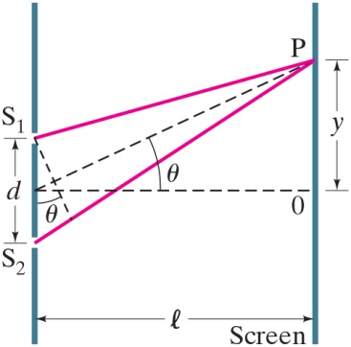


34-4 Intensity in the Double-Slit Interference Pattern (1 of 5)
The electric fields at the point P from the two slits are given by
where
Notes:
Figure 34-12. Determining the intensity in a double-slit interference pattern. Not to scale: in fact l >> d, and the two rays become essentially parallel.
LD: A vertically oriented grating with two slits is shown on the left. The slit on the top is labeled S subscript 1 and the slit at the bottom is labeled S subscript 2. The distance between the two slits is d. A vertical line labeled Screen is shown on the right and is at a distance of l from the grating. A ray of light from S subscript 1 extends toward the upper right and meets the screen at a point labeled P. Another ray of light from S subscript 2 extends toward the upper right and meets the screen at P. A diagonal dashed line from the point where the first ray starts at S subscript 1 extends toward the lower right and is drawn such that it is perpendicular to the ray extending from S subscript 2. The angle between the diagonal dashed line and the grating is theta. A horizontal dashed line from a central point between the two gratings extends to the right and meets the screen at a point labeled 0. A diagonal dashed line from the central point between the two gratings extends toward the upper right and meets P. The angle between the horizontal dashed line and the diagonal dashed line is theta. The vertical distance between P and 0 is y.

Slide 21
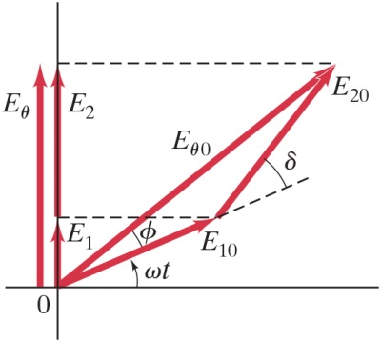

34-4 Intensity in the Double-Slit Interference Pattern (2 of 5)
The two waves can be added using phasors, to take the phase difference into account:
Notes:
Figure 34-13. Phasor diagram for double-slit interference pattern.
LD: A short vertical arrow labeled E subscript 1 from the origin of the axis points upward along the vertical axis. A slightly longer vertical arrow labeled E subscript 2 from the tip of E subscript 1 points upward along the vertical axis. An arrow labeled E subscript theta shown to the left of the vertical axis from the horizontal axis extends vertically upward till it is in line with the tip of E subscript 2. A diagonal arrow labeled E subscript 10 from the origin extends to the upper right till its tip is in line with E subscript 1 and is inclined at an angle of omega t from the horizontal axis. A dashed line from E subscript 10 continues to extend toward the upper right. An arrow labeled E subscript 20 from the tip of E subscript 10 extends to the upper left of the dashed line drawn from the tip of E subscript 10 till it is in line with the tip of E subscript 2 and is inclined at an angle delta with the dashed line. An arrow labeled E subscript theta 0 from the origin extends to the upper right till it reaches the tip of E subscript 20. E subscript theta 0 is to the left of E subscript 10 and is inclined at an angle phi from it. A horizontal dashed connects the tips of E subscript 1 and E subscript 10. Another horizontal dashed connects the tips of E subscript 2, E subscript 20, and E subscript theta 0.

Slide 22
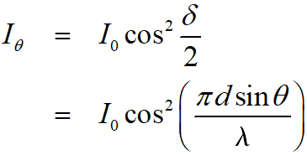
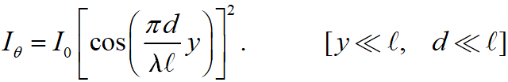
34-4 Intensity in the Double-Slit Interference Pattern (3 of 5)
The time-averaged intensity is proportional to the square of the field:

Slide 23
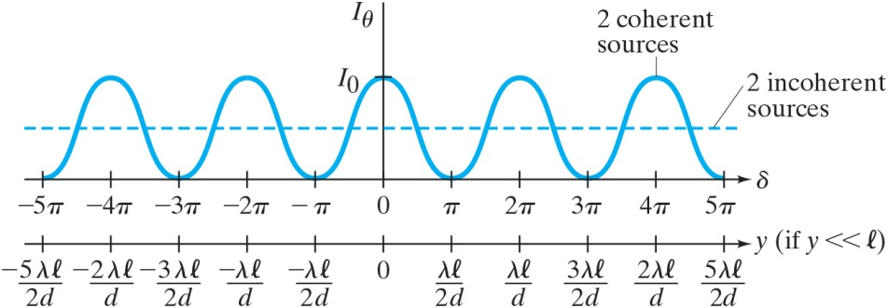
34-4 Intensity in the Double-Slit Interference Pattern (4 of 5)
This plot shows the intensity as a function of angle.
Notes:
Figure 34-14. Intensity I as a function of phase difference δ and position on screen y (assuming y << l).
LD: The horizontal axis is labeled delta and ranges from negative 5 pi to 5 pi in increments of 1 pi unit. A horizontal linear scale labeled y (if y is much less than l) shown vertically below the horizontal axis ranges from negative 5 lambda l by 2 d to 5 lambda l by 2 d in increments of 1 lambda l by 2 d unit. The horizontal scale and the horizontal axis are aligned such that the intervals on both the scales are in line with each other. The vertical axis is labeled I subscript theta and has a marking labeled I subscript 0 on it. The intensity pattern is a transverse wave with consistent wavelength and amplitude and has five peaks. The wave starts at (negative 5 pi, 0), extends to the upper right, reaches its peak at (negative 4 pi, I subscript 0), extends toward the lower right, and meets the horizontal axis at (negative 3 pi, 0). From (negative 3 pi, 0), the wave extends to the upper right, reaches its peak at (negative 2 pi, I subscript 0), extends toward the lower right, and meets the horizontal axis at (negative pi, 0). From (negative pi, 0), the wave extends to the upper right, reaches its peak at (0, I subscript 0), extends toward the lower right, and meets the horizontal axis at (pi, 0). From (pi, 0), the wave extends to the upper right, reaches its peak at (2 pi, I subscript 0), extends toward the lower right, and meets the horizontal axis at (3 pi, 0). From (3 pi, 0), the wave extends to the upper right, reaches its peak at (4 pi, I subscript 0), extends toward the lower right, and meets the horizontal axis at (5 pi, 0). The peak at (4 pi, I subscript 0) is labeled 2 coherent sources. A horizontal dashed line labeled 2 incoherent sources passes through approximately the center of the wave.

Slide 24


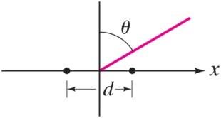
34-4 Intensity in the Double-Slit Interference Pattern (5 of 5)
Example 34-5: Antenna intensity.
Two radio antennas are located close to each other, separated by a distance d. The antennas radiate in phase with each
other, emitting waves of intensity
at wavelength
(a) Calculate
the net intensity as a function of
for points very far from the
antennas. (b) for
determine I and find in which directions I
is a maximum and a minimum. (c) Repeat part (b) when
Notes:
Figure 34-15: Example 34–5.The two dots represent the antennas.
LD: The horizontal axis is labeled x, and the vertical axis is unnamed. The dots are located close to each other and are at equal distance from the origin. The distance between the two dots is d. A pink diagonal line from the origin extends toward the upper right. The angle between the diagonal line and the vertical axis is theta.

Slide 25
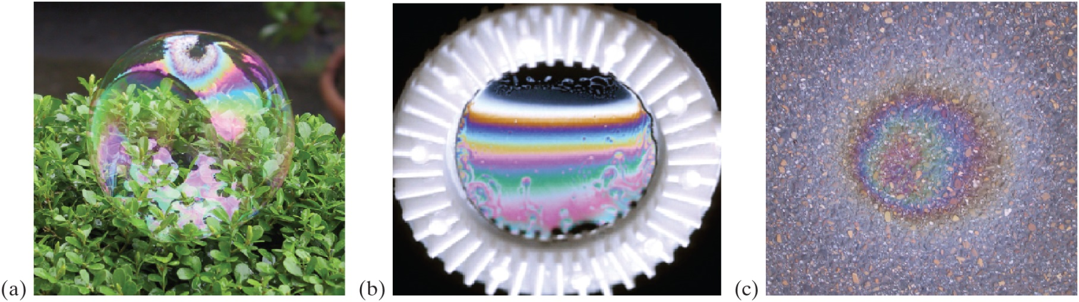
34-5 Interference in Thin Films (1 of 8)
Another way path lengths can differ, and waves interfere, is if they travel through different media. If there is a very thin film of material—a few wavelengths thick—light will reflect from both the bottom and the top of the layer, causing interference. This can be seen in soap bubbles and oil slicks.
Notes:
Figure 34-16. Thin-film interference patterns seen in (a) a soap bubble, (b) a thin film of soapy water, and (c) a thin layer of oil on wet pavement.
LD: In part (“a”), a photograph of a magnified image of a soap bubble resting on the ground is shown. Various bright colors are seen on the shiny surface of the bubble. In part (b), a photograph of a thin film of soapy water in the middle of a circular ring is shown. Multiple horizontal beams of bright colors are seen one below the other on the shiny surface of the layer. In part (c), a photograph of a thin layer of oil on the surface of a wet pavement is shown. Nearly circular concentric layers of bright-colored light are seen one within the other on the surface of the oil.

Slide 26
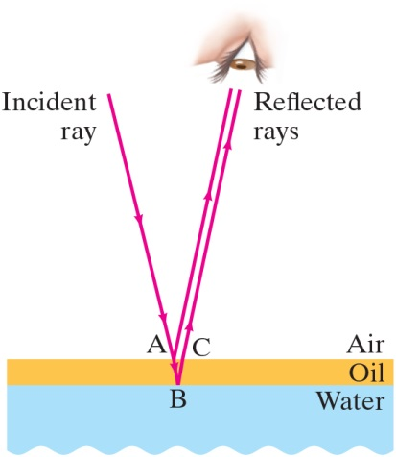
34-5 Interference in Thin Films (2 of 8)
The wavelength of the light will be different in the oil and the air, and the reflections at points A and B may or may not involve phase changes.
Notes:
Figure 34-17. Light reflected from the upper and lower surfaces of a thin film of oil lying on water. We assume the light rays are (nearly) perpendicular to the oil surface, but are drawn at an angle so we can distinguish them.
LD: The layer of water labeled Water is colored blue and is shown at the bottom of the figure. The oil layer labeled Oil is colored yellow and is shown as a thin horizontally-oriented rectangle in contact with the upper surface of the water. The area above the oil layer is labeled air. A ray of light labeled Incident ray from the upper left extends diagonally toward the lower right, meets the upper surface of the oil layer at a point labeled “A”, extends further down, and meets the lower surface of the oil layer at a point labeled B. Two rays from “A” and B, respectively, extend to the upper right and meets the eye of the observer. The two rays are labeled Reflected rays and are parallel to each other.

Slide 27
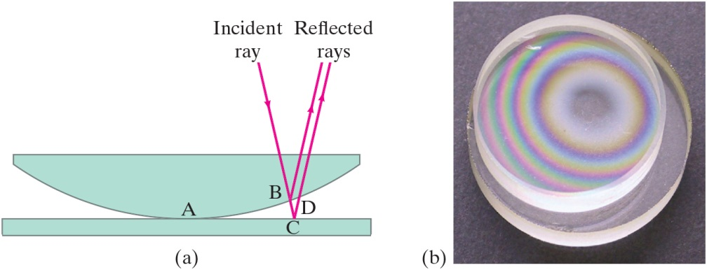
34-5 Interference in Thin Films (3 of 8)
A similar effect takes place when a shallowly curved piece of glass is placed on a flat one. When viewed from above, concentric circles appear that are called Newton’s rings.
Notes:
Figure 34-18. Newton’s rings. (a) Light rays reflected from upper and lower surfaces of the thin air gap can interfere. (b) Photograph of interference patterns using white light.
LD: In part (“a”), a curved glass surface shown as a half convex surface is placed on top of a thin flat glass surface shown as a thin rectangular surface. The point at which the two surfaces are in contact is labeled “A”. To the right of “A”, a ray of light labeled Incident ray from the upper left extends diagonally toward the lower right, meets the lower curved surface of the glass surface on the top at a point labeled B, extends further down, and meets the upper surface of the flat glass surface at the bottom at a point labeled B. A ray from B extends toward the upper right. Another ray parallel to the ray from C extends to the upper right, meets the lower curved surface of the glass surface on the top at a point labeled D, and extends further up. The two rays from B and C are labeled Reflected rays. In part (b), a top-view photograph of the interference pattern observed on the surface of a curved glass surface placed on a flat glass surface is shown. Concentric rings of different colors are observed. No color is seen at the point where the two surfaces appear to be in contact.

Slide 28
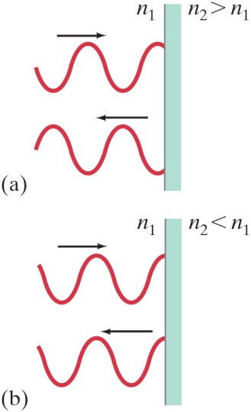
34-5 Interference in Thin Films (4 of 8)
A beam of light reflected by a material with index of refraction greater than that of the material in which it is traveling, changes phase
by
or
cycle.
Alternatively, if the index of refraction of the reflecting materials is less than that of the material in which the light is traveling, no phase change occurs.
Notes:
Figure 34-19. (a) Reflected ray changes phase by 180° or ½ cycle if n2 > n1, but (b) does not if n2 < n1.
LD: In both parts, a vertical line shaded on its right side is shown on the right of the figure. The incident wave shown on the top from the left moves to the right and strikes the vertical line. A right pointing arrow is shown above the incident ray. The reflected ray is shown vertically below the incident ray and appears to be moving toward the left from the vertical line. A left pointing arrow is shown above the reflected ray. In part (“a”), the side to the left of the vertical line is labeled n subscript 1, and the side to its right is labeled n subscript 2 is greater than n subscript 1. The reflected ray appears to be flipped such that the crests of the incident ray are in line with the troughs of the reflected ray and vice versa. In part (b), the side to the left of the vertical line is labeled n subscript 1 and the side to its right is labeled n subscript 2 is less than n subscript 1. The reflected ray appears to be in phase with the incident ray such that the crests and troughs of the incident ray are in line with the crests and troughs of the reflected ray, respectively.

Slide 29
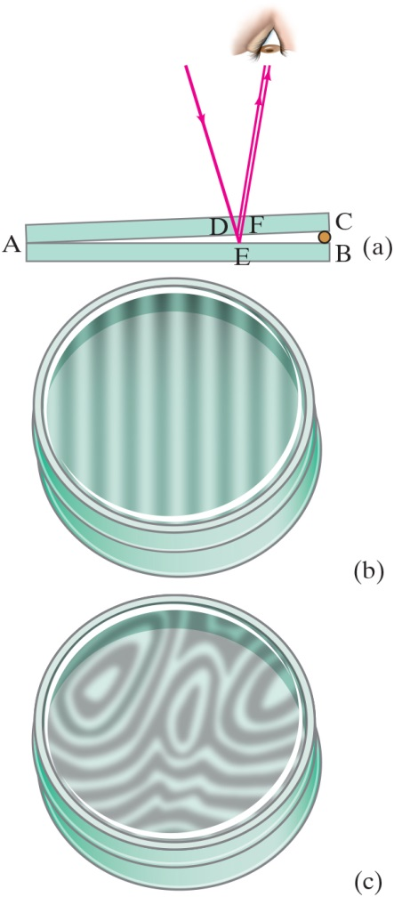
34-5 Interference in Thin Films (5 of 8)
Example 34-6: Thin film of air, wedge-shaped.
A very fine wire
in diameter is placed between two flat glass plates. Light whose wavelength in air is 600 n m falls (and is viewed) perpendicular to the plates and a series of bright and dark bands is seen. How many light and dark bands will there be in this case? Will the area next to the wire be bright or dark?
Notes:
Figure 34-20. (a) Light rays reflected from the upper and lower surfaces of a thin wedge of air (between two glass plates) interfere to produce bright and dark bands. (b) Pattern observed when glass plates are optically flat; (c) pattern when plates are not so flat. See Example 34–6.
LD: In part (“a”), two thin rectangles representing the glass plates are placed one above the other such that the left sides of the plates are in contact while the right sides appear to be separated by a small separator resulting in the formation of a triangular wedge on the right. The left sides of the plates is labeled “A”. The right side of the bottom plate is labeled B, and the right side of the top plate is labeled C. A ray of light from the upper left extends to the lower right, passes through the lower side of the top plate at a point labeled D, and meets the upper side of the lower plate at a point labeled E. From D, the ray gets reflected toward the upper right and meets the eye of an observer. From E, the ray gets reflected parallel to the ray from D toward the upper right, passes through a point labeled F on the lower side of the top plate, and meets the eye of the observer. In part (b), the pattern observed from the top view of two circular glass plates with flat surfaces separated by a small distance is shown. Vertical dark beams separated by thin vertical white stripes are seen. In part (c), the pattern observed from the top view of two circular glass plates with slightly curved surfaces separated by a small distance is shown. An abstract pattern with distorted dark curves alternating with white curves is seen.

Slide 30
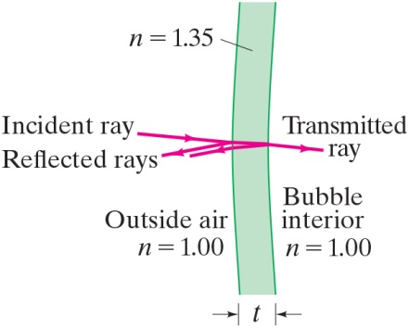

34-5 Interference in Thin Films (6 of 8)
Example 34-7: Thickness of soap bubble skin.
A soap bubble appears green
at the point on
its front surface nearest the viewer. What is the smallest thickness the soap bubble film
could have? Assume
Notes:
Figure 34-21. Soap bubble. Example 34–7. The incident and reflected rays are assumed to be perpendicular to the bubble’s surface. They are shown at a slight angle so we can distinguish them.
LD: The stripe is labeled n equals 1.35 and has a thickness labeled t. The portion to the left of the stripe is labeled Outside air n equals 1.00. The portion to the right of the stripe is labeled Bubble interior n equals 1.00. A ray of light labeled Incident ray from the upper left extends to the lower right and passes across the two sides of the stripe. The ray exiting the stripe on the right is labeled Transmitted ray. Two parallel rays labeled Reflected rays from the points where the incident ray meets the left and right sides of the stripe extend to the lower right.

Slide 31
34-5 Interference in Thin Films (7 of 8)
Problem Solving: Interference
Interference occurs when two or more waves arrive simultaneously at the same point in space.
Constructive interference occurs when the waves are in phase.
Destructive interference occurs when the waves are out of phase.
An extra half-wavelength shift occurs when light reflects from a medium with higher refractive index.

Slide 32
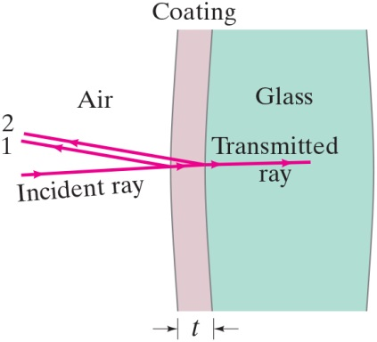
34-5 Interference in Thin Films (8 of 8)
Example 34-8: Nonreflective coating.
What is the thickness of
an optical coating of
whose index of refraction is
and which is
designed to eliminate reflected light at wavelengths (in air) around 550 n m when incident normally on glass
for which
Notes:
Figure 34-23. Example 34–8. Incident ray of light is partially reflected at the front surface of a lens coating (ray 1) and again partially reflected at the rear surface of the coating (ray 2), with most of the energy passing as the
transmitted ray into the glass.
LD: The stripe is labeled Coating and has a thickness labeled t. The portion to the left of the stripe is labeled Air. The portion to the right of the stripe is shaded blue and is labeled Glass. A ray of light labeled Incident ray from the lower left extends to the upper right and passes across the two sides of the stripe. The ray exiting the stripe on the right is labeled Transmitted ray. Two parallel rays from the points where the incident ray meets the left and right sides of the stripe extend to the upper right. The ray reflected from the left side of the stripe is labeled 1, and the ray reflected from the right side of the stripe is labeled 2.

Slide 33
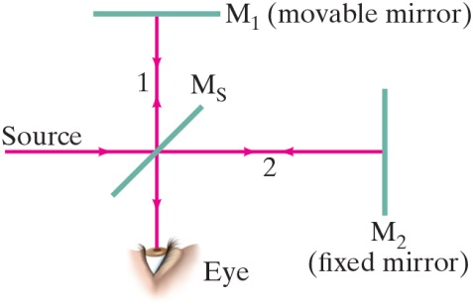
34-6 Michelson Interferometer
The Michelson interferometer is centered around a beam splitter, which transmits about half the light hitting it and reflects the rest. It can be a very sensitive measure of length.
Notes:
Figure 34-24. Michelson interferometer.
LD: The diagram consists of a movable mirror labeled M subscript 1 (movable mirror), a half-silvered mirror labeled M subscript S, a fixed mirror labeled M subscript 2 (fixed mirror), a source of light, and an observer. M subscript 1 is shown as a horizontal line on the top. M subscript S is shown vertically below M subscript 1 at the center of the figure. M subscript 2 is shown as a vertical line horizontally to the right of M subscript S. The eye of the observer is shown vertically below M subscript S. A ray of light from Source starts as an arrow from the left and points horizontally to the right toward the center of M subscript S. M subscript S splits the light ray from the source into two rays. The first ray labeled 1 is deflected vertically upward and strikes the center of M subscript 1. 1 is reflected back by M subscript 1 as a vertical arrow superimposed on 1 pointing downward at M subscript s. The second ray labeled 2 from M subscript s is deflected horizontally to the right as an arrow pointing right and strikes M subscript 2. 2 is reflected back by M subscript 2 as a horizontal arrow superimposed on 2 pointing to the left at M subscript S. Both the superposed light rays reflected by M subscript 1 and M subscript 2, respectively, meet at the same point on M subscript S, get deflected vertically downward, and meet the observer’s eye.

Slide 34
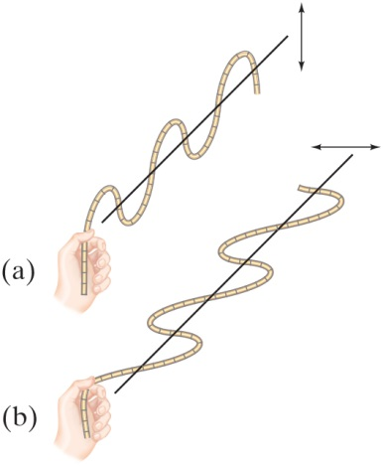
34-7 Polarization (1 of 9)
Light is polarized when its electric fields oscillate in a single plane, rather than in any direction perpendicular to the direction of propagation.
Notes:
Figure 34-25. Transverse waves on a rope polarized (a) in a vertical plane and (b) in a horizontal plane.
LD: In part (“a”), a hand appears to be holding the left end of the rope and moving it upward and downward forming a transverse wave along the vertical plane. A vertical double-headed arrow shown on the right of the rope indicates the direction of the motion of the rope. A horizontal line passes the middle of the wave. In part (b), a hand appears to be holding the left end of the rope and moving it sideward forming a transverse wave along the horizontal plane. A horizontal double-headed arrow shown on the right of the rope indicates the direction of motion of the rope. A horizontal line passes the middle of the wave.

Slide 35
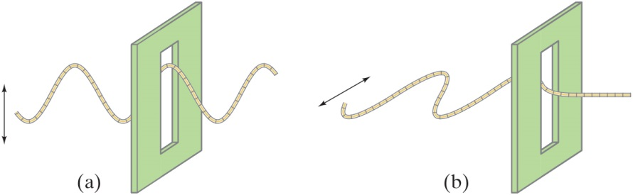
34-7 Polarization (2 of 9)
Polarized light will not be transmitted through a polarized film whose axis is perpendicular to the polarization direction.
Notes:
Figure 34-26. (a) A vertically polarized wave passes through a vertical slit, but (b) a horizontally polarized wave will not.
LD: In each part, a rectangular screen with a vertical slit is shown on the right. The rope forms a horizontally oriented transverse wave that appears to be traveling from left to right. In part (“a”), the rope forms waves polarized in the vertical plane. A vertical double-headed arrow is shown to the left of the rope. The rope appears to have passed half-way through the slit. In part (b), the rope forms waves polarized in the horizontal plane. A horizontal double-headed arrow is shown to the left of the rope. The rope appears to be stuck near its first peak passing through the slit.

Slide 36
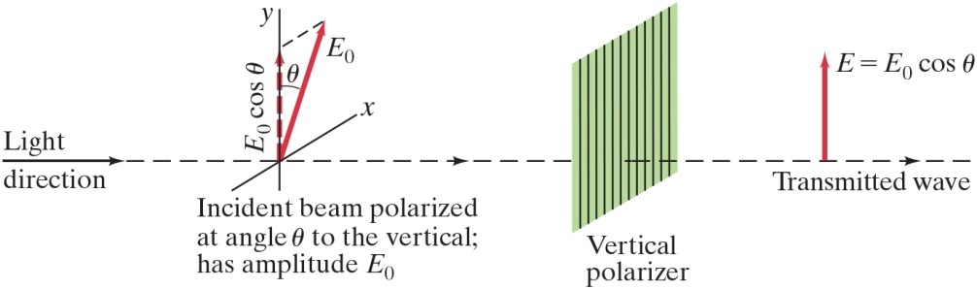
34-7 Polarization (3 of 9)
When light passes through a polarizer, only the component parallel to the polarization axis is transmitted. If the incoming light is plane-polarized, the outgoing intensity is:
Notes:
Figure 34-28. Vertical Polaroid transmits only the vertical component of a wave (electric field) incident upon it.
LD: A vertically aligned rectangular screen with parallel vertical lines is labeled Vertical polarizer and is shown toward the right of the figure. The x y coordinate plane tilted to the right is placed parallelly to the left of the polarizer. A vertical dashed arrow labeled E subscript 0 cosine theta from the origin extends upward along the positive y axis. A diagonal arrow labeled E subscript 0 from the origin points to the upper right and is inclined at an angle theta from the y axis. A dashed line connects the tips of E subscript 0 cosine theta and E subscript 0. The coordinate plane with the arrows is labeled Incident beam polarized at angle theta to the vertical; has amplitude E subscript 0. A right-pointing horizontal arrow labeled Light direction is shown on the left of the coordinate plane. The right-pointing arrow extends to the right as a horizontal dashed line with arrowheads pointing to the right, passes through the origin of the coordinate plane, passes through the screen, and extends beyond the screen. The dashed line to the right of the screen is labeled Transmitted wave. A vertical arrow labeled E equals E subscript 0 cosine theta from transmitted wave points upward and has the same magnitude as E subscript 0 cosine theta shown on the coordinate plane.

Slide 37
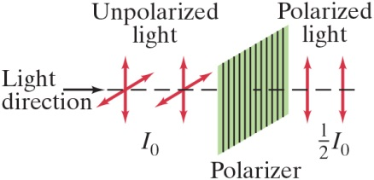
34-7 Polarization (4 of 9)
Unpolarized light (light with random directions of polarization) can be thought of as two plane-polarized beams of equal magnitude perpendicular to one another. Passing unpolarized light through a polarizer reduces the intensity by half.
Notes:
Figure 34-29. Unpolarized light has equal intensity vertical and horizontal components. After passing through a polarizer, one of these components is eliminated. The intensity of the light is reduced to half.
LD: Unpolarized light having an intensity of I subscript 0 is shown on the left as two two-dimensional coordinate planes tilted to the right placed side by side and parallel to each other. A vertically aligned rectangular screen with parallel vertical lines is labeled Polarizer and is shown to the right of Unpolarized light. The screen is parallel to Unpolarized light. A right-pointing horizontal arrow labeled Light direction is shown on the left of Unpolarized light. The right-pointing arrow extends to the right as a horizontal dashed line with arrowheads pointing to the right, passes through Unpolarized light, passes through the screen, and extends beyond the screen. Two vertical double-headed arrows labeled Polarized light have the intensity of one half I subscript 0.

Slide 38
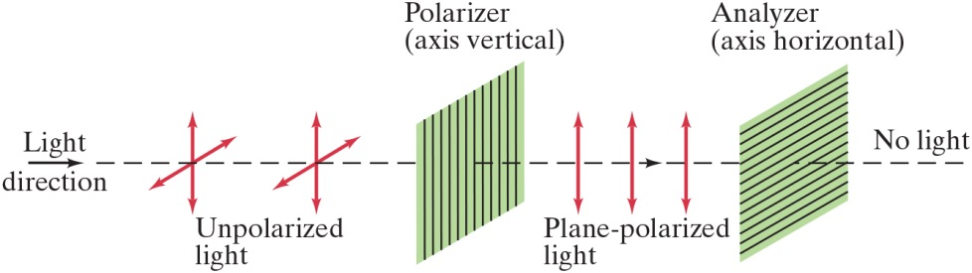
34-7 Polarization (5 of 9)
This means that if initially unpolarized light passes through crossed polarizers, no light will get through the second one.
Notes:
Figure 34-30. Crossed Polaroids completely eliminate light.
LD: Unpolarized light is shown on the left as two two-dimensional coordinate planes tilted to the right placed side by side and parallel to each other. Two vertically aligned rectangular screens with different patterns representing the polarizers are shown to the right of the unpolarized light. The screens are parallel to each other and Unpolarized light. A right-pointing horizontal arrow labeled Light direction is shown on the left of Unpolarized light. The right-pointing arrow extends to the right as a horizontal dashed line with arrowheads pointing to the right, passes through Unpolarized light, passes through the two screens, and extends beyond the screen on the right. The screen on the left has parallel vertical lines and is labeled Polarizer (axis vertical). The screen on the right has parallel horizontal lines and is labeled Analyzer (axis horizontal). Three parallel vertical double-headed arrows labeled Plane-polarized light are shown between Polarizer and Analyzer. A label No light is shown above the horizontal dashed line to the right of the screen on the right.

Slide 39
34-7 Polarization (6 of 9)
Example 34-9: Two Polaroids at
Unpolarized light passes through two Polaroids; the axis of the first is vertical and that of the second is
at
to the vertical. Describe the orientation
and intensity of the transmitted light.

Slide 40
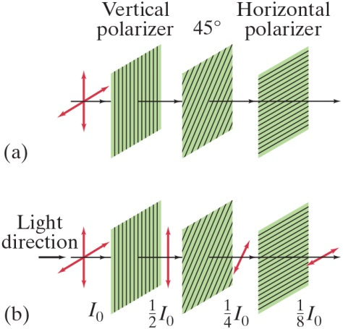
34-7 Polarization (7 of 9)
Conceptual Example 34-10: Three Polaroids.
When unpolarized light falls on two
crossed Polaroids
no light passes through. What happens if a third Polaroid,
with axis at
to each of
the other two, is placed between them?
Notes:
Figure 34-32. Example 34-10.
LD: The unpolarized light is shown on the left as a two-dimensional coordinate plane tilted to the right. Three vertically aligned rectangular screens with different patterns representing the polarizers are shown to the right of the unpolarized light. The screens are parallel to each other and the unpolarized light. In each part, a horizontal line with arrowheads pointing to the right starts from the unpolarized light, passes through the three screens, and extends beyond the third screen on the right. In part (“a”), the screen on the left has parallel vertical lines and is labeled Vertical polarizer. The screen in the middle has diagonal lines slanting upward to the right and is labeled 45 degrees. The screen on the right has parallel horizontal lines and is labeled Horizontal polarizer. In part (b), the unpolarized light, the three screens, and the horizontal line passing through them from part (“a”) is shown. A right-pointing horizontal arrow labeled Light direction is shown on the left of the unpolarized light. The intensity of the unpolarized light is labeled I subscript 0. A vertical double-headed arrow labeled one half I subscript 0 is shown between the left and the middle screens. A diagonal double-headed arrow slanted to the right labeled one fourth I subscript 0 is shown between the middle and the right screens. A horizontal double-headed arrow labeled one eighth I subscript 0 is shown to the right of the right screen. The length of the arrows appear to reduce from one half I subscript 0 to one eighth I subscript 0.

Slide 41
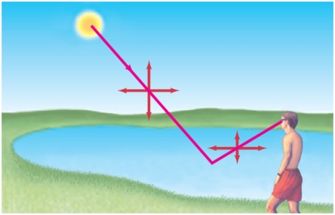
34-7 Polarization (8 of 9)
Light is also partially polarized after reflecting from a nonmetallic surface. At a special angle, called the polarizing angle or Brewster’s angle, the polarization is 100%.
Notes:
Figure 34-33. Light reflected from a nonmetallic surface, such as the smooth surface of water in a lake, is partially polarized parallel to the surface.
LD: The observer is shown standing and facing toward the lake and is toward the lower right of the figure. The Sun is shown on the upper left. A ray of light from the Sun extends to the lower right, strikes the surface of the water, extends to the upper right, and meets the eyes of the observer. Two perpendicular double-headed arrows are shown on the incident ray such that the incident ray passes through their center. Two perpendicular double-headed arrows are shown on the reflected ray such that the reflected ray passes through their center. Here, the horizontal arrow is slightly smaller than the one observed on the incident ray while the vertical arrows in both appear to be of the same length.

Slide 42
34-7 Polarization (9 of 9)
Example 34-11: Polarizing angle.
(a) At what incident angle is sunlight reflected from a lake perfectly plane-polarized? (b) What is the refraction angle?

Slide 43
34-8 Liquid Crystal Displays (LCD) (1 of 2)
Liquid crystals are unpolarized in the absence of an external voltage, and will easily transmit light. When an external voltage is applied, the crystals become polarized and no longer transmit; they appear dark.
Liquid crystals can be found in many familiar applications, such as cell phones and flat-panel computer screens.

Slide 44
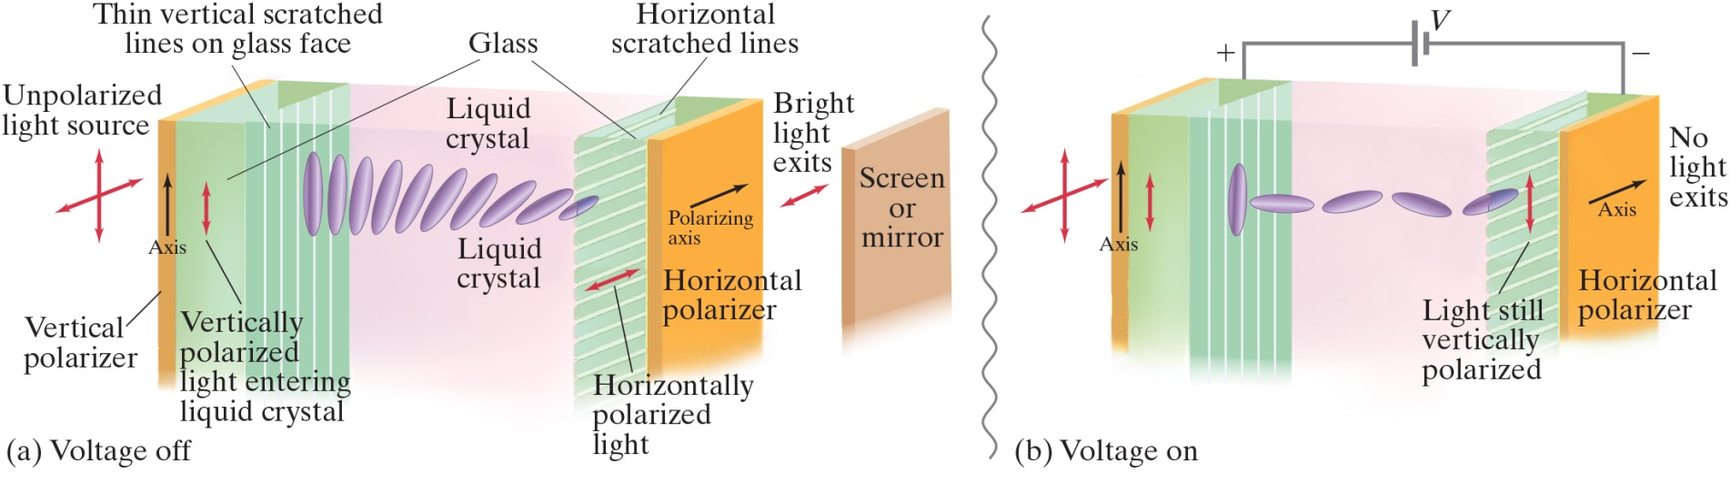
34-8 Liquid Crystal Displays (LCD) (2 of 2)
This particular type of liquid crystal, called a twisted crystal, shows how the crystal passes light when the voltage is off but not when it is on.
Notes:
Figure 34-38. (a) “Twisted” form of liquid crystal. Light polarization plane is rotated 90°. Only one line of molecules is shown. (b) Molecules disoriented by electric field. Plane of polarization is not changed, so light does not pass through the horizontal polarizer. (The transparent electrodes are not shown.)
LD: In both parts, the light source labeled Unpolarized light source is shown on the left. The unpolarized light from the source resembles a two-dimensional coordinate plane tilted to the right. A vertically oriented thick rectangular sheet labeled Vertical polarizer is shown horizontally to the right of the unpolarized light. The sheet is colored orange and is parallel to the unpolarized light. An upward-pointing arrow labeled Axis is shown on the front face of Vertical polarizer. A thick vertically oriented rectangular box labeled Glass is in contact with the right face of Vertical polarizer. The box is colored translucent green and has parallel equidistant vertical white lines drawn on its left face. The lines are labeled Thin vertical scratched lines on glass face. A vertical double-headed arrow labeled Vertically polarized light entering liquid crystal is shown embedded within this Glass. A vertically oriented rectangular box with a much higher width than that of Glass is in contact with the right face of Glass. This box is labeled Liquid crystal and is colored translucent pink. Another thick vertically oriented rectangular box labeled Glass is in contact with the right face of Liquid crystal. Both the boxes labeled Glass have the same dimensions. The second glass on the right has parallel equidistant horizontal white lines drawn on its left face. The lines are labeled Horizontal scratched lines. Another vertically oriented thick rectangular sheet labeled Horizontal polarizer is in contact with the right face of the second glass. Both the orange sheets appear to have the same dimensions. A horizontal arrow pointing to the right is shown on the left face of Horizontal polarizer and is labeled Polarizing axis. Part (“a”) is labeled Voltage off. A vertically oriented thick rectangular sheet labeled Screen or mirror is shown horizontally to the right of Horizontal polarizer and is separated by a distance. Within Liquid crystal, multiple instances of a single liquid crystal molecule changing its orientation are shown. The instance of the molecule close to the vertical scratched lines on the glass is aligned vertically. The molecule appears to be rotating gradually in the clockwise direction till it reaches Horizontal polarizer. The instance of the molecule close to the horizontal scratched lines on the glass is aligned horizontally and is in line with the horizontal scratched lines on the glass. A horizontal double-headed arrow labeled Horizontally polarized light is shown embedded within the glass next to Horizontal polarizer. A horizontal double-headed arrow labeled Bright light exits is shown in between Horizontal polarizer and Screen or mirror. Part (b) is labeled Voltage on. A voltage source labeled V has its positive terminal connected to the glass with vertical scratched lines and its negative terminal connected to the glass with horizontal scratched lines. Within Liquid crystal, multiple instances of a single liquid crystal molecule changing its orientation are shown. The instance of the molecule close to the vertical scratched lines on the glass is aligned vertically. The molecule appears to be rotating gradually in random directions till it reaches Horizontal polarizer. The instance of the molecule close to the horizontal scratched lines on the glass is slightly tilted to the upper right. A vertical double-headed arrow labeled Light still vertically polarized is shown near the left face of the glass next to Horizontal polarizer. A label No light exits is shown to the right of Horizontal polarizer.

Slide 45
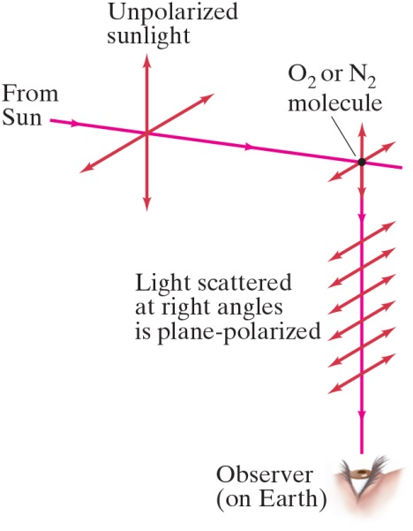
34-9 Scattering of Light by the Atmosphere
Skylight is partially polarized due to scattering from molecules in the air. The amount of polarization depends on the angle that your line of sight makes with the Sun.
Notes:
Figure 34-41. Unpolarized sunlight scattered by molecules of the air. An observer at right angles sees planepolarized light, since the component of oscillation along the line of sight emits no light along that line.
LD: Unpolarized sunlight is shown on the left as a two-dimensional coordinate plane tilted to the right. A smaller coordinate plane with a point labeled O subscript 2 or N subscript 2 molecule at its origin is shown to the right of Unpolarized sunlight. The two coordinate planes are horizontally in line and parallel to each other. A ray of light from a point labeled From Sun on the left of Unpolarized sunlight extends horizontally to the right, passes through the origin of Unpolarized sunlight, extends further to the right, strikes O subscript 2 or N subscript 2 molecule, gets deflected vertically downward and meets a human eye labeled Observer (on Earth). Six parallel horizontal double-headed arrows are shown along the vertical line that meets the Observer and are in line with the horizontal axis of the smaller coordinate plane on the right.

Slide 46
34-10 Brightness: Lumens and Luminous Intensity (1 of 2)
The intensity of light as perceived depends not only on the actual intensity but also on the sensitivity of the eye at different wavelengths.
Luminous flux:
Luminous intensity (luminous flux per unit of solid
angle):
lumen/steradian or
Illuminance: luminous flux per unit area

Slide 47
34-10 Brightness: Lumens and Luminous Intensity (2 of 2)
Example 34-12: Lightbulb illuminance.
The brightness of a particular type of 100-W lightbulb is rated at 1700 l m. Determine (a) the luminous intensity and (b) the illuminance at a distance of 2.0 m.

Slide 48
34-11 Efficiency of Lightbulbs
We can compare the efficiencies of different types of lightbulbs using the lumen. We also give typical lifetimes.
Traditional 100-W incandescent bulb:
Compact fluorescent bulb (C F L):
L E D (light-emitting diode) bulb:

Slide 49

Summary of Chapter 34 (1 of 4)
The wave theory of light is strengthened by the interference and diffraction of light.
Huygens’ principle: every point on a wave front is a source of spherical wavelets.
Wavelength of light in a medium with index of refraction n:
Young’s double-slit experiment demonstrated interference.

Slide 50


Summary of Chapter 34 (2 of 4)
In the double-slit experiment, constructive interference occurs when
and destructive interference when
Two sources of light are coherent if they have the same frequency and maintain the same phase relationship.

Slide 51
Summary of Chapter 34 (3 of 4)
Interference can occur between reflections from the front and back surfaces of a thin film.
Light undergoes a
phase change if it reflects
from a medium of higher index of refraction.
Polarized light has its electric field vectors in a single plane.
The intensity of plane-polarized light is reduced after it passes through another polarizer.

Slide 52
Summary of Chapter 34 (4 of 4)
Light can also be polarized by reflection; the reflected
light is completely polarized if the incident angle
is
given by
The brightness of a lightbulb may be specified in lumens, which takes into account the sensitivity of the eye.

Slide 53

Copyright
This work is protected by United States copyright laws and is provided solely for the use of instructors in teaching their courses and assessing student learning. Dissemination or sale of any part of this work (including on the World Wide Web) will destroy the integrity of the work and is not permitted. The work and materials from it should never be made available to students except by instructors using the accompanying text in their classes. All recipients of this work are expected to abide by these restrictions and to honor the intended pedagogical purposes and the needs of other instructors who rely on these materials.

