Slide 1


Physics for Scientists and Engineers with Modern Physics
Fifth Edition
Chapter 35
Diffraction
Copyright © 2023 Pearson Education, Inc. All Rights Reserved
Notes:
If this PowerPoint presentation contains mathematical equations, you may need to check that your computer has the following installed:
1) MathType Plugin
2) Math Player (free versions available)
3) NVDA Reader (free versions available)

Slide 2
Units of Chapter 35 (1 of 2)
Diffraction by a Single Slit or Disk
Intensity in Single-Slit Diffraction Pattern
Diffraction in the Double-Slit Experiment
Interference vs. Diffraction
Limits of Resolution; Circular Apertures
Resolution of Telescopes and Microscopes; the
Limit
Resolution of the Human Eye and Useful Magnification

Slide 3
Units of Chapter 35 (2 of 2)
Diffraction Grating
The Spectrometer and Spectroscopy
Peak Widths and Resolving Power for a Diffraction Grating
X-Rays and X-Ray Diffraction
X-Ray Imaging and Computed Tomography (CT Scan)
Specialty Microscopes and Contrast

Slide 4
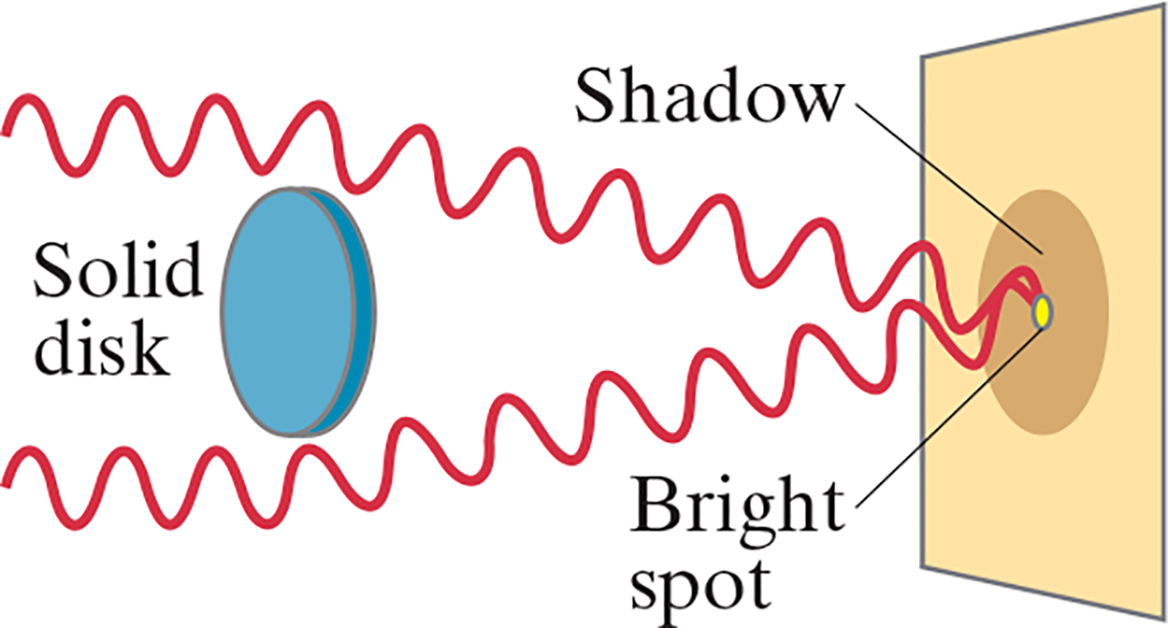
35-1 Diffraction by a Single Slit or Disk (1 of 6)
If light is a wave, it will diffract around a single slit or obstacle.
Notes:
Figure 35-1. If light is a wave, a bright spot will appear at the center of the shadow of a solid disk illuminated by a point source of monochromatic light.
LD: A circular disk oriented vertically is seen on the left. A vertical plane with a circular shadow of the disk on its left face is seen on the right. The disc and the plane are parallel to each other. The disc is labeled Solid disk and its shadow is labeled Shadow. Two parallel horizontal transverse waves appear to travel from the left and strike the upper and lower edges of the disk from where they bend inward such that they converge at a point at the center of the shadow of the disc on the plane. A circular spot labeled Bright spot is seen at the point where the waves converge at the center of the shadow.

Slide 5
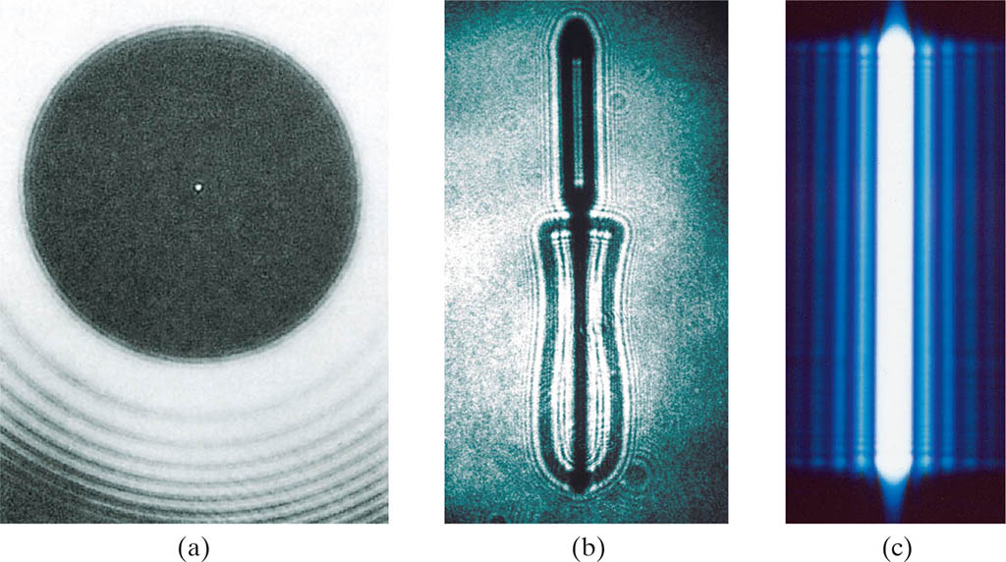
35-1 Diffraction by a Single Slit or Disk (2 of 6)
The resulting pattern of light and dark stripes is called a diffraction pattern.
Notes:
Figure 35-2. Diffraction pattern of (a) a circular disk (a coin), (b) razor, (c) a single slit, each illuminated by a coherent point source of monochromatic light, such as a laser.
LD: Part (“a”) is a photograph of a shadow of a circular disk. The shadow appears black against a gray background. A bright spot is seen at the center of the circular shadow. Few concentric dark curved lines are seen below the shadow. Part (b) is a photograph of a sharp shadow of a swivel potato peeler. The shadow appears black against a gray background. A bright outline is seen near all the edges of the shadow. Part (c) is a photograph of the diffraction pattern of a single vertical slit. The pattern appears blue against a black background and resembles a set of vertical stripes. The stripe at the center is brightest. The intensity of the stripes adjacent to the central stripe gradually decreases as we move away from the central stripe.

Slide 6
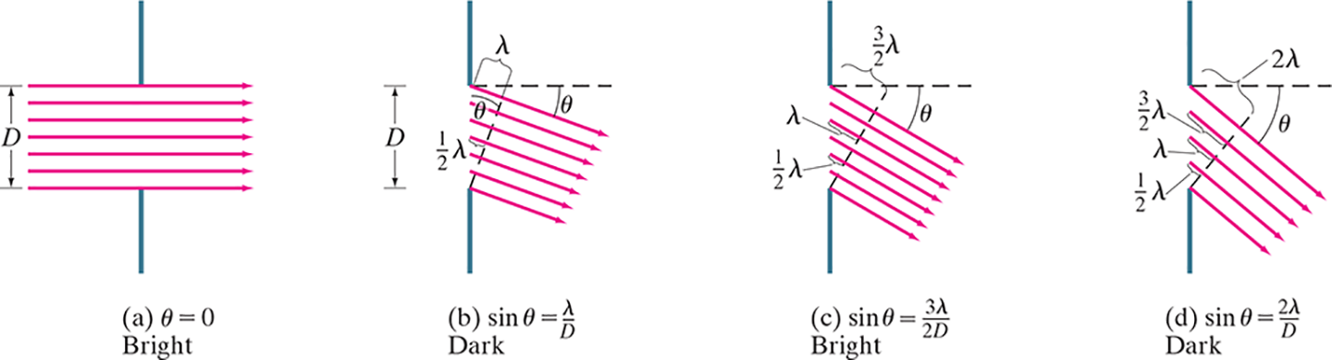
35-1 Diffraction by a Single Slit or Disk (3 of 6)
This pattern arises because different points along a slit create wavelets that interfere with each other just as a double slit would.
Notes:
Figure 35-4. Analysis of diffraction pattern formed by light passing through a narrow slit of width D.
LD: In all four parts, two vertical lines placed one below the other and separated by a distance of D are shown. Parallel equidistant rays of light are shown passing through that slit at different angles. The first and the last rays are in contact with the top and the bottom of the slit, respectively. Part (“a”) is labeled (“a”) theta equals 0, Bright. Here, seven rays of light are moving horizontally from left to right. Part (b) is labeled (b) sine theta equals lambda by D, Dark. A dashed horizontal line is drawn at the top of the slit. The rays of light are moving from upper left to lower right and are inclined at an angle theta from the horizontal dashed line. A diagonal dashed line drawn from the bottom of the slit extends toward the upper right and meets the horizontal dashed line. The diagonal line is drawn such that it is perpendicular to the rays of light. The distance between the top of the slit and the point where the diagonal dashed line meets the first ray is lambda. The distance between the slit and the point where the diagonal dashed line meets the fourth ray is one-half lambda. Part (c) is labeled (c) sine theta equals 3 lambda by 2 D, Bright. A dashed horizontal line is drawn at the top of the slit. Seven rays of light are moving from upper left to lower right and are inclined at an angle theta from the horizontal dashed line. A diagonal dashed line drawn from the bottom of the slit extends toward the upper right and meets the horizontal dashed line. The diagonal line is drawn such that it is perpendicular to the rays of light. The distance between the top of the slit and the point where the diagonal dashed line meets the first ray is 3 by 2 lambda. The distance between the slit and the point where the diagonal dashed line meets the third ray is lambda. The distance between the slit and the point where the diagonal dashed line meets the fifth ray is one-half lambda. Part (d) is labeled (d) sine theta equals 2 lambda by D, Dark. A dashed horizontal line is drawn at the top of the slit. Five rays of light are moving from upper left to lower right and are inclined at an angle theta from the horizontal dashed line. A diagonal dashed line drawn from the bottom of the slit extends toward the upper right and meets the horizontal dashed line. The diagonal line is drawn such that it is perpendicular to the rays of light. The horizontal distance between the top of the slit and the point where the diagonal dashed line meets the first is 2 lambda. The distance between the slit and the point where the diagonal dashed line meets the second ray is 3 by 2 lambda. The distance between the slit and the point where the diagonal dashed line meets the third ray is lambda. The distance between the slit and the point where the diagonal dashed line meets the fourth ray is one-half lambda.

Slide 7
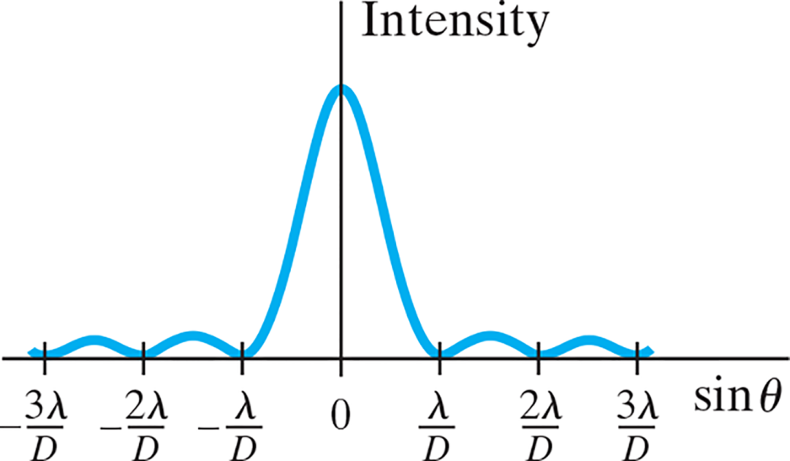
35-1 Diffraction by a Single Slit or Disk (4 of 6)
The minima of the single-slit diffraction pattern occur when
Notes:
Figure 35-5. Intensity in the diffraction pattern of a single slit as a function of sin θ. Note that the central maximum is not only much higher than the maxima to each side, but it is also twice as wide (2λ/D wide) as compared to the others (only λ/D wide each).
LD: The x axis is labeled sine theta and ranges from negative 3 lambda by D to 3 lambda by D in increments of lambda by D units. The y axis is labeled Intensity. The diffraction pattern resembles a transverse wave with five peaks. The wave starts at (negative 3 lambda by D, 0), rises to the upper right, has a small peak, and ends at (negative 2 lambda by D, 0). From (negative 2 lambda by D, 0), the wave rises to the upper right, has a small peak, and ends at (negative lambda by D, 0). From (negative lambda by D, 0), the wave rises to the upper right, reaches its maxima at a point on the y axis, extends toward the lower right, and ends at (lambda by D, 0). This peak has the highest intensity. From (lambda by D, 0), the wave rises to the upper right, has a small peak, and ends at (2 lambda by D, 0). From (2 lambda by D, 0), the wave rises to the upper right, has a small peak, and ends at (3 lambda by D, 0). The other four small peaks have nearly the same intensity.

Slide 8
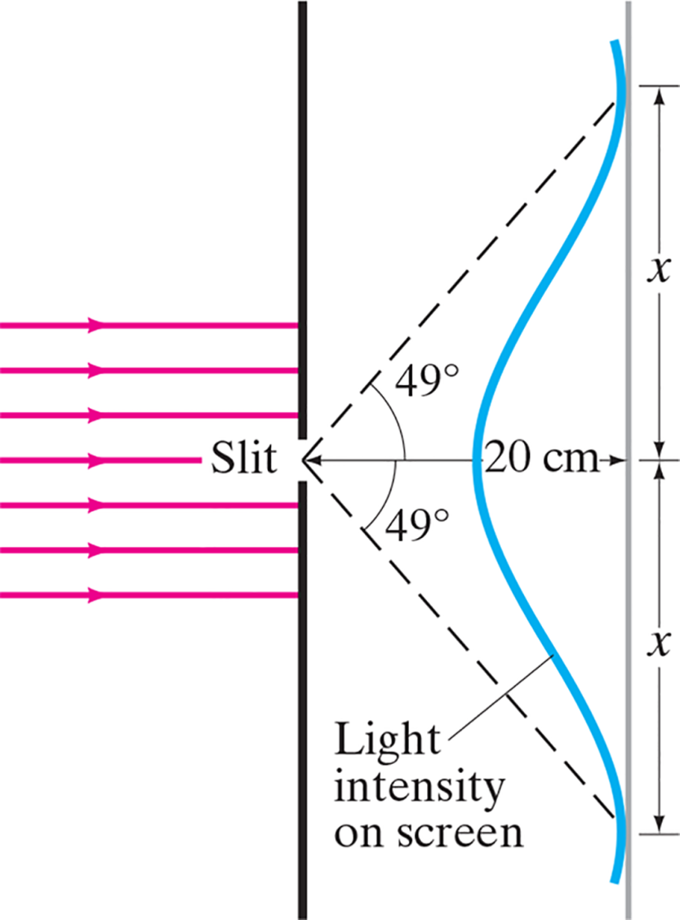
35-1 Diffraction by a Single Slit or Disk (5 of 6)
Example 35-1: Single-slit diffraction maximum.
Light of wavelength 750 n m passes through a slit
wide. How
wide is the central maximum (a) in degrees, and (b) in centimeters, on a screen 20 c m away?
Notes:
Figure 35-6. Example 35–1.
LD: Two vertical lines placed one below the other and separated by a small distance labeled Slit are shown. Parallel horizontal rays of light are seen striking the two lines from the left. The rays are equidistant from each other. To the right of the two lines, another vertical line representing the screen is shown. The distance between the slit and the screen is 20 c m. The diffraction pattern of the light is shown as a curved wave along the screen with a peak on the left. The wave is labeled Light intensity on screen. The peak of the curve is horizontally in line with the center of the slit. The vertical distance between the peak and the points where the curved wave meets the screen on either side is x. Two diagonal dashed lines from the center of the slit extend toward the upper and the lower right, respectively, and end at the points where the curved wave meets the screen. The angle between the two dashed lines and a horizontal drawn from the center of the slit is 49 degrees.

Slide 9

35-1 Diffraction by a Single Slit or Disk (6 of 6)
Conceptual Example 35-2: Diffraction spreads.
Light shines through a small rectangular slit that is narrower in the vertical direction than the horizontal. (a) Would you expect the diffraction pattern to be more spread out in the vertical direction or in the horizontal direction? (b) Should a rectangular loudspeaker horn at a stadium be high and narrow, or wide and flat?
Notes:
Figure 35-7. Example 35–2.

Slide 10
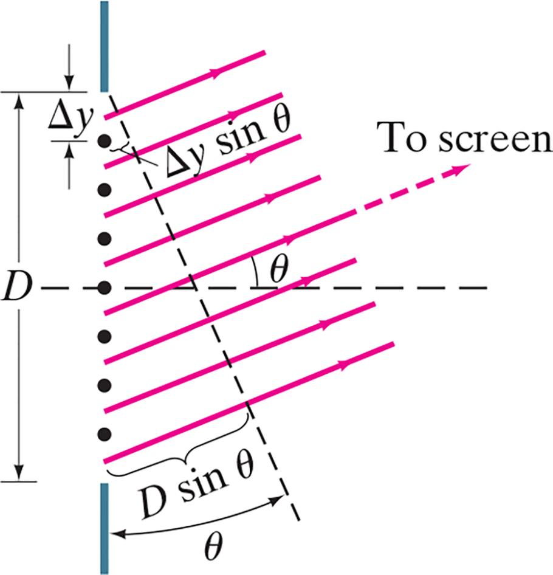

35-2 Intensity in Single-Slit Diffraction Pattern (1 of 5)
Light passing through a single slit can be divided into a series of narrower strips; each contributes the same amplitude to the total intensity on the screen, but the phases differ due to the differing path lengths:
Notes:
Figure 35-8. Slit of width D divided into N strips of width delta y.
LD: Two vertical lines placed one below the other and separated by a distance labeled D are shown. Multiple dots vertically in line with the two lines are shown between the slit. The dots are equidistant from each other. The distance between the top of the slit and the first dot is labeled delta y. Parallel horizontal rays of light are seen passing through the slit from the lower left to the upper right toward the screen. The rays are equidistant from each other. A horizontal dashed line is drawn at the center of the slit. The angle between the rays of light and the horizontal is theta. A diagonal dashed line inclined at an angle theta from the vertical lines is drawn from the top of the slit and extends toward the lower right. The diagonal line is drawn such that it is perpendicular to the rays of light. The perpendicular distance between the first dot and the diagonal line is delta y sine theta. The perpendicular distance between the bottom of the slit and the diagonal line is delta y sine theta.

Slide 11
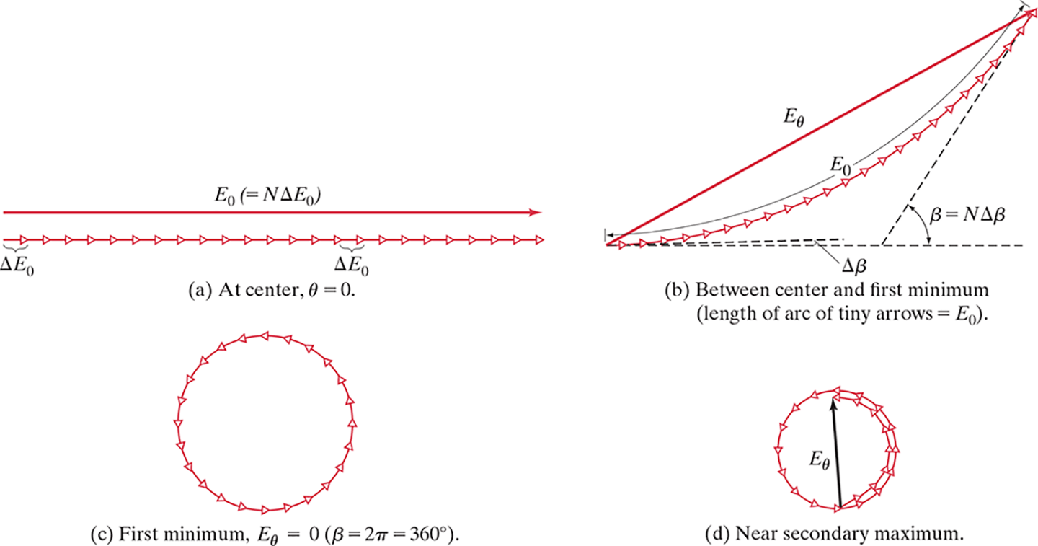
35-2 Intensity in Single-Slit Diffraction Pattern (2 of 5)
Phasor diagrams give us the intensity as a function of angle.
Notes:
Figure 35-9. Phasor diagram for single-slit diffraction, giving the total amplitude E sub θ at four different angles θ.
LD: Part (“a”) is labeled At center, theta equals 0. A long arrow pointing horizontally to the right is shown. The arrow is labeled E subscript 0 (equals N Delta E subscript 0). Multiple tiny arrows with triangle arrowheads pointing to the right are shown below the long arrow. Each tiny arrow has a length of delta E subscript 0. The arrows are attached one beside the other. Together, the tiny arrows form a horizontal line. Part (b) is labeled Between center and first minimum (length of arc of tiny arrows equals E subscript 0). A long arrow from the bottom left points diagonally toward the upper right. The arrow is labeled E subscript theta. Multiple tiny arrows with triangle arrowheads pointing to the right are shown attached one beside the other forming an arc below E subscript theta. The arc spans from the tail to the head of E subscript theta and its total length is labeled E subscript 0. A horizontal dashed line is drawn from the tail of E subscript theta. A dashed line is drawn tangential to the second tiny arrow and close to the horizontal dashed line. The distance between the two dashed lines is labeled Delta beta. A dashed line drawn tangential to the last arrow of the arc close to the head of E subscript theta extends toward the lower left and meets the horizontal dashed line. The angle between these two dashed lines is beta equals N Delta beta. Part (c) is labeled First minimum, E subscript theta equals 0 (beta equals 2 pi equals 360 degrees). Multiple tiny arrows with triangle arrowheads pointing in the counterclockwise direction are shown attached one beside the other forming a complete circle. Part (d) is labeled Near secondary maximum. Multiple tiny arrows with triangle arrowheads pointing in the counterclockwise direction are shown attached one beside the other forming a complete circle and a half circle. An arrow labeled E subscript theta from where the half circle starts extends toward the upper left till the head of the last tiny arrow.

Slide 12
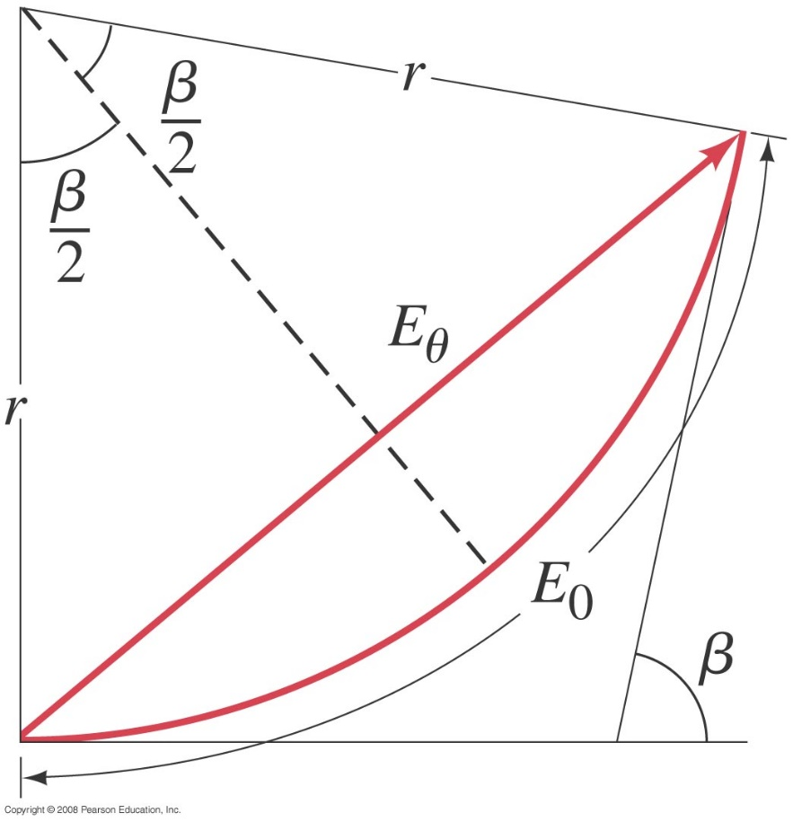
35-2 Intensity in Single-Slit Diffraction Pattern (3 of 5)
Taking the limit as the width becomes infinitesimally small gives the field as a function of angle:
Notes:
Figure 35-10. Determining amplitude E sub θ as a function of θ for single-slit diffraction.
LD: A long arrow labeled E subscript theta from the bottom left points diagonally toward the upper right. An arc is shown below E subscript theta. The arc spans from the tail to the head of E subscript theta and is labeled E subscript 0. The center of the arc is shown toward the upper left such that it is vertically above the tail of E subscript theta. Two lines each labeled r connect the center of the arc to the two ends of the arc. A horizontal line tangential to the arc from the tail of E subscript theta extends to the right. A diagonal line tangential to the arc from the head of E subscript theta extends to the lower left. The angle between the two lines in the counterclockwise direction is labeled beta. A diagonal dashed line from the center of the arc bisects the arc. The angle between each r and the diagonal dashed line is beta by 2.

Slide 13

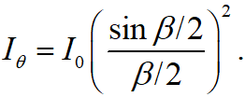
35-2 Intensity in Single-Slit Diffraction Pattern (4 of 5)
Finally, we have the phase difference and the intensity as a function of angle:
and

Slide 14
35-2 Intensity in Single-Slit Diffraction Pattern (5 of 5)
Example 35-3: Intensity at secondary maxima.
Estimate the intensities of the first two secondary maxima to either side of the central maximum.

Slide 15

35-3 Diffraction in the Double-Slit Experiment (1 of 3)
The double-slit experiment also exhibits diffraction effects, as the slits have a finite width. This means the
amplitude at an angle
will be modified by the same
factor as in the single-slit experiment:
The intensity is, as usual, proportional to the square of the field.

Slide 16
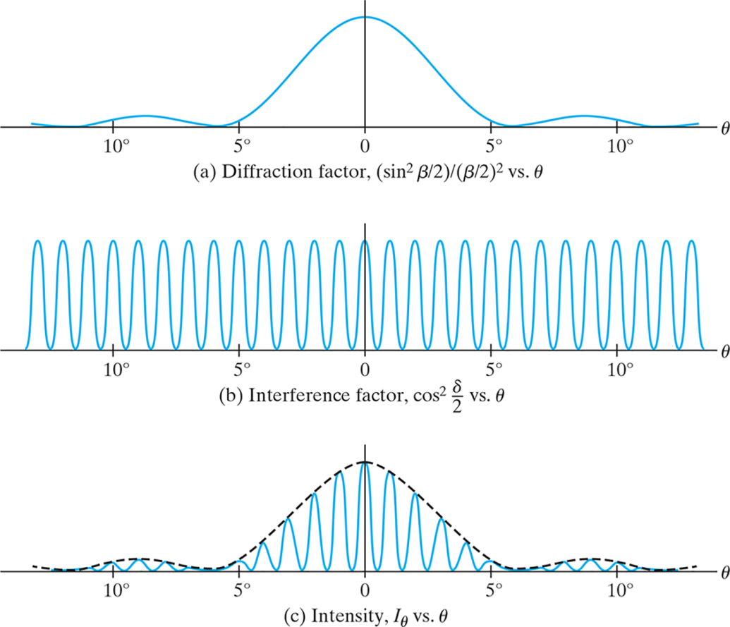
35-3 Diffraction in the Double-Slit Experiment (2 of 3)
The diffraction factor
(depends on
appears
as an “envelope” modifying the more rapidly varying interference factor
(depends on
Notes:
Figure 35-11. (a) Diffraction factor, (b) interference factor, and (c) the resultant intensity Iθ, plotted as a function of θ for d = 6D = 60λ.
LD: Part (“a”) is labeled Diffraction factor, StartFraction (sine square beta by 2) over (beta by 2) whole squared EndFraction versus theta. The horizontal axis is labeled theta and ranges from negative 10 degrees to 10 degrees in increments of 5 degrees. The two axes have their origin at 0. The diffraction pattern resembles a transverse wave with three peaks. The central peak has the highest amplitude while the other two peaks have the same amplitude. The wave starts at approximately (negative 11 degrees, 0), extends to the upper right, has a small peak, and ends at approximately (negative 6 degrees, 0). From (negative 6 degrees, 0), the wave rises toward the upper right, reaches its maximum at a point on the vertical axis, extends toward the lower right, and ends at approximately (6 degrees, 0). From (6 degrees, 0), the wave extends to the upper right, has a small peak, and ends at approximately (11 degrees, 0). Part (b) is labeled Interference factor, cosine square delta by 2 versus theta. The horizontal axis is labeled theta and ranges from negative 10 degrees to 10 degrees in increments of 5 degrees. The two axes have their origin at 0. The interference pattern resembles a transverse wave with consistent amplitude and wavelength across all the cycles of the wave. The wave appears compressed and approximately five cycles are seen withing each interval. Part (c) is labeled Intensity, I subscript theta versus theta. The horizontal axis is labeled theta and ranges from negative 10 degrees to 10 degrees in increments of 5 degrees. The two axes have their origin at 0. A dashed outline of the wave from part (“a”) is shown. The resultant intensity is shown as a transverse wave with a consistent wavelength similar to part (b) but varying amplitudes across the cycles. The peaks of the wave lie on the dashed outline of the wave from part (“a”).

Slide 17


35-3 Diffraction in the Double-Slit Experiment (3 of 3)
Example 35-4: Diffraction plus interference.
Show why the central diffraction peak shown,
plotted for the case where
contains 11 interference fringes.
Notes:
Figure 35-11. (c) the resultant intensity Iθ, plotted as a function of θ for d = 6D = 60λ.
LD: Part (c) is labeled Intensity, I subscript theta versus theta. The horizontal axis is labeled theta and ranges from negative 10 degrees to 10 degrees in increments of 5 degrees. The two axes have their origin at 0. A dashed outline of the wave from part (“a”) is shown. The resultant intensity is shown as a transverse wave with a consistent wavelength similar to part (b) but varying amplitudes across the cycles. The peaks of the wave lie on the dashed outline of the wave from part (“a”).

Slide 18
35-4 Interference vs. Diffraction
The patterns due to interference and diffraction arise from the same phenomenon—the superposition of coherent waves of different phase.
In general, we use the word “diffraction” when referring to an analysis of many infinitesimal and usually contiguous sources. We use the term “interference” when we superpose the waves from a finite (and usually small) number of coherent sources.

Slide 19
35-5 Limits of Resolution; Circular Apertures (1 of 5)
Resolution is the distance at which a lens can barely distinguish two separate objects.
Resolution is limited by aberrations and by diffraction. Aberrations can be minimized, but diffraction is unavoidable; it is due to the size of the lens compared to the wavelength of the light.

Slide 20

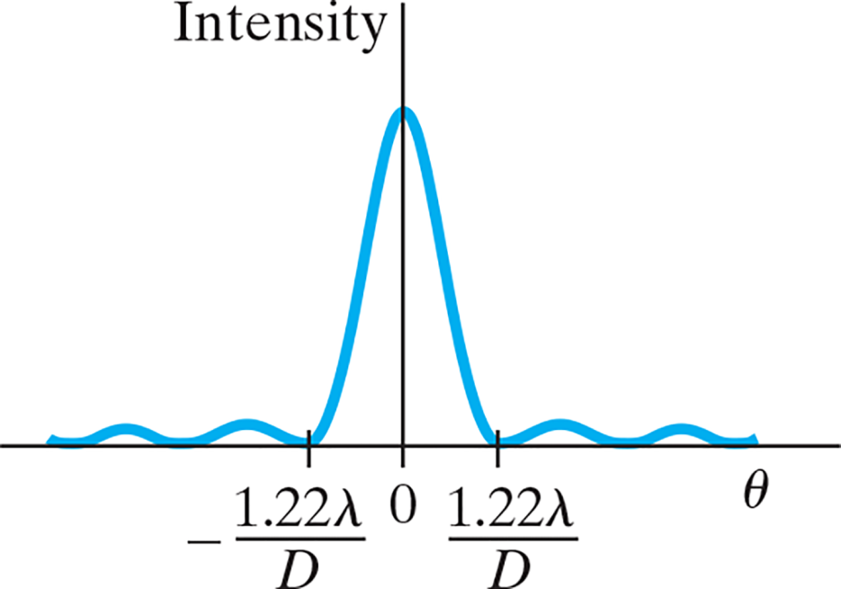
35-5 Limits of Resolution; Circular Apertures (2 of 5)
For a circular aperture of diameter D, the central maximum has an angular width:
Notes:
Figure 35-14. Intensity of light across the diffraction pattern of a circular hole.
LD: The horizontal axis is labeled theta and has the markings of negative 1.22 lambda by D, 0, and 1.22 lambda by D on it from left to right. the marking 0 is at the point where the two axes meet. The vertical axis is labeled Intensity. The diffraction pattern resembles a transverse wave with five peaks. The peak at the center has the highest intensity. It starts at (negative 1.22 lambda by D, 0), has its vertex at a point on the vertical axis, and ends at (1.22 lambda by D, 0). Two small peaks are seen on the left and on the right of the central peak, respectively.

Slide 21
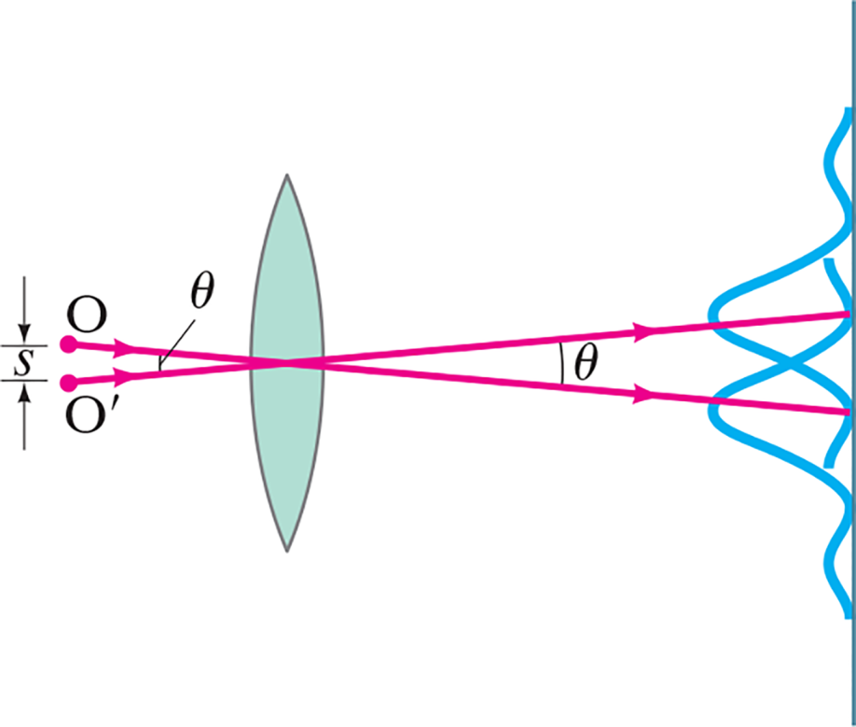
35-5 Limits of Resolution; Circular Apertures (3 of 5)
The Rayleigh criterion states that two images are just resolvable when the center of one peak is over the first minimum of the other.
Notes:
Figure 35-15. The Rayleigh criterion. Two images are just resolvable when the center of the diffraction peak of one is directly over the first minimum in the diffraction pattern of the other. The two point objects O and O’ subtend an angle θ at the lens; only one ray (it passes through the center of the lens) is drawn for each object, to indicate the center of the diffraction pattern of its image.
LD: The points are on the left and the screen is on the right. The lens is in between the points and the screen such that it is closer to the points. O is vertically above O prime and are separated by a small distance of s. A ray from O extends toward the lower right, passes through the center of the lens, and ends at a point on the screen. Another ray from O prime extends toward the upper right, passes through the center of the lens, and ends on the screen at a point above the point where the ray from O meets the screen. The angle between the two rays is theta. Two vertical transverse waves are shown along the screen such that their peaks are toward the left of the screen. The waves formed by the rays have their maximums on their respective rays. The ray from O coincides with the point where the lower end of the maximum of the wave formed by O prime meets the screen. The ray from O prime coincides with the point where the lower end of the maximum of the wave formed by O meets the screen.

Slide 22

35-5 Limits of Resolution; Circular Apertures (4 of 5)
Example 35-5: Hubble Space Telescope.
The Hubble Space Telescope (H S T) is a reflecting telescope that was placed in orbit above the Earth’s atmosphere, so its resolution would not be limited by turbulence in the atmosphere. Its objective
diameter is 2.4 m. For visible light, say
estimate the
improvement in resolution the Hubble offers over Earth-bound telescopes, which are limited in resolution by movement of the Earth’s atmosphere to about half an arc second. (Each degree is
divided into 60 minutes each containing 60 seconds, so
arc seconds.)

Slide 23

35-5 Limits of Resolution; Circular Apertures (5 of 5)
Example 35-6: Eye resolution.
You are in an airplane at an altitude of 10,000 m. If you look down at the ground, estimate the minimum separation s between objects that you could distinguish. Could you count cars in a parking lot? Consider only diffraction, and assume your pupil is about 3.0 m m in
diameter and

Slide 24


35-6 Resolution of Telescopes and
Microscopes; the
Limit (1 of 3)
For telescopes, the resolution limit is as we have defined it:
For microscopes, assuming the object is at the focal point, the resolving power is given by

Slide 25


35-6 Resolution of Telescopes and
Microscopes; the
Limit (2 of 3)
Example 35-7: Telescope resolution (radio wave vs. visible light).
What is the theoretical minimum angular separation of two stars that can just be resolved by (a) the 200-inch telescope on Palomar Mountain; and (b) the Arecibo radio telescope, whose diameter is 300 m? Assume
for the visible-light telescope in part (a), and
(the shortest wavelength at which the radio
telescope has been operated) in part (b).

Slide 26

35-6 Resolution of Telescopes and
Microscopes; the
Limit (3 of 3)
Typically, the focal length of a microscope lens is half its diameter, which shows that it is not possible to resolve details smaller than the wavelength being used:

Slide 27
35-7 Resolution of the Human Eye and Useful Magnification
The human eye can resolve objects that are about 1 c m apart at a distance of 20 m, or 0.1 m m apart at the near point.
This limits the useful magnification of a light microscope
to about

Slide 28
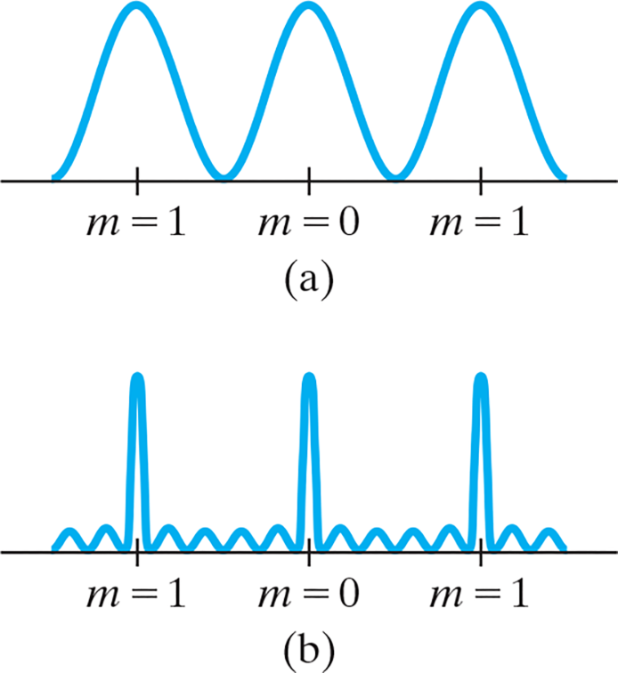
35-8 Diffraction Grating (1 of 5)
A diffraction grating consists of a large number of equally spaced narrow slits or lines. A transmission grating has slits, while a reflection grating has lines that
reflect light.
The more lines or slits there are, the narrower the peaks.
Notes:
Figure 35-19. Intensity as a function of viewing angle θ (or position on the screen) for (a) two slits, (b) six slits. For a diffraction grating, the number of slits is very large (≈104) and the peaks are narrower still.
LD: In both parts, a horizontal axis with the following intervals from left to right is shown: m equals 1, m equals 0, and m equals 1. In part (“a”), a transverse wave with three peaks having a consistent wavelength and amplitude is shown. The peaks of the waves are at m equals 1, m equals 0, and m equals 1. In part (b), a wave having three maximum peaks with four small peaks of similar amplitude in between two maximum peaks is shown. The maximums of the wave are at m equals 1, m equals 0, and m equals 1. The wave has a consistent wavelength. Two more small peaks having similar amplitude are shown before the first maximum peak and after the third maximum peak, respectively.

Slide 29

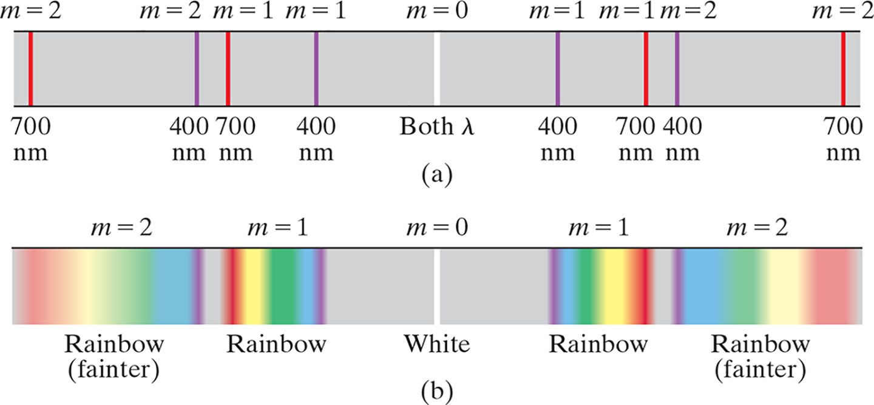
35-8 Diffraction Grating (2 of 5)
The maxima of the diffraction pattern are defined by
Notes:
Figure 35-20. Spectra produced by a grating: (a) two wavelengths, 400 nm and 700 nm; (b) white light. The second order will normally be dimmer than the first order. (Higher orders are not shown.) If the grating spacing is small enough, the second and higher orders will be missing.
LD: In part (“a”), a horizontal thin stripe colored blue is shown. A thin white vertical line shown at the center is labeled m equals 0; Both lambda. To the right of the white line, going from left to right in a sequential order, the following lines are seen: A purple vertical line labeled m equals 1, 400 n m; a red vertical line labeled m equals 1, 700 n m; a purple vertical line labeled m equals 2, 400 n m; and a red vertical line labeled m equals 2, 700 n m. The red line at m equals 1 and the purple line at m equals 2 are close to each other. To the left of the white line, going from right to left in a sequential order, the following lines are seen: A purple vertical line labeled m equals 1, 400 n m; a red vertical line labeled m equals 1, 700 n m; a purple vertical line labeled m equals 2, 400 n m; and a red vertical line labeled m equals 2, 700 n m. The red line at m equals 1 and the purple line at m equals 2 are close to each other. The entire spectrum is a palindrome. In part (b), a horizontal thin stripe colored blue is shown. A thin white vertical line shown at the center is labeled m equals 0; White. A point labeled m equals 1 shown to the left of m equals 0 has thin vertical beams representing VIBGYOR (in the sequence mentioned) and is labeled Rainbow. A point labeled m equals 2 shown to the left of m equals 1 has thin vertical beams representing VIBGYOR (in the sequence mentioned) and is labeled Rainbow (fainter). The intensity of the beams at m equals 2 is lesser than at m equals 1. The portion on the left of the central line labeled White is a mirror reflection of the portion on the right.

Slide 30
35-8 Diffraction Grating (3 of 5)
Example 35-8: Diffraction grating: line positions.
Determine the angular positions of the first- and second-order lines (maxima) for light of wavelength 400 n m and 700 n m incident on a grating containing 10,000 slits per centimeter. (Sometimes we say “lines per c m.”)

Slide 31

35-8 Diffraction Grating (4 of 5)
Example 35-9: Spectra overlap.
White light containing wavelengths from 400 n m to 750 n m strikes a grating containing 4000 slits/c m.
Show that the blue at
of the third-order
spectrum overlaps the red at 700 n m of the second order.

Slide 32
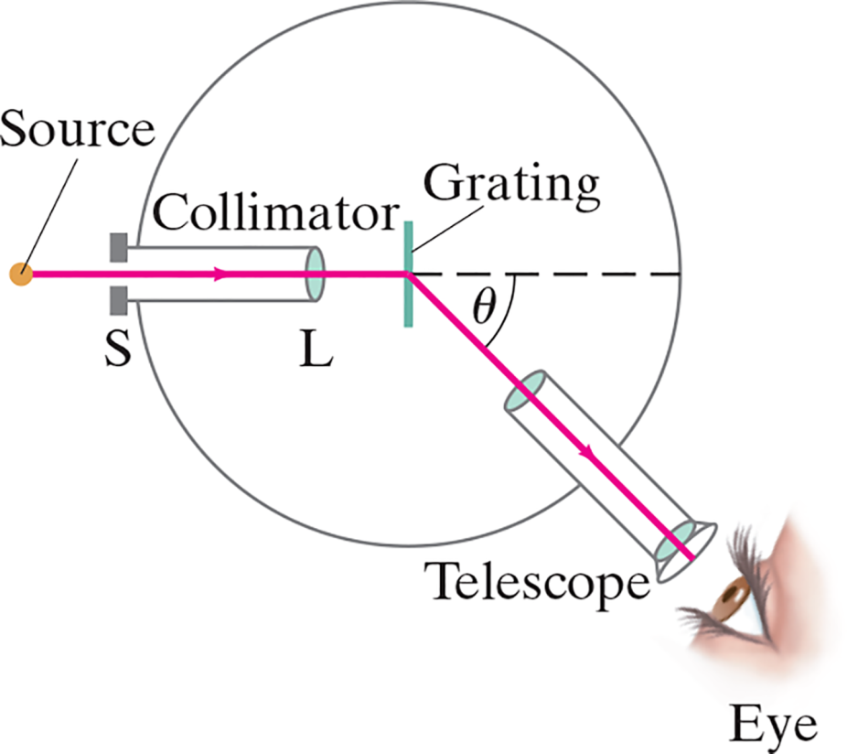
35-9 The Spectrometer and Spectroscopy (1 of 4)
A spectrometer makes accurate measurements of wavelengths using a diffraction grating or prism.
Notes:
Figure 35-21. Spectrometer or spectroscope.
LD: A vertically oriented Grating is shown at the center of a circle. A horizontally aligned tube labeled Collimator is shown on the left of the grating. The right end of the collimator has a lens labeled L. Its left end is outside the circle and has a small slit labeled S. A tube labeled Telescope shown on the lower right of the circle is slanted toward the left. Both the ends of the tube have lenses. The lower portion of the tube is outside the circle and is in line with a human eye. A point labeled Source is shown on the left of the slit. A horizontal dashed line from the center of the grating extends toward the right till the circumference of the circle. A horizontal ray of light from the source extends to the right, passes through S and L, strikes the center of the grating, gets deflected toward the lower right making an angle of theta with the horizontal dashed line, passes through the telescope, and meets the Eye.

Slide 33
35-9 The Spectrometer and Spectroscopy (2 of 4)
The wavelength can be determined to high accuracy by measuring the angle at which the light is diffracted:
where m is an integer representing the order, and d is the distance between grating slits.

Slide 34
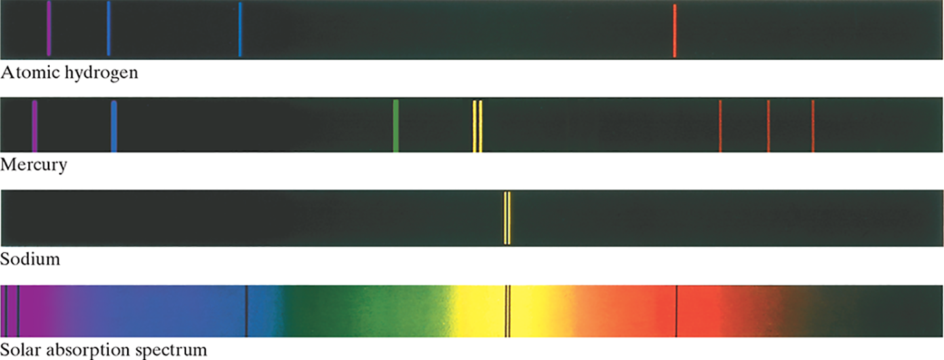
35-9 The Spectrometer and Spectroscopy (3 of 4)
Atoms and molecules can be identified when they are in a thin gas through their characteristic emission lines.
Notes:
Figure 35-22. Line spectra for the gases indicated, and the spectrum from the Sun showing absorption lines
LD: All four parts consist of thin vertical stripes colored black. In part (“a”), a purple vertical line is shown close to the left end of the stripe. A blue vertical line is shown to the left of the purple line. Another blue vertical line is shown to the right of the first blue line. A red vertical line is shown to the right of the center of the stripe. In part (b), a purple vertical line is shown close to the left end of the stripe. A blue vertical line is shown to the left of the purple line. The placement of the first two lines is similar to that seen in part (“a”). A green vertical line is shown to the left of the center of the stripe. Two yellow vertical lines are seen very close to each other at the center of the stripe. Three red lines are toward the right of the stripe. The red lines on the left and right of the central line are equally spaced from the central line. In part (c), only two yellow vertical lines are seen very close to each other at the center of the stripe. In part (d), a small portion at the extreme left of the stripe is colored purple, a slightly larger portion next to purple is colored blue. The central portion of the stripe is colored yellow. The region between blue and yellow is colored green. A small portion to the right of yellow is colored orange. A small portion to the right of orange is colored red. The remaining portion the right of red is colored black. Two vertical purple lines are seen close to each other and are in the purple region of the stripe. A vertical blue line is seen in the blue region of the stripe and is close to the green region. Two vertical black lines are seen close to each other and at the center of the stripe. A vertical black line is seen in the red region of the stripe.

Slide 35
35-9 The Spectrometer and Spectroscopy (4 of 4)
Example 35-10: Hydrogen spectrum.
Light emitted by hot hydrogen gas is observed with a spectroscope using a diffraction grating having
The spectral lines nearest to the center
are a violet line at
a blue line at
a blue-
green line at
and a red line at
from the center.
What are the wavelengths of these spectral lines of hydrogen?

Slide 36
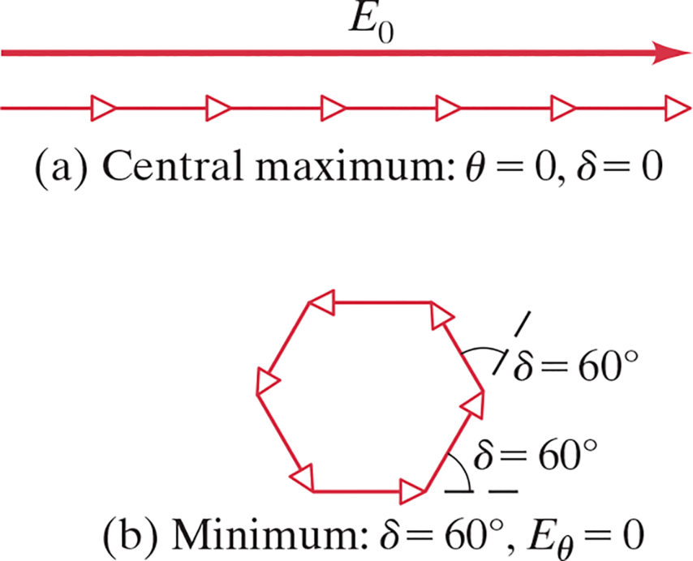
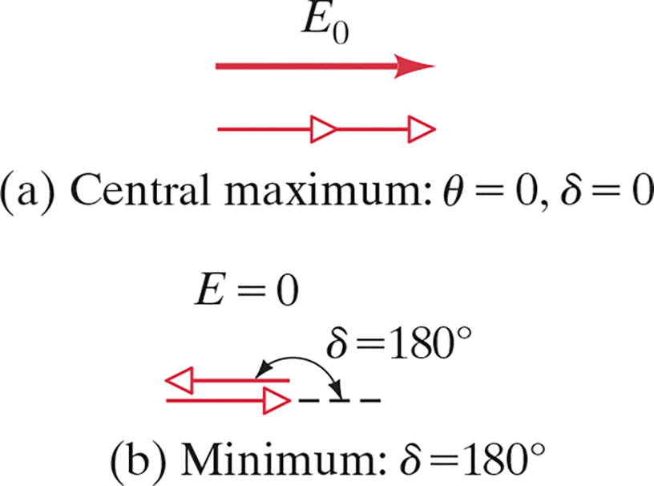
35-10 Peak Widths and Resolving Power for a Diffraction Grating (1 of 3)
These two sets of diagrams show the phasor relationships at the central maximum and at the first minimum for gratings of two and six slits.
Notes:
Figure 35-23. Phasor diagram for two slits (a) at the central maximum, (b) at the nearest minimum.
Figure 35-24. Phasor diagram for six slits (a) at the central maximum, (b) at the nearest minimum.
LD: Part (“a”) is labeled Central maximum: theta equals 0, delta equals 0. A short horizontal arrow labeled E subscript 0 pointing right is shown. Two tiny identical arrows with triangle arrowheads pointing right are placed one beside the other such that they form a line having the same length as E subscript 0. Part (b) is labeled Minimum: delta equals 180 degrees. Two tiny identical arrows with triangle arrowheads are placed one above the other. The tiny arrow at the bottom points to the right while the tiny arrow on the top points to the left. A horizontal dashed line from the tip of the arrow at the bottom extends to the right. A double-headed curved arrow labeled delta equals 180 degrees points at the arrow on the top and the horizontal dashed line. Note: E equals 0.
LD: Part (“a”) is labeled Central maximum: theta equals 0, delta equals 0. A long horizontal arrow labeled E subscript 0 pointing right is shown. Six tiny identical arrows with triangle arrowheads pointing right are placed one beside the other such that they form a line having the same length as E subscript 0. Part (b) is labeled Minimum: delta equals 60 degrees, E subscript theta equals 0. Six tiny identical arrows with triangle arrowheads pointing in the counterclockwise direction are placed one beside the other such that they form a hexagon. A horizontal dashed line extends to the right from the base of the hexagon. The angle between the dashed line and the adjacent arrow is delta equals 60 degrees.

Slide 37


35-10 Peak Widths and Resolving Power for a Diffraction Grating (2 of 3)
As the number of slits becomes large, the width of the central maximum becomes very narrow:
The resolving power of a diffraction grating is the minimum difference between wavelengths that can be distinguished:

Slide 38


35-10 Peak Widths and Resolving Power for a Diffraction Grating (3 of 3)
Example 35-11: Resolving two close lines.
Yellow sodium light, which consists of two wavelengths,
and
falls on a
7500-slit/c m diffraction grating. Determine (a) the maximum order m that will be present for these sodium lines, and (b) the width of grating necessary to resolve the two sodium lines.

Slide 39
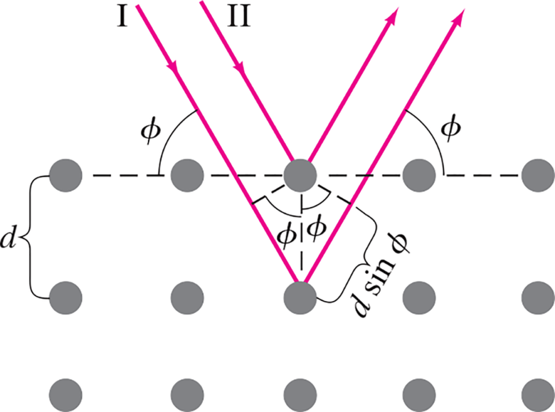
35-11 X-Rays and X-Ray Diffraction (1 of 2)
The wavelengths of X-rays are very short. Diffraction experiments are impossible to do with conventional diffraction gratings.
Crystals have spacing between their layers that is ideal for diffracting X-rays.
Notes:
Figure 35-28. X-ray diffraction by a crystal.
LD: A ray labeled 1 (in Roman numerals) from the upper left strikes the third point in the second row and reflects toward the upper right. A ray labeled 2 (in Roman numerals) from the upper left strikes the third point in the first row and reflects toward the upper right. The two rays are parallel. A horizontal dashed line is shown passing through the first row of points. The angle between the incident ray of the ray labeled 1 and the horizontal dashed line is labeled phi. The angle between the reflected ray of the ray labeled 1 and the horizontal dashed line is also labeled phi. A vertical dashed line is drawn between the third point in the first row and the third point in the second row. A diagonal dashed line inclined at an angle of phi from the third point in the first row extends toward the lower left and meets the incident ray of the ray labeled 1. This diagonal dashed line is perpendicular to the incident ray of the ray labeled 1. Another diagonal dashed line inclined at an angle of phi from the third point in the first row extends toward the lower right and meets the reflected ray of the ray labeled 1. This diagonal dashed line is perpendicular to the reflected ray of the ray labeled 1. The distance between the third point in the second row and points where the diagonal dashed lines meet the ray labeled 1 is labeled d sine phi.

Slide 40
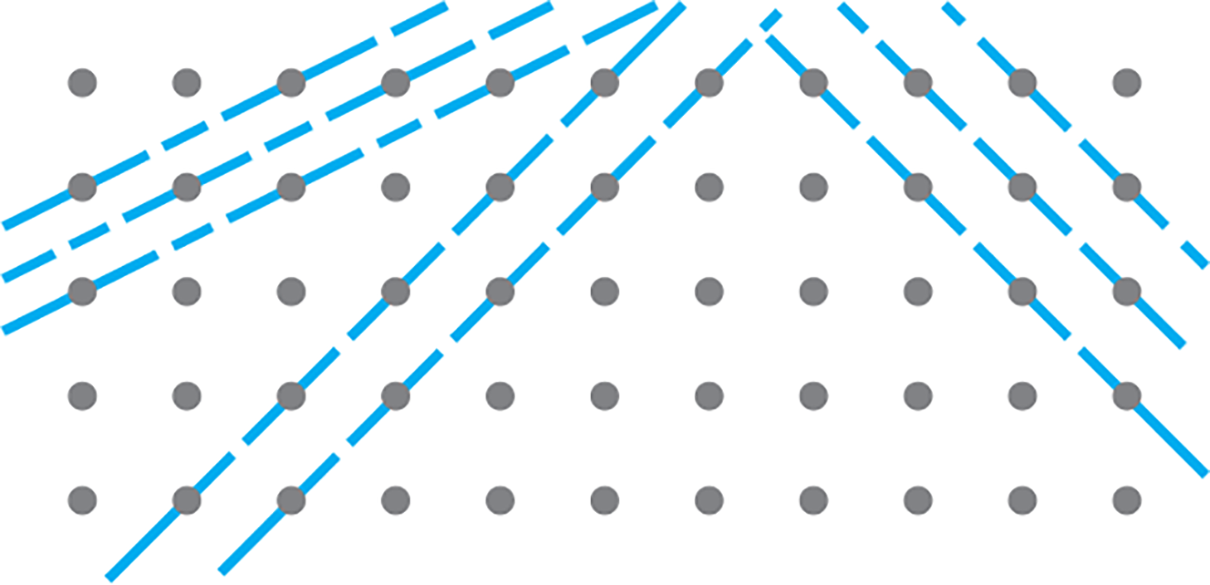
35-11 X-Rays and X-Ray Diffraction (2 of 2)
X-ray diffraction is now used to study the internal structure of crystals; this is how the helical structure of DNA was determined.
Notes:
Figure 35-29. X-rays can be diffracted from many possible planes within a crystal.
LD: Two parallel planes are seen passing through the third and the fourth points in the first row, and the first and second points of the second row, respectively. A third parallel plane is seen passing through the fifth point in the first row, third point in the second row, and the first point in the third row. Two parallel planes are seen passing through the sixth and seventh points in the first row, the fifth and sixth points in the second row, the fourth and fifth points in the third row, the third and fourth points in the fourth row, and the second and third points in the fifth row, respectively. Three parallel planes are seen passing through the eighth, ninth, and tenth points of the first row, and the ninth, tenth, and eleventh points of the second row, respectively. They extend downward till they exit the viewing window.

Slide 41
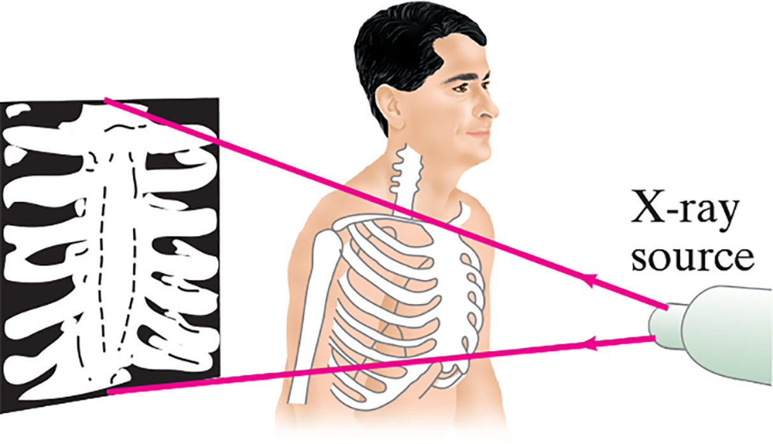
35-12 X-Ray Imaging and Computed Tomography (C T Scan) (1 of 4)
A normal X-ray image is formed by passing X-rays through the body; it is basically a shadow of the tissues it encounters. No focusing of the beam is done.
Notes:
Figure 35-31. Conventional X-ray imaging, which is essentially shadowing.
LD: The X-ray source is shown on the right. The rectangular film on which the X-rayed image will be cast is shown on the left. A man is shown standing in between the source and the film. The man is facing the source. Two rays emerge from the source, pass through the man, and meet the upper and lower ends of the film, respectively. The bones in the chest and the arms of the men are highlighted. An image of the rib cage is projected on the film.

Slide 42
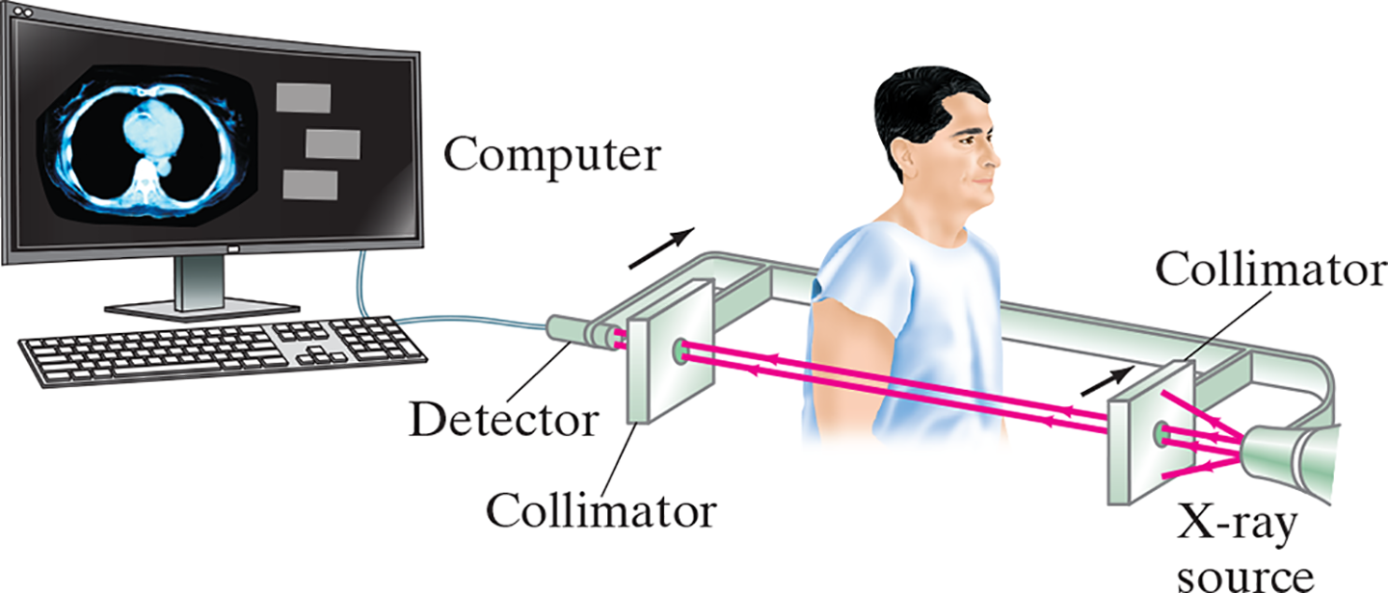
35-12 X-Ray Imaging and Computed Tomography (C T Scan) (2 of 4)
Computed tomography uses a collimated X-ray source and a detector to produce detailed images of the body, one slice at a time.
Notes:
Figure 35-32. Tomographic imaging: the X-ray source and detector move together across the body, the transmitted intensity being measured at a large number of points. Then the “source detector” assembly is rotated slightly (say, 1°) around a vertical axis, and another scan is made. This process is repeated for perhaps 180°. The computer reconstructs the image of the slice and it is presented on a computer screen. Normally the patient is not standing but lying down.
LD: The X-ray source is shown on the right. Two parallel rectangular plates with a hole at the center and separated by a distance are horizontally to the left of the X-ray source. Each of the plates is labeled Collimator. A short rod labeled Detector is horizontally to the left of the hole of the second rectangular plate that is away from the X-ray source. The other end of the detector is connected to the computer by a wire. A beam supports the X-ray source, the collimators, and the detector. A man, facing the X-ray source, is seen standing between the collimators such that his right arm is in between the two holes of the collimators. A beam of light emerges from the X-ray source. Two straight parallel rays are seen passing through the collimator plate close to the source, the arm of the man, and the second collimator and striking the detector. An image of the horizontal cross section of the bone is seen on the screen of the computer.

Slide 43
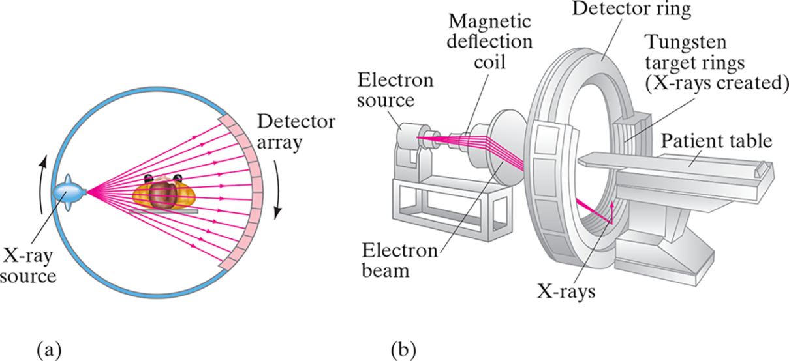
35-12 X-Ray Imaging and Computed Tomography (C T Scan) (3 of 4)
(a) A fan-beam C T scanner is similar to the one on the previous slide, but uses multiple beams and detectors to complete the scan more quickly. (b) In this scanner, a beam of electrons is directed by magnetic fields at targets surrounding the patient.
Notes:
Figure 35-33. (a) Fan-beam scanner. Rays transmitted through the entire body are measured simultaneously at each angle. The source and detector rotate to take measurements at different angles. In another type of fan-beam scanner, there are detectors around the entire 360° of the circle which remain fixed as the source moves. (b) In still another type, a beam of electrons from a source is directed by magnetic fields at tungsten targets
surrounding the patient.
LD: Part (“a”): A vertical circular ring with a man lying horizontally at the center, such that his head is facing the viewer, is shown. An elliptical object labeled X-ray source is shown next to the inner rim of the ring on the left. The X-rays are emitted toward the right from an opening on the right of the source. The rays are emitted from a single point but spread out such that they meet the opposite side of the ring at different angles. The points at which the rays meet the ring are shown as tiny quadrilaterals placed side by side along the arc of the ring and are labeled Detector array. The rays seem to pass through the man. The source and the ring seem to be rotating in the clockwise direction. Part (b): A type of fan-beam scanner machine is shown. The patient table is shown on the right. To its left, a thick circular structure is shown. The upper half of the circular structure is labeled Detector ring. The bottom half contains multiple semicircular rings labeled Tungsten target rings (X-rays created). To the left of the circular structure, an instrument consisting of an electron source, a magnetic deflection coil, and a circular disk having a diameter greater than the magnetic deflection coil, is shown. The disk is closer to the circular structure. The magnetic deflection coil is in between the electron source and the disk. The electron source, the magnetic deflection coil, and the circular disk are aligned such that they are horizontally in line with the center of the circular structure and the patient bed. The electron beam consisting of multiple rays originates from the source, strikes the magnetic deflection coil, gets deflected outward, meets the outer rim of the disk, gets deflected inward, converge at a single point on the Tungsten target rings, and gets deflected vertically upward.

Slide 44
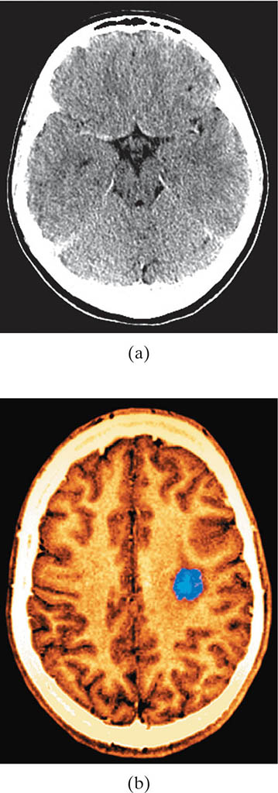
35-12 X-Ray Imaging and Computed Tomography (C T Scan) (4 of 4)
A detailed image can be formed if scans are done from many angles; producing the image requires complicated mathematical analysis. A more detailed scan is more sensitive but requires much more data.
Notes:
Figure 35-34. Two CT images, with different resolutions, each showing a cross section of a brain. Photo (a) is of low resolution; photo (b), of higher resolution, shows a brain tumor, and uses false color to highlight it.
LD: Part (“a”) is a low resolution black-and-white image of the scan. The outlines of the skull and the brain are visible. The outline of the skull is thin and white. The brain is colored gray. A thick uniform white space is seen between the brain and the skull. Part (b) is a high resolution colored image of the scan. The top view of the brain with its two distinct hemispheres is visible. A clear thick outline of the skull is also visible. The brain and the outline of the skull are colored orange. A thick uniform white space is seen between the brain and the skull. A blue spot is seen near the central sulcus of the right hemisphere of the brain.

Slide 45
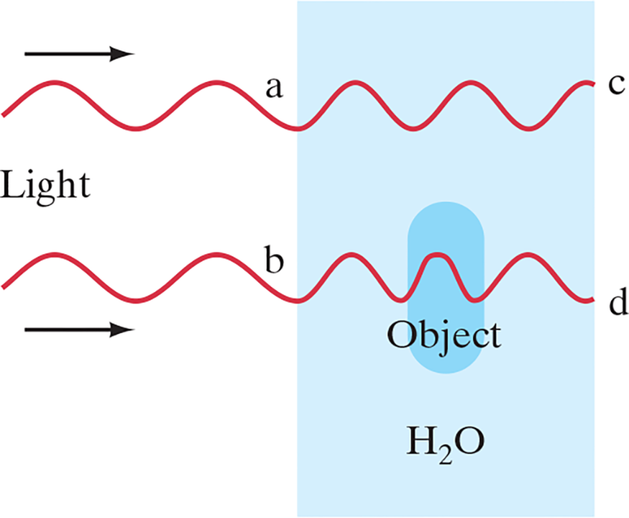
35-13 Specialty Microscopes and Contrast (1 of 2)
In addition to sufficient resolving power, a microscope must be able to distinguish the object from its background. The difference in brightness between the image of an object and the image of the surroundings is called contrast.
Notes:
Figure 35-37. Object—say, a bacterium—in a water solution.
LD: The water solution is represented as a rectangular surface labeled H subscript 2 O and is shown on the right of the figure. A vertical rod-shaped elliptical structure labeled Object is shown at the center of the rectangle. Two transverse waves of light with the same intensity and wavelength pass through the water solution from the left. The first wave on the top passes only through the solution while the second wave at the bottom passes through the solution and the Object that is suspended in it. The point at which the first wave meets the left side of the rectangular surface is labeled “a,” and the point at which it meets the right face of the rectangle after passing through the solution is labeled c. The wavelength of the wave reduces when it passes through the solution. The point at which the second wave meets the left side of the rectangular surface is labeled b, and the point at which it meets the right face of the rectangle after passing through the solution and the object is labeled d. The wavelength of the wave reduces when it enters the solution and reduces further as it enters the object. The wavelength of the wave increases after it exits the object and has a wavelength similar to the wavelength of the wave in the solution.

Slide 46
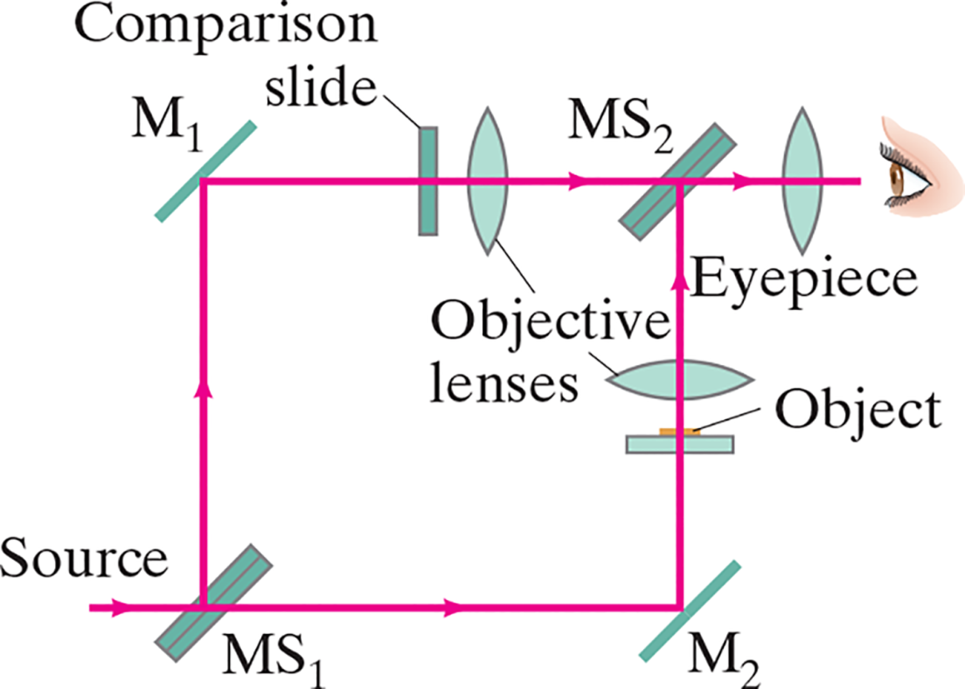
35-13 Specialty Microscopes and Contrast (2 of 2)
One way to increase contrast is by using an interference microscope, which can detect objects by the change in wavelength as the light passes through them.
Notes:
Figure 35-38. Diagram of an interference microscope.
LD: The two half-silvered mirrors are labeled M S subscript 1 and M S subscript 2, respectively. The two mirrors are labeled M subscript 1 and M subscript 2, respectively. The four mirrors are slanted to the right and are aligned such that they appear to be at the four corners of a rectangle. M S subscript 1 is at the lower-left corner, M subscript 1 is at the upper left corner, M S subscript 2 is at the upper right corner, and M subscript 2 is at the lower right corner of the rectangle. One of the objective lenses is between M subscript 1 and M S subscript 2 on the top side and is oriented vertically. The other objective lens is between M subscript 2 and M S subscript 2 on the right side and is oriented horizontally. The slide labeled Object is oriented horizontally and is between M subscript 2 and the objective lens on the right side of the rectangle. The slide labeled Comparison slide is oriented vertically and is between M subscript 1 and the objective lens on the top side of the rectangle. The two slides are close to their respective objective lenses. The lens labeled Eyepiece is horizontally to the right of M S subscript 2. A human eye is shown horizontally to the right of the Eyepiece. The source is shown horizontally to the left of M S subscript 1 on the lower-left corner of the rectangle. The ray of light originates at the source, travels to the right, and strikes M S subscript 1. After striking M S subscript 1, the ray splits into two. The first split ray travels straight toward the right along the bottom side of the rectangle and strikes M subscript 2. From there, the ray gets deflected upward, travels along the right side of the rectangle, passes through the Object slide and the object lens next to it, and strikes M S subscript 2. The second split ray gets deflected upward, travels along the left side of the rectangle, and strikes M subscript 1. From there, the ray gets deflected toward the right, travels along the top side of the rectangle, passes through the Comparison slide and the object lens next to it, and strikes M S subscript 2. The two rays that strike M S subscript 2 converge to form a single ray. This ray gets deflected horizontally to the right, passes through the Eyepiece, and meets the eye.

Slide 47

Summary of Chapter 35 (1 of 3)
Light bends around obstacles and openings in its path, yielding diffraction patterns.
Light passing through a narrow slit will produce a central bright maximum of width
Minima occur at

Slide 48

Summary of Chapter 35 (2 of 3)
Diffraction limits the resolution of images.
Diffraction grating has many parallel slits or lines; peaks of constructive interference are given by
A diffraction grating is used in a spectrometer to separate different colors and observe line spectra.

Slide 49
Summary of Chapter 35 (3 of 3)
X-rays are a form of electromagnetic radiation of very short wavelength that are produced when high-speed electrons strike a glass or metal target.
Computer tomography (C A T scan) uses many narrow X-ray beams to construct an image.

Slide 50

Copyright
This work is protected by United States copyright laws and is provided solely for the use of instructors in teaching their courses and assessing student learning. Dissemination or sale of any part of this work (including on the World Wide Web) will destroy the integrity of the work and is not permitted. The work and materials from it should never be made available to students except by instructors using the accompanying text in their classes. All recipients of this work are expected to abide by these restrictions and to honor the intended pedagogical purposes and the needs of other instructors who rely on these materials.

