Slide 1


Physics for Scientists and Engineers with Modern Physics
Fifth Edition
Chapter 37
Early Quantum Theory and Models of the Atom
Copyright © 2023 Pearson Education, Inc. All Rights Reserved
Notes:
If this PowerPoint presentation contains mathematical equations, you may need to check that your computer has the following installed:
1) MathType Plugin
2) Math Player (free versions available)
3) NVDA Reader (free versions available)

Slide 2
Units of Chapter 37 (1 of 2)
Blackbody Radiation; Planck’s Quantum Hypothesis
Photon Theory of Light and the Photoelectric Effect
Energy, Mass, and Momentum of a Photon
Compton Effect
Photon Interactions; Pair Production
Wave–Particle Duality; the Principle of Complementarity

Slide 3
Units of Chapter 37 (2 of 2)
Wave Nature of Matter
Electron Microscopes
Early Models of the Atom
Atomic Spectra: Key to the Structure of the Atom
The Bohr Model
de Broglie’s Hypothesis Applied to Atoms

Slide 4
37-1 Blackbody Radiation; Planck’s Quantum Hypothesis (1 of 7)
All objects emit radiation whose total intensity is proportional to the fourth power of their temperature. This is called thermal radiation; a blackbody is one that emits thermal radiation only.
The spectrum of blackbody radiation has been measured; it is found that the frequency of peak intensity increases linearly with temperature.

Slide 5
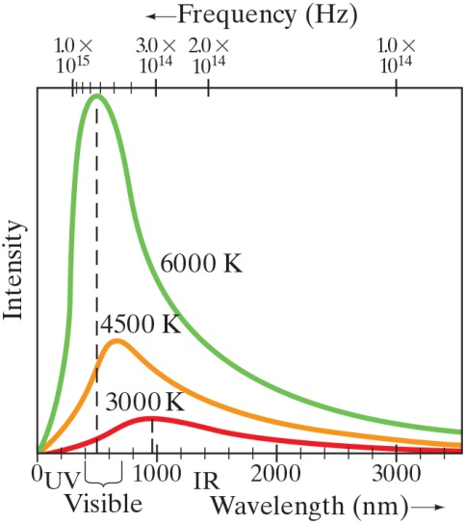

37-1 Blackbody Radiation; Planck’s Quantum Hypothesis (2 of 7)
This figure shows blackbody radiation curves for three different temperatures. Note that frequency increases to the left. The relationship between the temperature and peak wavelength is given by Wien’s law:
Notes:
Figure 37-1. Measured spectra of wavelengths and frequencies emitted by a blackbody at three different temperatures.
LD: Two horizontal axes are shown at the top and the bottom, respectively, of a spectrum graph. The horizontal axis at the bottom is labeled Wavelength (n m) and ranges from 0 to 3600 in intervals of 1000 units. Four uniform markings are also shown between each interval. The first small marking from the origin is labeled UV. The area between the second and the half of the fourth small marking from the origin is marked using a curly bracket labeled Visible. The second small marking from 1000 is labeled IR. The horizontal axis at the top is labeled Frequency (H z) and has the following markings from left to right: 1.0 multiplied by 10 raised to the 15th power, 3.0 multiplied by 10 raised to the 14th power, 2.0 multiplied by 10 raised to the 14th power, and 1.0 multiplied by 10 raised to the 14th power. The gap between 2.0 multiplied by 10 raised to the 14th power and 1.0 multiplied by 10 raised to the 14th power is greater than the gap between 1.0 multiplied by 10 raised to the 15th power and 3.0 multiplied by 10 raised to the 14th power. Six additional markings are shown in the gap between 1.0 multiplied by 10 raised to the 15th power and 3.0 multiplied by 10 raised to the 14th power with four markings close to the first value. The gap between 3.0 multiplied by 10 raised to the 14th power and 2.0 multiplied by 10 raised to the 14th power is lesser than the gaps between the other values. The vertical axis is labeled Intensity. The origin is labeled 0. Three curves start from 0. The first curve labeled 6000 K starts from 0, moves rapidly up to the right, peaks at maximum intensity at a point closer to 500 n m on the lower horizontal axis, and moves down to the right till it flattens out above the lower horizontal axis. A dashed vertical line drawn from the vertex of the curve 6000 K extends downward and meets the lower horizontal axis at the point 500 n m. The second curve labeled 4500 K starts from 0, moves up to the right, peaks up to a point vertically to the right of the vertex of the curve 6000 K, and moves down to the right till it flattens out just above the lower horizontal axis at an end point much below the curve 6000 K. The third curve labeled 3000 K starts from 0, goes up gradually to the right, peaks at a point before 1000 on the horizontal axis, then goes down gradually to the right till it flattens out just below the curve 4500 K at the end of the horizontal axis. A dashed vertical line drawn from the vertex of the curve 3000 K extends downward and meets the lower horizontal axis at the point before the marking 1000 n m.

Slide 6
37-1 Blackbody Radiation; Planck’s Quantum Hypothesis (3 of 7)
Example 37-1: The Sun’s surface temperature.
Estimate the temperature of the surface of our Sun, given that the Sun emits light whose peak intensity occurs in the visible spectrum at around 500 n m.
Notes:
Solution: Using Wien’s law we find T = 6000K.

Slide 7
37-1 Blackbody Radiation; Planck’s Quantum Hypothesis (4 of 7)
Example 37-2: Star color.
Suppose a star has a surface temperature of 32,500 K. What color would this star appear?

Slide 8
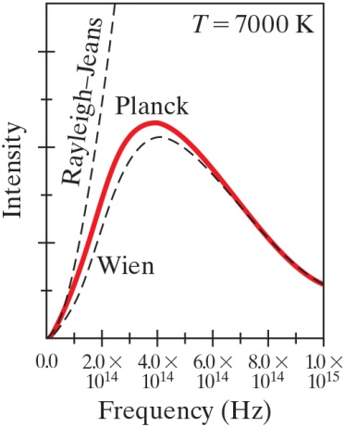
37-1 Blackbody Radiation; Planck’s Quantum Hypothesis (5 of 7)
The observed blackbody spectrum could not be reproduced using nineteenth-century physics. This plot shows the disagreement.
Notes:
Figure 37-2. Comparison of the Wien and the Rayleigh 9 Jeans theories to that of Planck, which closely follows experiment. The dashed lines show lack of agreement of older theories.
LD: The horizontal axis is labeled Frequency (H z) and ranges from 0.0 to 1.0 multiplied by 10 raised to the 15th power in intervals of 1.0 multiplied by 10 raised to the 14th power units. The vertical axis is labeled Intensity and has six uniform markings on it. Three curves start from the origin. The first dashed curve labeled Rayleigh-Jeans starts from the origin like a curve, and then moves rapidly up like a straight line to touch the maximum Intensity axis at a point just after the marking 2.0 multiplied by 10 raised to the 14th power on the horizontal axis. The second curve labeled Planck starts from the origin like a curve, extends to the upper right till it reaches its peak at approximately 3.8 multiplied by 10 raised to the 14th power on the horizontal axis and between the fourth and the fifth markings on Intensity axis, extends to the lower right till it reaches the end of the horizontal axis, and exits the viewing window just above the first marking on the Intensity axis. The third dashed curve labeled Wein starts from the origin like a curve, extends to the upper right till it reaches its peak at approximately 4.0 multiplied by 10 raised to the 14th power on the horizontal axis, slightly lower than the curve Planck and between the fourth and the fifth markings on Intensity axis, extends to the lower right till it reaches the end of the horizontal axis, and exits the viewing window just above the first marking on the Intensity axis. The curve Wien exits the viewing window along the same path as the curve Planck. A label T equals 7000 K is placed at the top right corner of the graph.

Slide 9

37-1 Blackbody Radiation; Planck’s Quantum Hypothesis (6 of 7)
A solution was proposed by Max Planck in 1900. He suggested that the energy of atomic oscillations within atoms cannot have an arbitrary value; it is related to the frequency:
The constant h is now called Planck’s constant.

Slide 10

37-1 Blackbody Radiation; Planck’s Quantum Hypothesis (7 of 7)
Planck found the value of his constant by fitting blackbody curves to the formula
giving
Planck’s proposal was that the energy of an oscillation had to be an integral multiple of h f. This is called the quantization of energy.

Slide 11
37-2 Photon Theory of Light and the Photoelectric Effect (1 of 9)
Einstein suggested that, given the success of Planck’s theory, light must be emitted in small energy packets:
These tiny packets, or particles, are called photons.

Slide 12
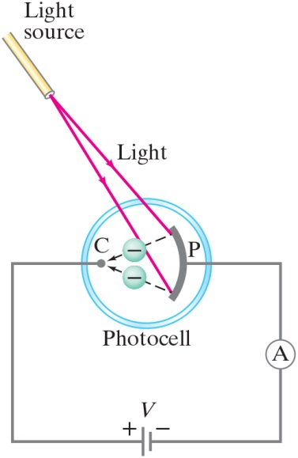
37-2 Photon Theory of Light and the Photoelectric Effect (2 of 9)
The photoelectric effect: if light strikes a metal, electrons are emitted. The effect does not occur if the frequency of the light is too low; the kinetic energy of the electrons increases with frequency.
Notes:
Figure 37-4. The photoelectric effect.
LD: The e m f source is labeled V. The positive terminal of V labeled plus is connected to a small electrode shown as a point labeled C. The negative terminal of V labeled minus is connected to an ammeter labeled "A," which is connected to a left open curved metal plate labeled P. A dashed arrow from the top of P points to the lower left at C. Another dashed arrow from the bottom of P points to the upper left at C. Two circles with a minus sign are placed near the tip of each dashed arrow, respectively. A circular ring labeled Photocell encloses C, the two circles with a minus sign, the two dashed arrows, and P. A cylindrical structure labeled Light source is placed at the top of the figure facing Photocell on its lower right. Two light beams labeled Light emitted by the light source point to the lower right and end at the top and the bottom of P, respectively.

Slide 13
37-2 Photon Theory of Light and the Photoelectric Effect (3 of 9)
If light is a wave, theory predicts:
Number of electrons and their energy should increase with intensity.
Frequency would not matter.

Slide 14
37-2 Photon Theory of Light and the Photoelectric Effect (4 of 9)
If light is particles, theory predicts:
Increasing intensity increases number of electrons but not energy.
Above a minimum energy required to break atomic bond, kinetic energy will increase linearly with frequency.
There is a cutoff frequency below which no electrons will be emitted, regardless of intensity.

Slide 15
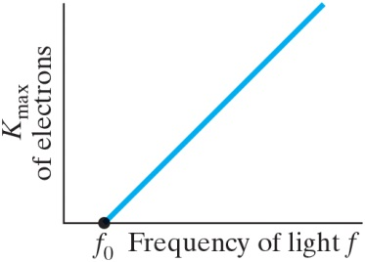
37-2 Photon Theory of Light and the Photoelectric Effect (5 of 9)
The particle theory assumes that an electron absorbs a single photon.
Plotting the kinetic energy vs. frequency:
This shows clear agreement with the photon theory, and not with wave theory.
Notes:
Figure 37-5. Photoelectric effect: the maximum kinetic energy of ejected electrons increases linearly with the frequency of incident light. No electrons are emitted if f < f0.
LD: The horizontal axis has a point labeled f subscript 0 marked close to the origin. A straight line from f subscript 0 extends toward the upper right and increases as Frequency of light f increases.

Slide 16

37-2 Photon Theory of Light and the Photoelectric Effect (6 of 9)
Example 37-3: Photon energy.
Calculate the energy of a photon of blue light,
in air (or vacuum).

Slide 17
37-2 Photon Theory of Light and the Photoelectric Effect (7 of 9)
Example 37-4: Photons from a lightbulb.
Estimate how many visible light photons a 100-W incandescent lightbulb emits per second. Assume the bulb has a typical efficiency of about 3% (i.e., 97% of the energy goes to heat).

Slide 18
37-2 Photon Theory of Light and the Photoelectric Effect (8 of 9)
Example 37-5: Photoelectron speed and energy.
What are the kinetic energy and the speed of an electron ejected from a sodium surface whose work
function is
when illuminated by light of
wavelength (a) 410 n m and (b) 550 n m?

Slide 19
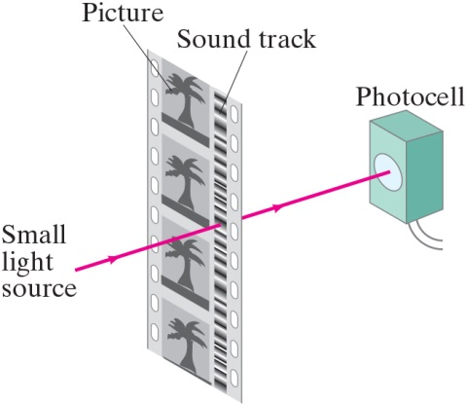
37-2 Photon Theory of Light and the Photoelectric Effect (9 of 9)
The photoelectric effect is how “electric eye” detectors work. It is also used for movie film sound tracks.
Notes:
Figure 37-6. Optical sound track on movie film. In the projector, light from a small source (different from that for the picture) passes through the sound track on the moving film. The light and dark areas on the sound track vary the intensity of the transmitted light which reaches the photocell, whose output current is then a replica of the original sound. This output is amplified and sent to the loudspeakers. High-quality projectors can show movies containing several parallel sound tracks to go to different speakers around the theater.
LD: A section of a film is shown in the form of a rectangle placed vertically and is slightly tilted to the left. The film is divided into four vertical sections with the two corner vertical sections having 10 uniformly placed perforations, respectively. The second section from the left is labeled Picture, has a larger width, and is divided into four squares each displaying a tree-shaped figure placed one below the other. The second section from the right labeled Sound track has a similar area as that of the corner sections and has variably shaded horizontal stripes stacked one below the other, resembling a vertical bar code. A rectangular box with a circle at the center of its left face is placed horizontally behind the film such that its left face is parallel to the film and is labeled Photocell. Two small wires are seen attached to the bottom left of Photocell. A horizontal light beam from a point labeled Small light source extends to the left of the figure, passes through Sound track section of the film, and ends at the center of the circle on the Photocell.

Slide 20

37-3 Energy, Mass, and Momentum of a Photon (1 of 3)
Clearly, a photon must travel at the speed of light. Looking at the relativistic equation for momentum, it is clear that this can only happen if its rest mass is zero.
We already know that the energy is h f; we can put this in the relativistic energy-momentum relation and find the momentum:

Slide 21

37-3 Energy, Mass, and Momentum of a Photon (2 of 3)
Example 37-6: Photosynthesis.
In photosynthesis, pigments such as chlorophyll in
plants capture the energy of sunlight to change
to useful carbohydrate. About nine photons are needed
to transform one molecule of
to carbohydrate and
Assuming light of wavelength
(chlorophyll
absorbs most strongly in the range 650 n m to 700 n m), how efficient is the photosynthetic process? The reverse chemical
reaction releases an energy of 4.9 e V/molecule of
so
4.9 e V is needed to transform one molecule of
to
carbohydrate.

Slide 22
37-3 Energy, Mass, and Momentum of a Photon (3 of 3)
Example 37-7: Photon momentum and force.
Suppose the
photons emitted per second from the
100-W lightbulb in Example 37-4 were all focused onto a piece of black paper and absorbed. (a) Calculate the momentum of one photon and (b) estimate the force all these photons could exert on the paper.

Slide 23

37-4 Compton Effect (1 of 3)
Compton did experiments in which he scattered X-rays from different materials. He found that the scattered X-rays had a slightly longer wavelength than the incident ones, and that the wavelength depended on the scattering angle:

Slide 24
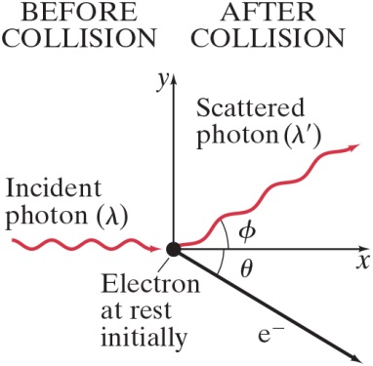
37-4 Compton Effect (2 of 3)
This is another effect that is correctly predicted by the photon model and not by the wave model.
Notes:
Figure 37-7. The Compton effect. A single photon of wavelength l strikes an electron in some material, knocking it out of its atom. The scattered photon has less energy (some energy is given to the electron) and hence has a longer wavelength λ’. (shown exaggerated). Experiments found scattered X-rays of just the wavelengths predicted by conservation of energy and momentum using the photon model.
LD: The horizontal axis is labeled x and the vertical axis is labeled y. A black dot is marked at the origin and labeled Electron at rest initially. A squiggly arrow labeled Incident photon (lambda) starts from a point on the negative x axis and points horizontally to the right at the black dot. An arrow labeled e superscript minus starts from the black dot and points to the lower right making an angle labeled theta with the positive x axis. Another squiggly arrow labeled Scattered photon (lambda prime) starts from the black dot and points to the upper right making an angle labeled phi with the positive x axis. A label BEFORE COLLISION is placed vertically above Incident photon, and a label AFTER COLLISION is placed vertically above Scattered photon.

Slide 25
37-4 Compton Effect (3 of 3)
Example 37-8: X-ray scattering.
X-rays of wavelength 0.140 n m are scattered from a very thin slice of carbon. What will be the wavelengths of X-rays scattered at
(a)
(b)
and (c)

Slide 26
37-5 Photon Interactions; Pair Production (1 of 3)
Photons passing through matter can undergo the following interactions:
Photoelectric effect: photon is completely absorbed, electron is ejected.
Photon may be totally absorbed by electron, but not have enough energy to eject it; the electron moves into an excited state.
The photon can scatter from an atom and lose some energy.
The photon can produce an electron–positron pair.

Slide 27
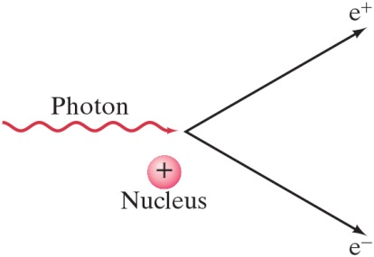
37-5 Photon Interactions; Pair Production (2 of 3)
In pair production, energy, electric charge, and momentum must all be conserved.
Energy will be conserved through the mass and kinetic energy of the electron and positron; their opposite charges conserve charge; and the interaction must take place in the electromagnetic field of a nucleus, which can contribute momentum.
Notes:
Figure 37-9. Pair production: a photon disappears and produces an electron and a positron. (This process requires an additional massive object, often an atomic nucleus, so that energy and momentum can be conserved. See next page.)
LD: A squiggly arrow labeled Photon pointing horizontally to the right is shown on the left. A circle having a positive sign and labeled Nucleus is shown below the tip of Photon. An arrow labeled e superscript negative from the tip of Photon points to the lower right. Another arrow labeled e superscript positive from the tip of Photon points to the upper right.

Slide 28
37-5 Photon Interactions; Pair Production (3 of 3)
Example 37-9: Pair production.
(a) What is the minimum energy of a photon that can produce an electron–positron pair? (b) What is this photon’s wavelength?

Slide 29
37-6 Wave–Particle Duality; the Principle of Complementarity (1 of 2)
We have phenomena such as diffraction and interference that show that light is a wave, and phenomena such as the photoelectric effect and the Compton effect that show that it is a particle.
Which is it?
This question has no answer; we must accept the dual wave–particle nature of light.

Slide 30
37-6 Wave–Particle Duality; the Principle of Complementarity (2 of 2)
The principle of complementarity states that both the wave and particle aspects of light are fundamental to its nature.
Indeed, waves and particles are just our interpretations of how light behaves.

Slide 31
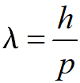
37-7 Wave Nature of Matter (1 of 5)
Just as light sometimes behaves like a particle, matter sometimes behaves like a wave.
The wavelength of a particle of matter is
This wavelength, called the de Broglie wavelength of a particle, is extraordinarily small.

Slide 32
37-7 Wave Nature of Matter (2 of 5)
Example 37-10: Wavelength of a ball.
Calculate the de Broglie wavelength of a 0.20-k g ball moving with a speed of 15 m/s.

Slide 33
37-7 Wave Nature of Matter (3 of 5)
Example 37-11: Wavelength of an electron.
Determine the wavelength of an electron that has been accelerated through a potential difference of 100 V.

Slide 34
37-7 Wave Nature of Matter (4 of 5)
The wave nature of matter becomes more important for very light particles such as the electron.
Electron wavelengths can easily be on the order of
electrons can be diffracted by crystals just as
X-rays can.

Slide 35
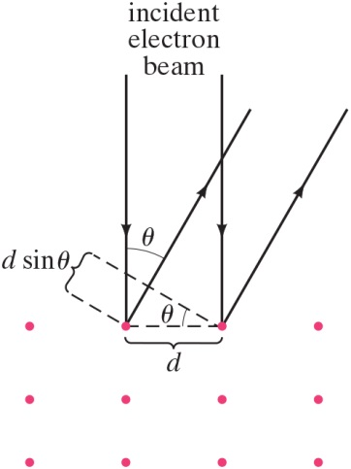
37-7 Wave Nature of Matter (5 of 5)
Example 37-12: Electron diffraction.
The wave nature of electrons is manifested in experiments where an electron beam interacts with the atoms on the surface of a solid, especially crystals. By studying the angular distribution of the diffracted electrons, one can indirectly measure the geometrical arrangement of atoms. Assume that the electrons strike perpendicular to the surface of a solid, and that
their energy is low,
e V, so that they
interact only with the surface layer of atoms. If the
smallest angle at which a diffraction maximum
occurs is at
what is the separation d between
the atoms on the surface?
Notes:
Figure 37-12. Example 37–12. The red dots represent atoms in an orderly array in a solid.
LD: 12 red-colored dots arranged in an orderly array of three rows and four columns are shown at the bottom of the figure. A dashed line labeled d is drawn between the second and the third dot of the top row. Two vertical parallel arrows labeled incident electron beam from the top point toward the second and the third dot on the top row. Two diagonal parallel arrows are drawn from the second and the third dot on the top row pointing to the upper right such that they make an angle labeled theta with incident electron beam. A second dashed line is drawn from the third dot on the top row toward the upper left such that it makes an angle labeled theta with the horizontal dashed line d. A third dashed line is drawn to the upper left from the second dot on the top row and is parallel to the second dashed line. The distance between the second and the third dashed lines is labeled d sine theta.

Slide 36
37-8 Electron Microscopes (1 of 4)
The wavelength of electrons will vary with energy, but is still quite short. This makes electrons useful for imaging—remember that the smallest object that can be resolved is about one wavelength. Electrons used in electron microscopes have wavelengths of about 0.004 n m.

Slide 37
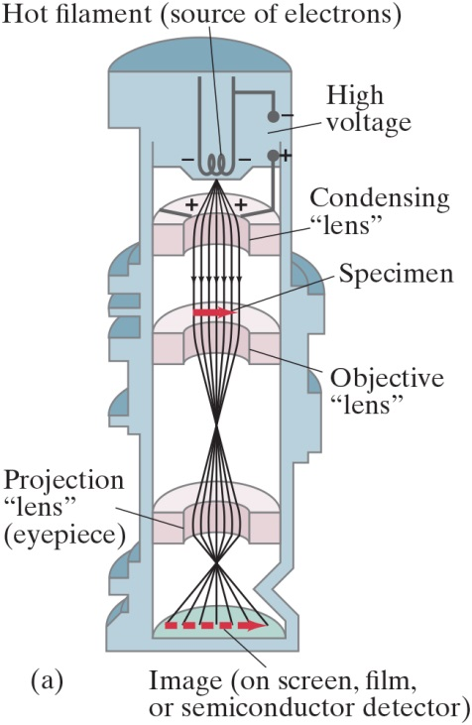
37-8 Electron Microscopes (2 of 4)
Transmission electron microscope—the electrons are focused by magnetic coils
Notes:
Figure 37-13. (a) Transmission electron microscope. The magnetic field coils are designed to be “magnetic lenses,” which bend the electron paths and bring them to a focus, as shown. The sensors of the image measure electron intensity only, not color.
LD: The cylindrical section has five segments from the top. The first segment on the top has the source of electrons while the fifth segment at the bottom is the place where the final image is detected. The middle three segments are shown as thick semicircular rings aligned horizontally such that the curved surface of the inner rim is visible to the observer. The second and third segments are placed closed to each other at the top near the first segment. The fourth segment is at the bottom above the fifth segment. There is a big gap between the third and the fourth segments. In the first segment, an open power supply labeled High voltage is shown on the right and has its negative terminal connected to a coiled filament labeled Hot filament (source of electrons) shown at the center of the first segment. The coil of the filament is toward the bottom and is negatively charged. The positive terminal of High voltage is connected to the second segment labeled Condensing "lens" which is positively charged. Electrons are generated from the filament on the top segment and sent to the second segment as seven radially outward arrows pointing downward. From the second segment, the radial arrows extend vertically downward as straight arrows, pass through a right pointing arrow labeled Specimen placed above the third segment labeled Objective "lens". From the third segment, these seven arrows extend downward as radially inward arrows, converge at a point at the center of the third and fourth segments, and continue to extend downward as seven radially outward arrows till they reach the fourth segment labeled Projection "lens" (eyepiece). From the fourth segment, these seven arrows extend downward as radially inward arrows, converge at a point near the fourth segment, and continue to extend downward as seven radially outward arrows till they reach the top of the fifth segment . A right pointing dashed arrow labeled Image (on screen, film, or semiconductor detector) spanning across the seven arrows is shown on the top surface of the fifth segment and is longer than the arrow labeled Specimen.

Slide 38
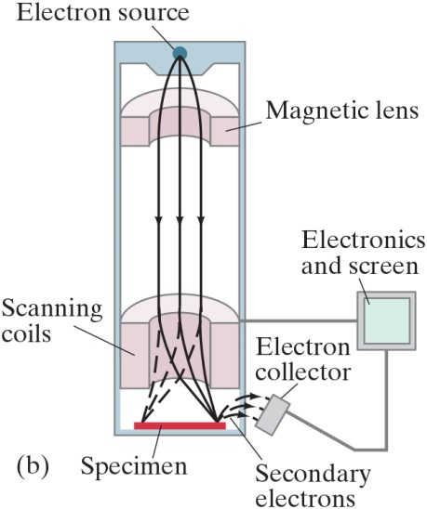
37-8 Electron Microscopes (3 of 4)
Scanning electron microscope—the electron beam is scanned back and forth across the object to be imaged.
Notes:
Figure 37-13. (b) Scanning electron microscope. Scanning coils move an electron beam back and forth across the specimen. Secondary electrons produced when the beam strikes the specimen are collected and their intensity affects the brightness of pixels in a monitor to produce a picture.
LD: The cylindrical section has four segments. The first segment on the top has the source of electrons while the bottom segment has the specimen. The second and third segments are shown as thick semicircular rings aligned horizontally such that the curved surface of the inner rim is visible to the observer. The second segment is placed close to the first segment and is thinner compared to the third segment. The third segment is placed close to the fourth segment. A dot is present at the center of the top segment and is labeled Electron source. Electrons are generated from this dot as three radially outward arrows pointing down toward the second segment labeled Magnetic lens. These three arrows pass the second segment as straight arrows pointing down till they reach the top surface of the third segment labeled Scanning coils. These three straight arrows diverge down from Scanning coils to the right corner of a thin rectangular block labeled Specimen placed on the fourth segment as three inward curving arrows. Similarly, three more straight arrows diverge down from Scanning coils to the left corner of Specimen at the bottom segment as three outward curving dashed arrows to represent the movement of electronic beam by Scanning coils across the Specimen. The three inward curving arrows at the right corner of Specimen produce three outward curving arrows pointing to the right labeled Secondary electrons onto a rectangular structure labeled Electron collector on the right. A wire connects Electron collector to a square shaped structure labeled Electronics and screen on the upper right. Another wire connects Scanning coils with Electronics and Screen on the right.

Slide 39
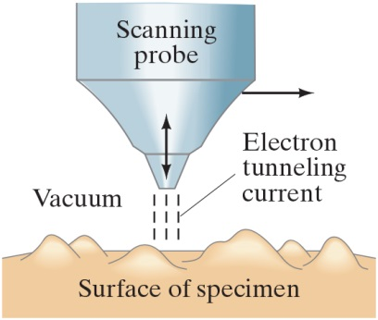
37-8 Electron Microscopes (4 of 4)
The scanning tunneling electron microscope contains a tiny probe whose tip is only a few atoms wide. It moves up and down as it is moved horizontally, and this motion is translated into an image of the surface.
Notes:
Figure 37-15. Scanning electron microscope. Scanning coils move an electron beam back and forth across the specimen. Secondary electrons produced when the beam strikes the specimen are collected and modulate the intensity of the beam in the CRT to produce a picture.
LD: The cones represent the tip of the probe. Below the probe, an irregular surface with multiple bumps is shown and is labeled Surface of specimen. Three dashed parallel lines labeled Electron tunneling current are drawn between the tip of the probe and the specimen’s surface. A label Vacuum is shown on the left of the probe. A double-headed vertical arrow is shown near the tip of the cone. A right pointing arrow is placed to the right of the probe.

Slide 40
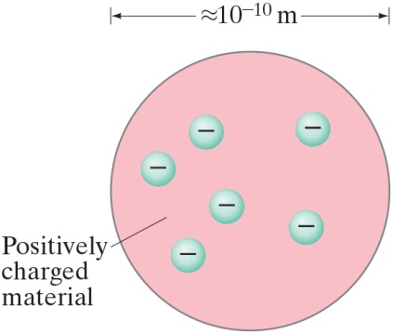
37-9 Early Models of the Atom (1 of 4)
It was known that atoms were electrically neutral, but that they could become charged, implying that there were positive and negative charges and that some of them could be removed.
One popular atomic model was the “plum-pudding” model:
Notes:
Figure 37-16. Plum-pudding model of the atom.
LD: A pink-colored circular structure labeled Positively charged material is shown. The diameter of the circle is indicated by a double-headed arrow labeled approximately 10 raised to the negative 10th power m. Six tiny blue circles with a negative sign are shown at random places within the circular structure.

Slide 41
37-9 Early Models of the Atom (2 of 4)
This model had the atom consisting of a bulk positive charge, with negative electrons buried throughout.
Rutherford did an experiment that showed that the positively charged nucleus must be extremely small compared to the rest of the atom. He scattered alpha particles—helium nuclei—from a metal foil and observed the scattering angle. He found that some of the angles were far larger than the plum-pudding model would allow.

Slide 42
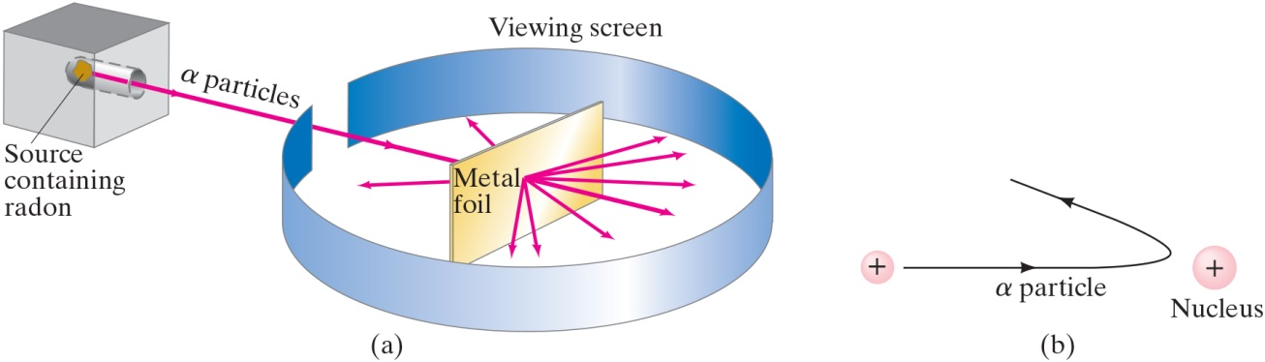
37-9 Early Models of the Atom (3 of 4)
The only way to account for the large angles was to assume that all the positive charge was contained within a tiny volume—now we know that the radius of the nucleus is 1/10,000 that of the atom.
Notes:
Figure 37-17. (a) Experimental setup for Rutherford’s experiment: α particles emitted by radon are deflected by the atoms of a thin metal foil and a few rebound backward. (b) Backward rebound of α particles explained as the repulsion from a heavy positively charged nucleus.
LD: Part ("a"): A thin rectangular structure placed horizontally and slightly tilted to the right facing the viewer is labeled Metal foil. A circular ribbon labeled Viewing screen is placed around Metal foil such that Metal foil is at its center. The ribbon has a small opening on the upper left. A cube with a horizontally aligned cylindrical section inside it is shown toward the upper left of the such that the cylindrical section is facing the Metal foil. A spherical substance labeled Source containing radon is at the right end of the cylindrical section. A straight beam labeled alpha particles emitted by the source passes through the opening of the ribbon and strikes the center of Metal foil. The beam passes through Metal foil and scatters out as seven radially outward facing arrows toward the inner surface of the ribbon. Two more arrows are reflected from Metal foil toward the inner surface of the ribbon. Part (b): A circle with a plus sign is shown to the right of the figure and labeled Nucleus. Another slightly smaller circle with a plus sign is shown to the left of the figure at the same horizontal plane as Nucleus. An arrow labeled alpha particle starts from the small circle on the left as a horizontal arrow pointing to the right and takes a U-turn as a curved arrow pointing to the upper left as it nears Nucleus.

Slide 43
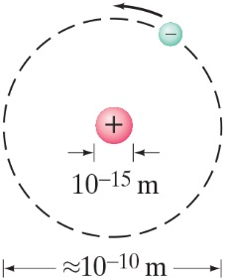
37-9 Early Models of the Atom (4 of 4)
Therefore, Rutherford’s model of the atom is mostly empty space:
Notes:
Figure 37-18. Rutherford’s model of the atom: electrons orbit a tiny positive nucleus (not to scale). The atom is visualized as mostly empty space.
LD: The nucleus is shown as a small pink circle with a positive sign at its center. The diameter of the nucleus is 10 raised to the negative 15th power m. The dashed circle with the nucleus at its center is shown. The electron shown as a small blue circle with a negative sign at its center is placed to the upper right of the nucleus. The electron is smaller than the nucleus. A curved arrow pointing in the counterclockwise direction is shown to the left of the electron. The diameter of the dashed circle is approximately 10 raised to the negative 10th power m.

Slide 44
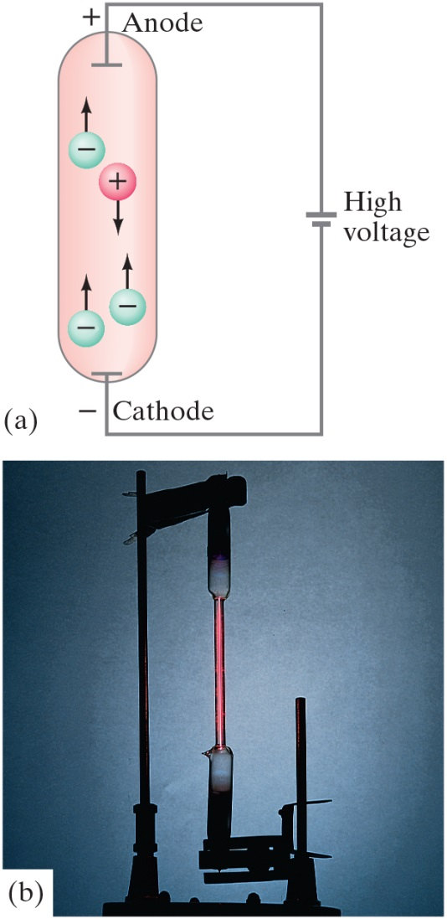
37-10 Atomic Spectra: Key to the Structure of the Atom (1 of 5)
A very thin gas heated in a discharge tube emits light only at characteristic frequencies.
Notes:
Figure 37-19. Gas-discharge tube: (a) diagram; (b) photo of an actual discharge tube for hydrogen.
LD: Part ("a"): The circuit diagram of the gas discharge tube has a cylinder on the left with its top section labeled Anode having a plus sign and its bottom section labeled Cathode having a minus sign. Two circles with minus signs are shown at the bottom of the cylinder each having a vertical arrow pointing up. A third circle with a minus sign is shown near the top left of the cylinder with a vertical arrow pointing up. Another circle with a plus sign is shown to the lower right of the third circle with a minus sign and has a vertical arrow pointing down. Anode of the cylinder is connected with the positive terminal of the voltage source labeled High voltage. Cathode of the cylinder is connected with the negative terminal of High voltage to complete the circuit. Part (b): A photograph of a hydrogen discharge tube is shown. A horizontal stand is shown at the bottom of the figure having a vertical stand connected on its left and right, respectively. The vertical stand on the right is connected to a horizontal stand on its left that has an inverted test tube attached to it. The bottom half of the test tube is darker than the upper half. The vertical stand on the left is taller than the vertical stand on the right and has another horizontal stand connected to its top right. An upright test tube is attached to the right end of the horizontal stand such that it is placed at the same vertical level as the inverted test tube. The upper half of this test tube is darker than the lower half. The round bottoms of both the test tubes are connected to each other through a thin glass pipe. The glass pipe appears to have a red-colored glow.

Slide 45
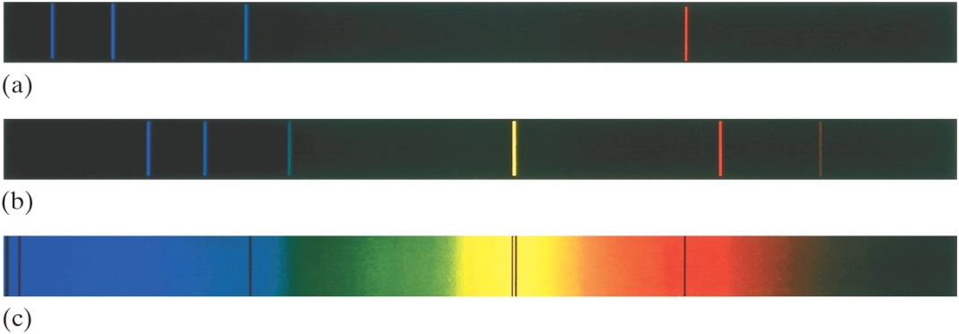
37-10 Atomic Spectra: Key to the Structure of the Atom (2 of 5)
An atomic spectrum is a line spectrum—only certain frequencies appear. If white light passes through such a gas, it absorbs at those same frequencies.
Notes:
Figure 37-20. Emission spectra of the gases (a) atomic hydrogen, (b) helium, and (c) the solar absorption spectrum.
LD: All three parts consist of thin vertical stripes colored black. In part (“a”), three blue vertical lines are shown close to the left end of the stripe. The distance between the first and the second blue lines is greater than the distance between the first vertical line and the left end of the stripe. The distance between the second and the third blue lines is greater than the distance between the first and the second vertical lines. A red vertical line is shown to the right of the center of the stripe. In part (b), three blue vertical lines are shown near the left end of the stripe. The distance between the second and the third blue lines is greater than the distance between the first and the second vertical lines. However, the distance between the second and the third blue lines is lesser than the distance between the first vertical line and the left end of the stripe. A yellow vertical line is shown near the center of the stripe. A red vertical line is shown to the right of the yellow line. A faint red vertical line is shown between the red line and the right end of the stripe. In part (c), The rectangular stripe has different colors in the background. To the right of blue, nearly 30 percent of the stripe near the left end is colored blue. Nearly 20 percent of the stripe is colored with gradients of green, where the intensity of darkness reduces gradually toward the right. Nearly 10 percent of the stripe near the center is colored yellow. Nearly 10 percent of the stripe to the right of yellow is colored orange. Nearly 15 percent of the stripe to the right of orange is colored with gradients of red where the intensity of darkness increases gradually toward the right. The remaining portion of the stripe is colored black. Two violet-colored vertical lines are placed close to the left corner of the stripe. A third violet-colored vertical line is placed closer to the right end of the blue-colored portion of the stripe. Two thin black-colored vertical lines are placed close to each other at the center of the yellow-colored portion of the stripe. These two black-colored vertical lines are placed in line with the yellow-colored vertical line from part (b). A third black-colored vertical line is placed near the left end of the red-colored portion of the stripe.

Slide 46

37-10 Atomic Spectra: Key to the Structure of the Atom (3 of 5)
The wavelengths of electrons emitted from hydrogen have a regular pattern:
This is called the Balmer series. R is the Rydberg constant:

Slide 47


37-10 Atomic Spectra: Key to the Structure of the Atom (4 of 5)
Other series include the Lyman series:
and the Paschen series:

Slide 48
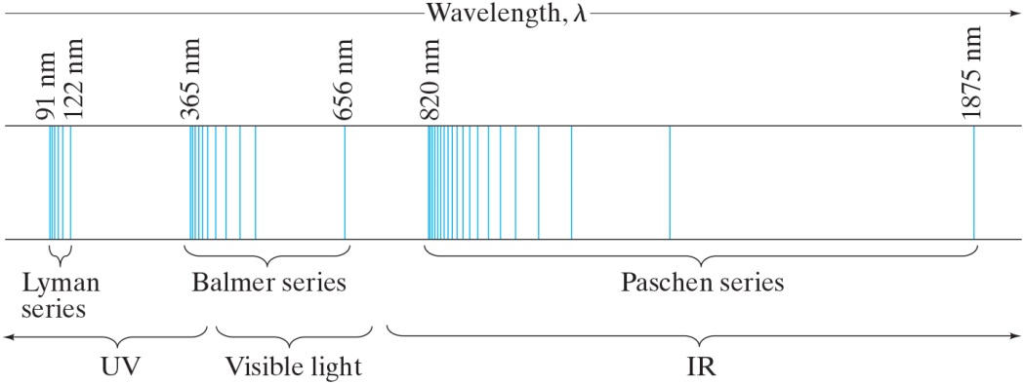
37-10 Atomic Spectra: Key to the Structure of the Atom (5 of 5)
A portion of the complete spectrum of hydrogen is shown here. The lines cannot be explained by the Rutherford theory.
Notes:
Figure 37-22. Line spectrum of atomic hydrogen. Each series fits the formula 1/λ = R(1/n’2 – 1/n2) where n’ = 1 for the Lyman series, n’ = 2 for the Balmer series, n’ = 3 for the Paschen series, and so on; n can take on all integer values from n = n’ + 1 up to infinity. The only lines in the visible region of the electromagnetic spectrum are part of the Balmer series.
LD: A horizontal stripe with multiple blue vertical lines is shown at the center. The top side of the stripe has markings indicating the wavelength of the vertical lines in n m, and an arrow labeled Wavelength, lambda pointing right is shown above the top side. From left to right, the following markings are shown: 91 n m, 122 n m, 365 n m, 656 n m, 820 n m, and 1875 n m. These markings are spaced according to the magnitude of the numbers given, and on the stripe, a vertical line is drawn at each of these markings. A few lines are placed close to the line at 91 n m such that they form a thin stripe. Two more lines are added between this thin stripe and the line at 122 n m. The lines between 91 n m and 122 n m are labeled Lyman series. After a certain distance, a few lines are placed closer to the right of the line at 365 n m such that they form a thin stripe. Seven more lines are added between this thin stripe and the line at 656 n m, where the gap between the seventh line and the line at 656 n m is the highest in the range. The lines between 365 n m and 656 n m are labeled Balmer series. After a certain distance, a few lines are placed closer to the right of the line at 820 n m such that they form a thin strip. 15 more lines are added adjacent to this thin stripe with increasing spacing. A huge gap is seen between the 15th line and the line at 1875 n m, which is close to the right end of the horizontal stripe. The lines between 820 n m and 1875 n m are labeled Paschen series. The region to the left of the thin stripe shown at 365 n m is labeled U V. The region from the right of the thin stripe shown at 365 n m till a point close to the line at 656 n m is labeled Visible light. The region from where Visible light ends till the right end of the horizontal stripe and beyond is labeled I R.

Slide 49
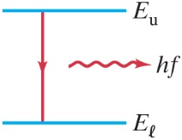
37-11 The Bohr Model (1 of 11)
Bohr proposed that the possible energy states for atomic electrons were quantized—only certain values were possible. Then, the spectrum could be explained as transitions from one level to another.
Notes:
Figure 37-23. An atom emits a photon (energy = hf) when its energy changes from Eu to a lower energy El .
LD: A squiggly arrow labeled h f pointing horizontally to the right is shown on the right of the vertical arrow.

Slide 50

37-11 The Bohr Model (2 of 11)
Bohr found that the angular momentum was quantized:

Slide 51
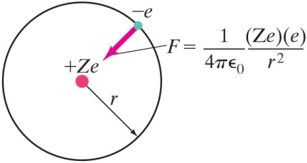
37-11 The Bohr Model (3 of 11)
An electron is held in orbit by the Coulomb force:
Notes:
Figure 37-24. Electric force (Coulomb’s law) keeps the negative electron in orbit around the positively charged nucleus.
LD: A slightly smaller blue point labeled negative e is shown on the circumference of the circle on the upper right of positive Z e. A force field vector arrow labeled F equals StartFraction 1 over 4 pi epsilon subscript 0 EndFraction multiplied by StartFraction (Z e) multiplied (e) over r squared EndFraction starts from minus e and points to the lower left at positive Z e.

Slide 52
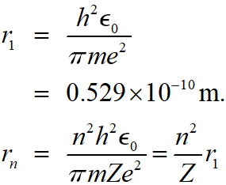
37-11 The Bohr Model (4 of 11)
Using the Coulomb force, we can calculate the radii of the orbits:

Slide 53
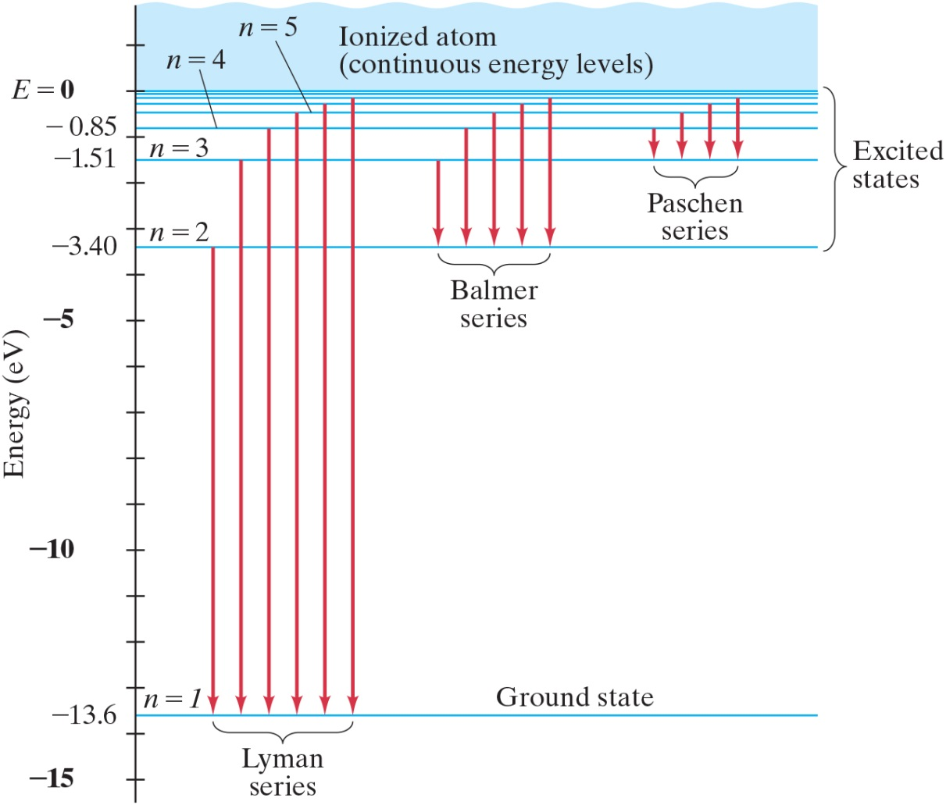
37-11 The Bohr Model (5 of 11)
The lowest energy level is called the ground state; the others are excited states.
Notes:
Figure 37-26. Energy-level diagram for the hydrogen atom, showing the transitions for the spectral lines of the Lyman, Balmer, and Paschen series (Fig. 37 9 22). Each vertical arrow represents an atomic transition that gives rise to the photons of one spectral line (a single wavelength or frequency).
LD: The energy-level diagram is shown along a vertical axis labeled Energy (e V). The axis ranges from negative 15 to 1 in increments of 1 unit. The point at 0 is labeled E equals 0. A horizontal line is drawn from 0. The region above the horizontal line is shaded blue and is labeled Ionized atom (continuous energy levels). A horizontal line is drawn from negative 13.6 and is labeled n equals 1; Ground state. A second horizontal line is drawn from negative 3.40 and is labeled n equals 2. A third horizontal line is drawn from negative 1.51 and is labeled n equals 3. A fourth horizontal line is drawn from negative 0.85 and is labeled n equals 4. A fifth horizontal line is drawn from approximately negative 0.50 and is labeled n equals 5. Two more horizontal lines with decreased spacing are drawn between the line at E equals 0 and n equals 5, and are close to E equals 0. The region between the line at E equals 0 and n equals 2 is labeled Excited states. From left to right, six parallel equidistant arrows start from n equals 2, n equals 3, n equals 4, n equals 5, and the two lines between n equals 5 and E equals 0 and point downward at n equals 1. This set of six arrows are labeled Lyman series. To the right of Lyman series, from left to right, five parallel equidistant arrows start from n equals 3, n equals 4, n equals 5, and the two lines between n equals 5 and E equals 0 and point downward at n equals 2. This set of five arrows are labeled Balmer series. To the right of Balmer series, from left to right, four parallel equidistant arrows start from n equals 4, n equals 5, and the two lines between n equals 5 and E equals 0 and point downward at n equals 3. This set of four arrows are labeled Paschen series.

Slide 54

37-11 The Bohr Model (6 of 11)
Example 37-13: Wavelength of a Lyman line.
Use this figure to determine the wavelength of the first Lyman line, the transition from
to
in a hydrogen
atom. In what region of the electromagnetic spectrum does this lie?
Notes:
Figure 37-26. Energy-level diagram for the hydrogen atom, showing the transitions for the spectral lines of the Lyman, Balmer, and Paschen series (Fig. 37 9 22). Each vertical arrow represents an atomic transition that gives rise to the photons of one spectral line (a single wavelength or frequency).
LD: The energy-level diagram is shown along a vertical axis labeled Energy (e V). The axis ranges from negative 15 to 1 in increments of 1 unit. The point at 0 is labeled E equals 0. A horizontal line is drawn from 0. The region above the horizontal line is shaded blue and is labeled Ionized atom (continuous energy levels). A horizontal line is drawn from negative 13.6 and is labeled n equals 1; Ground state. A second horizontal line is drawn from negative 3.40 and is labeled n equals 2. A third horizontal line is drawn from negative 1.51 and is labeled n equals 3. A fourth horizontal line is drawn from negative 0.85 and is labeled n equals 4. A fifth horizontal line is drawn from approximately negative 0.50 and is labeled n equals 5. Two more horizontal lines with decreased spacing are drawn between the line at E equals 0 and n equals 5, and are close to E equals 0. The region between the line at E equals 0 and n equals 2 is labeled Excited states. From left to right, six parallel equidistant arrows start from n equals 2, n equals 3, n equals 4, n equals 5, and the two lines between n equals 5 and E equals 0 and point downward at n equals 1. This set of six arrows are labeled Lyman series. To the right of Lyman series, from left to right, five parallel equidistant arrows start from n equals 3, n equals 4, n equals 5, and the two lines between n equals 5 and E equals 0 and point downward at n equals 2. This set of five arrows are labeled Balmer series. To the right of Balmer series, from left to right, four parallel equidistant arrows start from n equals 4, n equals 5, and the two lines between n equals 5 and E equals 0 and point downward at n equals 3. This set of four arrows are labeled Paschen series.

Slide 55
37-11 The Bohr Model (7 of 11)
Example 37-14: Wavelength of a Balmer line.
Use the Bohr model to calculate the wavelength of light emitted when a hydrogen atom makes a
transition from the
to the
energy level.

Slide 56

37-11 The Bohr Model (8 of 11)
Example 37-15: Absorption wavelength.
Use this figure to determine the maximum wavelength that hydrogen in its ground state can absorb. What would be the next smaller wavelength that would work?
Notes:
Figure 37-26. Energy-level diagram for the hydrogen atom, showing the transitions for the spectral lines of the Lyman, Balmer, and Paschen series (Fig. 37–22). Each vertical arrow represents an atomic transition that gives rise to the photons of one spectral line (a single wavelength or frequency).
LD: The energy-level diagram is shown along a vertical axis labeled Energy (e V). The axis ranges from negative 15 to 1 in increments of 1 unit. The point at 0 is labeled E equals 0. A horizontal line is drawn from 0. The region above the horizontal line is shaded blue and is labeled Ionized atom (continuous energy levels). A horizontal line is drawn from negative 13.6 and is labeled n equals 1; Ground state. A second horizontal line is drawn from negative 3.40 and is labeled n equals 2. A third horizontal line is drawn from negative 1.51 and is labeled n equals 3. A fourth horizontal line is drawn from negative 0.85 and is labeled n equals 4. A fifth horizontal line is drawn from approximately negative 0.50 and is labeled n equals 5. Two more horizontal lines with decreased spacing are drawn between the line at E equals 0 and n equals 5, and are close to E equals 0. The region between the line at E equals 0 and n equals 2 is labeled Excited states. From left to right, six parallel equidistant arrows start from n equals 2, n equals 3, n equals 4, n equals 5, and the two lines between n equals 5 and E equals 0 and point downward at n equals 1. This set of six arrows are labeled Lyman series. To the right of Lyman series, from left to right, five parallel equidistant arrows start from n equals 3, n equals 4, n equals 5, and the two lines between n equals 5 and E equals 0 and point downward at n equals 2. This set of five arrows are labeled Balmer series. To the right of Balmer series, from left to right, four parallel equidistant arrows start from n equals 4, n equals 5, and the two lines between n equals 5 and E equals 0 and point downward at n equals 3. This set of four arrows are labeled Paschen series.

Slide 57
37-11 The Bohr Model (9 of 11)
Example 37-16:
ionization energy.
(a) Use the Bohr model to determine the ionization
energy of the
ion, which has a single electron.
(b) Also, calculate the maximum wavelength a photon can have to cause ionization. The helium atom is the second atom, after hydrogen, in the Periodic Table.

Slide 58
37-11 The Bohr Model (10 of 11)
Conceptual Example 37-17: Hydrogen at
(a) Estimate the average kinetic energy of whole hydrogen atoms (not just the electrons) at room temperature. (b) Use the result to explain why, at room temperature, very few H atoms are in excited states and nearly all are in the ground state, and hence emit no light.

Slide 59
37-11 The Bohr Model (11 of 11)
The correspondence principle applies here as well—when the differences between quantum levels are small compared to the energies, they should be imperceptible.

Slide 60
37-12 de Broglie’s Hypothesis Applied to Atoms (1 of 2)
De Broglie’s hypothesis is the one associating a wavelength with the momentum of a particle. He proposed that only those orbits where the wave would be a circular standing wave will occur. This yields the same relation that Bohr had proposed.
In addition, it makes more reasonable the fact that the electrons do not radiate, as one would otherwise expect from an accelerating charge.

Slide 61
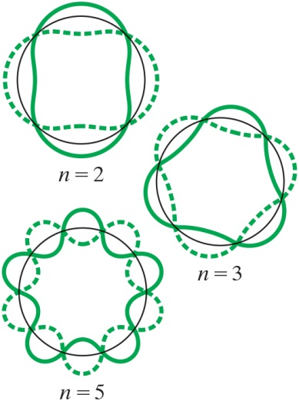
37-12 de Broglie’s Hypothesis Applied to Atoms (2 of 2)
These are circular standing waves for
3, and 5.
Notes:
Figure 37-29. Standing circular waves for two, three, and five wavelengths on the circumference; n, the number of wavelengths, is also the quantum number.
LD: The figure is divided into three parts. Each part has a circle with a solid curve and a dashed curve drawn along the circumference of the circle. Each of the curves resemble a sine wave and have the same magnitude. The dashed curve is drawn as a mirror image of the solid curve such that the crests of one curve are in line with the troughs of the other curve and both the curves intersect the circle at the same points. The ends of the wave are joined together to form a loop. The first part is labeled n equals 2. Each of the curve has two cycles. Together, the curves resemble two perpendicular fat rods with rounded edges and having each of its two side curved inward. The second part is labeled n equals 3. Each of the curve has three cycles. Together, the curves resemble two superimposed triangles with rounded vertices and having each of its side curved inward. The triangles are aligned such that the vertices of one triangle are in line with the centers of the curved sides of the other triangle. The third part is labeled n equals 5. Each of the curve has five cycles. Together, the curves resemble two superimposed rounded five-pointed stars. The stars are aligned such that the vertices of one star are between the vertices of the other star.

Slide 62


Summary of Chapter 37 (1 of 3)
Planck’s hypothesis: molecular oscillation energies are quantized:
Light can be considered to consist of photons, each of
energy
and momentum
Photoelectric effect: incident photons eject electrons out of material.

Slide 63
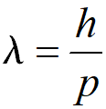
Summary of Chapter 37 (2 of 3)
Compton effect and pair production also support photon theory.
Wave–particle duality—both light and matter have both wave and particle properties.
Wavelength of an object:

Slide 64
Summary of Chapter 37 (3 of 3)
Principle of complementarity: both wave and particle properties are necessary for complete understanding.
Rutherford showed that atom has tiny nucleus.
Line spectra are explained by electrons having only certain specific orbits.
Ground state has the lowest energy; the others are called excited states.
Notes:
55

Slide 65

Copyright
This work is protected by United States copyright laws and is provided solely for the use of instructors in teaching their courses and assessing student learning. Dissemination or sale of any part of this work (including on the World Wide Web) will destroy the integrity of the work and is not permitted. The work and materials from it should never be made available to students except by instructors using the accompanying text in their classes. All recipients of this work are expected to abide by these restrictions and to honor the intended pedagogical purposes and the needs of other instructors who rely on these materials.

